Slide 1
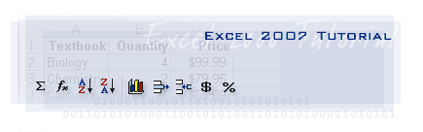

Slide 2
Manipulating Data
Select Data
Copy and Paste
Cut and Paste
Undo and Redo
Auto Fill
Modifying a Worksheet
Insert Cells, Rows and Columns
Delete Cells, Rows and Columns
Find and Replace
Go To Command
Spell Check
Performing Calculations
Excel Formulas
Calculate with Functions
Function Library
Relative, Absolute, & Mixed Functions
Linking Worksheets
Getting Started
Spreadsheets
Microsoft Office Button
Ribbon
Quick Access Toolbar
Mini Toolbar
Customize Excel
Popular
Formulas
Proofing
Save
Advanced
Customize
Working with a Workbook
Create a Workbook
Save a Workbook
Open a Workbook
Entering Data

Slide 3
Macros
Recording a Marco
Running a Macro
Sort and Filter
Basic Sorts
Custom Sorts
Filter
Graphics
Adding a Picture
Adding Clip Art
Editing Pictures and Clip Art
Adding Shapes
Adding SmartArt
Charts
Create a Chart
Modify a Chart
Chart Tools
Copy a Chart to Word
Formatting a Worksheet
Convert Text to Columns
Modify Fonts
Format Cells Dialog Box
Add Borders and Colors to Cells
Change Column Width and Row Height
Hide or Unhide Rows and Columns
Merge Cells
Align Cell Contents
Developing a Workbook
Format Worksheet Tabs
Reposition Worksheets in a Workbook
Insert and Delete Worksheets
Copy and Paste Worksheets
Page Properties and Printing
Set Print Titles
Create a Header and a Footer
Set Page Margins
Change Page Orientation
Set Page Breaks
Print a Range
Customize the Layout
Split a Worksheet
Freeze and Unfreeze Rows & Columns
Hide and Unhide Worksheets

Slide 4
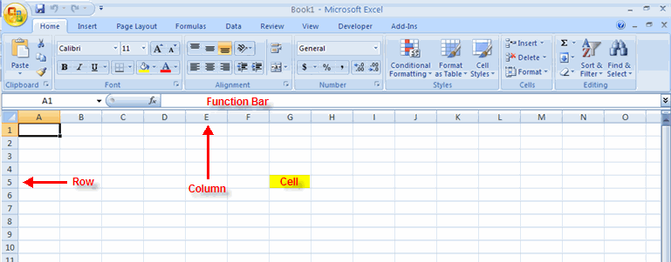
Getting Started
Getting started with Excel 2007 you will notice that there are many similar features to previous versions. You will also notice that there are many new features that you’ll be able to utilize. There are three features that you should remember as you work within Excel 2007: the Microsoft Office Button, the Quick Access Toolbar, and the Ribbon. The function of these features will be more fully explored below.

Slide 5
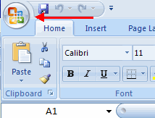
Spreadsheets A spreadsheet is an electronic document that stores various types of data. There are vertical columns and horizontal rows. A cell is where the column and row intersect. A cell can contain data and can be used in calculations of data within the spreadsheet. An Excel spreadsheet can contain workbooks and worksheets. The workbook is the holder for related worksheets.
Microsoft Office Button The Microsoft Office Button performs many of the functions that were located in the File menu of older versions of Excel. This button allows you to create a new workbook, Open an existing workbook, save and save as, print, send, or close.

Slide 6
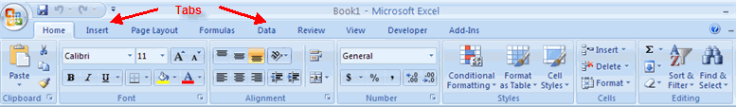
Ribbon The ribbon is the panel at the top portion of the document It has seven tabs: Home, Insert, Page Layouts, Formulas, Data, Review, and View. Each tab is divided into groups. The groups are logical collections of features designed to perform function that you will utilize in developing or editing your Excel spreadsheets.

Slide 7
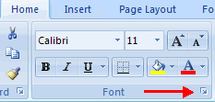
Commonly utilized features are displayed on the Ribbon. To view additional features within each group, click the arrow at the bottom right corner of each group.

Slide 8
Home: Clipboard, Fonts, Alignment, Number, Styles, Cells, Editing Insert: Tables, Illustrations, Charts, Links, Text Page Layouts: Themes, Page Setup, Scale to Fit, Sheet Options, Arrange Formulas: Function Library, Defined Names, Formula Auditing, Calculation Data: Get External Data, Connections, Sort & Filter, Data Tools, Outline Review: Proofing, Comments, Changes View: Workbook Views, Show/Hide, Zoom, Window, Macros

Slide 9
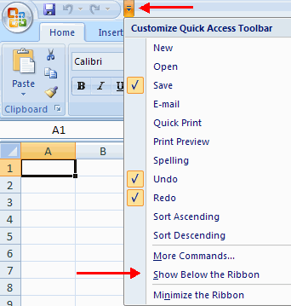
Quick Access Toolbar The quick access toolbar is a customizable toolbar that contains commands that you may want to use. You can place the quick access toolbar above or below the ribbon. To change the location of the quick access toolbar, click on the arrow at the end of the toolbar and click Show Below the Ribbon.

Slide 10
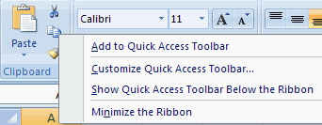
You can also add items to the quick access toolbar. Right click on any item in the Office Button or the Ribbon and click Add to Quick Access Toolbar and a shortcut will be added.

Slide 11

Mini Toolbar A new feature in Office 2007 is the Mini Toolbar. This is a floating toolbar that is displayed when you select text or right-click text. It displays common formatting tools, such as Bold, Italics, Fonts, Font Size and Font Color.

Slide 12
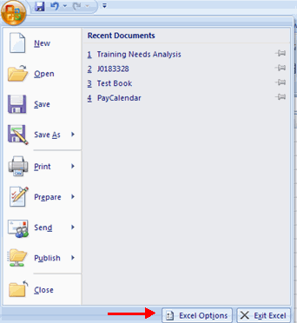
Customize Excel
Excel 2007 offers a wide range of customizable options that allow you to make Excel work the best for you. To access these customizable options:
Click the Office Button
Click Excel Options

Slide 13
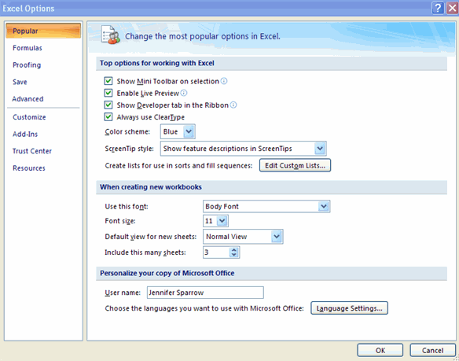
Popular These features allow you to personalize your work environment with the mini toolbar, color schemes, default options for new workbooks, customize sort and fill sequences user name and allow you to access the Live Preview feature. The Live Preview feature allows you to preview the results of applying design and formatting changes without actually applying it.

Slide 14
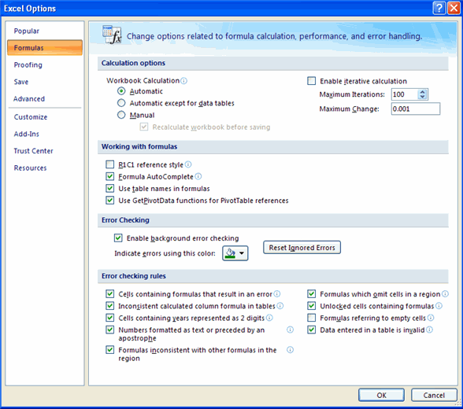
Formulas This feature allows you to modify calculation options, working with formulas, error checking, and error checking rules.

Slide 15
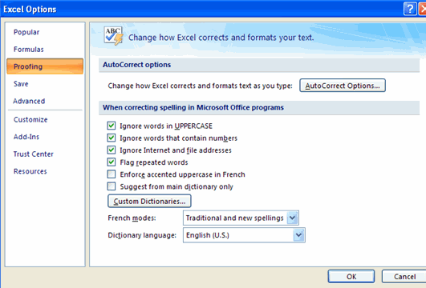
Proofing This feature allows you personalize how word corrects and formats your text. You can customize auto correction settings and have word ignore certain words or errors in a document through the Custom Dictionaries.

Slide 16
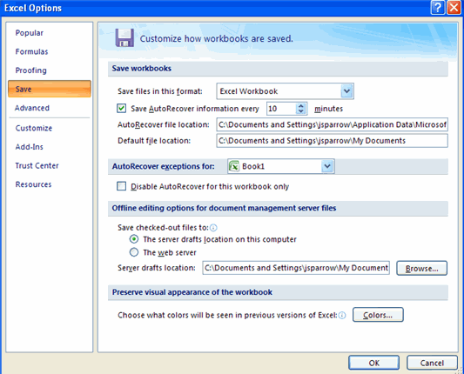
Save This feature allows you personalize how your workbook is saved. You can specify how often you want auto save to run and where you want the workbooks saved.

Slide 17
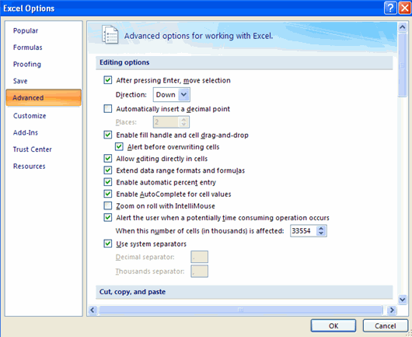
Advanced This feature allows you to specify options for editing, copying, pasting, printing, displaying, formulas, calculations, and other general settings.

Slide 18
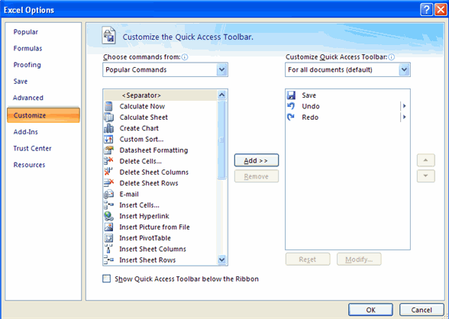
Customize Customize allows you to add features to the Quick Access Toolbar. If there are tools that you are utilizing frequently, you may want to add these to the Quick Access Toolbar.

Slide 19
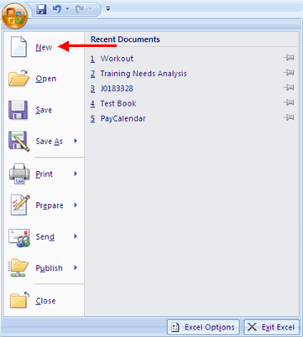
Working with a Workbook
Create a Workbook To create a new Workbook:
Click the Microsoft Office Toolbar
Click New
Choose Blank Document

Slide 20
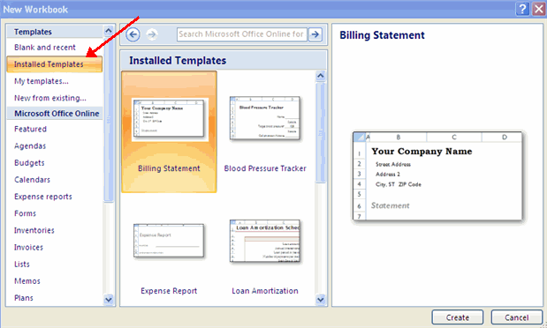
If you want to create a new document from a template, explore the templates and choose one that fits your needs.

Slide 21
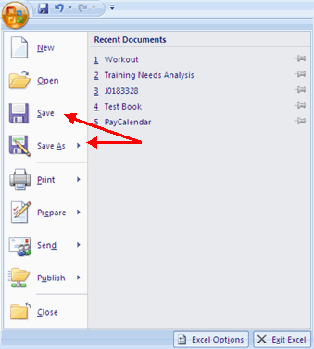
Save a Workbook When you save a workbook, you have two choices: Save or Save As. To save a document:
Click the Microsoft Office Button
Click Save

Slide 22
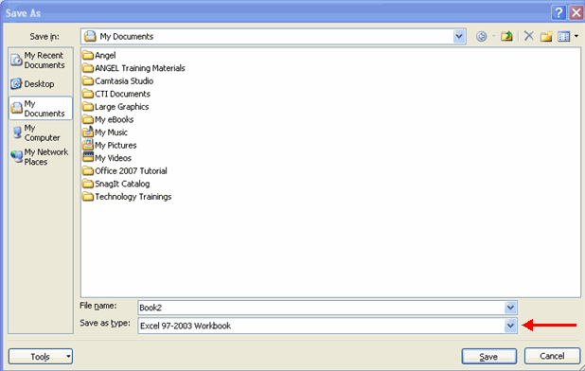
You may need to use the Save As feature when you need to save a workbook under a different name or to save it for earlier versions of Excel. Remember that older versions of Excel will not be able to open an Excel 2007 worksheet unless you save it as an Excel 97-2003 Format. To use the Save As feature:
Click the Microsoft Office Button
Click Save As
Type in the name for the Workbook
In the Save as Type box, choose Excel 97-2003 Workbook

Slide 23
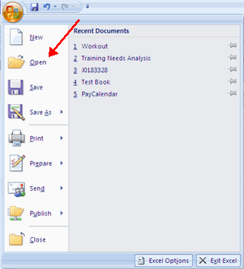
Open a Workbook To open an existing workbook:
Click the Microsoft Office Button
Click Open
Browse to the workbook
Click the title of the workbook
Click Open

Slide 24
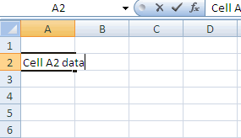
Entering Data There are different ways to enter data in Excel: in an active cell or in the formula bar. To enter data in an active cell:
Click in the cell where you want the data
Begin typing

Slide 25
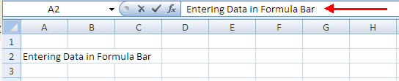
To enter data into the formula bar
Click the cell where you would like the data
Place the cursor in the Formula Bar
Type in the data

Slide 26
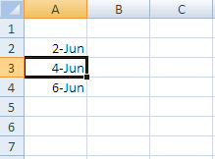
Manipulating Data
DATA
Excel allows you to move, copy, and paste cells and cell content through cutting and pasting and copying and pasting.
Select Data To select a cell or data to be copied or cut:
Click the cell

Slide 27
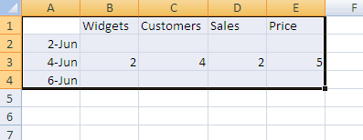
Click and drag the cursor to select many cells in a range

Slide 28
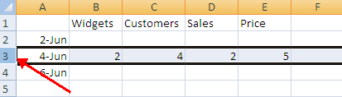

Select a Row or Column To select a row or column click on the row or column header.
Copy and Paste To copy and paste data:
Select the cell(s) that you wish to copy
On the Clipboard group of the Home tab, click Copy

Slide 29


Select the cell(s) where you would like to copy the data
On the Clipboard group of the Home tab, click Paste
Cut and Paste To cut and paste data:
Select the cell(s) that you wish to copy
On the Clipboard group of the Home tab, click Cut
Select the cell(s) where you would like to copy the data
On the Clipboard group of the Home tab, click Paste

Slide 30
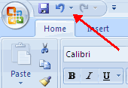
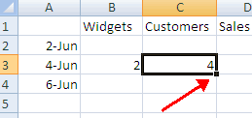
Undo and Redo To undo or redo your most recent actions:
On the Quick Access Toolbar
Click Undo or Redo
Auto Fill The Auto Fill feature fills cell data or series of data in a worksheet into a selected range of cells. If you want the same data copied into the other cells, you only need to complete one cell. If you want to have a series of data (for example, days of the week) fill in the first two cells in the series and then use the auto fill feature. To use the Auto Fill feature:
Click the Fill Handle
Drag the Fill Handle to complete the cells

Slide 31
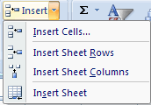
Modifying a Worksheet
Insert Cells, Rows, and Columns To insert cells, rows, and columns in Excel:
Place the cursor in the row below where you want the new row, or in the column to the left of where you want the new column
Click the Insert button on the Cells group of the Home tab
Click the appropriate choice: Cell, Row, or Column

Slide 32
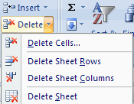
Delete Cells, Rows and Columns To delete cells, rows, and columns:
Place the cursor in the cell, row, or column that you want to delete
Click the Delete button on the Cells group of the Home tab
Click the appropriate choice: Cell, Row, or Column

Slide 33
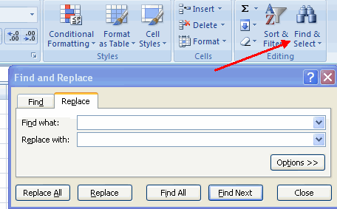
Find and Replace To find data or find and replace data:
Click the Find & Select button on the Editing group of the Home tab
Choose Find or Replace
Complete the Find What text box
Click on Options for more search options

Slide 34
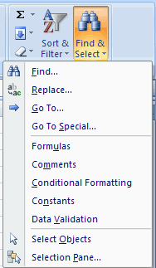
Go To Command The Go To command takes you to a specific cell either by cell reference (the Column Letter and the Row Number) or cell name.
Click the Find & Select button on the Editing group of the Home tab
Click Go To

Slide 35
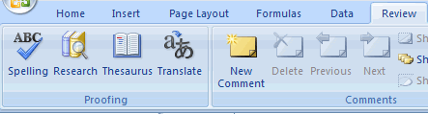
Spell Check To check the spelling:
On the Review tab click the Spelling button

Slide 36
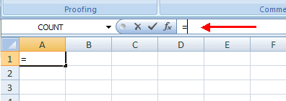
Performing Calculations
Excel Formulas A formula is a set of mathematical instructions that can be used in Excel to perform calculations. Formals are started in the formula box with an = sign.
There are many elements to and excel formula.
References: The cell or range of cells that you want to use in your calculation Operators: Symbols (+, -, *, /, etc.) that specify the calculation to be performed Constants: Numbers or text values that do not change Functions: Predefined formulas in Excel

Slide 37
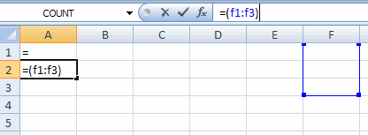
To create a basic formula in Excel:
Select the cell for the formula
Type = (the equal sign) and the formula
Click Enter

Slide 38
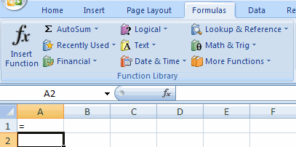
Calculate with Functions A function is a built in formula in Excel. A function has a name and arguments (the mathematical function) in parentheses. Common functions in Excel:
Sum: Adds all cells in the argument Average: Calculates the average of the cells in the argument Min: Finds the minimum value Max: Finds the maximum value Count: Finds the number of cells that contain a numerical value within a range of the argument
To calculate a function:
Click the cell where you want the function applied
Click the Insert Function button
Choose the function
Click OK

Slide 39
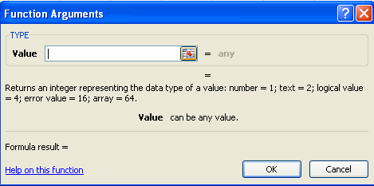
Complete the Number 1 box with the first cell in the range that you want calculated
Complete the Number 2 box with the last cell in the range that you want calculated

Slide 40
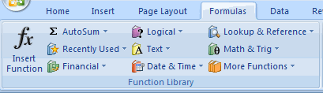
Function Library The function library is a large group of functions on the Formula Tab of the Ribbon. These functions include:
AutoSum: Easily calculates the sum of a range Recently Used: All recently used functions Financial: Accrued interest, cash flow return rates and additional financial functions Logical: And, If, True, False, etc. Text: Text based functions Date & Time: Functions calculated on date and time Math & Trig: Mathematical Functions

Slide 41
Relative, Absolute and Mixed References
Calling cells by just their column and row labels (such as "A1") is called relative referencing. When a formula contains relative referencing and it is copied from one cell to another, Excel does not create an exact copy of the formula. It will change cell addresses relative to the row and column they are moved to. For example, if a simple addition formula in cell C1 "=(A1+B1)" is copied to cell C2, the formula would change to "=(A2+B2)" to reflect the new row. To prevent this change, cells must be called by absolute referencing and this is accomplished by placing dollar signs "$" within the cell addresses in the formula. Continuing the previous example, the formula in cell C1 would read "=($A$1+$B$1)" if the value of cell C2 should be the sum of cells A1 and B1. Both the column and row of both cells are absolute and will not change when copied. Mixed referencing can also be used where only the row OR column fixed. For example, in the formula "=(A$1+$B2)", the row of cell A1 is fixed and the column of cell B2 is fixed.
Linking Worksheets You may want to use the value from a cell in another worksheet within the same workbook in a formula. For example, the value of cell A1 in the current worksheet and cell A2 in the second worksheet can be added using the format "sheetname!celladdress". The formula for this example would be "=A1+Sheet2!A2" where the value of cell A1 in the current worksheet is added to the value of cell A2 in the worksheet named "Sheet2".

Slide 42
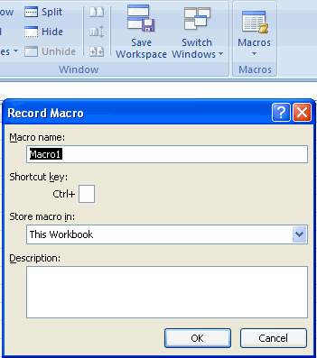
Macros
Macros are advanced features that can speed up editing or formatting you may perform often in an Excel worksheet. They record sequences of menu selections that you choose so that a series of actions can be completed in one step.
Recording a Macro To record a Macro:
Click the View tab on the Ribbon
Click Macros
Click Record Macro
Enter a name (without spaces)
Enter a Shortcut Key
Enter a Description

Slide 43
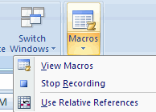
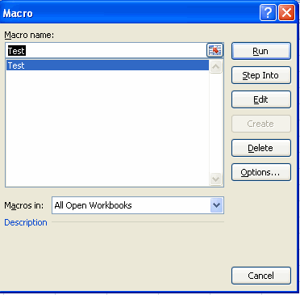
Perform the Macro
Click Marcos
Click Stop Recording
Running a Macro To run a Macro from the Keyboard shortcut, simply press the keys that you have programmed to run the Macro. Or you can view all macros and run by:
Click Macros
Click View Macros
Choose the Macro and click Run

Slide 44
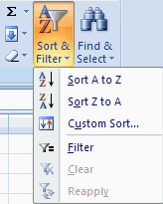
Sort and Filter
Sorting and Filtering allow you to manipulate data in a worksheet based on given set of criteria.
Basic Sorts To execute a basic descending or ascending sort based on one column:
Highlight the cells that will be sorted
Click the Sort & Filter button on the Home tab
Click the Sort Ascending (A-Z) button or Sort Descending (Z-A) button

Slide 45
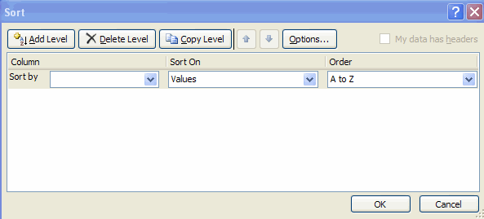
Custom Sorts To sort on the basis of more than one column:
Click the Sort & Filter button on the Home tab
Choose which column you want to sort by first
Click Add Level
Choose the next column you want to sort
Click OK

Slide 46
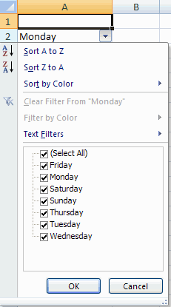
Filtering Filtering allows you to display only data that meets certain criteria. To filter:
Click the column or columns that contain the data you wish to filter
On the Home tab, click on Sort & Filter
Click Filter button
Click the Arrow at the bottom of the first cell
Click the Text Filter
Click the Words you wish to Filter

Slide 47
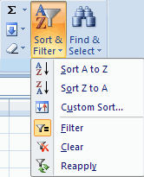
To clear the filter click the Sort & Filter button
Click Clear

Slide 48
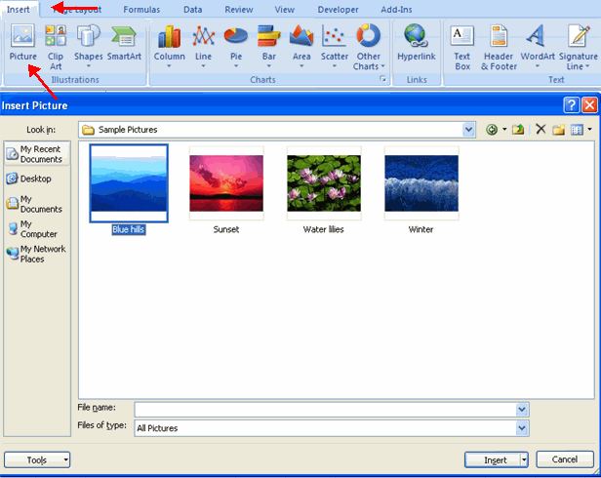
Graphics
Adding a Picture To add a picture:
Click the Insert tab
Click the Picture button
Browse to the picture from your files
Click the name of the picture
Click Insert
To move the graphic, click it and drag it to where you want it

Slide 49
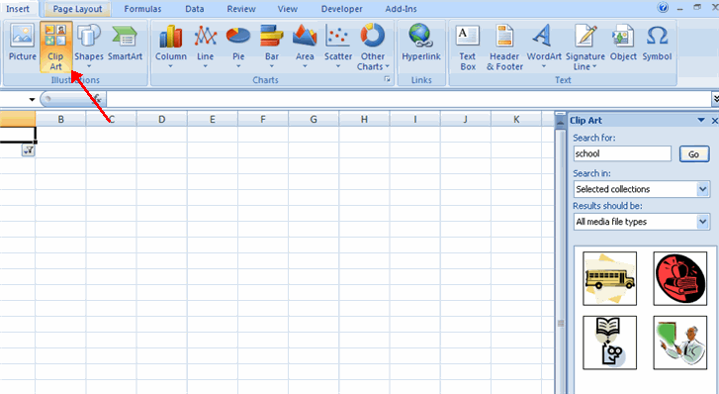
Adding Clip Art To add Clip Art:
Click the Insert tab
Click the Clip Art button
Search for the clip art using the search Clip Art dialog box
Click the clip art
To move the graphic, click it and drag it to where you want it

Slide 50
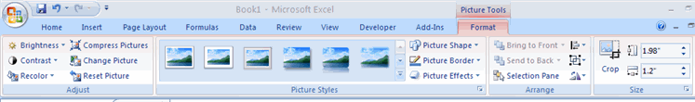
Editing Pictures and Clip Art When you add a graphic to the worksheet, an additional tab appears on the Ribbon. The Format tab allows you to format the pictures and graphics. This tab has four groups:
Adjust: Controls the picture brightness, contrast, and colors Picture Style: Allows you to place a frame or border around the picture and add effects Arrange: Controls the alignment and rotation of the picture Size: Cropping and size of graphic

Slide 51
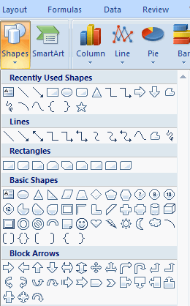
Adding Shapes To add Shape:
Click the Insert tab
Click the Shapes button
Click the shape you choose

Slide 52
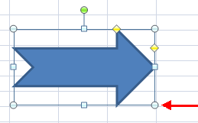
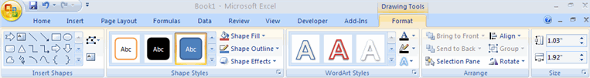
Click the Worksheet
Drag the cursor to expand the Shape
To format the shapes:
Click the Shape
Click the Format tab

Slide 53
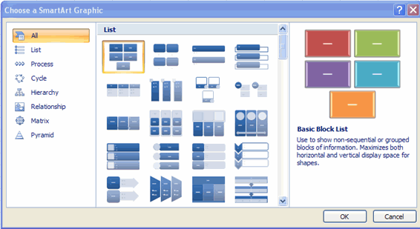
Adding SmartArt SmartArt is a feature in Office 2007 that allows you to choose from a variety of graphics, including flow charts, lists, cycles, and processes. To add SmartArt:
Click the Insert tab
Click the SmartArt button
Click the SmartArt you choose

Slide 54

Select the Smart Art
Drag it to the desired location in the worksheet
To format the SmartArt:
Select the SmartArt
Click either the Design or the Format tab
Click the SmartArt to add text and pictures.

Slide 55

Charts
Charts allow you to present information contained in the worksheet in a graphic format. Excel offers many types of charts including: Column, Line, Pie, Bar, Area, Scatter and more. To view the charts available click the Insert Tab on the Ribbon.
Create a Chart To create a chart:
Select the cells that contain the data you want to use in the chart
Click the Insert tab on the Ribbon
Click the type of Chart you want to create

Slide 56

Modify a Chart Once you have created a chart you can do several things to modify the chart.
To move the chart:
Click the Chart and Drag it another location on the same worksheet, or
Click the Move Chart button on the Design tab
Choose the desired location (either a new sheet or a current sheet in the workbook)

Slide 57

To change the data included in the chart:
Click the Chart
Click the Select Data button on the Design tab

Slide 58

To reverse which data are displayed in the rows and columns:
Click the Chart
Click the Switch Row/Column button on the Design tab

Slide 59

To modify the labels and titles:
Click the Chart
On the Layout tab, click the Chart Title or the Data Labels button
Change the Title and click Enter

Slide 60


Chart Tools The Chart Tools appear on the Ribbon when you click on the chart. The tools are located on three tabs: Design, Layout, and Format. Within the Design tab you can control the chart type, layout, styles, and location.
Within the Layout tab you can control inserting pictures, shapes and text boxes, labels, axes, background, and analysis.

Slide 61


Within the Format tab you can modify shape styles, word styles and size of the chart.
Copy a Chart to Word
Select the chart
Click Copy on the Home tab
Go to the Word document where you want the chart located
Click Paste on the Home tab

Slide 62

Format Worksheet
Convert Text to Columns Sometimes you will want to split data in one cell into two or more cells. You can do this easily by utilizing the Convert Text to Columns Wizard.
Highlight the column in which you wish to split the data
Click the Text to Columns button on the Data tab
Click Delimited if you have a comma or tab separating the data, or click fixed widths to set the data separation at a specific size.

Slide 63

Modify Fonts Modifying fonts in Excel will allow you to emphasize titles and headings. To modify a font:
Select the cell or cells that you would like the font applied
On the Font group on the Home tab, choose the font type, size, bold, italics, underline, or color

Slide 64

Format Cells Dialog Box In Excel, you can also apply specific formatting to a cell. To apply formatting to a cell or group of cells:
Select the cell or cells that will have the formatting
Click the Dialog Box arrow on the Alignment group of the Home tab

Slide 65

There are several tabs on this dialog box that allow you to modify properties of the cell or cells.
Number: Allows for the display of different number types and decimal places Alignment: Allows for the horizontal and vertical alignment of text, wrap text, shrink text, merge cells and the direction of the text. Font: Allows for control of font, font style, size, color, and additional features Border: Border styles and colors Fill: Cell fill colors and styles
Add Borders and Colors to Cells Borders and colors can be added to cells manually or through the use of styles. To add borders manually:
Click the Borders drop down menu on the Font group of the Home tab
Choose the appropriate border

Slide 66

To apply colors manually:
Click the Fill drop down menu on the Font group of the Home tab
Choose the appropriate color

Slide 67

To apply borders and colors using styles:
Click Cell Styles on the Home tab
Choose a style or click New Cell Style

Slide 68

Change Column Width and Row Height To change the width of a column or the height of a row:
Click the Format button on the Cells group of the Home tab
Manually adjust the height and width by clicking Row Height or Column Width
To use AutoFit click AutoFit Row Height or AutoFit Column Width

Slide 69

Hide or Unhide Rows or Columns To hide or unhide rows or columns:
Select the row or column you wish to hide or unhide
Click the Format button on the Cells group of the Home tab
Click Hide & Unhide

Slide 70

Merge Cells To merge cells select the cells you want to merge and click the Merge & Center button on the Alignment group of the Home tab. The four choices for merging cells are:
Merge & Center: Combines the cells and centers the contents in the new, larger cell Merge Across: Combines the cells across columns without centering data Merge Cells: Combines the cells in a range without centering Unmerge Cells: Splits the cell that has been merged

Slide 71

Align Cell Contents To align cell contents, click the cell or cells you want to align and click on the options within the Alignment group on the Home tab. There are several options for alignment of cell contents:
Top Align: Aligns text to the top of the cell Middle Align: Aligns text between the top and bottom of the cell Bottom Align: Aligns text to the bottom of the cell Align Text Left: Aligns text to the left of the cell Center: Centers the text from left to right in the cell Align Text Right: Aligns text to the right of the cell Decrease Indent: Decreases the indent between the left border and the text Increase Indent: Increase the indent between the left border and the text Orientation: Rotate the text diagonally or vertically

Slide 72

Format Worksheet Tab You can rename a worksheet or change the color of the tabs to meet your needs. To rename a worksheet:
Open the sheet to be renamed
Click the Format button on the Home tab
Click Rename sheet
Type in a new name
Press Enter

Slide 73

To change the color of a worksheet tab:
Open the sheet to be renamed
Click the Format button on the Home tab
Click Tab Color
Click the color

Slide 74


Reposition Worksheets in a Workbook To move worksheets in a workbook:
Open the workbook that contains the sheets you want to rearrange
Click and hold the worksheet tab that will be moved until an arrow appears in the left corner of the sheet
Drag the worksheet to the desired location
Insert and Delete Worksheets To insert a worksheet
Open the workbook
Click the Insert button on the Cells group of the Home tab
Click Insert Sheet

Slide 75


To delete a worksheet
Open the workbook
Click the Delete button on the Cells group of the Home tab
Click Delete Sheet
Copy and Paste Worksheets: To copy and paste a worksheet:
Click the tab of the worksheet to be copied
Right click and choose Move or Copy
Choose the desired position of the sheet
Click the check box next to Create a Copy
Click OK

Slide 76

Page Properties and Printing
Set Print Titles The print titles function allows you to repeat the column and row headings at the beginning of each new page to make reading a multiple page sheet easier to read when printed. To Print Titles:
Click the Page Layout tab on the Ribbon
Click the Print Titles button
In the Print Titles section, click the box to select the rows/columns to be repeated
Select the row or column
Click the Select Row/Column Button
Click OK

Slide 77


Create a Header or Footer To create a header or footer:
Click the Header & Footer button on the Insert tab
This will display the Header & Footer Design Tools Tab
To switch between the Header and Footer, click the Go to Header or Go to Footer button
To insert text, enter the text in the header or footer
To enter preprogrammed data such as page numbers, date, time, file name or sheet name, click the appropriate button
To change the location of data, click the desired cell

Slide 78

Set Page Margins To set the page margins:
Click the Margins button on the Page Layout tab
Select one of the give choices, or

Slide 79


Click Custom Margins
Complete the boxes to set margins
Click Ok
Change Page Orientation To change the page orientation from portrait to landscape:
Click the Orientation button on the Page Layout tab
Choose Portrait or Landscape

Slide 80


Set Page Breaks You can manually set up page breaks in a worksheet for ease of reading when the sheet is printed. To set a page break:
Click the Breaks button on the Page Layout tab
Click Insert Page Break
Print a Range There may be times when you only want to print a portion of a worksheet. This is easily done through the Print Range function. To print a range:
Select the area to be printed
Click the Print Area button on the Page Layout tab
Click Select Print Area

Slide 81

Layout
Split a Worksheet You can split a worksheet into multiple resizable panes for easier viewing of parts of a worksheet. To split a worksheet:
Select any cell in center of the worksheet you want to split
Click the Split button on the View tab
Notice the split in the screen, you can manipulate each part separately

Slide 82

Freeze Rows and Columns You can select a particular portion of a worksheet to stay static while you work on other parts of the sheet. This is accomplished through the Freeze Rows and Columns Function. To Freeze a row or column:
Click the Freeze Panes button on the View tab
Either select a section to be frozen or click the defaults of top row or left column
To unfreeze, click the Freeze Panes button
Click Unfreeze

Slide 83


Hide Worksheets To hide a worksheet:
Select the tab of the sheet you wish to hide
Right-click on the tab
Click Hide
To unhide a worksheet:
Right-click on any worksheet tab
Click Unhide
Choose the worksheet to unhide

