Slide 1
CHAPTER 1
INTRODUCTION
Ercan Kahya
Civil Eng. Dept., ITU
Water Resources, ITU - E. Kahya

Slide 2
1.1 General
WR Engineer deals with
“Planning + design + construction & operation”
of WR systems to
CONTROL, UTILIZE & MANAGE
water efficiently.
Water Resources, ITU - E. Kahya

Slide 3
* Systems Analysis →
to obtain optimum solution for the design & operation
of a WR system.
* Available fresh water in the earth < 1% of the total water
Recent significant concepts:
“SUSTAINABLE DEVELOPMENT”
Using & saving limited existing water resources for longer period with the desired quality
Water Resources, ITU - E. Kahya

Slide 4
“HYDROPOLITICS”
Sharing of international waters on the basis of water laws
The branch of WR Engineering is an interdisciplinary.
Water Resources, ITU - E. Kahya

Slide 5
1.2 Characteristics of WR Projects
Uniqueness <no standardized design>
Uncertainty <hydrologic data!>
Socio-economic Aspect (GAP project)
Forecasting <based on the socio-economic growth required>
Economy of Scale
<The property is defined as: “Cost per unit capacity of WR systems decreases as the capacity needed increases.”>
Irreversibility
<No chance for cancellation or changing components of a completed dam>
Water Resources, ITU - E. Kahya

Slide 6
1.3 WR Developments in Turkey
< Please, take a look at the text book! >
Water Resources, ITU - E. Kahya

Slide 7
CHAPTER 2
RESERVOIRS
Ercan Kahya
Civil Eng. Dept., ITU
Water Resources, ITU - E. Kahya

Slide 8
2.1 General
- Collection of water behind a dam or barrier for use during ??? flow period.
- ALSO for a water-supply, irrigation, flood mitigation or hydroelectric needs by drawing water directly from a stream
Fig. 1.1
During a specified time interval,
S (supply) < D (demand) :
→ Need for “water storage”
Water Resources, ITU - E. Kahya

Slide 9
Two categories of reservoirs:
1- Storage (conservation) [i.e., Atatürk dam]
2- Distribution (service) [for emergencies & fire fighting]
2.2 Physical Characteristics of Reservoirs
❖ Primary function is to store
❖ Most important characteristic: “storage capacity”
Water Resources, ITU - E. Kahya

Slide 10
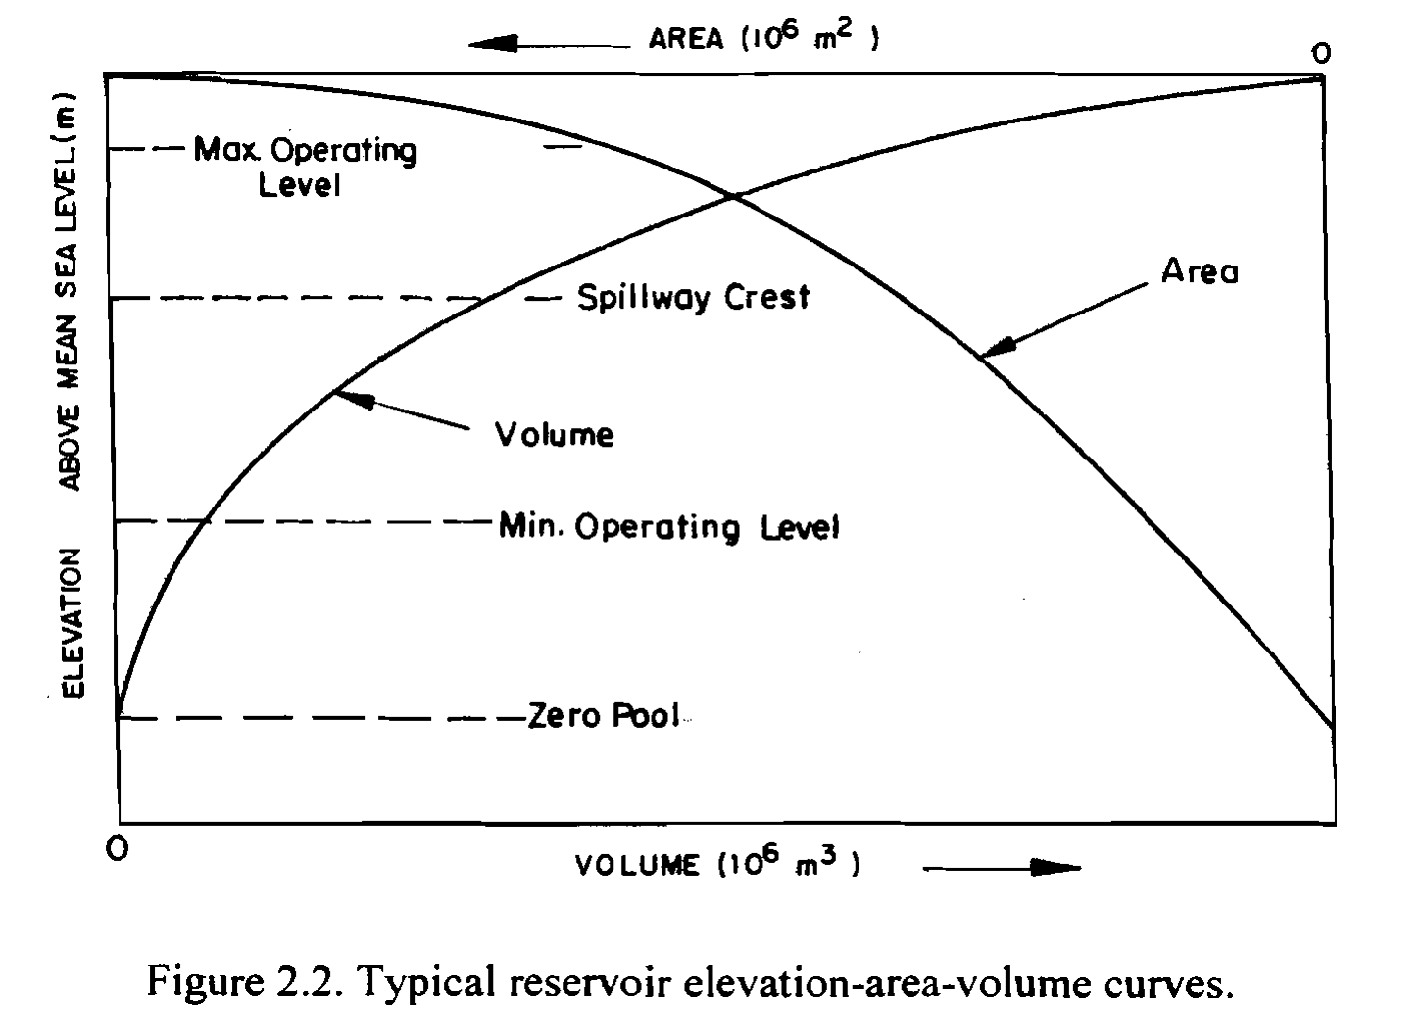
Elevation-Area-Volume Curves
- Given that location & dam height; to determine reservoir volume
Water Resources, ITU - E. Kahya

Slide 11
Elevation-Area-Volume Curves
“Area-elevation” curve:
by measuring the area enclosed within each contour in the reservoir site using a planimeter.
✪ Usually a 1/5000 scaled topographic map
“Elevation-storage” curve:
the integration of an area-elevation curve.
 The storage between any two elevations can be obtained by the product of average surface area at two elevations multiplied by the difference in elevation.
Water Resources, ITU - E. Kahya

Slide 12
Total reservoir storage components:
Normal pool level
Minimum pool level
Active storage
Dead storage
Flood control storage
Surcharge storage
Water Resources, ITU - E. Kahya

Slide 13
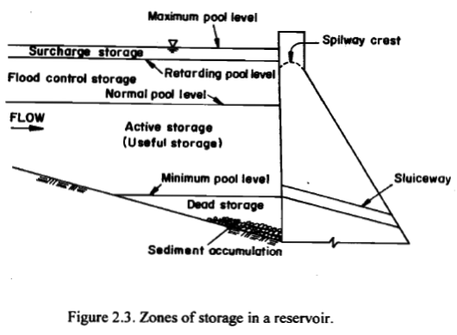
Water Resources, ITU - E. Kahya

Slide 14
General Guidelines for a reservoir site
Cost of the dam
Cost of real estate
Topographic conditions to store water
Possibility of deep reservoir
Avoiding from tributary areas < sediment-rich field >
Quality of stored water
Reliable hill-slopes < stable against landslides >
Water Resources, ITU - E. Kahya

Slide 15
2.3 Reservoir Yield
Yield: the amount of water that reservoir can deliver in a prescribed interval of time.
→ Depends on inflow and capacity
→ Its relation with capacity is important in design
& operation of a storage reservoir.
Firm (safe) yield: the amount of water that can be supplied during a critical period.
→ Period of lowest natural flow
→ Never been determined by certainty…
Water Resources, ITU - E. Kahya

Slide 16
Target yield: specified for a reservoir based on the estimated demands.
❖ The problem is to provide sufficient reservoir capacity with a risk of meeting the target.
Secondary yield: water available in excess of firm yield during high flow periods
Water Resources, ITU - E. Kahya

Slide 17
2.4 Selection of Capacity of a Storage Reservoir
Designing the capacity of a storage reservoir involves with determination of the critical period during
“Inflow < Demand”
In general, four methods to find out the capacity:
1- Flow (Discharge) run curve method
2- Mass curve
3- Sequent-peak algorithm
4- Operation study
5- Optimization analysis & stochastic models
Water Resources, ITU - E. Kahya

Slide 18
Flow Run Curve Method
Incoming Volume
Incoming, Demanded Volume (10⁶ m³)
200
180
160
140
120
100
80
60
40
20
1
2
3
4
5
6
7
8
9
10
11
12
13
14
15
16
17
18
Time (month)

Slide 19
Flow Run Curve Method
Incoming Volume
Demanded Volume
Incoming, Demanded Volume (10⁶ m³)
200
180
160
140
120
100
80
60
40
20
1
2
3
4
5
6
7
8
9
10
11
12
13
14
15
16
17
18
Time (month)

Slide 20
Flow Run Curve Method
Deficient
Volume
V₃
V₂
Incoming, Demanded Volume (10⁶ m³)
200
180
160
140
120
100
80
60
40
20
V₁
1
2
3
4
5
6
7
8
9
10
11
12
13
14
15
16
17
18
Time (month)
V₄

Slide 21
Flow Run Curve Method
Excessive
Volume
Deficient
Volume
Incoming, Demanded Volume (10⁶ m³)
200
180
160
140
120
100
80
60
40
20
F1
1
2
3
4
5
6
7
8
9
10
11
12
13
14
15
16
17
18
F2
Time (month)
F3

Slide 22
Flow Run Curve Method
Excessive Volume: F
Deficient Volume: V
ΣF > ΣV ➔ Va = max V
ΣF = ΣV ➔ Va = max (F,V)
ΣF < ΣV ➔ Va = max F

Slide 23
MASS CURVE ANALYSIS
Proposed by Ripple in 1883.
Graphical inspection of the entire record of historical (or synthetic) streamflow for a critical period.
Provides storage requirements by evaluating ∑(S-D)
Valid only when ∑D < ∑S during the period of record.
Works well when releases are constant.
Otherwise use of sequent-peak algorithm suggested.
Water Resources, ITU - E. Kahya

Slide 24
Features of Mass Curve:
Cumulative plotting of net reservoir inflow.
Slope of mass curve gives value of inflow (S) at that time.
Slope of demand curve gives the demand rate (D) or yield.
The difference between the lines (a+b) tangent to the demand line (∑D) drawn at the highest and lowest points (A and B, respectively) of mass curve (∑S) gives the rate of withdrawal from reservoir during that critical period.
Water Resources, ITU - E. Kahya

Slide 25
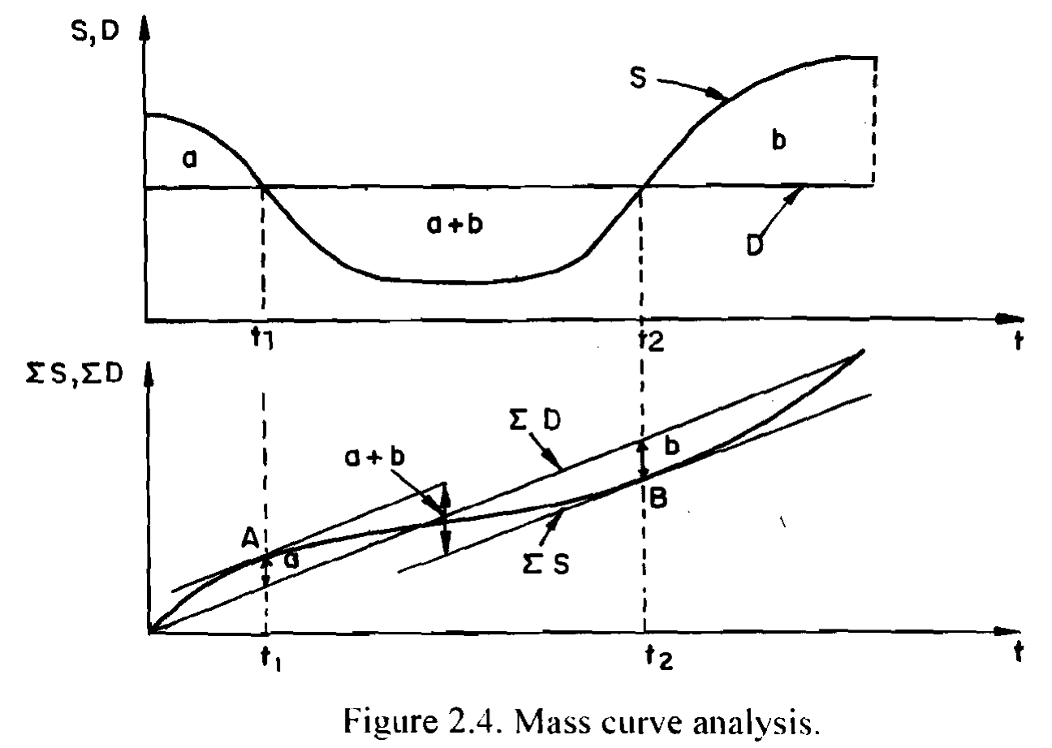
The maximum cumulative value between tangents is the required storage capacity (active storage).
◉ Note that 100% regulation (∑D = ∑S) is illustrated in Figure 2.4.
Water Resources, ITU - E. Kahya

Slide 26
Use of Mass Curve to Determine Reservoir capacity for a Known Yield:
ΣS, ΣD
(m³)
Incoming Flow Cumulative
Curve (IFCC)
ΣS
0
Time (month)

Slide 27
Use of Mass Curve to Determine Reservoir capacity for a Known Yield:
ΣS, ΣD
(m³)
IFCC
ΣS
ΣD
Demand Cumulative Curve
Annual Demand
1 year
0
Time (month)

Slide 28
Use of Mass Curve to Determine Reservoir capacity for a Known Yield:
ΣS, ΣD
(m³)
IFCC
ΣS
ΣD
Annual Demand
1 year
0
Zaman (ay)

Slide 29
Use of Mass Curve to Determine Reservoir capacity for a Known Yield:
ΣS, ΣD
(m³)
IFCC
Demand Cumulative Curve
ΣS
V₃
V₂
ΣD
V₁
Annual Demand
1 year
0
Time (month)

Slide 30
Use of Mass Curve to Determine Reservoir capacity for a Known Yield:
ΣS, ΣD
(m³)
IFCC
Demand Cumulative Curve
ΣS
V₃
overflow
V₂
ΣD
V₁
Annual Demand
1 year
0
Time (month)

Slide 31
Use of Mass Curve to Determine Reservoir capacity for a Known Yield:
ΣS, ΣD
(m³)
IFCC
Max. Reservoir
Capacity
ΣS
V₃
overflow
V₂
ΣD
V₁
Demand Cumulative Curve
Annual Demand
1 year
0
Time (month)

Slide 32
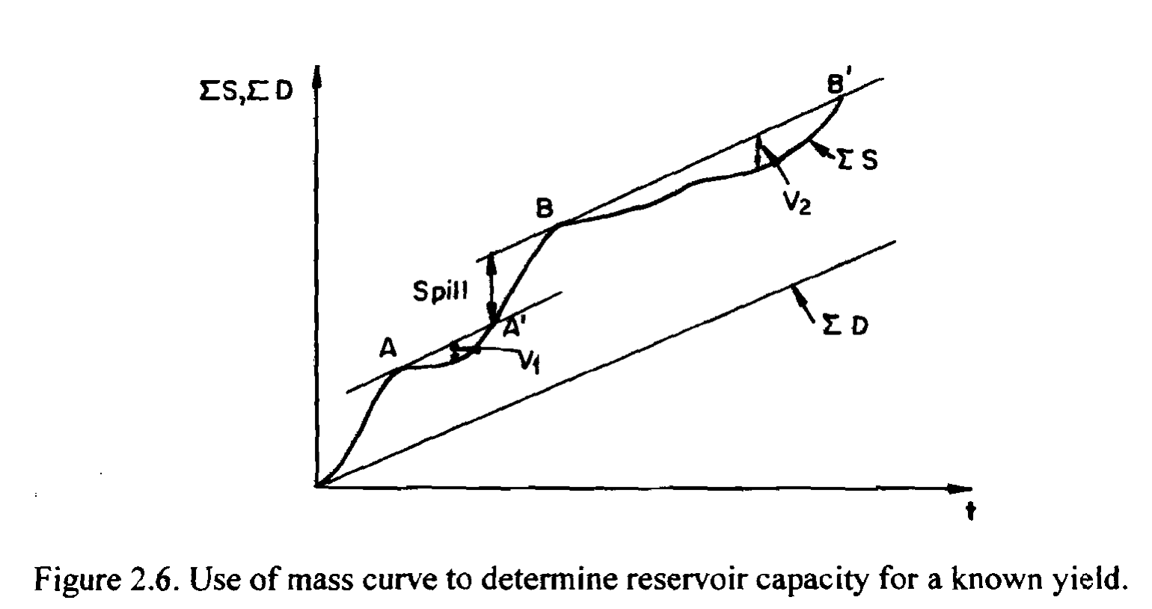
Use of Mass Curve to Determine Reservoir capacity for a Known Yield:
SUMMARY: using the figure from your text book.
V_{a} = max {V_{i}}
Water Resources, ITU - E. Kahya

Slide 33
Use of Mass Curve to Find Possible Yield from a Fixed Size Reservoir
ΣS, ΣD
(m³)
ΣD
Time (month)

Slide 34
Use of Mass Curve to Find Possible Yield from a Fixed Size Reservoir
ΣS, ΣD
(m³)
V
V
ΣD
V
D₂
Time (month)

Slide 35
Use of Mass Curve to Find Possible Yield from a Fixed Size Reservoir
ΣS, ΣD
(m³)
V
Slope = D₁
V
ΣD
V
D₁
Time (month)

Slide 36
Use of Mass Curve to Find Possible Yield from a Fixed Size Reservoir
ΣS, ΣD
(m³)
V
Slope = D₂
Slope = D₁
V
ΣD
V
D₁
D₂
Time (month)

Slide 37
Use of Mass Curve to Find Possible Yield from a Fixed Size Reservoir
ΣS, ΣD
(m³)
Slope= D₃
V
Slope = D₂
Slope = D₁
V
ΣD
D₃
V
D₁
D₂
Time (month)

Slide 38
Use of Mass Curve to Find Possible Yield from a Fixed Size Reservoir
ΣS, ΣD
(m³)
Slope = D₃
V
Slope = D₂
Firm
Yield
Slope = D₁
V
ΣD
D₃
V
D₁
D₂
Time (month)

Slide 39
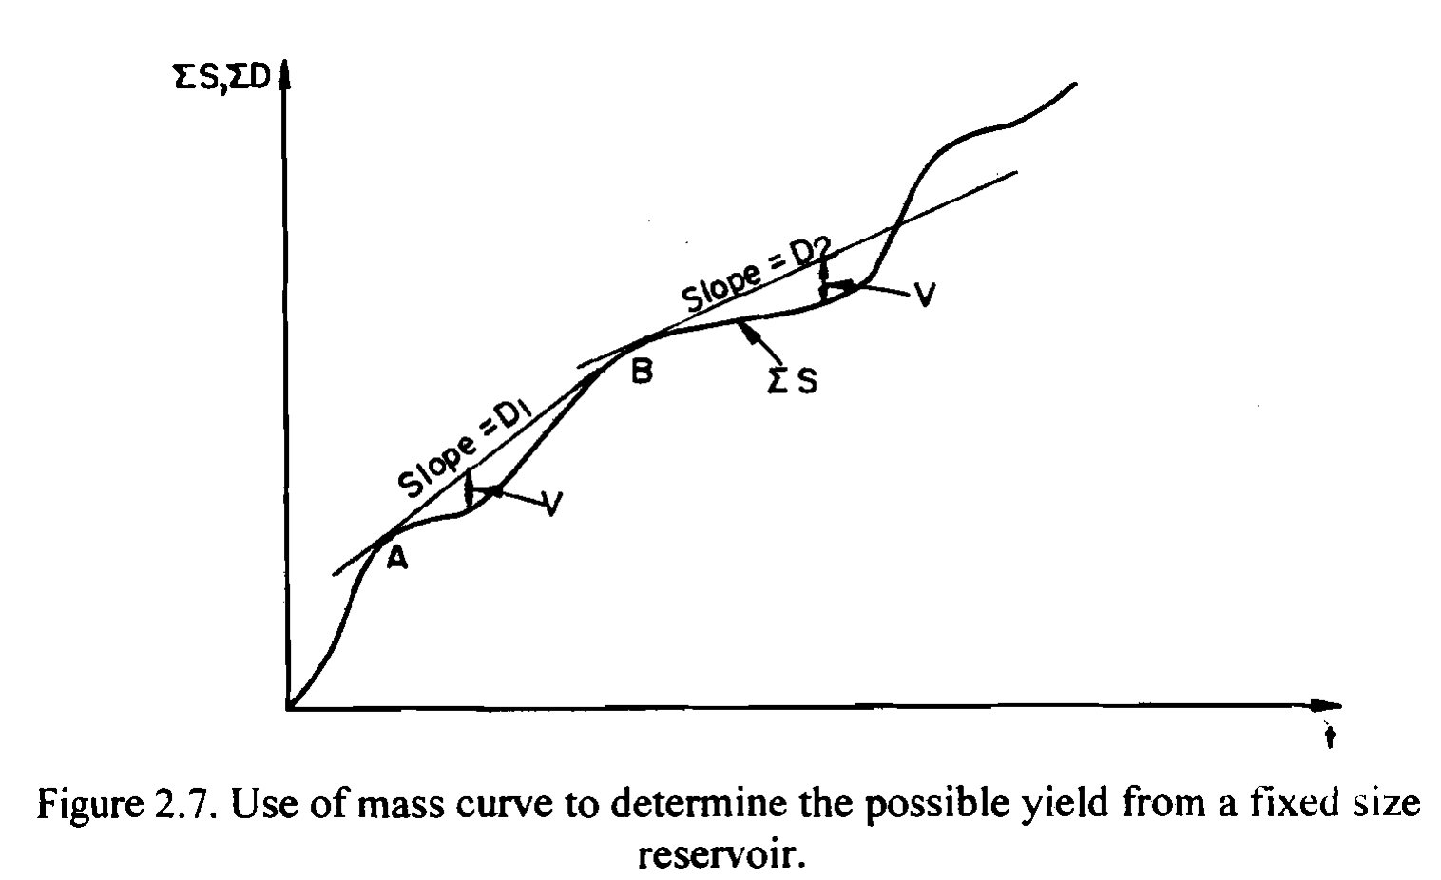
Use of Mass Curve to Find Possible Yield from a Fixed Size Reservoir
SUMMARY: using the figure from your text book.
D = min {D_{i}}
Water Resources, ITU - E. Kahya

Slide 40
SEQUENT-PEAK ALGORITHM (SPA)
❖ SPA is a modification of the Mass Curve analysis for lengthy time series and particularly suited to computer coding.
The procedures involve the following steps:
1- Plot ∑(Inflow-Withdrawal): in symbolized fashion → ∑(S-D)
Water Resources, ITU - E. Kahya

Slide 41
SEQUENT-PEAK ALGORITHM (SPA)
Σ(St – Dt)
(+)
t
(-)

Slide 42
SEQUENT-PEAK ALGORITHM (SPA)
2- Locate the initial peak and the next peak
(aka sequent peak),
3- Compute the storage required which is the difference between the initial peak and the lowest trough in the interval,
4- Repeat the process for all sequent peaks,
5- Determine the largest value of storages as
“STORAGE CAPACITY”.
Water Resources, ITU - E. Kahya

Slide 43
SEQUENT-PEAK ALGORITHM (SPA)
Σ(St – Dt)
(+)
t
(-)

Slide 44
SEQUENT-PEAK ALGORITHM (SPA)
Σ(St – Dt)
V₃
V₂
V₁
(+)
C = V₂
t
(-)

Slide 45
SEQUENT-PEAK ALGORITHM (SPA)
Analytical solution to SPA is good for computer coding & use the equations below:
V_{t} = D_{t} – S_{t} + V_{t-1} if positive
V_{t} = 0 otherwise
V_{t} : required storage capacity at the end of period t
V_{t-1} : required storage capacity at the end of preceding period t
D_{t} : release during period t
S_{t} : inflow during period t
* Assign V_{t=0} = 0
** Compute V_{t} successively for up to twice the record length
*** Va = max {V_{t}}
Water Resources, ITU - E. Kahya

Slide 46
SEQUENT-PEAK ALGORITHM (SPA)
10⁶ m³
Example:
Incoming monthly flow during the critical period (1973-1975) for Çatalan dam are given in the nearby table.
Find active volume of the reservoir for 85% regulation using SPA.
Monthly Demand Volume:
294 x % 85 = 250

Slide 47
10⁶ m³
Example Cont’d:
If positive
V_{t} = D_{t} – S_{t} + V_{t-1}
Otherwise
V_{t} = 0
Analytical
Solution

Slide 48
Example Cont’d:
Graphical
Solution

Slide 49
Example Cont’d:

Slide 50
OPERATION STUDY
- defined as a simulated operation of the reservoir according to a presumed operation plan (or a set of rules)
- provides the adequacy of a reservoir
- based on monthly solution of hydrologic continuity equation
Water Resources, ITU - E. Kahya

Slide 51
OPERATION STUDY
used to
a) Determine the required capacity,
b) Define the optimum rules for operation,
c) Select the installed capacity for powerhouses,
d) Make other decisions regarding to planning.
Water Resources, ITU - E. Kahya

Slide 52
OPERATION STUDY
carried out
(1) only for an extremely low flow period & presents the required capacity to overcome the selected drought;
(2) for the entire period & presents the power production for each year.
Water Resources, ITU - E. Kahya

Slide 53
OPTIMIZATION ANALYSIS & STOCHASTIC MODELS
Reliability of Reservoir Yield
See the text book & class discussion for the details
Water Resources, ITU - E. Kahya

Slide 54
2.8 Reservoir Sedimentation
Sediments → eventually fill all reservoirs
determine the useful life of reservoirs
important factor in planning
■ River carry some suspended sediment and move
bed load (larger solids along the bed).
■ Large suspended particles + bed loads → deposited at the head of the reservoir & form delta.
■ Small particles → suspend in the reservoir or flow over the dam.
Water Resources, ITU - E. Kahya

Slide 55
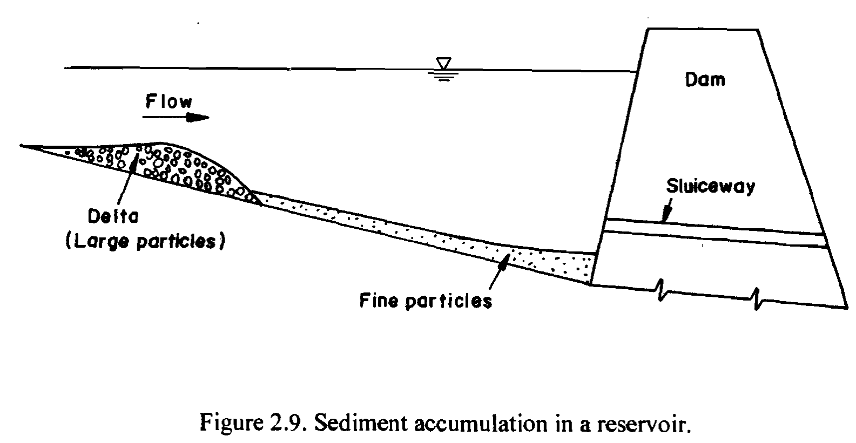
Water Resources, ITU - E. Kahya

Slide 56
■ Bed load ≈ 5 to 25 % of the suspended load in the plain rivers
≈ 50 % of the suspended load in the mountainous rivers
☻ Unfortunately, the total rate of sediment transport in Turkey > 18 times that in the whole Europe
(500x10⁶ tons/year)
Water Resources, ITU - E. Kahya

Slide 57
“RESERVOIR SEDIMENTATION RATE”
▬ based on survey of existing reservoirs, containing
* Specific weight of the settled sediments
* % of entering sediment which is deposited
“TRAP EFFICIENCY”:
% of inflowing sediment retained in the reservoir
▬ function of the ratio of reservoir capacity to total inflow.
Water Resources, ITU - E. Kahya

Slide 58
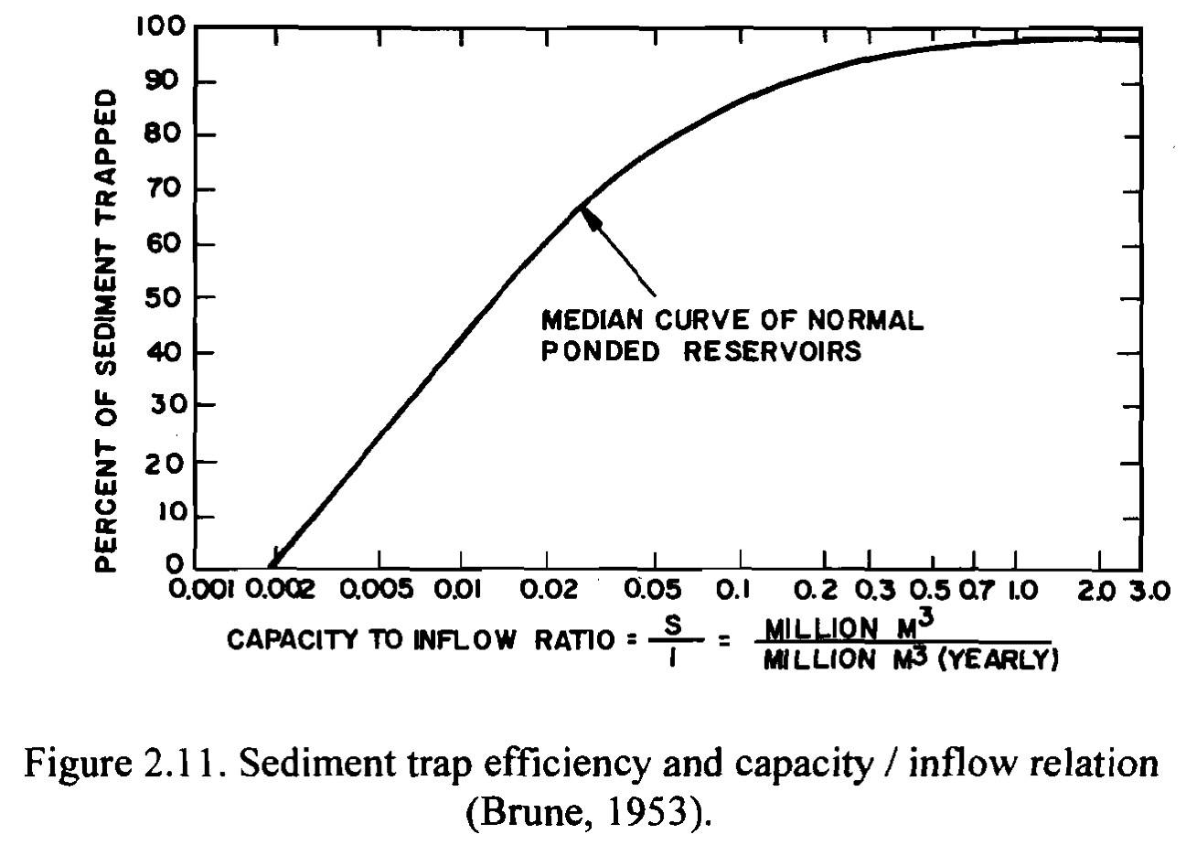
Water Resources, ITU - E. Kahya

Slide 59
IMPORTANT NOTES:
► “Prediction of sediment accumulation”
-- Difficult due to high range of variability in sediment discharge
► SOLUTION: “Continuous hydrologic simulation models”
-- used for prediction purposes
< But, at least, 2-3 years daily data are needed for calibration of the model. >
Water Resources, ITU - E. Kahya

Slide 60
IMPORTANT NOTES:
► “To control amount of entering sediment”:
(a) Upstream sedimentation basins,
(b) Vegetative screens,
(c) Soil conservation methods (i.e., terraces),
(d) Implementing sluice gates at various levels.
(e) Dredging of settled materials, but not economical!
Water Resources, ITU - E. Kahya

