Slide 1
WATER RESOURCES
Mehmet Özger
Civil Engineering Department
Hydraulics Lab.

Slide 2
Some informations about myself
I usually prefer not to indicate fixed receiving hours. I am usually working in my office and therefore I am willing to receive students any time. Appointments can be fixed by email.
Email: ozgerme@itu.edu.tr
Phone: 212 285 3717
Web: http://web.itu.edu.tr/~ozgerme/

Slide 3
Learning Objectives
Water Resources Engineering is about solving problems to secure water for people, based on a scientific understanding of hydrologic and hydraulic processes. This includes protection from excess water and from water shortage, as well as providing sufficient water for a sustainable environment.
At the end of this class you will:
be aware of water resources issues at local , national and global scale,
be able to qualitatively and quantitatively describe the main processes in the hydrologic cycle, and
be able to provide solutions for typical water resources problems found in practice.

Slide 4
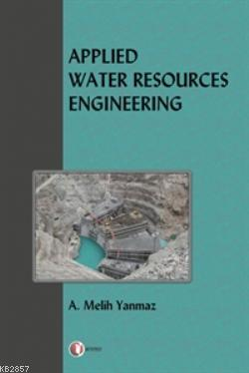

Suggested text book
This textbook covers the all topics included in the class.
Additional textbook
Notes:
Detailed Contents Chapter 1. Introduction.
1.1 Background.
1.2 The Worldâ ™s FreshWater Resources.
1.3 Water Use in the United States.
1.4 Systems of Units.
1.5 What Is Water?
1.6 The Future of Water Resources.
Chapter 2. Principles of Flow in Hydrosystems.
2.1 Properties Involving Mass or Weight of Water.
2.2 Viscosity.
2.3 Elasticity.
2.4 Pressure and Pressure Variation.
2.5 Surface Tension.
2.6 Flow Visualization.
2.7 Laminar and Turbulent Flow.
2.8 Discharge.
Chapter 3. Flow Processes and Hydrostatic Forces.
3.1 Control Volume Approach for Hydrosystems.
3.2 Continuity.
3.3 Energy.
3.4 Momentum.
3.5 Pressure and Pressure Forces in Static Fluids.
3.5.1 Hydrostatic Forces.
3.5.2 Buoyancy.
3.6 Velocity Distribution.
Chapter 4. Hydraulic Processes: Pressurized Pipe Flow.
4.1 Classification of Flow.
4.2 Pressurized (Pipe) Flow.
4.2.1 Energy Equation.
4.2.2 Hydraulic and Energy Grade Lines.
4.3 Headlosses.
4.3.1 Shear-Stress Distribution of Flow in Pipes.
4.3.2 Velocity Distribution of Flow in Pipes.
4.3.3 Headlosses from Pipe Friction.
4.3.4 Form (Minor) Losses.
4.4 Forces in Pipe Flow.
4.5 Pipe Flow in Simple Networks.
4.5.1 Series Pipe Systems.
4.5.2 Parallel Pipe Systems.
4.5.3 Branching Pipe Flow.
4.6 Measurement of Flowing Fluids in Pressure Conduits.
4.6.1 Measurement of Static Pressure.
4.6.2 Measurement of Velocity.
4.6.3 Measurement of Discharge.
Chapter 5. Hydraulic Processes: Open-Channel Flow.
5.1 Steady Uniform Flow.
5.1.1 Energy.
5.1.2 Momentum.
5.1.3 Best Hydraulic Sections for Uniform Flow in Nonerodible Channels.
5.2 Specific Energy, Momentum, and Specific Force.
5.2.1 Specific Energy.
5.2.2 Momentum.
5.2.3 Specific Force.
5.3 Steady, Gradually Varied Flow.
5.3.1 Gradually Varied Flow Equations.
5.3.2 Water Surface Profile Classification.
5.4 Gradually Varied Flow for Natural Channels.
5.4.1 Development of Equations.
5.4.2 Energy Correction Factor.
5.4.3 Application for Water Surface Profile.
5.5 Rapidly Varied Flow.
5.6 Discharge Measurement.
5.6.1 Weir.
5.6.2 Flumes.
5.6.3 Stream Flow Measurement: Velocity-Area-Integration Method.
Chapter 6. Hydraulic Processes: Groundwater Flow.
6.1 Groundwater Concepts.
6.2 Saturated Flow.
6.2.1 Governing Equations.
6.2.2 Flow Nets.
6.3 Steady-State One-Dimensional Flow.
6.4 Steady-State Well Hydraulics.
6.4.1 Flow to Wells.
6.4.2 Confined Aquifers.
6.4.3 Unconfined Aquifers.
6.5 Transient Well Hydraulicsâ Confined Conditions.
6.5.1 Nonequilibrium Well Pumping Equation.
6.5.2 Graphical Solution.
6.5.3 Cooperâ Jacob Method of Solution.
6.6 Transient Well Hydraulicsâ Unconfined Conditions.
6.7 Transient Well Hydraulicsâ Leaky Aquifer Conditions.
6.8 Boundary Effects: Image Well Theory.
6.8.1 Barrier Boundary.
6.8.2 Recharge Boundary.
6.8.3 Multiple Boundary Systems.
6.9 Simulation of Groundwater Systems.
6.9.1 Governing Equations.
6.9.2 Finite Difference Equations.
6.9.3 MODFLOW.
Chapter 7. Hydrologic Processes.
7.1 Introduction to Hydrology.
7.1.1 What Is Hydrology?
7.1.2 The Hydrologic Cycle.
7.1.3 Hydrologic Systems.
7.1.4 Atmospheric and Ocean Circulation.
7.2 Precipitation (Rainfall).
7.2.1 Precipitation Formation and Types.
7.2.2 Rainfall Variability.
7.2.3 Disposal of Rainfall on a Watershed.
7.2.4 Design Storms.
7.2.5 Estimated Limiting Storms.
7.3 Evaporation.
7.3.1 Energy Balance Method.
7.3.2 Aerodynamic Method.
7.3.3 Combined Method.
7.4 Infiltration.
7.4.1 Unsaturated Flow.
7.4.2 Greenâ Ampt Method.
7.4.3 Other Infiltration Methods.
Chapter 8. Surface Runoff.
8.1 Drainage Basins.
8.2 Hydrologic Losses and Rainfall Excess.
8.3 Rainfall-Runoff Analysis Using Unit Hydrograph Approach.
8.4 Synthetic Unit Hydrographs.
8.5 S-Hydrographs.
8.6 SCS Rainfall-Runoff Relation .
8.7 Curve Number Estimation and Abstractions.
8.7.1 Antecedent Moisture Conditions.
8.7.2 Soil Group Classification.
8.7.3 Curve Numbers.
8.8 SCS Unit Hydrograph Procedure.
8.8.1 Time of Concentration.
8.8.2 Time to Peak.
8.8.3 Peak Discharge.
8.9 Kinematic-Wave Overland Flow Runoff Model.
8.10 Computer Models for Rainfall-Runoff Analysis.
Chapter 9. Reservoir and Stream Flow Routing.
9.1 Routing.
9.2 Hydrologic Reservoir Routing.
9.3 Hydrologic River Routing.
9.4 Hydraulic (Distributed) Routing.
9.4.1 Unsteady Flow Equations: Continuity Equation.
9.4.2 Momentum Equation.
9.5 Kinematic Wave Model for Channels.
9.5.1 Kinematic Wave Equations.
9.5.2 U.S. Army Corps of Engineers HEC-1 Kinematic Wave Model for
Overland Flow and Channel Routing.
9.5.3 KINEROS Channel Flow Routing Model.
9.5.4 Kinematic Wave Celerity.
9.6 Muskingum-Cunge Model.
9.7 Implicit Dynamic Wave Model.
Chapter 10. Probability, Risk, and Uncertainty Analysis for Hydrologic and Hydraulic Design.
10.1 Probability Concepts.
10.2 Commonly Used Probability Distributions.
10.2.1 Normal Distribution.
10.2.2 Log-Normal Distribution.
10.3 Hydrologic Design for Water Excess Management.
10.3.1 Hydrologic Design Scale.
10.3.2 Hydrologic Design Level (Return Period).
10.3.3 Hydrologic Risk.
10.3.4 Hydrologic Data Series.
10.4 Hydrologic Frequency Analysis.
10.5 U.S Water Resources Council Guidelines for Flood Flow Frequency Analysis.
10.5.1 Procedure.
10.5.2 Testing for Outliers.
10.6 Analysis of Uncertainties.
10.7 Risk Analysis: Composite Hydrologic and Hydraulic Risk.
10.7.1 Reliability Computation by Direct Integration.
10.7.2 Reliability Computation Using Safety Margin/Safety Factor.
10.8 Computer Models for Floodflow Frequency Analysis.
Chapter 11. Water Withdrawals and Uses.
11.1 Water-Use Dataâ Classification of Uses.
11.2 Water for Energy Production.
11.3 Water for Agriculture.
11.3.1 Irrigation Trends and Needs.
11.3.2 Irrigation Infrastructure.
11.3.3 Irrigation System Selection and Performance.
11.3.4 Water Requirements for Irrigation.
11.3.5 Impacts of Irrigation.
11.4 Water Supply/Withdrawals.
11.4.1 Withdrawals.
11.4.2 Examples of Regional Water Supply Systems.
11.5 Water Demand and Price Elasticity.
11.5.1 Price Elasticity of Water Demand.
11.5.2 Demand Models.
11.6 Drought Management.
11.6.1 Drought Management Options.
11.6.2 Drought Severity.
11.6.3 Economic Aspects of Water Shortage.
11.7 Analysis of Surface Water Supply.
11.7.1 Surface-Water Reservoir Systems.
11.7.2 Storageâ Firm Yield Analysis for Water Supply.
11.7.3 Reservoir Simulation.
Chapter 12. Water Distribution.
12.1 Introduction.
12.1.1 Description, Purpose, and Components of Water Distribution Systems.
12.1.2 Pipe Flow Equations.
12.2 System Components.
12.2.1 Pumps.
12.2.2 Pipes and Fittings.
12.2.3 Valves.
12.3 System Configuration and Operation.
12.4 Hydraulics of Simple Networks.
12.4.1 Series and Parallel Pipe Flow.
12.4.2 Branching Pipe Flow.
12.5 Pump Systems Analysis.
12.5.1 System Head Curves.
12.5.2 Pump Operating Point.
12.5.3 System Design for Water Pumping.
12.6 Network Simulation.
12.6.1 Conservation Laws.
12.6.2 Network Equations.
12.6.3 Network Simulation: Hardyâ Cross Method.
12.6.4 Network Simulation: Linear Theory Method.
12.6.5 Extended-Period Simulation.
12.7 Modeling Water Distribution Systems.
12.7.1 Computer Models.
12.7.2 Calibration.
12.7.3 Application of Models.
12.7.4 Water Quality Modeling.
12.8 Hydraulic Transients.
12.8.1 Hydraulic Transients in Distribution Systems.
12.8.2 Fundamentals of Hydraulic Transients.
12.8.3 Control of Hydraulic Transients.
Chapter 13. Water for Hydroelectric Generation.
13.1 Role of Hydropower.
13.2 Components of Hydroelectric Plants.
13.2.1 Elements to Generate Electricity.
13.2.2 Hydraulics of Turbines.
13.2.3 Power System Terms and Definitions.
13.3 Determining Energy Potential.
13.3.1 Hydrologic Data.
13.3.2 Water Power Equations.
13.3.3 Turbine Characteristics and Selection.
13.3.4 Flow Duration Method.
13.3.5 Sequential Streamflow-Routing Method.
13.3.6 Power Rule Curve.
13.3.7 Multipurpose Storage Operation.
Chapter 14. Flood Control.
14.1 Introduction.
14.2 Floodplain Management.
14.2.1 Floodplain Definition.
14.2.2 Hydrologic and Hydraulic Analysis of Floods.
14.2.3 Floodways and Floodway Fringes.
14.2.4 Floodplain Management and Floodplain Regulations.
14.2.5 National Flood Insurance Program.
14.2.6 Stormwater Management and Floodplain Management.
14.3 Flood-Control Alternatives.
14.3.1 Structural Alternatives.
14.3.2 Nonstructural Measures 542
14.4 Flood Damage and Net Benefit Estimation.
14.4.1 Damage Relationships.
14.4.2 Expected Damages.
14.4.3 Risk-Based Analysis.
14.5 U.S. Army Corps of Engineers Risk-Based Analysis for Flood-Damage Reduction Studies.
14.5.1 Terminology.
14.5.2 Benefit Evaluation.
14.5.3 Uncertainty of Stage-Damage Function.
14.6 Operation of Reservoir Systems for Flood Control.
14.6.1 Flood-Control Operation Rules.
14.6.2 Tennessee Valley Authority (TVA) Reservoir System Operation.
Chapter 15. Stormwater Control: Storm Sewers and Detention.
15.1 Stormwater Management.
15.2 Storm Systems.
15.2.1 Information Needs and Design Criteria.
15.2.2 Rational Method Design.
15.2.3 Hydraulic Analysis of Designs.
15.2.4 Storm Sewer Appurtenances.
15.2.5 Risk-Based Design of Storm Sewers.
15.3 Stormwater Drainage Channels.
15.3.1 Rigid-Lined Channels.
15.3.2 Flexible-Lined Channels.
15.4 Stormwater Detention.
15.4.1 Why Detention? Effects of Urbanization.
15.4.2 Types of Surface Detention.
15.4.3 Sizing Detention.
15.4.4 Detention Basin Routing.
15.4.5 Subsurface Disposal of Stormwater.
Chapter 16. Stormwater Control: Street and Highway Drainage and Culverts.
16.1 Drainage of Street and Highway Pavements.
16.1.1 Design Considerations.
16.1.2 Flow in Gutters.
16.1.3 Pavement Drainage Inlets.
16.1.4 Interception Capacity and Efficiency of Inlets on Grade.
16.1.5 Interception Capacity and Efficiency of Inlets in Sag Locations.
16.1.6 Inlet Locations.
16.1.7 Median, Embankment, and Bridge Inlets.
16.2 Hydraulic Design of Culverts.
16.2.1 Culvert Hydraulics.
16.2.2 Culvert Design.
Chapter 17. Design of Spillways and Energy Dissipation for Flood Control Storage and
Conveyance Systems.
17.1 Hydrologic Considerations.
17.2 Dams.
17.2.1 Type of Dams.
17.2.2 Hazard Classification of Dams.
17.2.3 Spillway Capacity Criteria.
17.2.4 Safety of Existing Dams.
17.2.5 Hydraulic Analysis of Dam Failures.
17.2.6 Examples of Dams and Spillways.
17.3 Spillways.
17.3.1 Functions of Spillways.
17.3.2 Overflow and Free-Overfall (Straight Drop ) Spillways.
17.3.3 Ogee (Overflow) Spillways.
17.3.4 Side Channel Spillways.
17.3.5 Drop Inlet (Shaft or Morning Glory) Spillways.
17.3.6 Baffled Chute Spillways.
17.3.7 Culvert Spillways.
17.4 Hydraulic-Jump Type Stilling Basins and Energy Dissipators.
17.4.1 Types of Hydraulic Jump Basins.
17.4.2 Basin I.
17.4.3 Basin II.
17.4.4 Basin III.
17.4.5 Basin IV.
17.4.6 Basin V.
17.4.7 Tailwater Considerations for Stilling Basin Design.
17.5 Other Types of Stilling Basins.
17.6 Gates and Valves.
17.6.1 Spillway Crest Gates.
17.6.2 Gates for Outlet Works.
17.6.3 Valves for Outlet Works.
17.7 Outlet Works.
Chapter 18. Sedimentation and Erosion Hydraulics.
18.0 Introduction.
18.1 Properties of Sediment.
18.1.1 Size and Shape.
18.1.2 Measurement of Size Distribution.
18.1.3 Settling Analysis for Finer Particles.
18.1.4 Fall Velocity.
18.1.5 Density.
18.1.6 Other Important Relations.
18.2 Bed Forms and Flow Resistance.
18.2.1 Bed Forms.
18.2.2 Sediment Transport Definitions.
18.2.3 Flow Resistance.
18.3 Sediment Transport.
18.3.1 Incipient Motion.
18.3.2 Sediment Transport Functions.
18.3.3 Armoring.
18.4 Bed Load Formulas.
18.4.1 Duboys Formula.
18.4.2 Meyer-Peter and Muller Formula.
18.4.3 Schoklitsch Formula.
18.5 Suspended Load.
18.6 Total Sediment Load (Bed Material Load Formulas).
18.6.1 Colbyâ ™s Formula.
18.6.2 Ackers-White Formula.
18.6.3 Yangâ ™s Unit Stream Power Formula.
18.7 Watershed Sediment Yield.
18.8 Reservoir Sedimentation.
18.9 Stream Stability at Highway Structures.
18.9.1 Factors that Affect Stream Stability.
18.9.2 Basic Engineering Analysis.
18.9.3 Countermeasures (Flow Control Structure) for Stream Instability.
18.9.4 Spurs.
18.9.5 Guide Banks (Spur Dikes).
18.9.6 Check Dams (Channel Drop Structures).
18.10 Bridge Scour.
18.10.1 Design Approach.
18.10.2 Contraction Scour.
18.10.3 Local Scour at Piers.
18.10.4 Live-Bed Scour at Abutments.
Appendix A. Newton-Raphson Method.
Finding the root for a single nonlinear equation.
Application to Solve Manningâ ™s Equation for Normal Depth.
Finding the roots of a system of nonlinear equations.
Index.

Slide 5
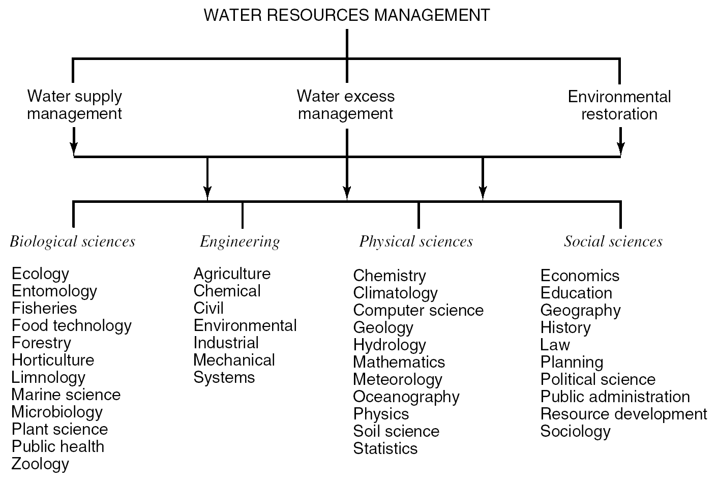
What is Water Resources Engr./Manag.?
Figure 1.1.1 (p. 1)
Ingredients of water resources management (from Mays, 1996).

Slide 6
Ancient
Hydrologic
History
Nile River
The longest river in the world
(6650 km)
Hydrology has been a subject of investigation and engineering for millennia. For example, about 4000 B.C. the Nile was dammed to improve agricultural productivity of previously barren lands. Mesopotamian towns were protected from flooding with high earthen walls. Aqueducts were built by the Greeks and Ancient
Romans, while the History of China shows they built irrigation and flood control works. The ancient Sinhalese used hydrology to build complex irrigation Works in Sri Lanka, also known for invention of the Valve Pit which allowed construction of large reservoirs, anicuts and canals which still function.
Loucks and van Beek, 2006
Notes:
http://en.wikipedia.org/wiki/Nilometer
Nilometer is the name given to one of several devices that are different in design but that all serve the same function: measuring water levels in the River Nile and thus allowing the keeping of comparative historic records.
Every summer, torrential rains in the highlands of Ethiopia cause a drastic increase in the volume of water flowing into the Nile from its tributaries. Between June and September, the reaches of the Nile running through Egypt would burst their banks and cover the adjacent flood plain. When the waters receded, around September or October, they left behind a rich alluvial deposit of exceptionally fertile black silt over the croplands. The inundation – akhet in the Egyptian language – was one of the three seasons into which the Ancient Egyptians divided their years. (See Season of the Inundation.)
It would be difficult to overstate the importance of the annual flood to Egyptian civilization. A moderate inundation was a vital part of the agricultural cycle; however, a lighter monsoon than normal would cause famine, and too much flood water would be equally disastrous, washing away much of the infrastructure built on the flood plain. Records from Pharaonic times indicate that on average, one year of out every five saw an inundation that was either over-abundant or fell short of expectations.
The ability to predict the volume of the coming inundation was part of the mystique of the Ancient Egyptian priesthood. The same skill also played a political and administrative role, since the quality of the year's flood was used to determine the levels of tax to be paid, in kind, by the peasantry to their rulers. This is where the nilometer came into play, with priests monitoring the day-to-day level of the river and announcing the awaited arrival of the summer flood.
The simplest nilometer design is a vertical column submerged in the waters of the river, with marked intervals indicating the depth of the water. One that follows this simple design, albeit housed in an elaborate and ornate stone structure, can still be seen on the island of Rodah in central Cairo. While this nilometer dates only as far back as 861 AD, when the Abbasid caliph al-Mutawakkil ordered its construction, it was built on a site occupied by an earlier specimen.
The second nilometer design comprises a flight of stairs leading down into the water, with depth markings along the walls. The best known example of this kind can be seen on the island of Elephantine in Aswan. This location was also particularly important, since for much of Egyptian history Elephantine marked Egypt's southern border and was therefore the first place where the onset of the annual flood was detected.
The most elaborate design involved a channel or culvert that led from the riverbank – often running for a considerable distance – and then fed a well, tank, or cistern. These nilometer wells were most frequently located within the confines of temples, where only the priests and rulers were allowed access. A particularly fine example, with a deep, cylindrical well and a culvert opening in the surrounding wall, can be seen at the Temple of Kom Ombo to the north of Aswan.
While nilometers originated in Pharaonic times, they continued to be used by the later civilizations that held sway in Egypt. In the 20th century, the Nile's annual inundation was first greatly checked, and then eliminated entirely, with the construction of the Aswan dams. While the Aswan High Dam's impact on Egypt and its agriculture has been controversial for other, more complex reasons, it has also had the additional effect of rendering the nilometer obsolete.

Slide 7
Major Reservoirs of Water
[does not add to 100% due to rounding, numbers differ slightly depending on study used]

Slide 8
The water resources are composed of all
Surface water potential (rivers, lakes, …)
Underground water potential (groundwater…)

Slide 9
Water resources system
It is a system that control, utilize and manage water in an efficient manner
What are the systems:
Dams
Water supply systems
Waster water collection systems
Treatment plants
Flood mitigation

Slide 10
There are two significant factors for water pollution
Growing population
Advancement in technology

Slide 11
Hydropolitics
Transboundry rivers of Turkey
Euphrates (Fırat)
Tigris (Dicle)
Çoruh
Meriç

Slide 12
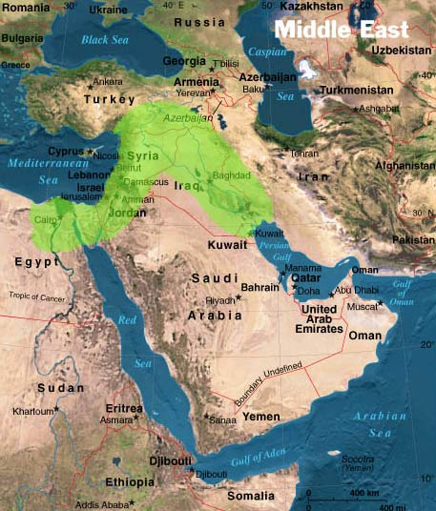
Fertile crescent

Slide 13
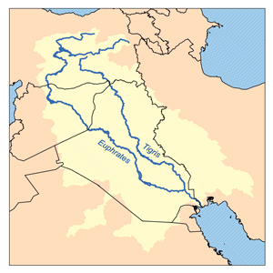
E-T river basin
Headwaters are located in Turkey
Turkey contributes nearly %60 of streamflow
Turkey promises daily 500m3/s water for all seasons.
Turkey regulates the flows

Slide 14

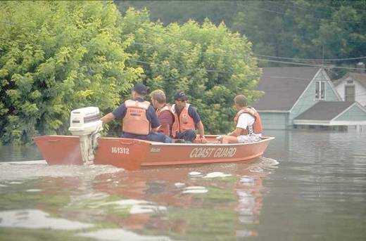
Floods
Damage survey in St. Genevieve, Missouri,
during the 1993 Midwest floods [courtesy of FEMA].
Floods cause extensive damage: “during 1991-1995, flood related damage totaled more than US$200 billion (not inflation adjusted) globally, representing close to 40% of all economic damage attributed to natural disasters in the period -- (Pielke Jr. and Downton, 2000, citing IFRCRCS, 1997). In the United States, annual flood damage runs in the billions of dollars (Pielke Jr. and Downton, 2000). Improved prediction of floods could reduce these costs substantially, in addition to reducing flood-induced loss of life.
Notes:
http://www.usgcrp.gov/usgcrp/Library/watercycle/wcsgreport2001/wcsg2001chapter1.htm

Slide 15
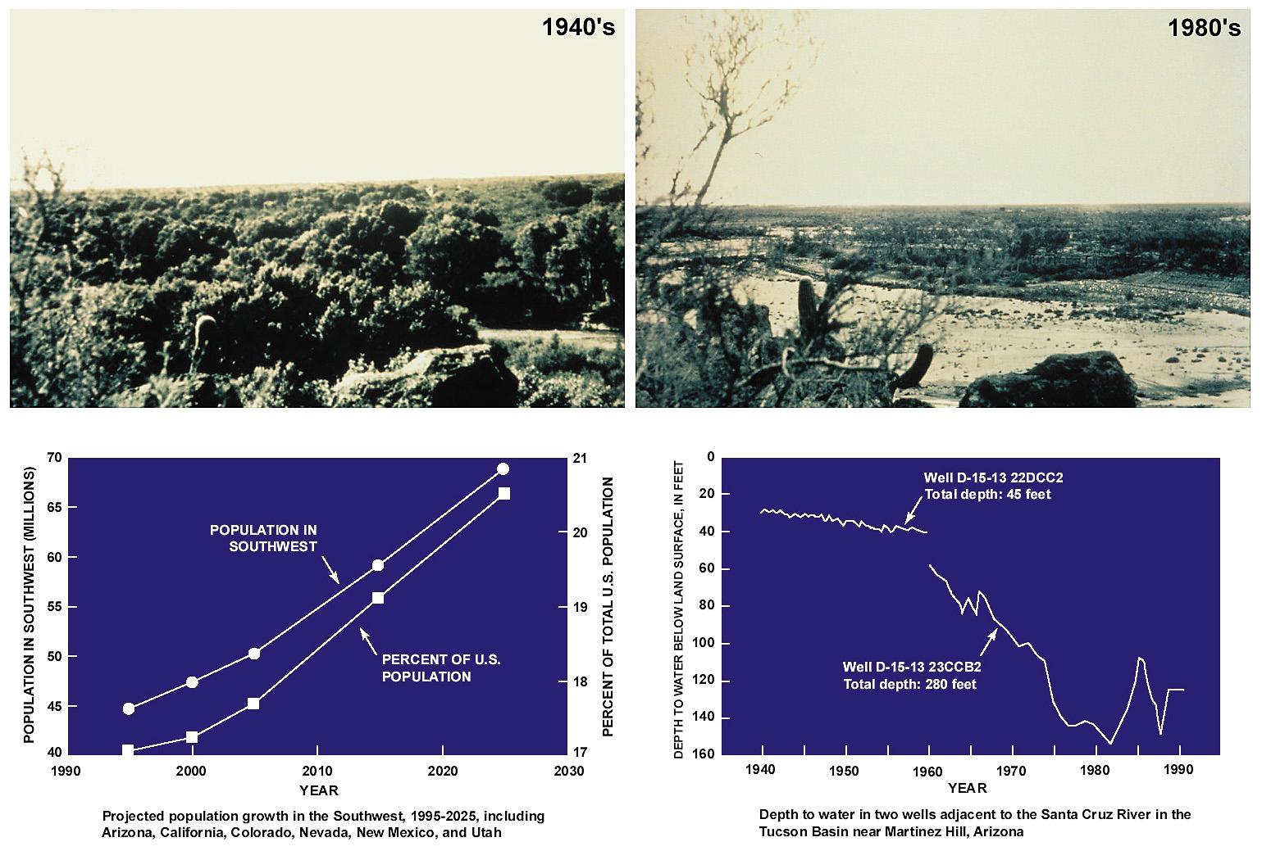
Droughts
Notes:
http://www.usgcrp.gov/usgcrp/Library/watercycle/wcsgreport2001/wcsg2001chapter1.htm
In the arid and semiarid Southwest, riparian areas associated with streams, rivers, and wetlands occupy a very limited portion of the landscape yet harbor a disproportionately large percentage of the region's biological diversity. Development of groundwater resources for a growing population and increased irrigated agriculture in the last 50 years has resulted in outright elimination or alteration of many perennial streams and associated riparian ecosystems. The Tucson Basin in southern Arizona provides a vivid example of the impacts of ground-water development on these riparian ecosystems.
The repeat photographs of a section of the river south of Tucson near Martinez Hill in 1940 and 1989 illustrate the dramatic impact of lower ground-water levels from pumping on the Santa Cruz riparian system. In the 1940's a vibrant cottonwood/willow forest and mesquite bosque was present. By 1989 the riparian vegetation was virtually eliminated. The changes to the stream are profound and nearly impossible to reverse. Data from two wells near Martinez Hill indicate ground-water level declines of more than 30 meters (100 feet) in the area. The future promises even greater pressure on the region's water supply, not only for riparian preservation, but also for agriculture and support of burgeoning population growth.
Courtesy of Stan Leake [USGS, WRD, Tucson, AZ] and Dave Goodrich [USDA-ARS, Tucson, AZ].

Slide 16
Characteristics of water resources projects
Uniqueness
Uncertainty
Socio-economic aspects
Forecasting (energy demand forecasting)
Irreversibility
Economy of scale

Slide 17
Problems face us:
Growing population in developing countries
Uncertain impacts of climate change
Conflicts over shared frehwater resources
Thinning of ozone layer
Destruction of rain forest
Threats to wetlands, farmlands and other renewable sources

Slide 18
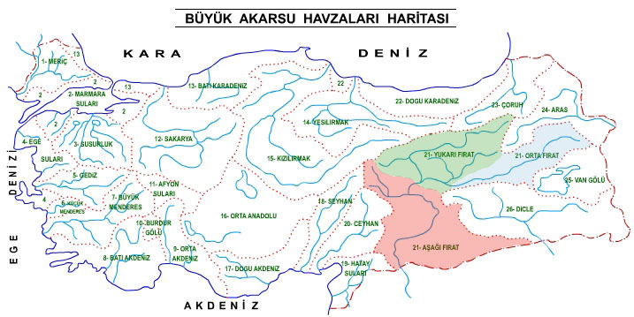
Water resources development in Turkey

Slide 19
Completion and renewal of water supply and waste water collection systems
Watershed management
Development of flood mitigation facilities
Searching for navigational facilities

Slide 20
Organizations responsible for water
Ministry of Forestry and Water Affairs
  State hydraulic works (DSİ)
  Water management directorate general
  State meteorological organization (DMİ)

Slide 21
Ongoing big projects in Turkey
Water transfer to North Cyprus
Deriner Dam

Slide 22
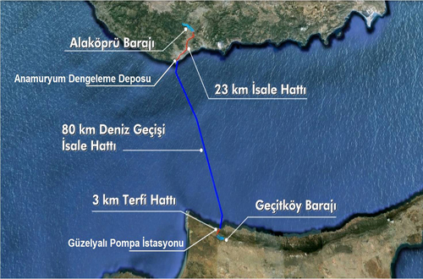
Water transfer to North Cyprus

Slide 23
expected to cost at least 1 billion Turkish liras, or $550 million,
using an experimental technology: a pipeline in the Mediterranean Sea.
But environmental experts question the sustainability of transferring water out of its natural basin,
The project calls for Turkey to transfer 75 million cubic meters of water a year to Northern Cyprus.

Slide 24
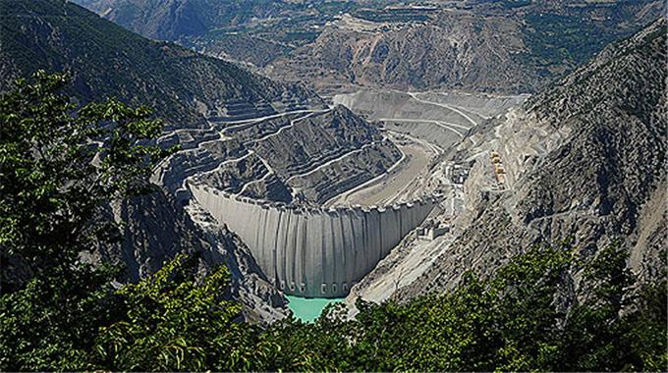
Deriner Dam

Slide 25
is a concrete double-curved arch dam on the Çoruh River
Highest 6th dam all over the World
Capacity: 670 MW

Slide 26
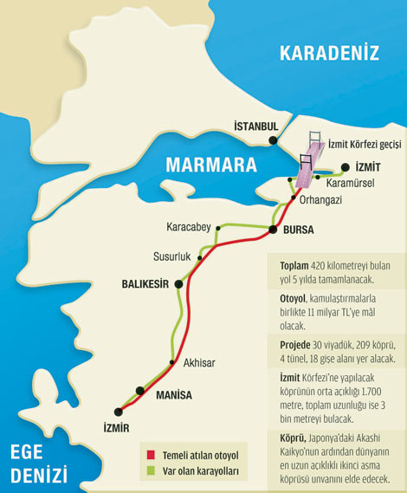
İzmit bay bridge

Slide 27
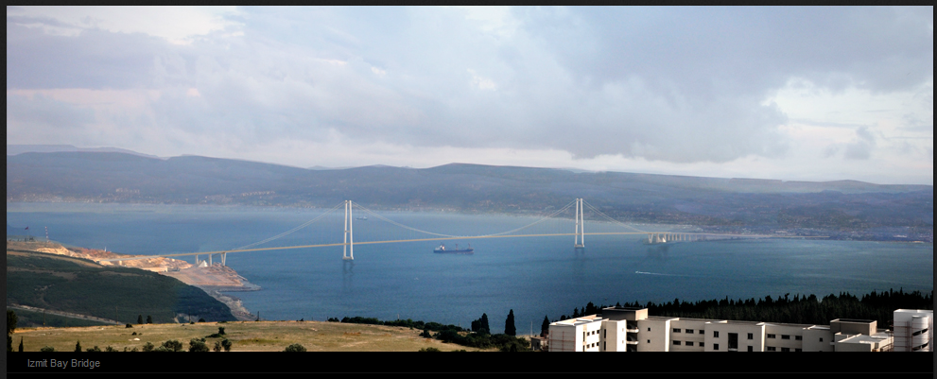
Total length: 2800m
Main span: 1500m
Height of pylons: 230m

Slide 28
