Slide 1
Formation of the Dam Body
For Concrete Gravity dams:
Low-heat cements → to reduce shrinkage problem
Concrete is placed in “blocks”
“Keyways” are built between sections to make the dam act as a monolith
Upstream face
Upstream face
Keyways
Downstream face
Downstream face

Slide 2
“Waterstops” are placed near upstream face to prevent leakage
Copper strip
Copper strip
Waterstops
“Inspection galleries” permit access to the interior of concrete
Dams and are needed for seepage determination, grouting operations and etc.

Slide 3

For Earth-fill dams
Constructed in multi-layer formation
(Layers: impervious, filter and outer)
First place the materials in layers of 50 cm and then compact these materials.
For high dams, horizontal berms are constructed to enhance slope stability
Protect the upstream face of dam against wave action
(i.e., concrete or riprap)
Protect the downstream face against rainfall erosion
(i.e., planting grass or riprap)

Slide 4
Cross section of typical earth dams
1 on 2.5
1 on 2
Silt
Sandy
gravel
Silt clay
(a) Simple zoned embankment
1 on 2.5
1 on 2.5
Clay core
Silt
Rock-fill toe
Silt
Pervious strata
Transition zone
Pervious foundation
(b) Earth dam with core extending to impervious foundation

Slide 5
Cross section of typical earth dams
1 on 2
1 on 3.1
Clay blanket
1 on 3.8
Silt
Sandy
gravel
Silt clay
Pervious material
Concrete cutoff wall
(c) Earth dam on pervious material

Slide 6
For Rock-fill dams:
Core and filter zones are similarly constructed as the earth dam
Due to heavy rocks on the sides, these dams
  have steeper slopes
  have less materials
  are economic
Construction period is shorter and easy to increase the crest elevation
Width of dam crest: There are two traffic lanes
Elevation of dam crest: There is no overtopping during design flood
Freeboard: See the table for recommendations

Slide 7
Select Compacted Rock
Rolled
Medium
Size
Rock
1.3
1.3
1
1
Reinforced Concrete Membrane
Coarse
Dumped Rock
Cutoff wall
(a) Impermeable face
Cross-section of typical Rock-fill dams
Graded transition sections
1.4
1.4
1
Clay core
1
Dumped or
Rolled rock
Rolled rock
Dumped Rock
(0.2m)
(1.5m)
Grout curtain
(b) Impermeable earth-core

Slide 8
GRAVITY DAMS
Recep YURTAL

Slide 9
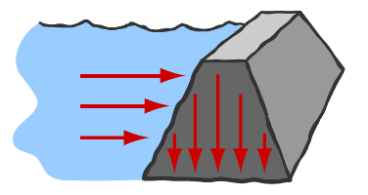
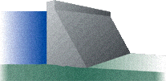
Concrete Gravity Dams
Resist the forces by their own weight

Slide 10
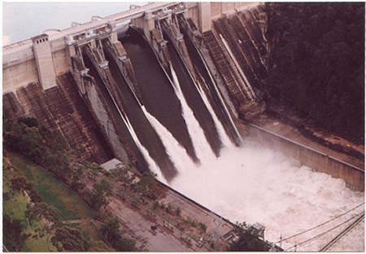
Concrete Gravity Dams

Slide 11
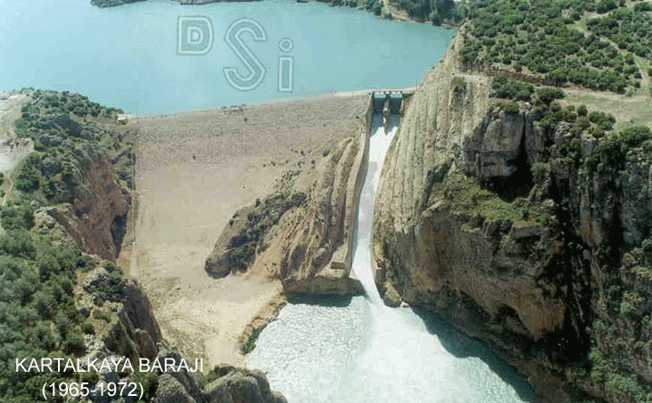
Concrete Gravity Dams

Slide 12
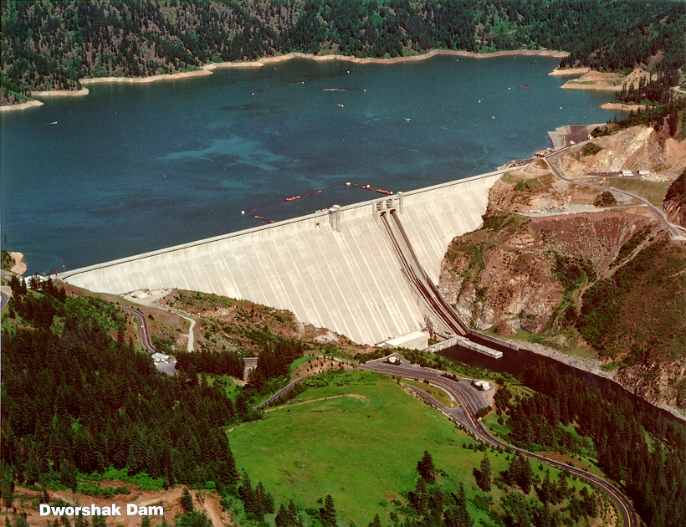
Concrete Gravity Dams

Slide 13
Concrete Gravity Dams
Why & Where we prefered?
  Sağlam ve geçirimsizliği sağlanabilecek yeterli kalınlıkta kaya temellerin uygun bir derinlikte bulunduğu orta genişlikteki vadilerde
  Yeterli miktarda ve istenen özellikte agrega malzemesinin bulunduğu, çimento naklinin ekonomik olduğu yerlerde
  Büyük taşkın debilerinin baraj gövdesi üzerinden mansaba aktarılması gereken durumlarda
  Baraj üzerinden bir ulaşım yolu geçirilmesi gereken durumlarda tercih edilir
  Savaş ve sabotaja karşı daha dayanıklı olması da ayrıca bir tercih nedeni olabilir.

Slide 14
Concrete Gravity Dams
Types:
    Straight Gravity Dams
    Arch Gravity Dams
  Baraj ekseni, iki yamaç arasındaki en kısa bağlantıyı sağlayacak şekilde bir doğru ile birleştirilir.
  Temel kayasının yapısına, derzlere veya emniyet ihtiyacına bağlı olarak kavisli de yapılabilir.

Slide 15
Concrete Gravity Dams
Design Criteria:
  En uygun kesit, etki eden en önemli dış kuvvet olan haznedeki hidrostatik su basıncı dağılımına uyum sağlayan, tabana doğru genişleyen üçgen kesit seçilir. Üçgenin tepesi genellikle haznedeki en yüksek su seviyesidir.
  Memba yüzeyi düşey veya %10 ‘u geçmeyecek şekilde eğimli yapılır.
  Baraj boş haldeyken çekme gerilmelerini önlemek, dolu haldeyken kayma ve devrilme emniyetini artırmak için yüksek barajlarda memba yüzeyi genellikle eğimli planlanır.
  Üçgenin tepe kısmında, duvar kalınlığını artırmak, yamaçlar arası ulaşımı sağlamak gibi nedenlerle dikdörtgen kesitli bir başlık bulunur.

Slide 16
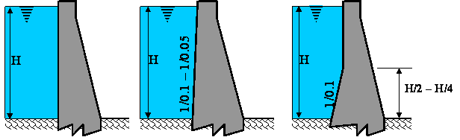
Concrete Gravity Dams
Design Criteria:

Slide 17
Design Principles:
Concrete Gravity Dams
Ağırlık barajı hesaplarında üçgen profil gözönüne alınır.
Üçgen kesitin minimum boyutları, barajın kendi ağırlığı, hidrostatik su basıncı ve taban su basıncının etki ettiği normal yükleme durumunda çekme gerilmeleri meydana gelmeyecek şekilde belirlenir.
Bunun için:
α
H
b

Slide 18
Concrete Gravity Dams
For the dam dimensions:
Check out the safety for
Overturning
Shear & sliding
Bearing capacity of foundation
No tensile stresses are allowed in the dam body

Slide 19
Overturning Check
1/m_{d}
H
B

Slide 20
Overturning Check
H
B

Slide 21
Overturning Check
H
B

Slide 22
Overturning Check
H
B

Slide 23
Overturning Check
H
B

Slide 24
Overturning Check
H
B

Slide 25
Sliding Check
1/m_{d}
H
B

Slide 26
Sliding Check
H
B

Slide 27
Sliding Check
H
B

Slide 28
Sliding Check
H
B

Slide 29
Sliding Check
1/m_{d}
H
B

Slide 30
Bearing Capacity Check
1/m_{d}
H

Slide 31
3.5.1 FORCES ON GRAVITY DAMS
Free body diagram showing forces acting on a gravity dam

Slide 32



The following loads should be considered:
A) WEIGHT (W_{C}): Dead load and acts at the centroid of the section
B) HYDROSTATIC FORCES:
Water in the reservoir + tailwater causes Horizontal H_{u} H_{d} &
Vertical F_{h1v} F_{h2v}
C) UPLIFT FORCE (F_{u}): acts under the base as:

Slide 33

D) FORCE OF SEDIMENT ACCUMULATION (F_{s}):
Determined by the lateral earth pressure expression
where
F_{s} : the lateral earth force per unit width,
γ_{s} : the submerged specific weight of soil,
h_{s} : the depth of sediment accumulation relative to reservoir bottom elevation,
θ : the angle of repose.
  ◉ This force acts at h_{s} /3 above the reservoir bottom.

Slide 34
E) ICE LOADS (F_{i}): considered in cold climate
Ice force per unit width of dam (kN/m) can be determined
from the following table:
Thickness of ice sheet (cm) | Change in temperature (ºC/hr)
 | 2.5 | 5 | 7.5
25 | 30 | 60 | 95
50 | 58 | 90 | 150
75 | 75 | 115 | 160
100 | 100 | 140 | 180

Slide 35
F) EARTHQUAKE FORCE (F_{d}):
Acting horizontally and vertically at the center of gravity
k (earthquake coefficient): Ratio of earthquake acceleration to gravitational acceleration.

Slide 36

G) DYNAMIC FORCE (F_{w}) :
In the reservoir, induced by earthquake as below
⬥ Acts at a distance 0.412 h₁ from the bottom
F_{w} : the force per unit width of dam
C : constant given by
θ’ : angle of upstream face of the dam from vertical (ºC)
  For vertical upstream face ➔ C = 0.7
'

Slide 37
H) FORCES ON SPILLWAYS (∑F):
Determined by using momentum equation btw two successive sections:
ρ : the density of water
Q : the outflow rate over the spillway crest
ΔV: the change in velocity between sections 1 and 2 (v₂-v₁)
◉ Momentum correction coefficients can be assumed as unity.

Slide 38
I) WAVE FORCES :
Considered when a long fetch exists
LOADING CONDITIONS:
Usual loading
B &Temperature Stresses at normal conditions + C + A + E + D
Unusual loading
B & Temperature Stresses at min. at full upstream level + C + A +D
Severe loading
Forces in usual loading + earthquake forces

Slide 39
3.5.2 STABILITY CRITERIA
Dam must be safe against
(1) Overturning for all loading conditions
→ resisting moments
→ overturning moments
Safety factor:
F.S_{O} ≥ 2,0 (usual loading)
F.S_{O} ≥ 1,5 (unusual loading)

Slide 40
STABILITY CRITERIA
(2) Sliding over any horizontal plane
f = friction coef. btw any two planes
Safety factor:
FSS ≥ 1,5 (usual loading )
FSS ≥ 1,0 (unusual or severe loading)

Slide 41
STABILITY CRITERIA
(3) Shear and sliding together
A : Area of shear plane (m²)
τ_{s} : Allowable shear stress in concrete in contact with foundation
Safety factor:
FS_{ss} ≥ 5,0 (usual loading)
FS_{ss} ≥ 3,0 (unusual or severe loading)

Slide 42
STABILITY CRITERIA
(4) Between foundation and dam contact stresses (σ) > 0
at all points
There are two cases for the base pressure:

Slide 43
Base Pressure Check
CASE 1: e ≤ B/6
B
Pt ≤ σ_{s}
DAM BASE
Ph ≤ σ_{s}
Ph
Pt
e
ΣV

Slide 44
Base Pressure Check
B
CASE 2: e > B/6
DAM BASE
Pt
Pt ≤ σ_{s}
e
ΣV

