Slide 1
Lecture 2: Deformation, reference frame,
Kinematic analysis of deformation
B. Natalin

Slide 2
Stress, strain, and deformation
The stress (σ) acting on a plane is the force per unit area of the plane (σ = F/area).
The deformation refers to changes in shape, position, or orientation of a body resulting from the application of a differential stress (i.e., a state in which the magnitude of stress is not the same in all directions).
The strain is a distortion or change in shape of a body

Slide 3
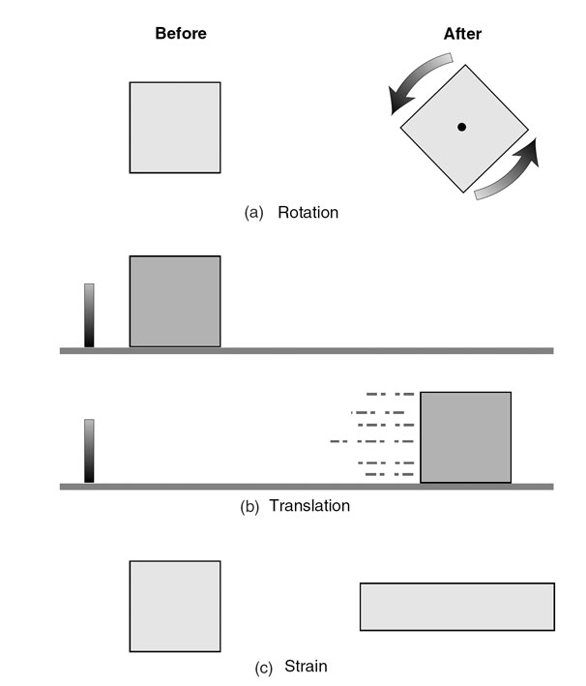
The three components of deformation:
(a) rotation
(b) translation
(c) strain.

Slide 4
Reference frame
In structural geology it is undeformed state. We can’t know whether a rock body has been moved or distorted unless we know where it originally was and what its original shape was.
If we know both the original and final positions of an array of points in a body of rock, we can describe a deformation with mathematical precision by defining a coordinate transformation.

Slide 5
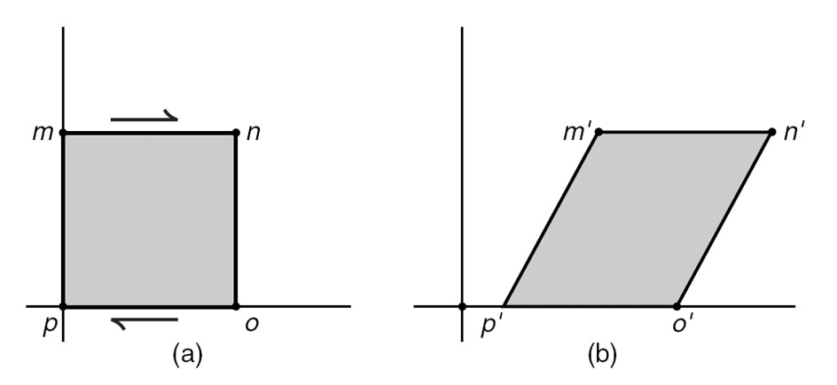
Deformation represented as a coordinate transformation. Points m, n, o, and p move to new positions m′, n′, o′, and p′.

Slide 6
Reference frame
External
Internal

Slide 7
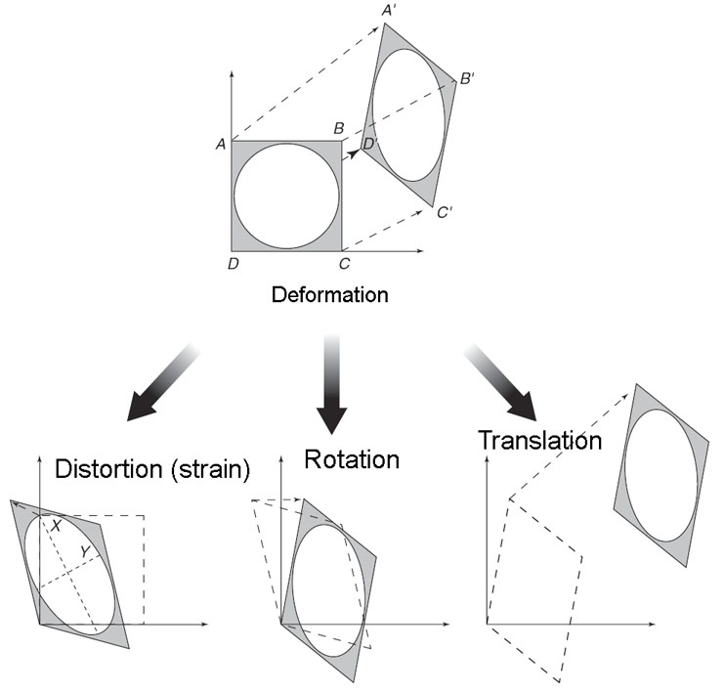
Deformation and reference frame
Deformation is defined relative to a reference frame
External reference frame is used translation and rotation
Internal reference frame is used for strain

Slide 8
Bedding as internal reference
• Strata are deposited horizontally. This is the Law of Original Horizontality, which makes bedding an internal reference frame
• Strata follow one another in chronological, but not necessarily continuous, order. This is known as the Law of Superposition
• Strata occur in laterally continuous and parallel layers in a region.

Slide 9
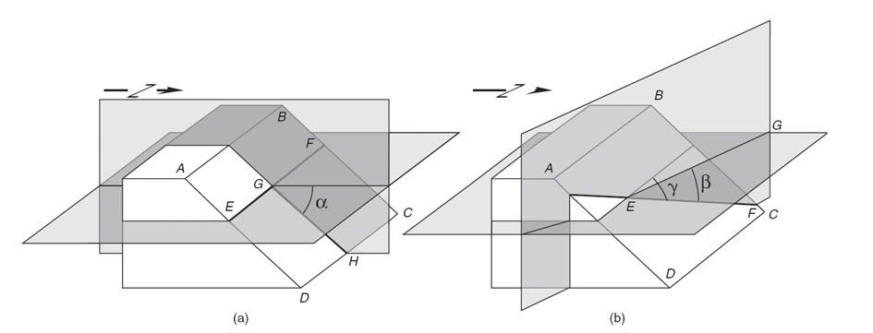
Terminology related to geometry and representation of geologic structures
Apparent dip | Dip of a plane in an imaginary vertical plane that is not perpendicular to the strike. The apparent dip is less than or equal to the true dip.
Attitude | Orientation of a geometric element in space
(True) dip | The slope of a surface; formally, the angle of a plane with the horizontal measured in an imaginary vertical plane that is perpendicular to the strike
Dip direction | Azimuth of the horizontal line that is perpendicular to the strike

Slide 10
Terminology related to geometry and representation of geologic structures
Pitch | Angle between a linear element that lies in a given plane and the strike of that plane (also rake)
Plunge | Angle of linear element with earth’s surface in imaginary vertical plane
Plunge direction | Azimuth of the plunge direction
Strike | Azimuth of the horizontal line in a dipping plane or the intersection between a given plane and the horizontal surface (also trend)
Trend | Azimuth of any feature in map view; sometimes used as synonym for strike

Slide 11
Interpretation of deformed rocks
• Sharp discontinuities in lithologic patterns are faults, unconformities, or intrusive contacts.
• Deformed areas can be subdivided into a number of regions that contain consistent structural attitudes (structural domains). For example, an area with folded strata can be subdivided into regions with relatively constant dip direction (or even dip), such as the limbs and hinge areas of large-scale folds.
• The simplest but internally consistent interpretation is most correct. This is also known as the least-astonishment principle.

Slide 12
Concept of detailed structural analysis
Geometrical (descriptive) analysis
Kinematic analysis
Dynamic analysis

Slide 13
Geometrical (descriptive) analysis
Location of a structure
Characteristics of a structure
Orientation of a structure (stereonet)
Relationships of structures
Establishing of structural paragenesis
Establishing deformation episodes
Creation of geometrical model

Slide 14
Descriptive analysis: Collection of data
Observations in points - satisfactory for reconnaissance studies - satisfactory for large structures - bad for detail analysis
Vertical cross section - many types of structures could be missed
Structural strip maps - the best

Slide 15
Structural strip maps

Slide 16
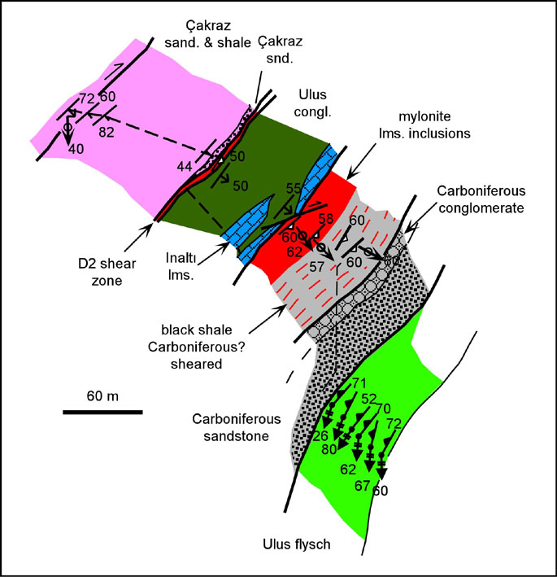
Structural strip maps

Slide 17
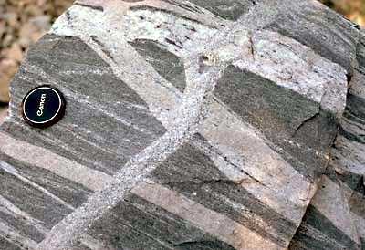
Relationships of structures

Slide 18
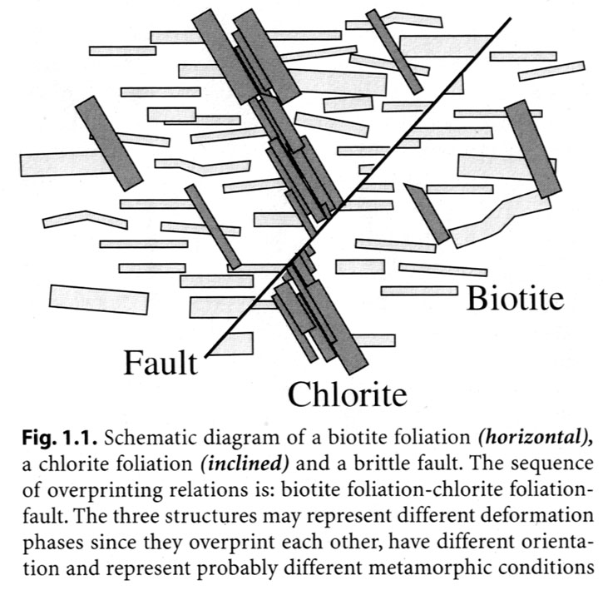
Relationships of structures

Slide 19
Crosscutting relationships
Intersections of geological bodies
Intersections of geological structure - faults - foliations - folds - relationships of geometric elements

Slide 20
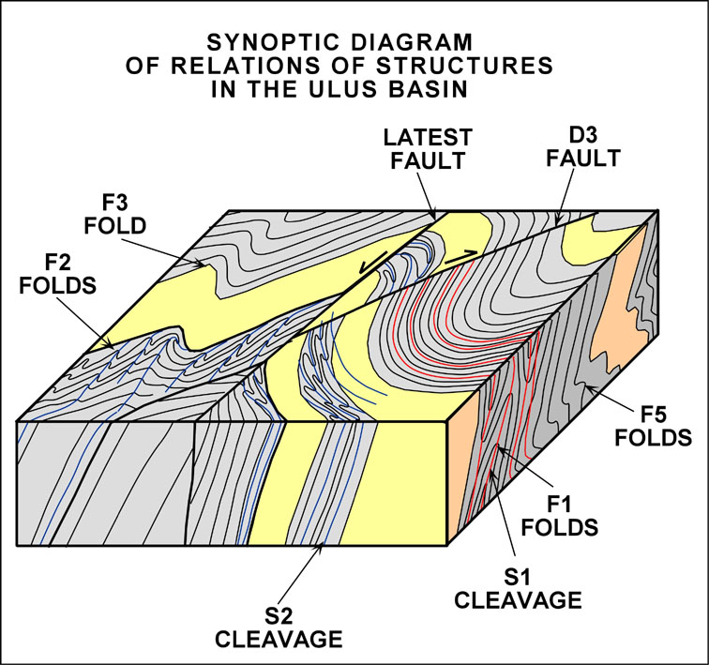
Relationships of geometric elements

Slide 21
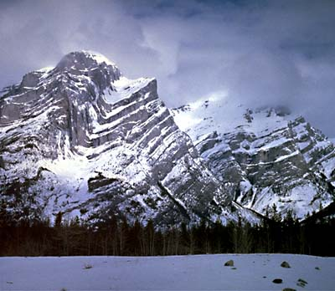
Relationships of geometric elements

Slide 22
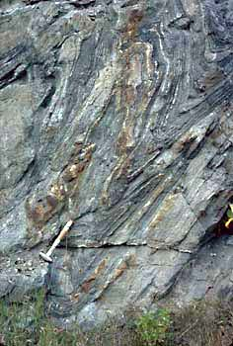
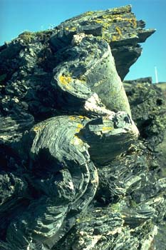
Relationships of geometric elements

Slide 23
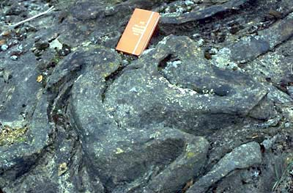
Relationships of geometric elements

Slide 27
Sheath folds
98% of sheath folds generated during simple shear and general shear display (R0 < 1) cats-eye-fold patterns
sheath folds generated during constriction display (R0 > 1) bulls-eye-folds (Alsop and Holdsworth, 2006)

Slide 28
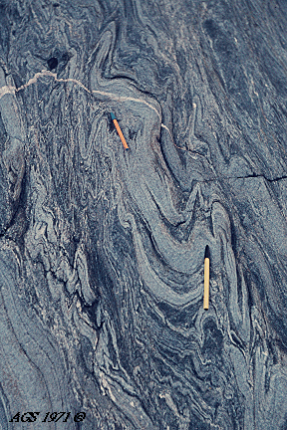
Relationships of geometric elements

Slide 29
The objectives of studying of a poly-deformed area are:
1) to isolate the individual phases of deformations and metamorphism;
2) to determine the temporal and spatial relationships between phases of deformation;
3) to determine kinematic significance of deformation phases

Slide 30
A generation of structures –structures that are formed during the same time interval in response to the same stress (structural paragenesis)
A phase of deformation is the time interval during which a single generation of structures is produced

Slide 31
Problems of establishing and interpreting deformation phases
Overprinting relationships may be produced by a single deformation phase (non-coaxial progressive deformation; sheath folds)

Slide 32
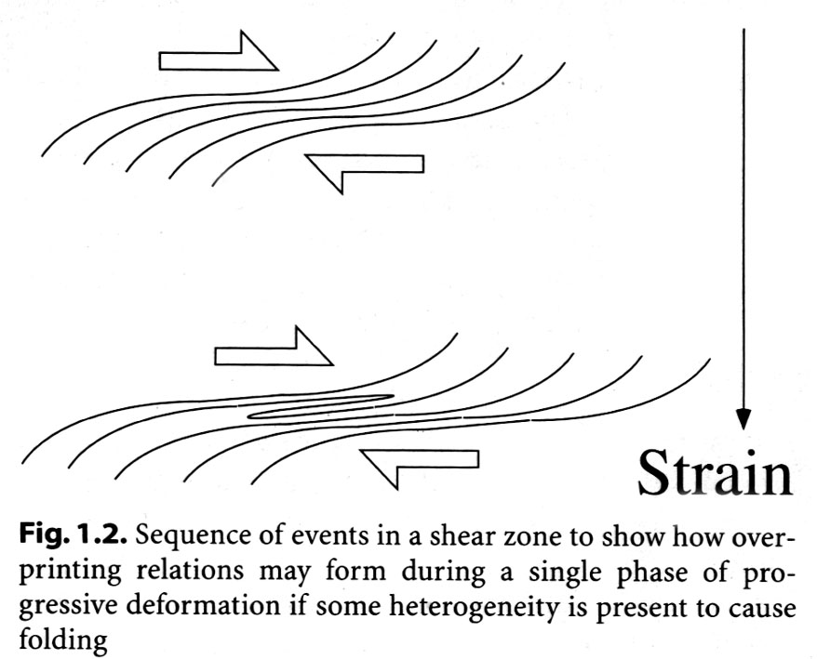
Problems of establishing and interpreting deformation phases

Slide 33
Problems of establishing and interpreting deformation phases
Subsequent deformation phases do not necessarily produce overprinting relations (the stress field and a similar metamorphic grade, Strandja massif)

Slide 34
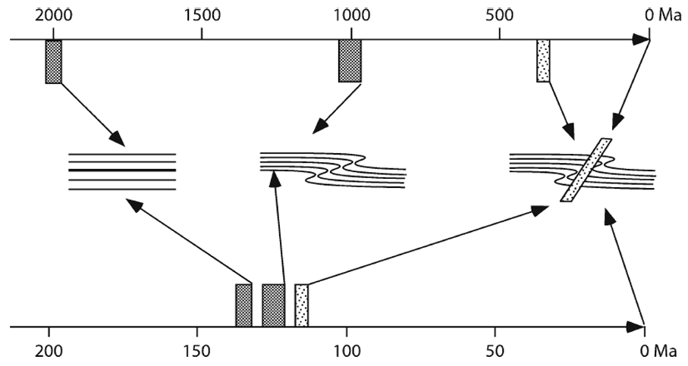
Problems of establishing
Only relative age of deformation phases can be established
Notes:
Overprinting structures shown at centre right could form over any time interval, e.g. over 2 000 Ma (upper bar) or over 30 Ma (lower bar)

Slide 35
Problems of establishing
The significance of deformation phases depends on the scale of observation - the axial planar foliation may be rotated to such an extent that a crenulation cleavage is locally formed - motion of a thrust over ramp
Deformation phases may be diachronous (accretionary wedges)

Slide 36
The concept of deformation phases is very useful despite the mentioned problems of the establishing and the frequent diachronous development of deformation in orogenic belts

Slide 37
Overprinting relation and deformation phases
Different mineral assemblages that represent a gap in metamorphic grade must belong to different deformation phases;
Overprinting folds with oblique axial surfaces represent different deformation phases

Slide 38
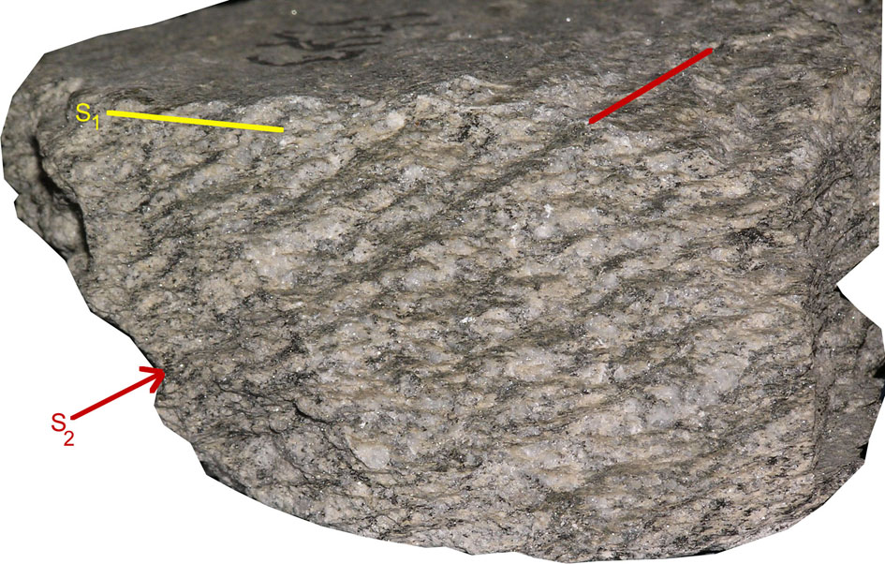
Two foliations
Liniations have different orientations

Slide 39
Overprinting relation and deformation phases
Shortened boudins are commonly formed by overprinting of two deformation phases
Intrusive veins or dykes can be important to separate phases of deformation and their associated foliations

Slide 40
Structural domain
Structural domain is a region where geometry and orientation of structures are similar
Boundaries of a domain are usually related to late phase folds or faults

Slide 41
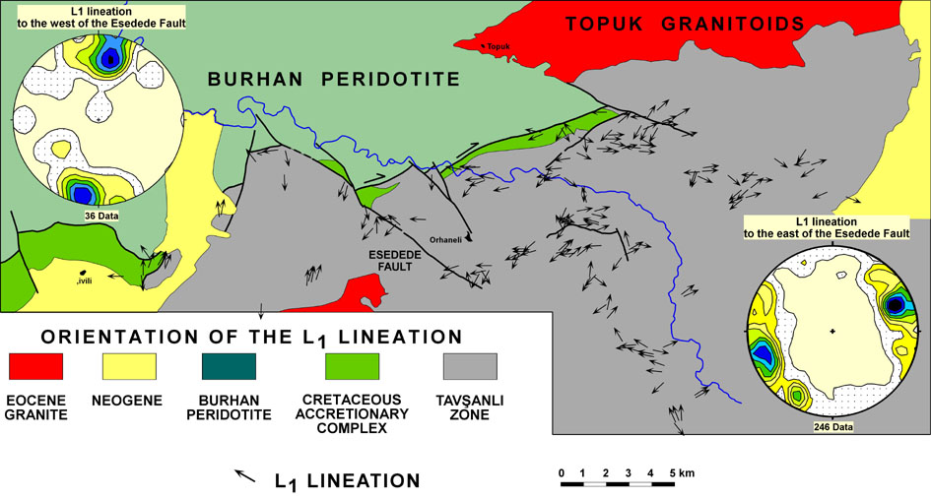
Structural domain

Slide 42
Fabric elements depend on scale

Slide 43
Structural elements
Physical elements: - bedding - foliation
Geometrical elements: - axial plane - hinge - enveloping surface

Slide 44
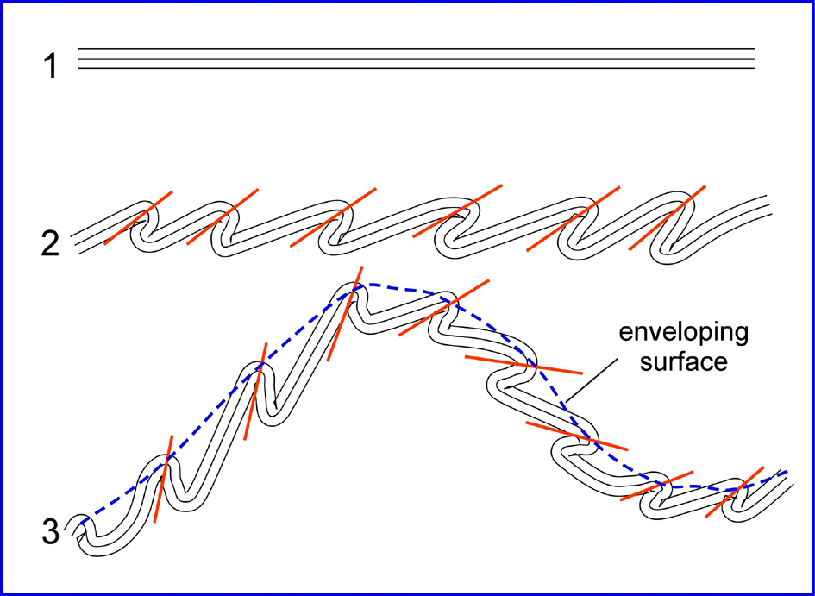
Enveloping surface

Slide 45
Foliation and lineation
Foliation is very close spaced parallel planar alignment of structural features or fabric elements

Slide 46
Planar and linear structure
Planar structures: - cleavage - bedding - layering - axial planes
Linear structures - flute cast - mineral lineation - hinge

Slide 47
Labels in structural geology
Planar structures – S
Linear structures – L
Folds – F
Deformation episode – D
Synsedimentary structures – S₀, L₀, F₀
First episode of deformation – S₁, L₁, F₁
Second episode of deformation S₂, L₂, F₂

