Slide 1
Lecture 1: Introduction, geological structures, primary structures
Kinematic analysis of deformation
B. Natalin

Slide 2
Structural geology and tectonics
Structural geology is the study of deformation of rocks
- we study such features as folds, faults, their geometry, movements, origins;
- largely descriptive;
- distinction in terms of individual structures
- micro-, meso- (mega-), and macro scale

Slide 3
Structural geology and tectonics
Tectonics is the study of evolution and development structures at regional scale
Tectonics is:
- largely genetic
- historical
- integrative
- macro- and global scale

Slide 4
Structural geology and structural geologist
A structural geologist:
Describes and depicts geologic structures
Delineates rock bodies and units and their relationships
Elucidates deformation history.
Thus a structural geologist is:
a geological historian, especially as concerns the development of geologic structures
careful observer
a configurational scientist in open ended research (always new, better, more highly refined ways for improved depiction and interpretation)

Slide 5
Structural geology brings together:
Stratigraphy
Paleontology
Petrology
Geophysics
Geochronology

Slide 6
Barriers to understanding
Vastness of the Earth volume
Vastness of geological time
Complexity of natural system
Record is not complete

Slide 7
Structures
A geologic structure is a geometric feature in rock whose shape, form, and distribution can be described
Depending on the purpose of study geologists classify structures using different criteria

Slide 8
Structures: Classification based on geometry
• Planar (or subplanar) surface
• Curviplanar surface
• Linear feature
Classes of structures: Bedding, joint, vein, fault, fold, shear zone, foliation, and lineation.

Slide 9
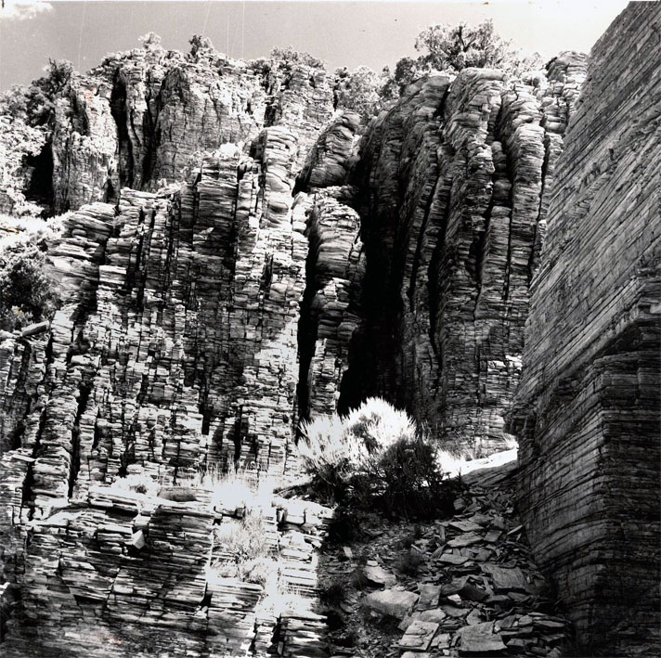
Planar structures
Joints and bedding

Slide 10
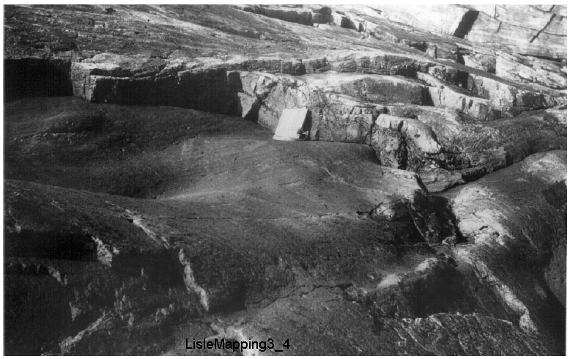
Curviplanar surface of bedding

Slide 11
Classification based on geologic significance
Primary: formed as a consequence of the formation process of the rock itself
• Local gravity-driven: formed due to slip down an inclined surface; slumping at any scale driven by local excess gravitational potential
• Local density-inversion driven: formed due to local lateral variations in rock density, causing a local buoyancy force
• Fluid-pressure driven: formed by injection of unconsolidated material due to sudden release of pressure
• Tectonic: formed due to a) plate interactions; b) interaction between the asthenosphere and the lithosphere; c) crustal-scale or lithosphere-scale gravitational potential energy; d) the tendency of crust to achieve isostatic compensation.

Slide 12
Classification based on timing of formation
• Syn-formational: formed at the same time as the material that will ultimately form the rock
• Penecontemporaneous: formed before full lithification, but after initial deposition
Post-formational: formed after the rock has fully formed, as a consequence of phenomena not related to the immediate environment of rock formation

Slide 13
Classification based on the deformation mechanism
• Fracturing: related to development or coalescence of cracks in rock
• Frictional sliding: related to the slip of one body of rock past another, or of grains past one another, both of which are resisted by friction
• Plasticity: resulting from deformation by the internal flow of crystals without loss of cohesion, or by non-frictional sliding of crystals past one another
• Diffusion: resulting from material transport either solid-state or assisted by a fluid (dissolution)

Slide 14
Classification based on the mesoscopic cohesiveness during deformation
• Brittle: formed by loss of cohesion across a mesoscopic discrete surface
• Ductile: formed without loss of cohesion across a mesoscopic discrete surface
• Brittle/ductile: involving both brittle and ductile aspects

Slide 15
Classification based on the strain significance
• Contractional: resulting in shortening of a region
• Extensional: resulting in extension of a region
• Strike-slip: resulting from movement without either shortening or extension

Slide 16
Classification based on the distribution in a volume of rock
• Continuous: occurs through the rock body at all scales
• Penetrative: occurs throughout the rock body, at the scale of observation; up close, there may be spaces between the structures
• Localized: continuous or penetrative structure occurs only within a definable region
• Discrete: structure occurs as an isolated feature

Slide 17
Primary and Nontectonic Structures
Structures that form during or shortly after the deposition of rocks, and are not an immediate consequence of deformation
Nontectonic structures
Depositional, penecontemporaneous, intrusive, and gravity-slide structures for both sedimentary and igneous rocks

Slide 18
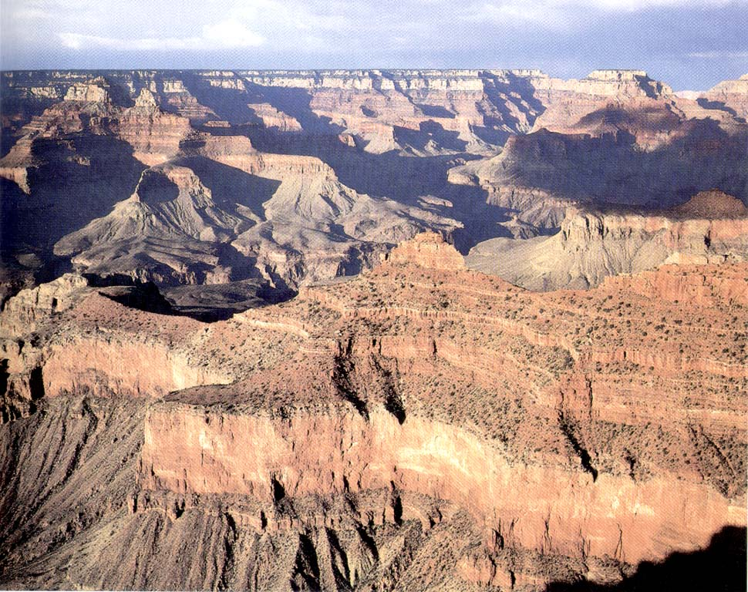
Sedimentary structures
Bedding = layering = stratification

Slide 19
Bedding – Primary layering in a sedimentary rock, formed during deposition, manifested by changes in texture, color, and/or composition; may be emphasized in outcrop by the presence of parting
Overturned beds – Beds that have been rotated past vertical in an Earth–surface frame of reference; as a consequence, facing is down
Parting – The tendency of sedimentary layers to split or fracture along planes parallel to bedding; parting may be due to weak bonds between beds of different composition, or may be due to a preference for bedparallel orientation of clay

Slide 20
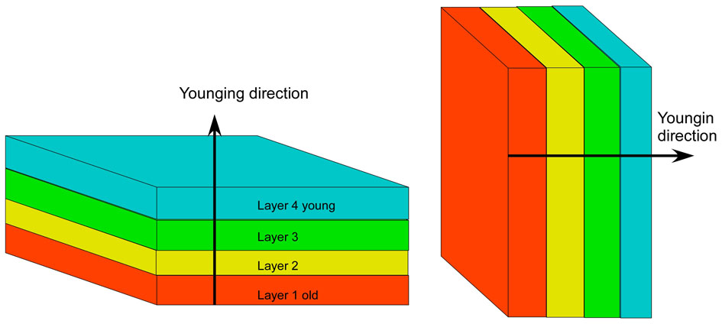
Stratigraphic facing (= Younging direction) – The direction to younger strata, or, in other words, the direction to the depositional top of beds

Slide 21
The use of bedding in structural analysis
The Law of Original Horizontality
Bedding provides a reference frame
Bedding is labeled S₀ (pronounced ess-zero), where the S is an abbreviation for planar structures (surface)
Bedding provides information on depositional environment, younging direction, current direction
Homoclinal

Slide 22
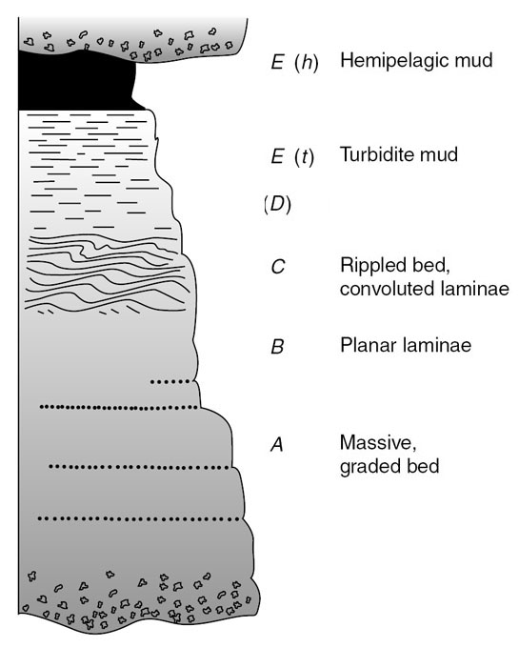
Graded beds and younging direction
During settling, the largest grains fall first, and the finest grains last
Bouma sequence in turbidites
Flysch

Slide 23
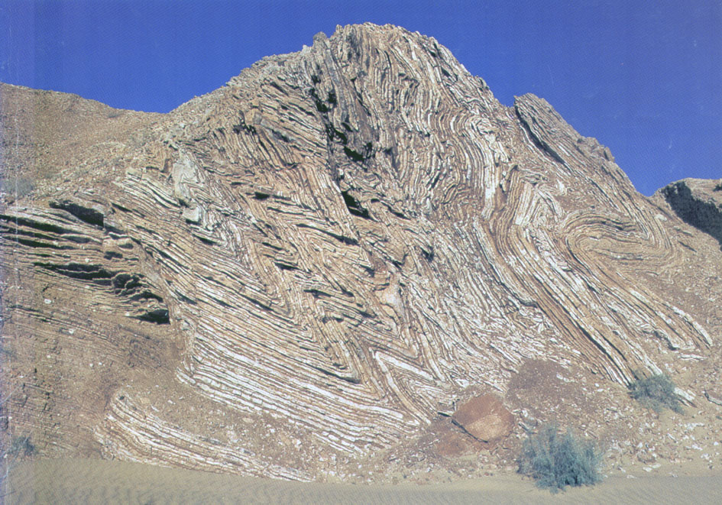

Slide 24
Cross beds and younging direction
Sedimentation on a lee side
Topset, forset, and bottomset beds
Erosion of topset beds
Clear stratigraphic facing and current indicator

Slide 25
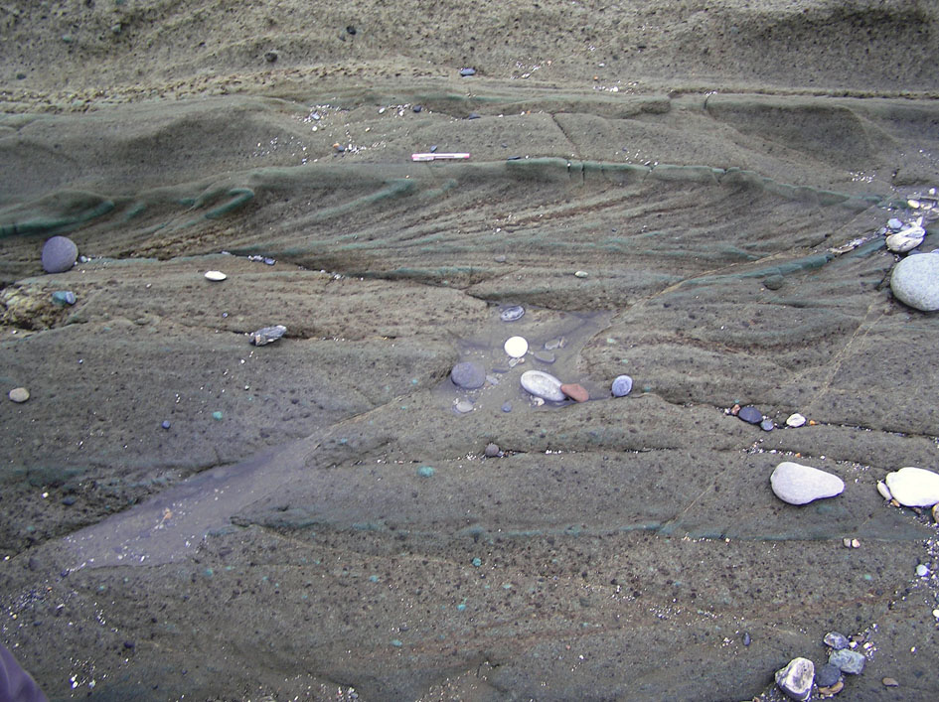

Slide 26
Cross beds in fluvial deposits of the Manzurka Formation, Baikal Lake
Erosion of topset

Slide 27
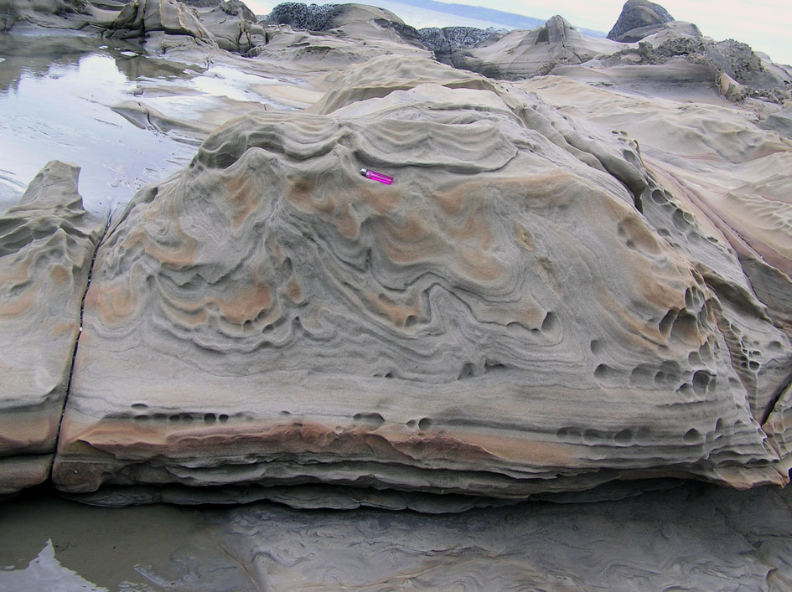
Convolute folds

Slide 28
Disrupted Bedding
Load casts
Sand volcanoes
Clastic dikes
Studies of disrupted bedding, sedimentary dikes, and sand volcanoes provide an important basis for determining the recurrence interval of large earthquakes

Slide 29
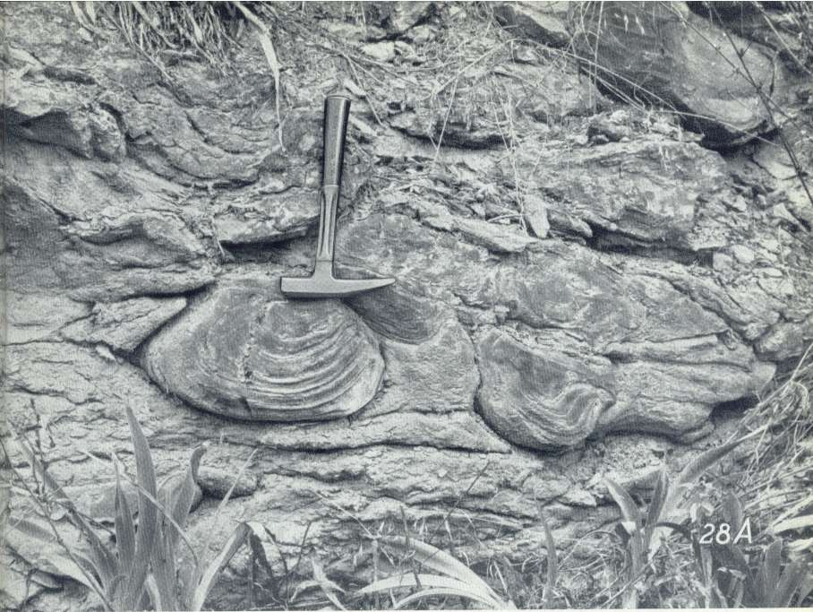
Load casts
Extend downward from a sand layer into an underlying mud or very fine sand layer

Slide 30
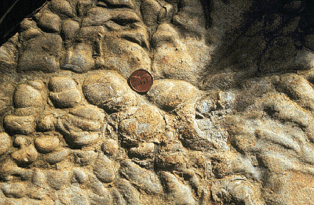
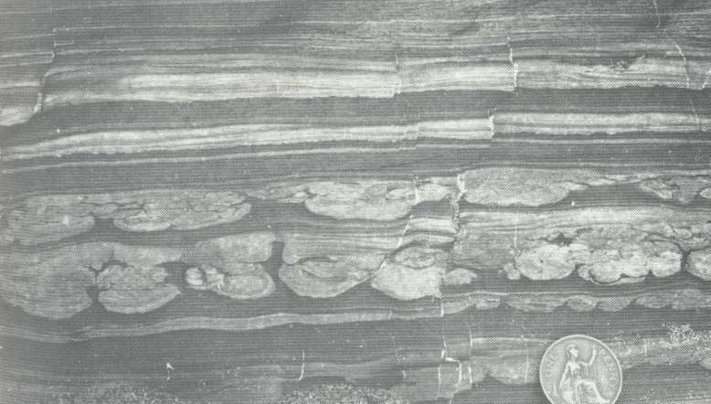
Load casts

Slide 31
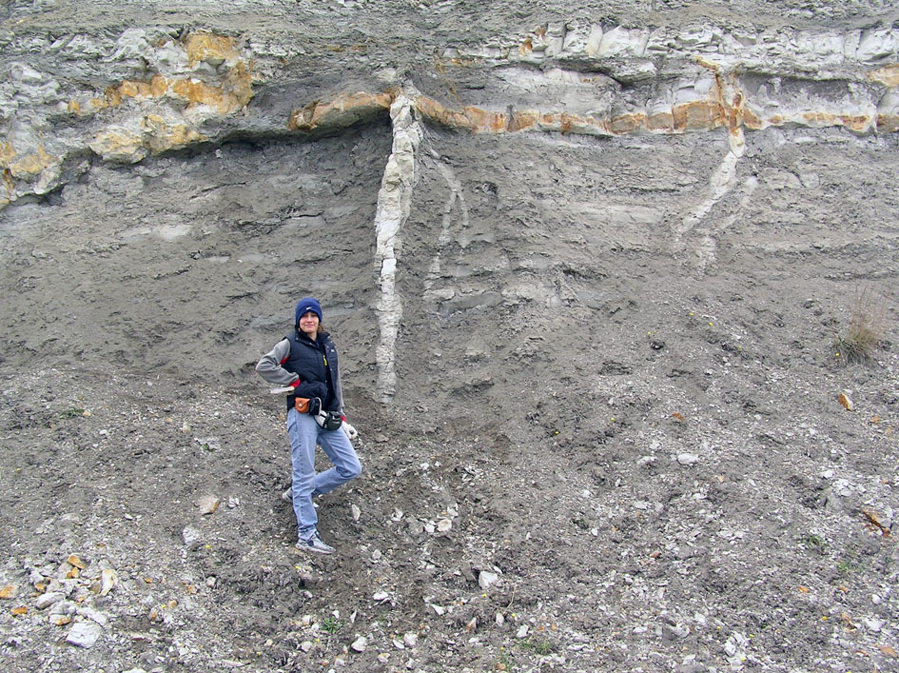
Clastic dikes

Slide 32
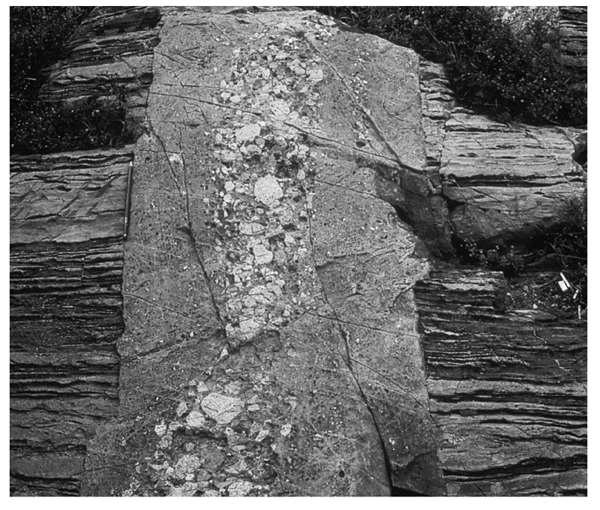
Clastic dikes

Slide 33
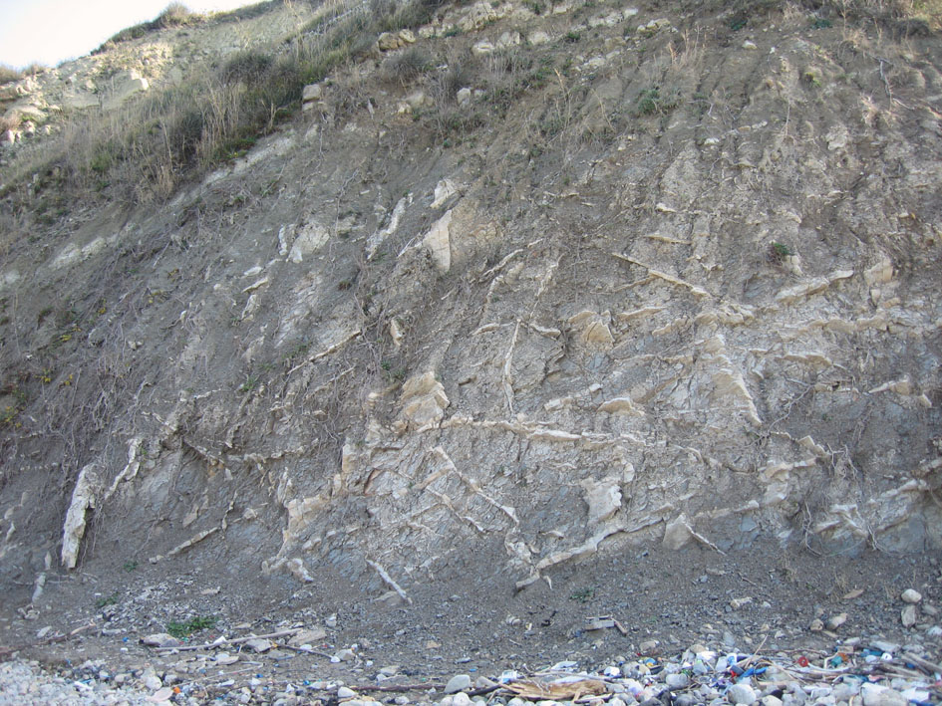
Clastic dikes

Slide 34
Conformable and unconformable contacts
Disconformity beds above and below the unconformity are parallel to one another, but there is an age difference between the two sequences
Angular unconformity strata below the unconformity have a different attitude than strata
above the unconformity.
Nonconformity strata were deposited on a basement of older crystalline rocks.
Buttress unconformity beds of the younger sequence were deposited in a region of significant predepositional topography

Slide 35
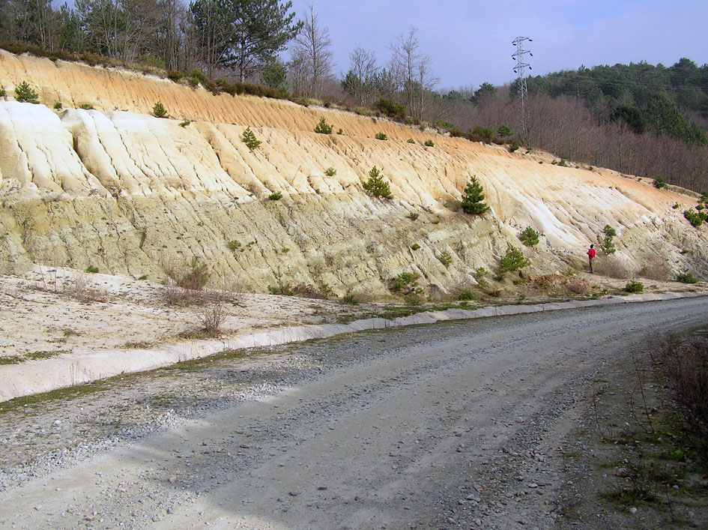
Angular unconformity
Base of white rocks

Slide 36
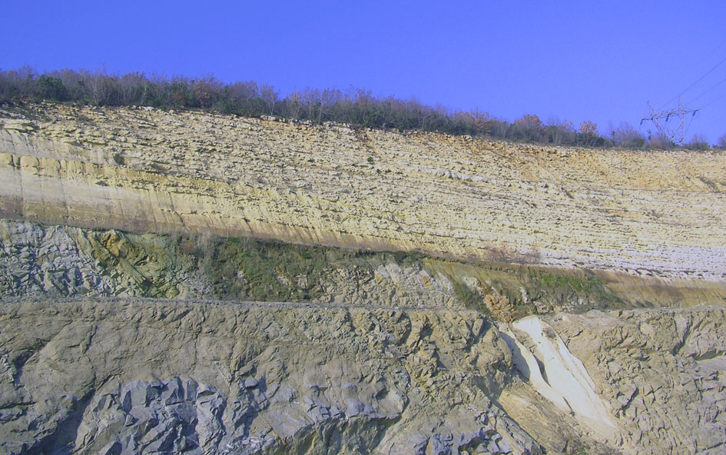
Nonconformity

Slide 37
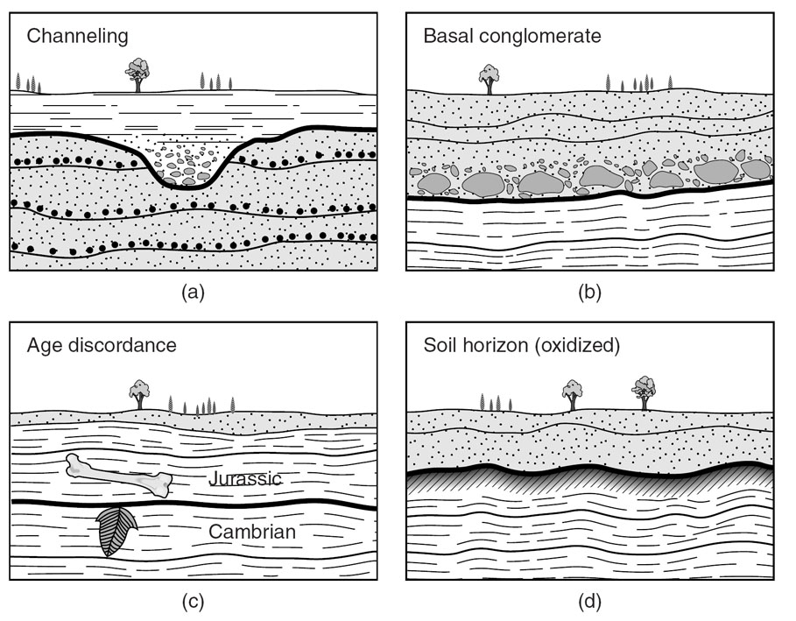
How to identify unconformities?

Slide 38
Compaction and Diagenetic
Structures
Compaction results in a decrease in porosity (>50% in shale and >20% in sand) that results in an increase in the density of the sediment
Compaction of mud leads to development of a preferred orientation of clay - shale
Deeper compaction can cause pressure solution

Slide 39
Penecontemporaneous Structures
Deposition on a preexisting slope or tilting prior to full lithification in a tectonically active region can pull the layers down the slope
Fluid pressure in the layers keeps the layers apart
Debris flows
The deformed interval is intraformational, meaning that it is bounded both above and below by relatively undeformed strata

Slide 40
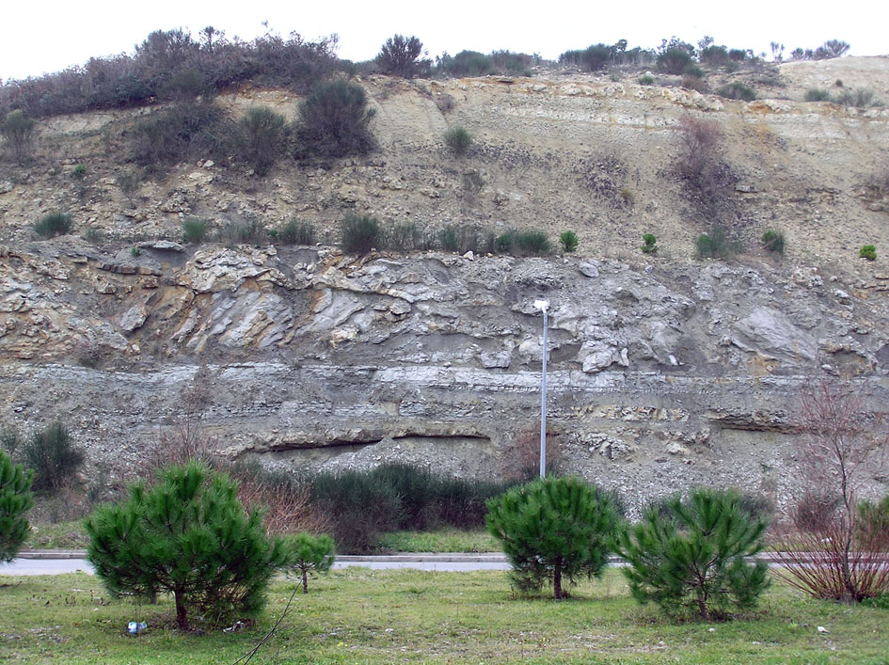
Gizem slump, Karaburun

Slide 41
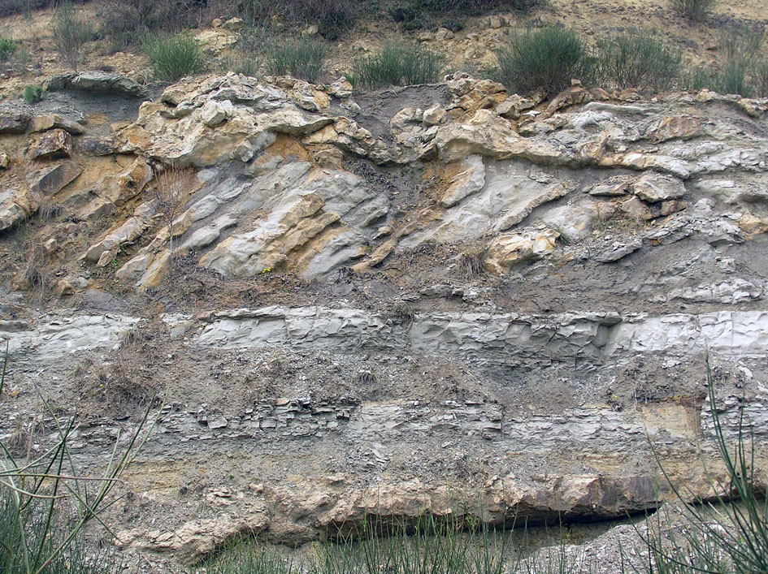

Slide 42
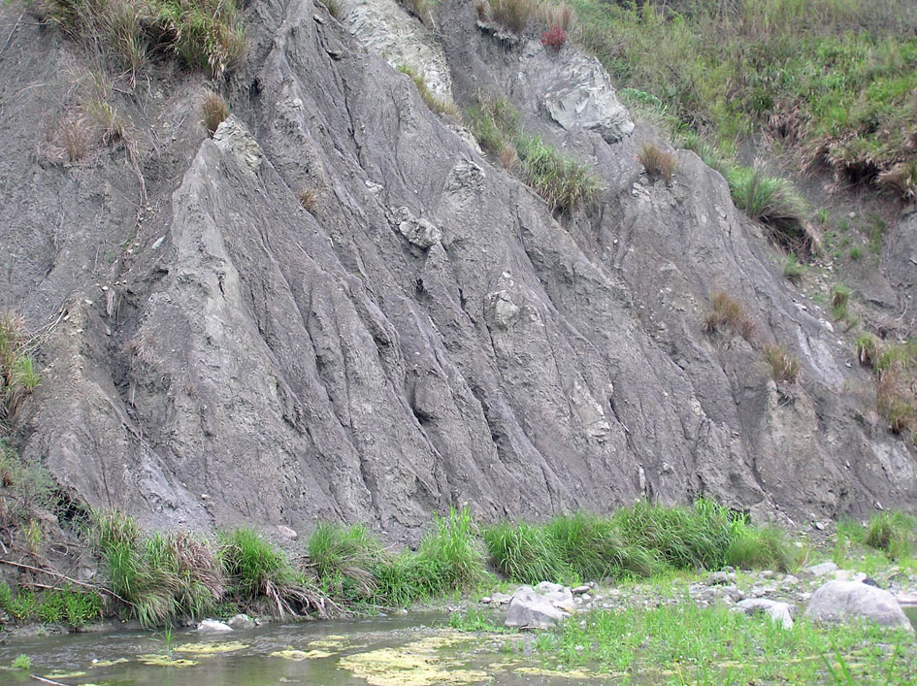
Debris-flow deposits

Slide 43
Salt structures
Salt is a sedimentary rock that forms by the precipitation of evaporate minerals (typically halite [NaCl] and gypsum or anhydrite calcium sulfates) from saline water
Rifts and passive continental margins
Salt is much weaker than sedimentary rocks it may deform solely in response to gravity – halokinesis

Slide 44
Maximum Freeboard
Pressures equal under sediment and under salt
ρ_{sed}gZ = ρ_{salt}g(Z+F)
F = Δρ Z / ρ_{salt}
E.g. Δρ = 200 kg /m³, Z = 2 km, ρ_{salt} = 2000 kg/m³ gives F = 200 m
F
ρ_{sed}
Z
ρ_{salt}
Ian Davison

Slide 45
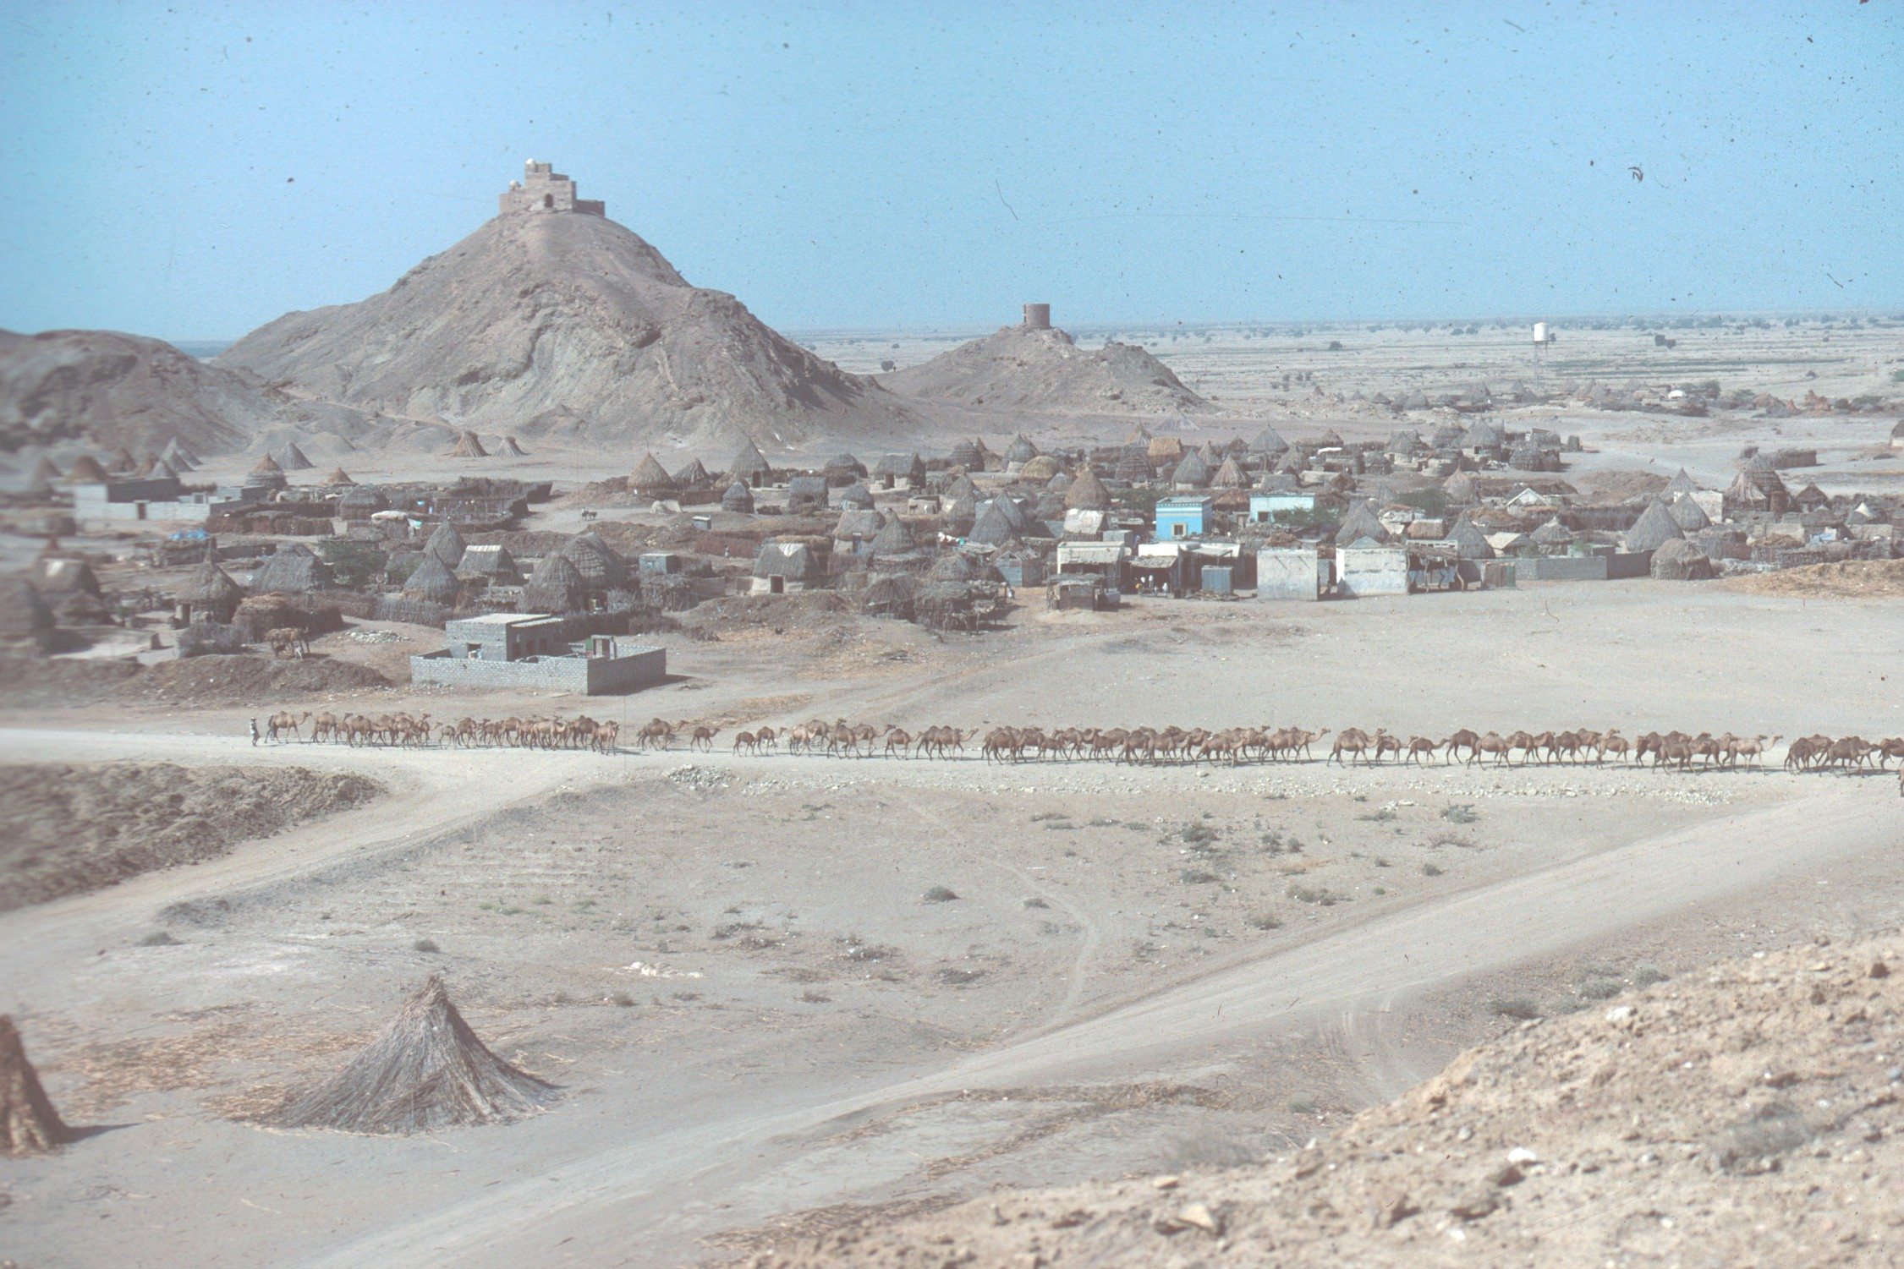
Diapiric freeboard and buoyancy-Al Salif Yemen
Davison et al. 1996

Slide 46
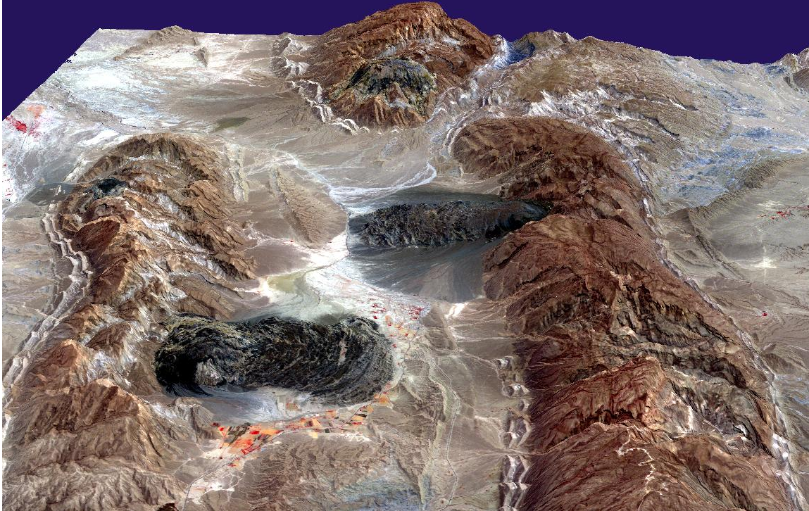
Salt glaciers, Iran

Slide 47
Igneous structures
Extrusive rocks are formed either from lava that flowed over the surface of the Earth and cooled under air or water, or from ash that exploded out of a volcanic vent
Intrusive rocks cooled beneath the surface of the Earth

Slide 48
Magma is less dense than the surrounding
rock, and buoyancy forces cause it to rise
At the level of neutral buoyancy, the
magma may form a sheet intrusion, or may pool in a large magma chamber that solidifies into a blob-like intrusion called a pluton
Batholith
Pluton
Stock
Laccolith
Dike (Dyke)
Dike swarms
Sill

Slide 49
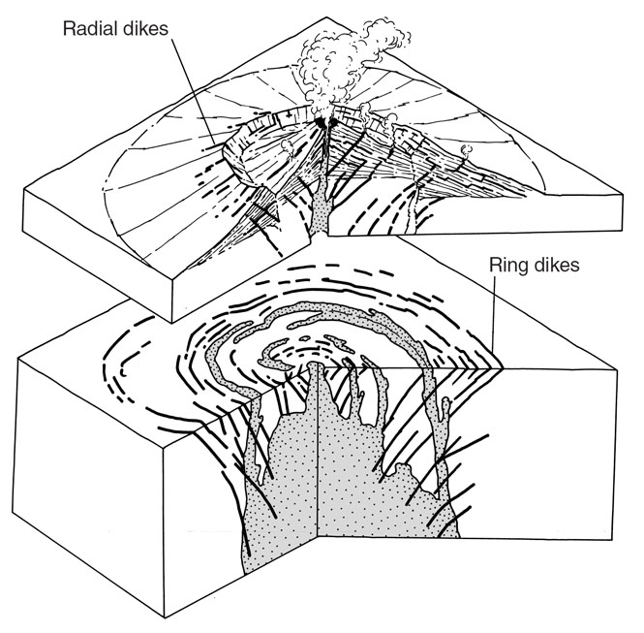
Ring dikes
Radial dikes

Slide 50
Plutons
Temperature gradient – 20 - 40°/km
Shallow level plutons – sharp contacts
Deep level plutons – gradual contacts
Migmatites

Slide 51
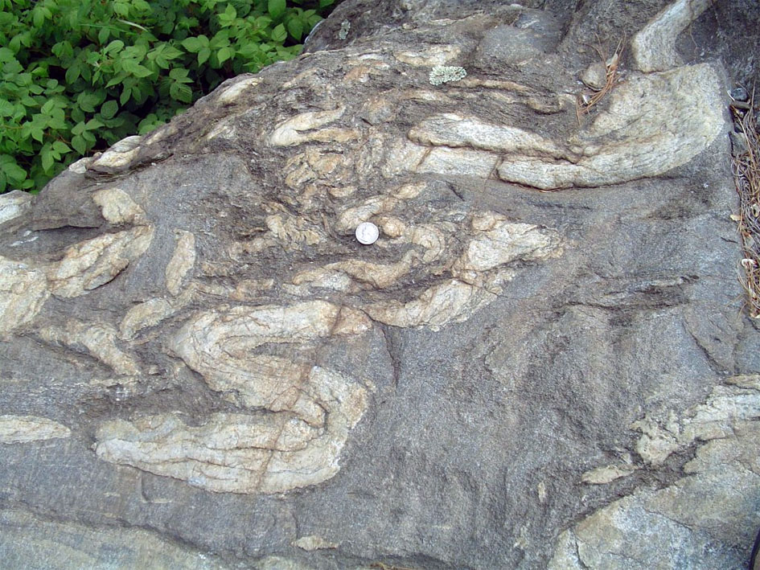

Slide 52
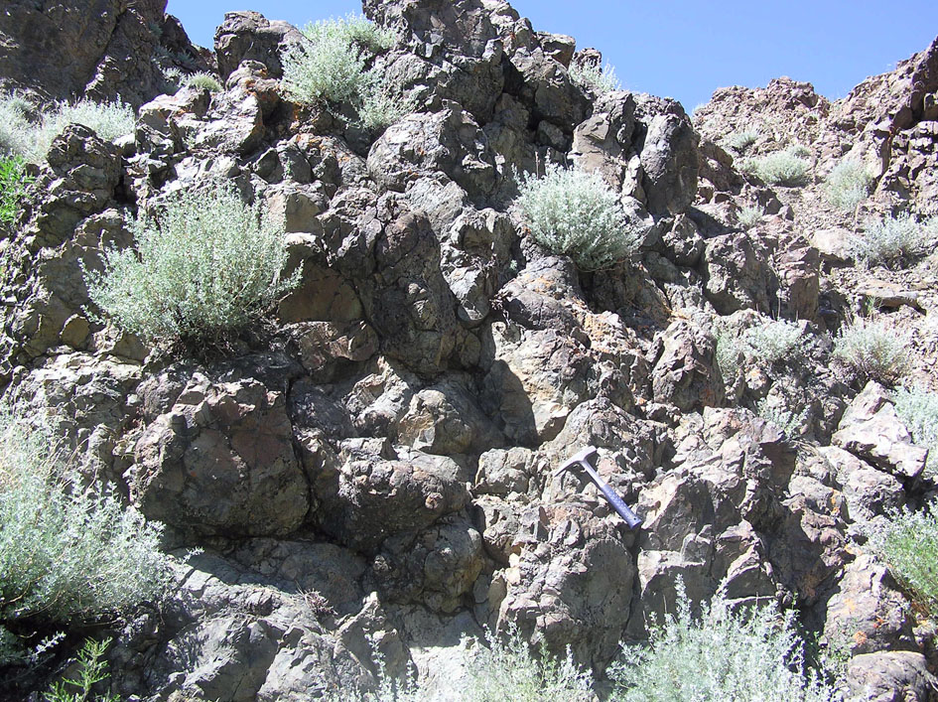
Pillow lavas

Slide 53
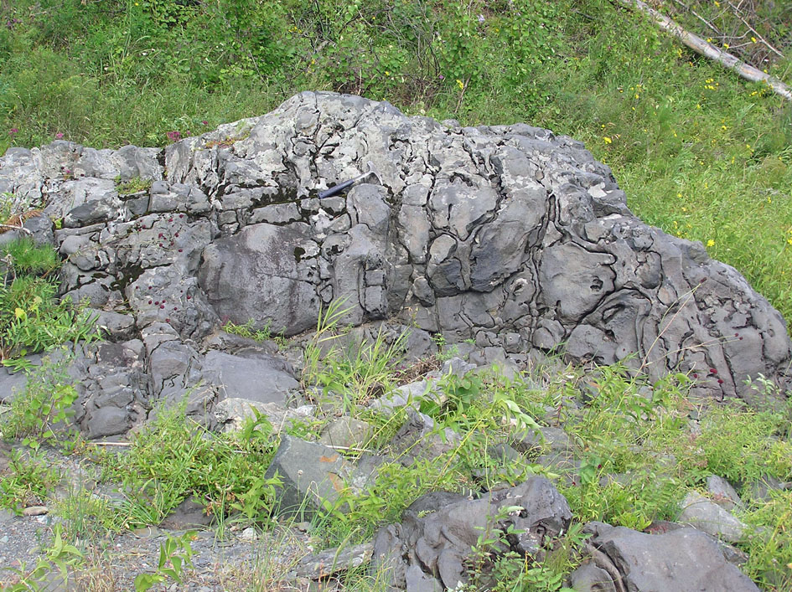

Slide 54
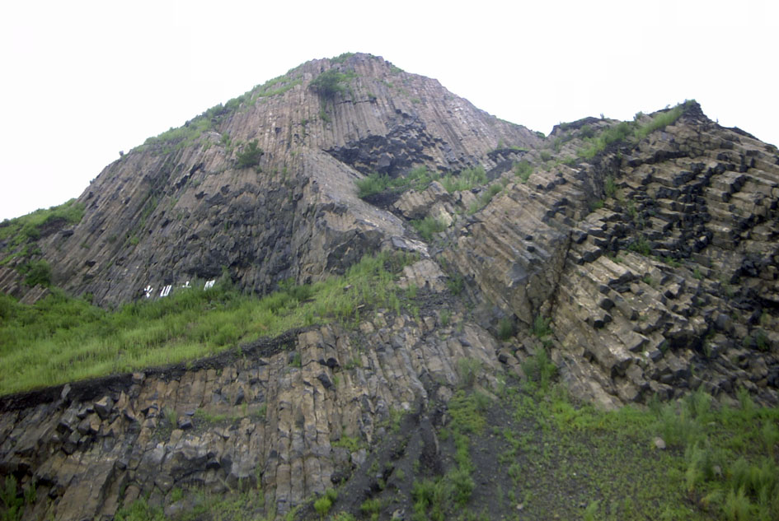
Columnar jointing

Slide 55
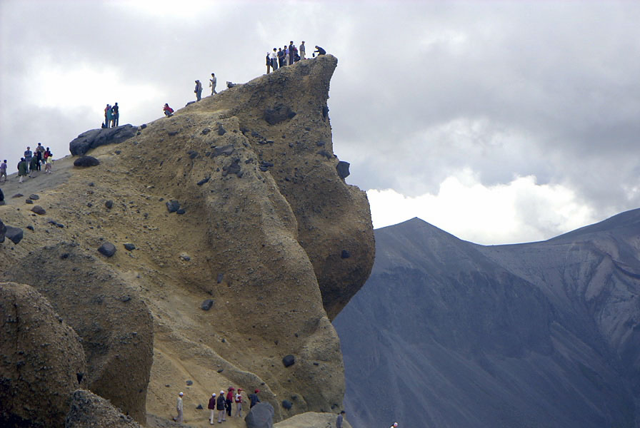
Tuffs

Slide 56
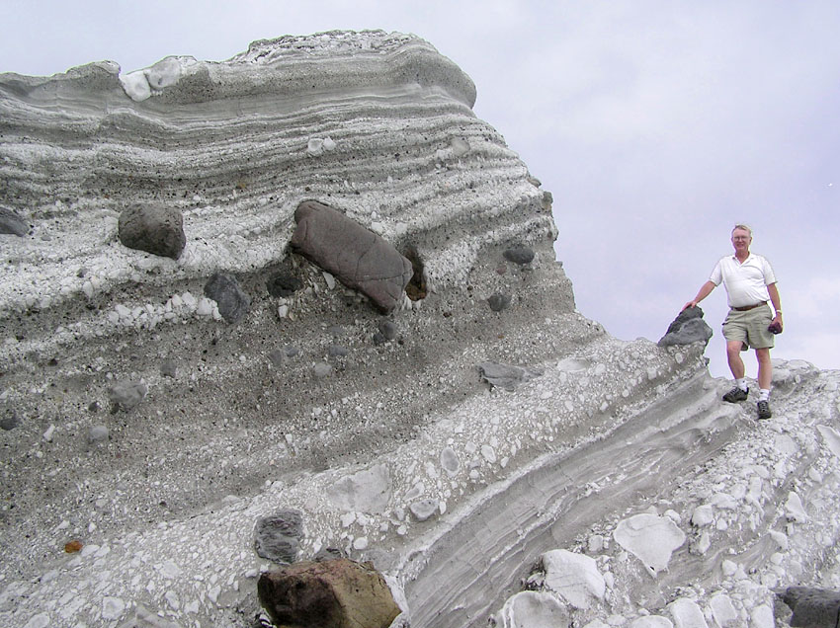
Kent Condie in Taiwan

