Slide 1
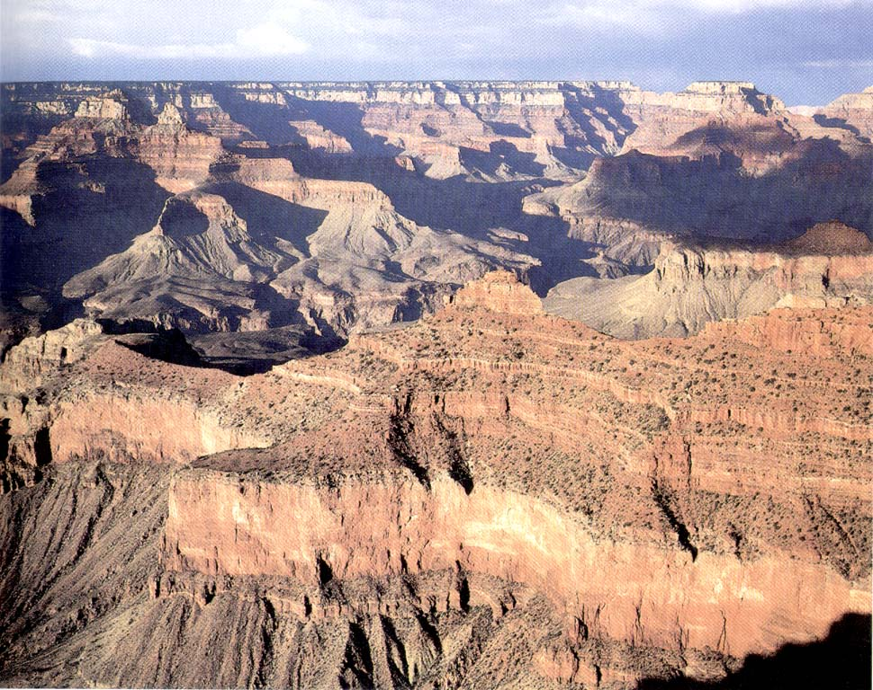
Horizontal and continuous beds

Slide 2
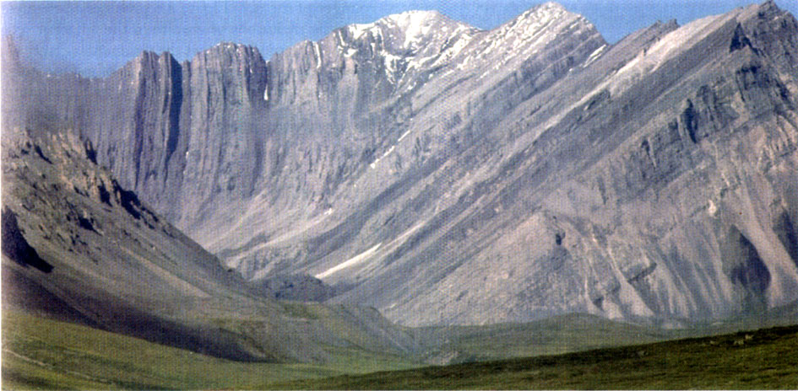
Folded beds

Slide 3
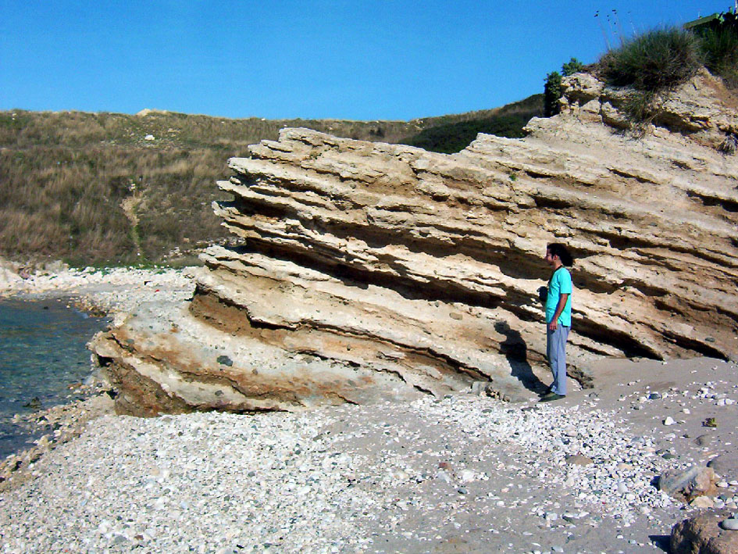
Tilted beds

Slide 4
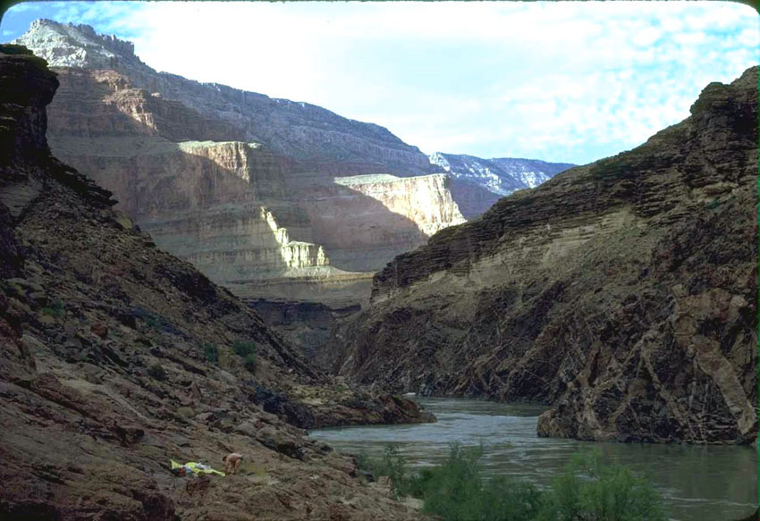
Discordant relationships
Bedding above the discordance
Discordance (nonconformity)
Tilted bedding below discordance (nonconformity)

Slide 5
Sedimentary structures
Stratification and bedforms:
Bedding-plane markings:
Bedding and lamination - Laminated bedding - Graded bedding - Massive (structureless) bedding
Bedforms
Irregular stratification
Groove cast; striations, bounce, brush, prod, and roll mark
Flute cast
Load cast
Mudcracks and syneresis cracks
Other structures: - Sedimentary sills and dykes

Slide 6
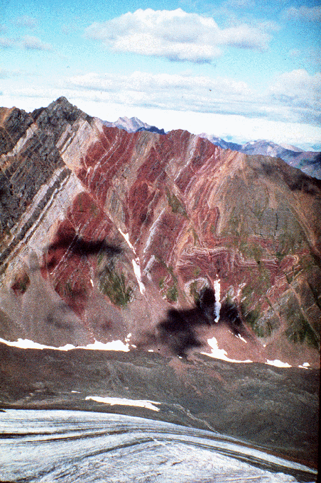
Bedding
Beds, or strata are tabular or lenticular layers of sedimentary rock that have lithologic, textural, or structural unity that clear distinguishes them from layers above and bellow.
Groups of similar beds or cross beds are called bedsets.

Slide 7
Description of bedding
Thick beds | Beds that are 30–100 cm thick. Very thick beds are tens of m thick.
Medium beds | Beds that are 10–30 cm thick
Thin beds | Beds that are less than 3 cm thick
Thinly laminated beds | Beds that are less than 0.3 cm thick
Rhythmic beds | A sequence of beds in which the contrast between adjacent beds is repeated periodically for a substantial thickness of strata

Slide 8
Description of bedding
Lateral continuity
Termination - merging of bedding planes (pinch-out) - lateral gradation of composition (die out) - meeting of crosscutting features such as channel or unconformity
Parallel bedding
Wavy bedding

Slide 9
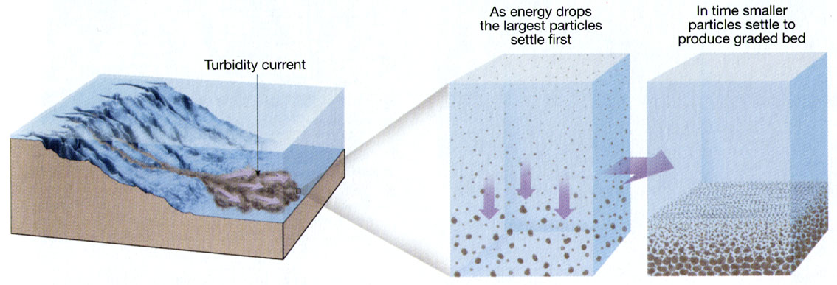
Mechanisms of bedding formation
sedimentation from suspension
horizontal accretion from a moving bed load (bed load is a part of the stream load that moves on or immediately above the stream bed; stream load is all material that is transported by a stream)
encroachment into the lee of an obstacle.

Slide 10
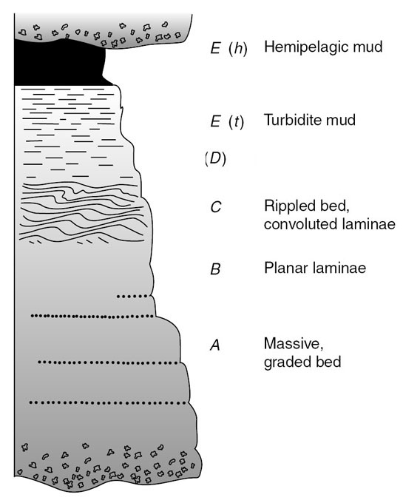
Graded bedding
Gradual change of grain size within a bed
Commonly produced by turbidity currents
Helps to determine the base (lower surface) and the top (upper surface) of a bed

Slide 11
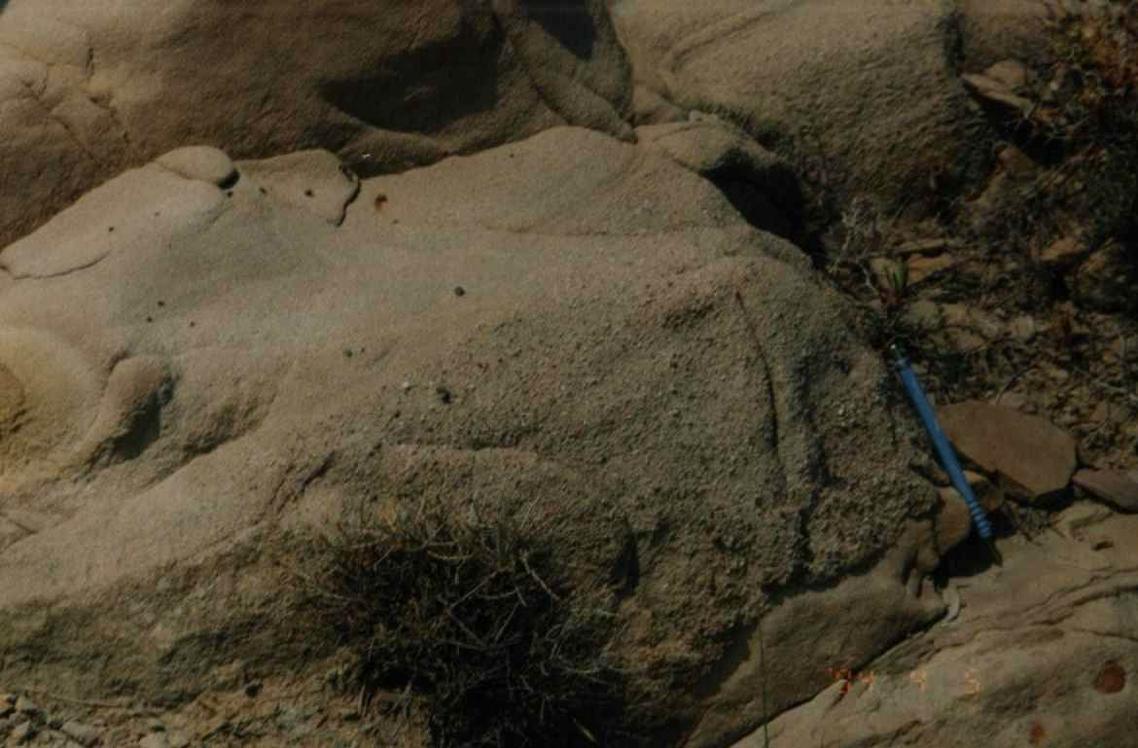
GRADED BEDDING
TOP
Sandstones
Conglomerates
Up The Section
BOTTOM

Slide 12
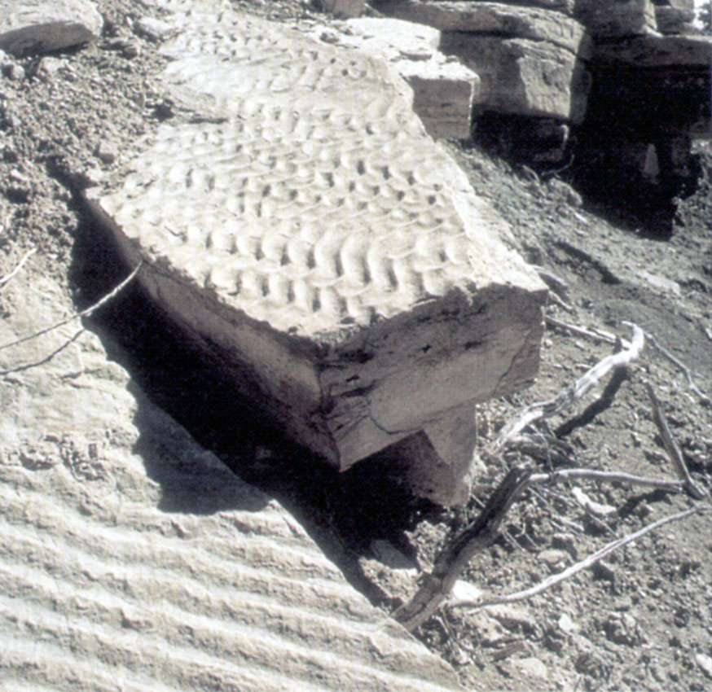
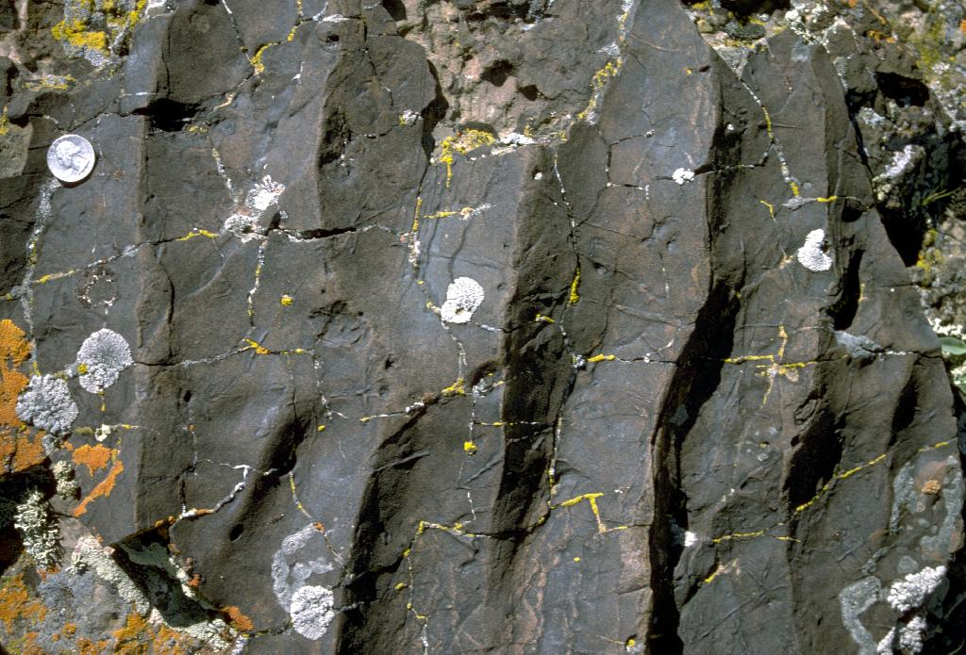
Bedforms – structures of the surface of a bed
Cross-bedding
Ripple cross-lamination
Flaser and lenticular bedding

Slide 13
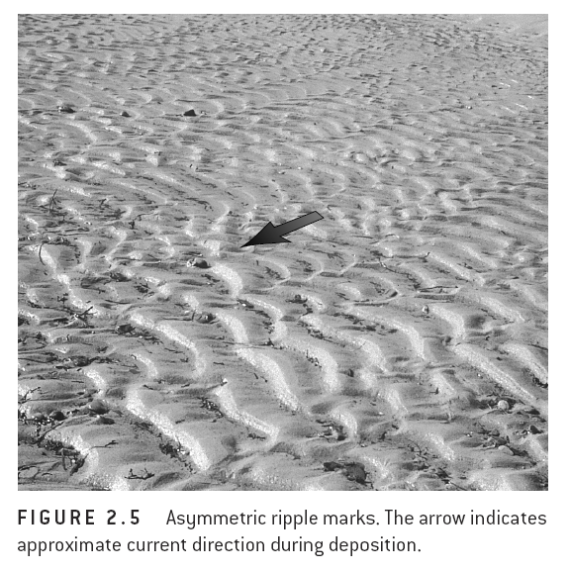
Ripple mark

Slide 14
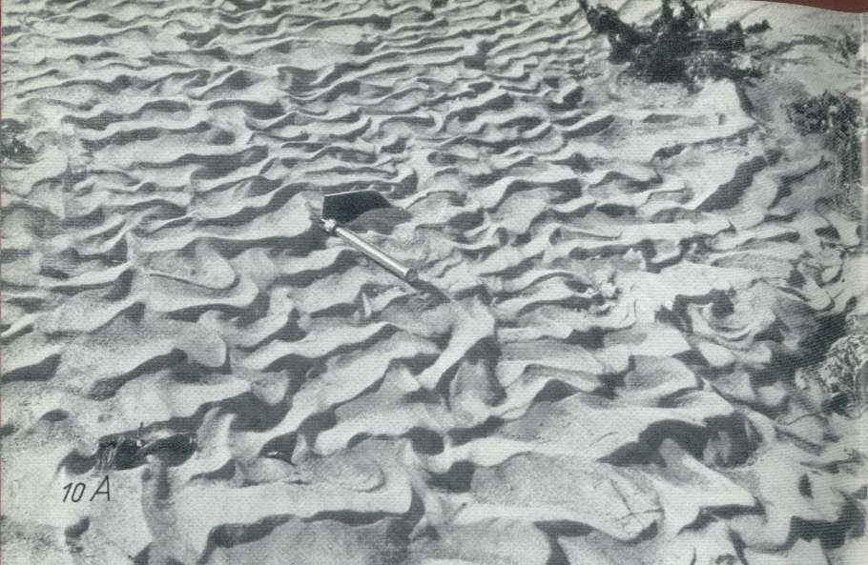
Assymetric flow ripples from Vermillon River
(Asimetrik akıntı ripple’ları. Vermillon Nehri.)

Slide 15
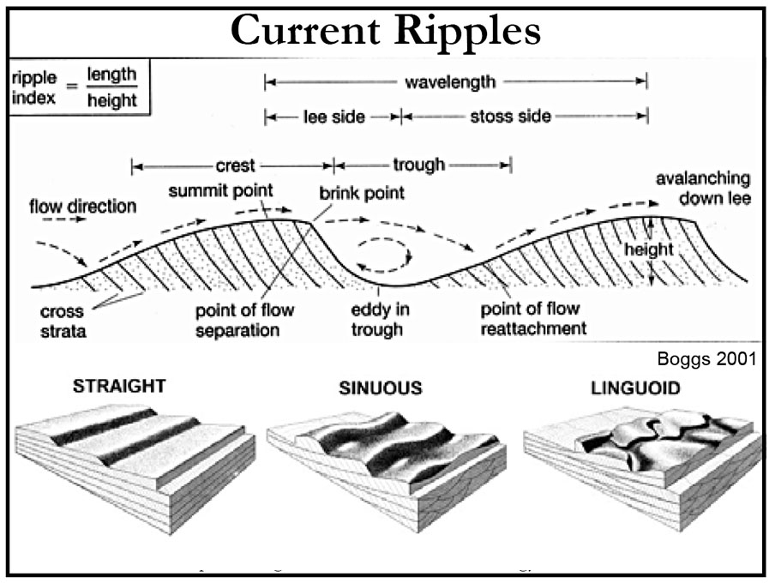

Slide 16
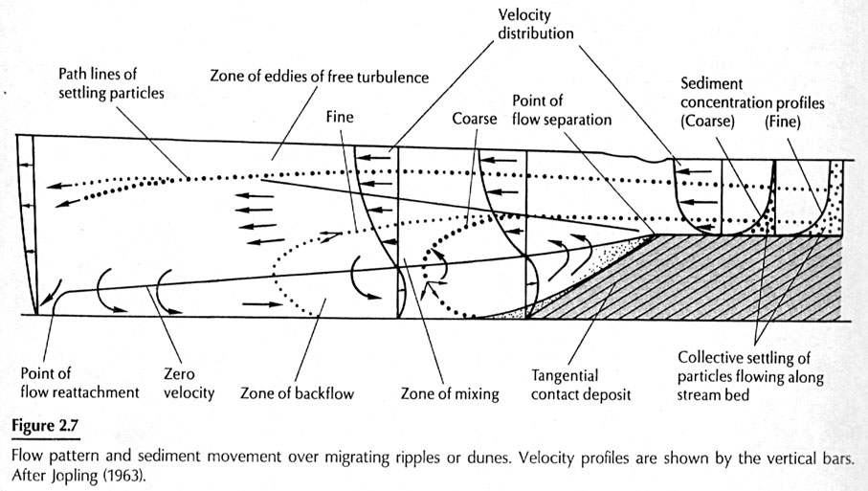

Slide 17
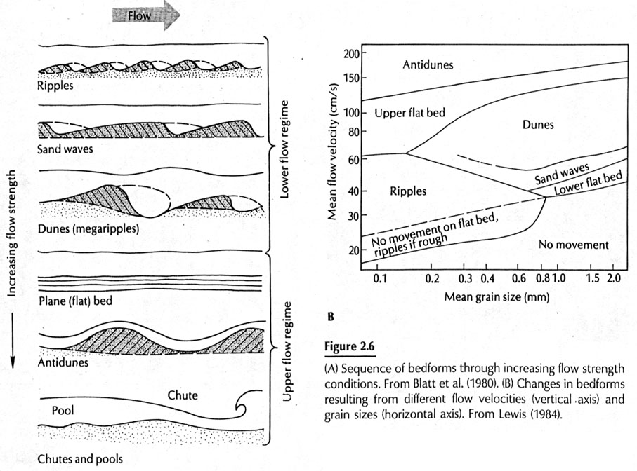

Slide 18
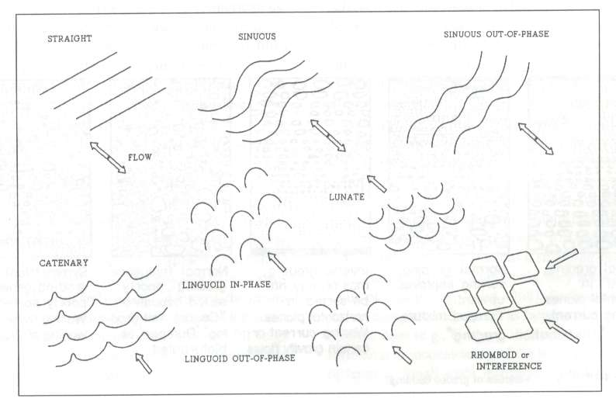

Slide 19
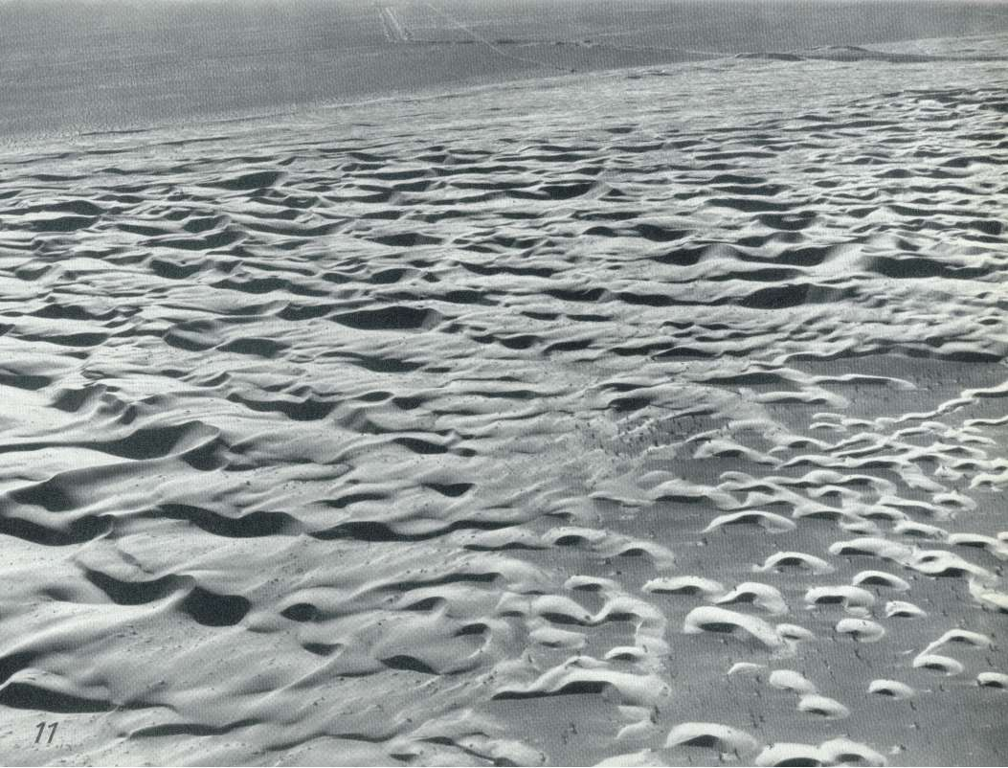
Appearence of antidunes from air

Slide 20
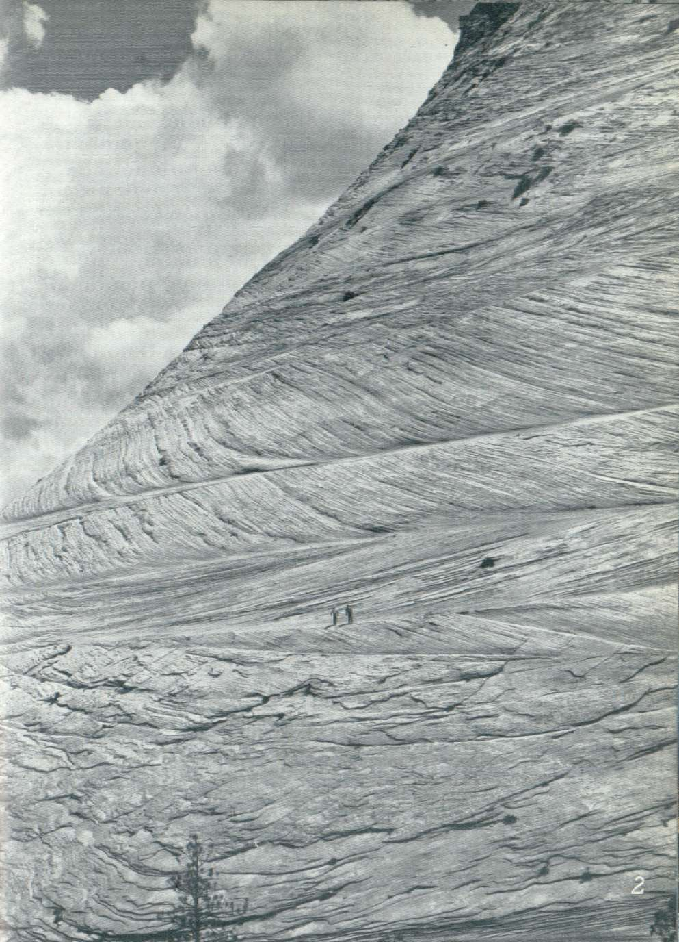
Cross stratification
Cross stratification from Jurassic age Navajo sandstones. Flow direction is from left to right
Cross str. occurs because of overlaping of ripplemarks.

Slide 21
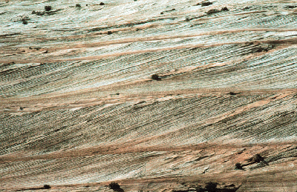
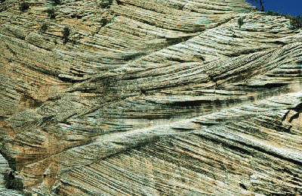
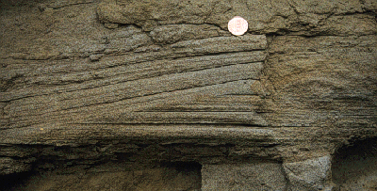
Tabular cross bed (düzlemsel)
Convulute crs. Bed.(Kama şeklinde)
Hummocky crs bed.

Slide 22
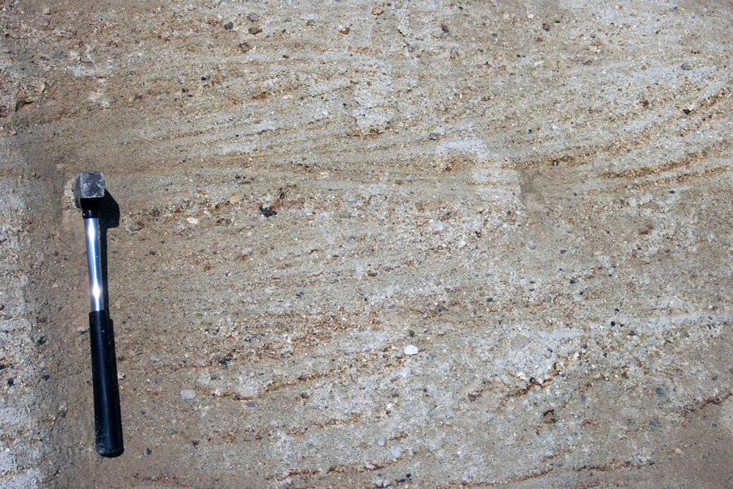

Slide 23
Irregular stratification
Convolute bedding and lamination
Flame structures
Channels
Scour-and-fill structures

Slide 24
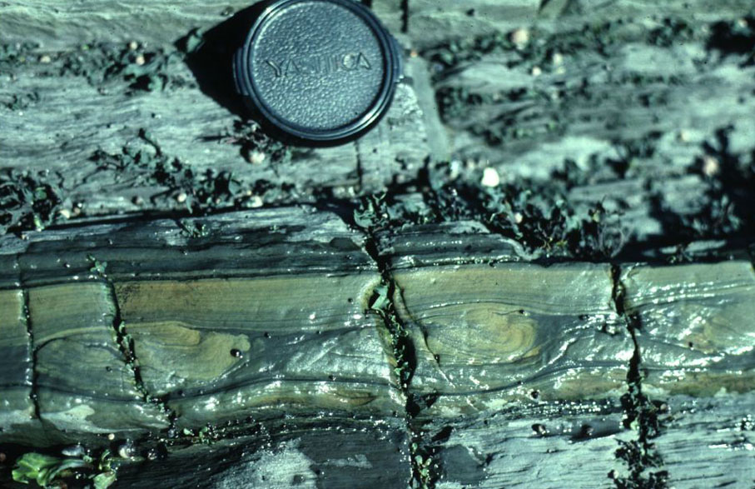
Convulute lamination

Slide 25
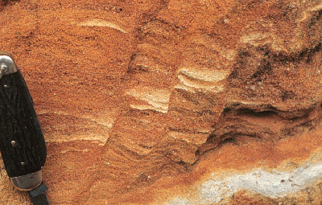
Synsedimentary Faults

Slide 26
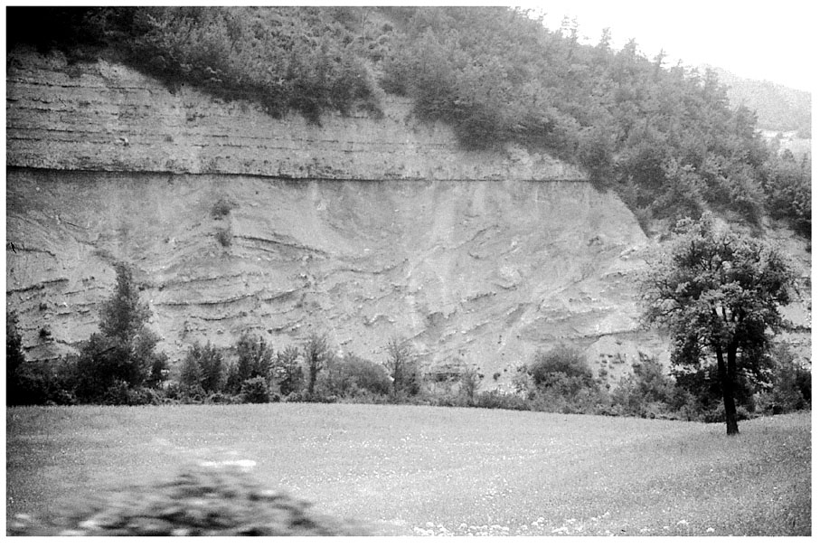
Penecontemporaneous folds in the Maranosa Arenaci (Italian Apennines)

Slide 27
Bedding-plane markings
Groove cast; striations, bounce, brush, prod, and roll mark
Flute cast
Load cast
Mudcracks and syneresis cracks

Slide 28
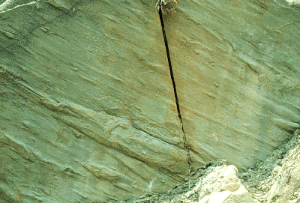
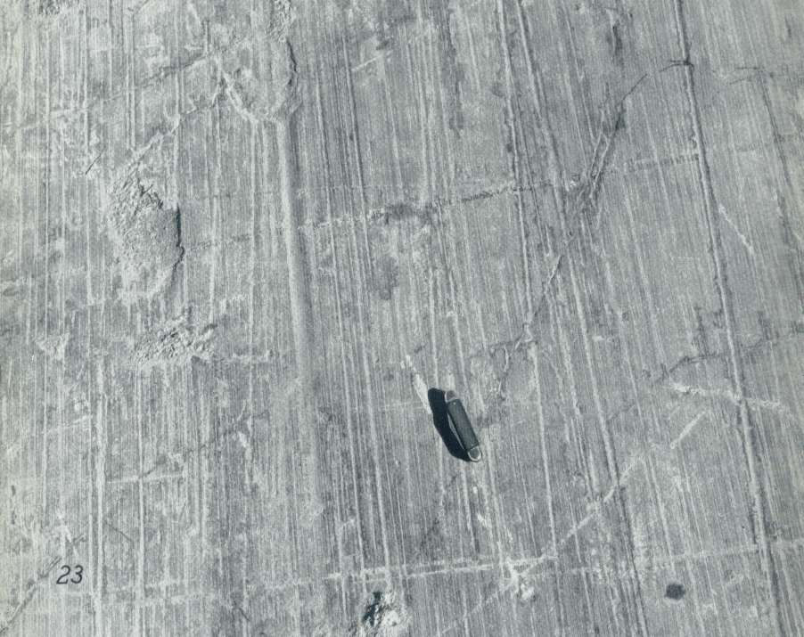
Grooves (Oluk yapıları)
Striations
(Buzul kertikleri)

Slide 29
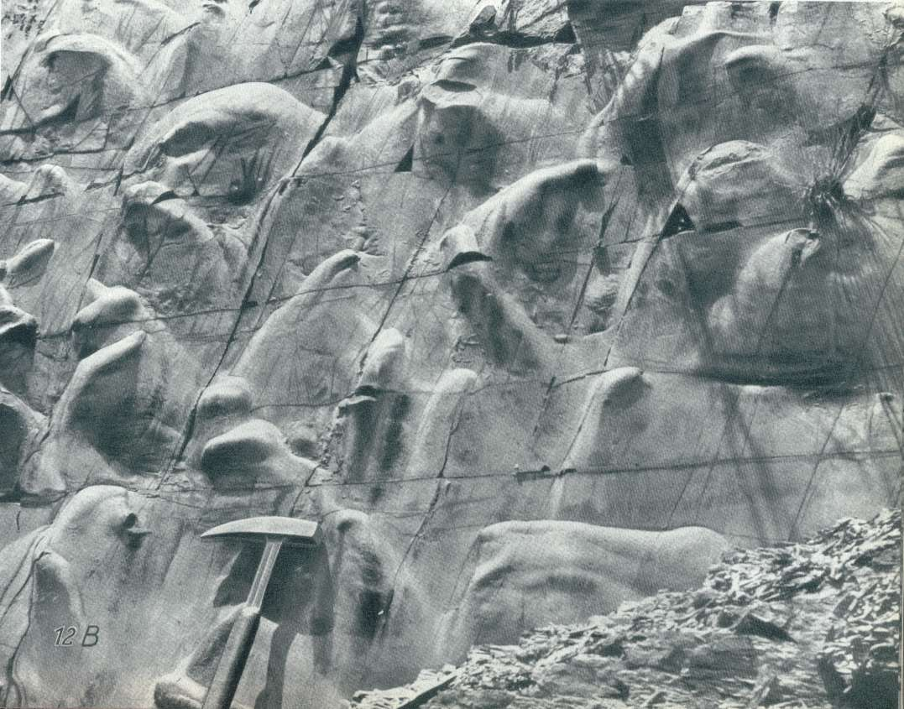
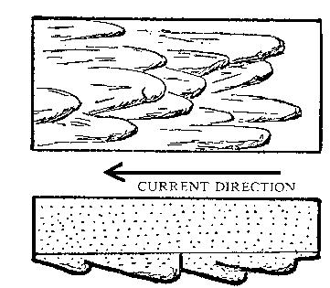
Kaval yapıları (flute casts). Akıntı yönü yukardan aşağıya.

Slide 30
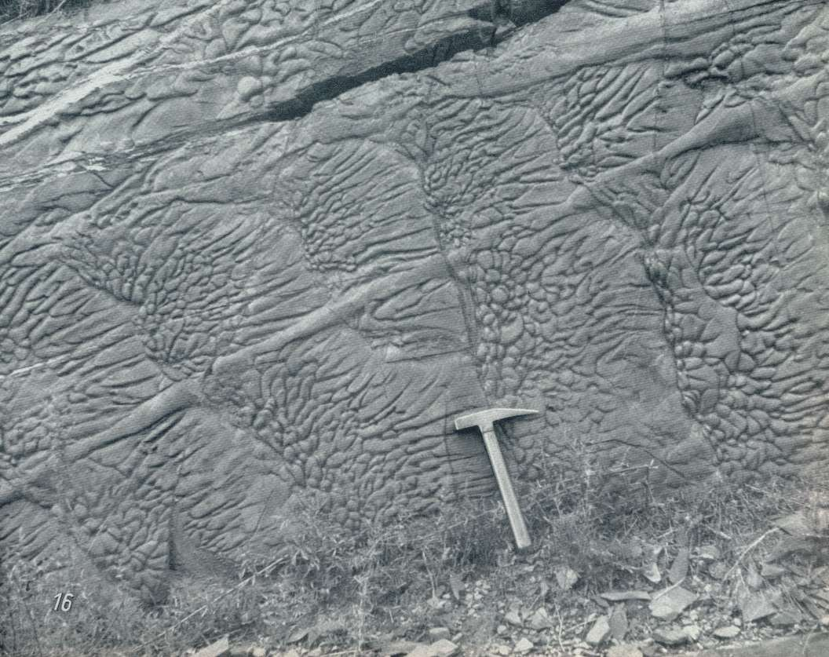
Flute marks
Load casts
Groove casts

Slide 31
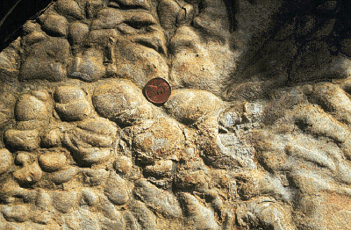
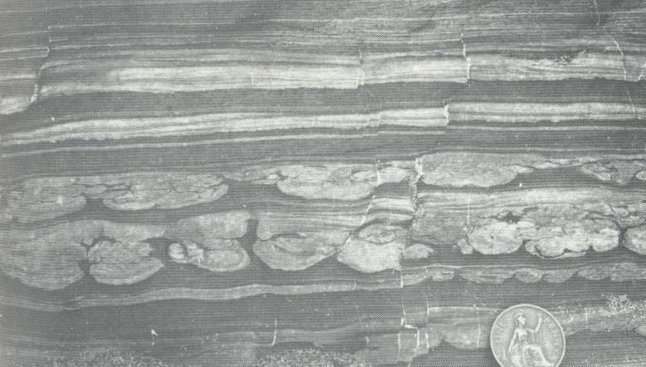
Load structures
They form prior to lithification where a denser sand lies on top of less dense mud and a disturbance by a storm or an earthquake causes blobs of sand to sink into the underlying mud.

Slide 32
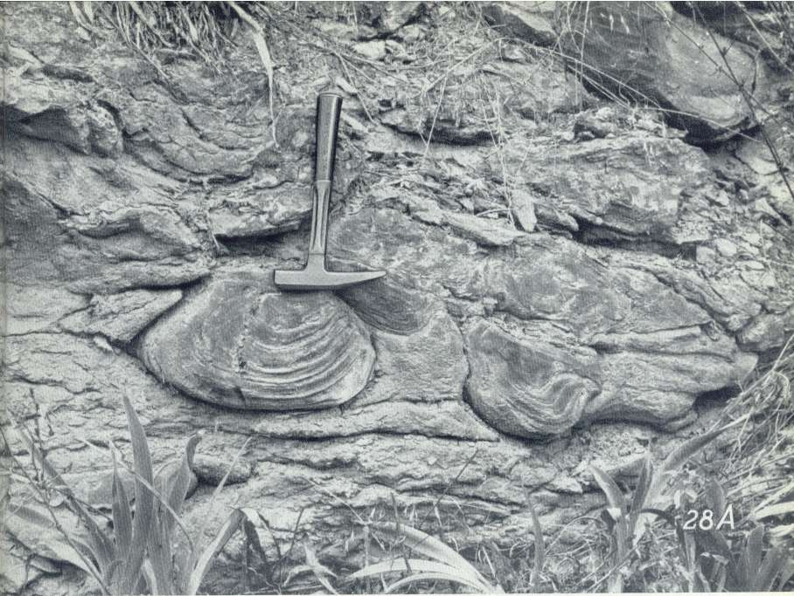
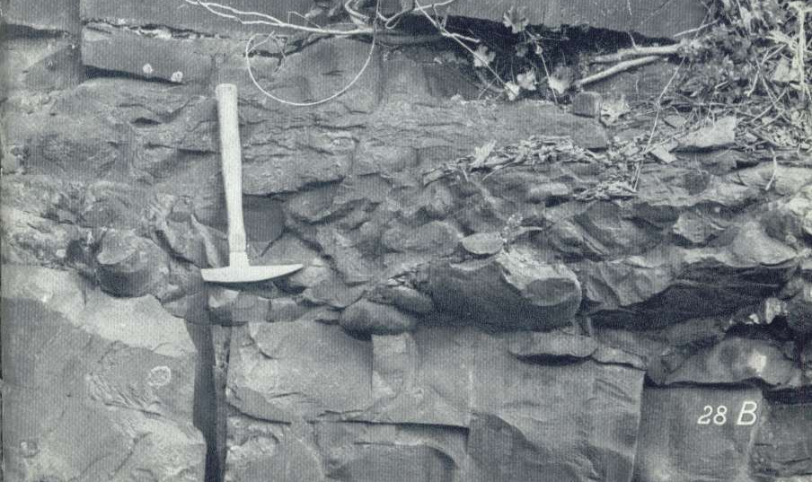
Ball-and-pillow structures
protrusions extending downward from a sand layer into an underlying mud or very fine sand layer

Slide 33

Mudcracks and syneresis cracks

Slide 34
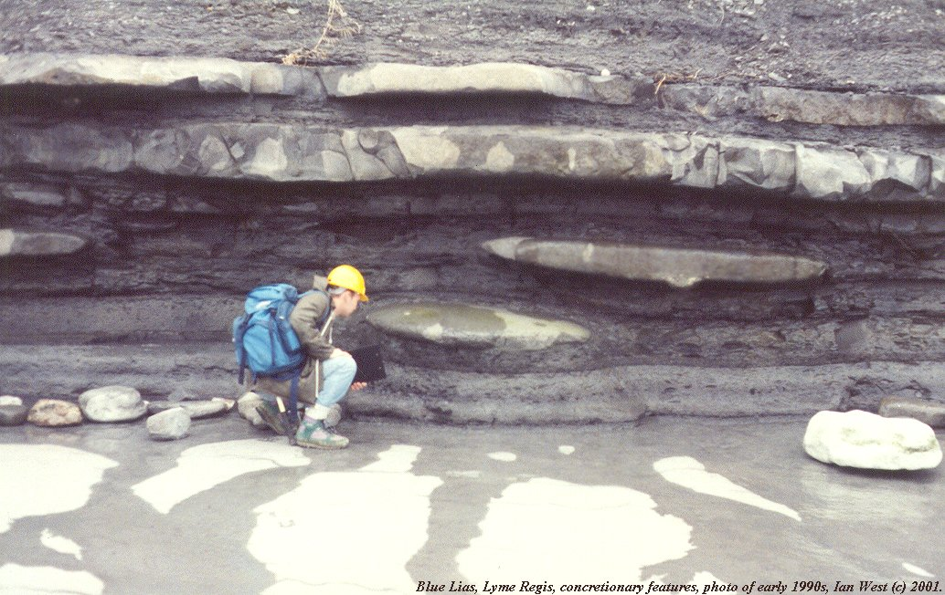
Carbonate nodule within shales
Nodule : A small rounded mass in a contrasting rock matrix.

Slide 35
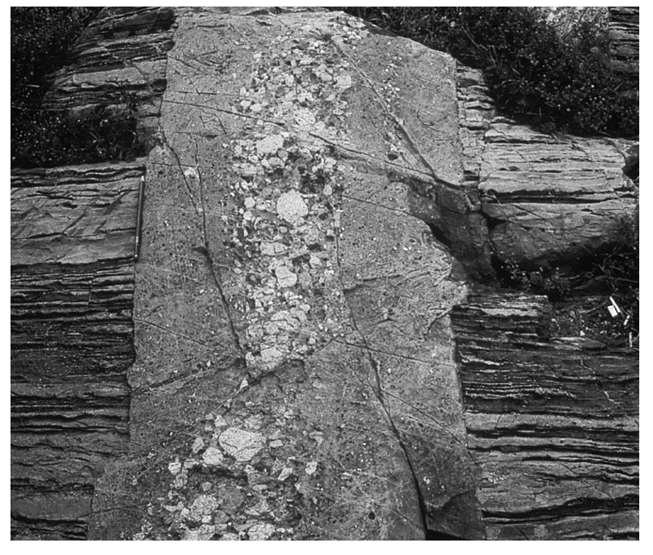
Sedimentary sills and dykes

Slide 36
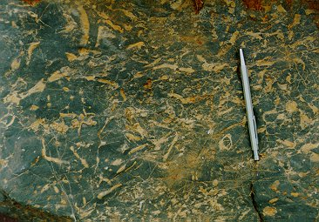
Biogenic sedimentary structures

Slide 37
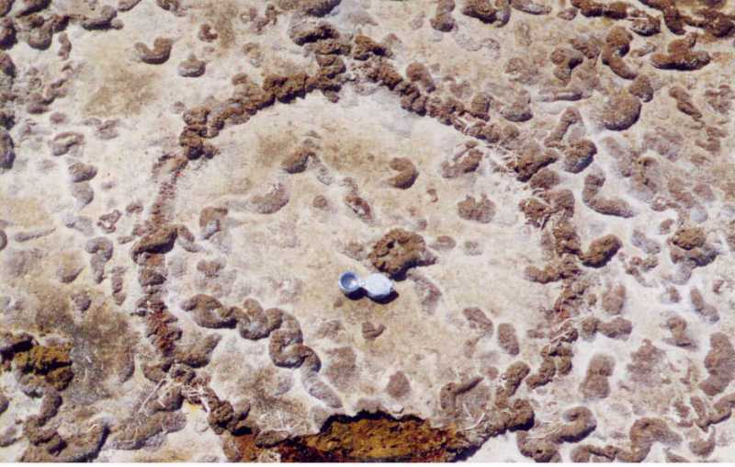
Biogenic structures

Slide 38
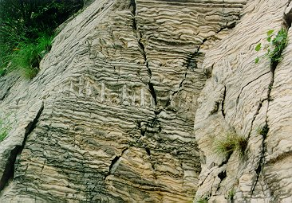
Bioturbation – horizontal bedding is disturbed by burrow and boring channels of fossils

Slide 39
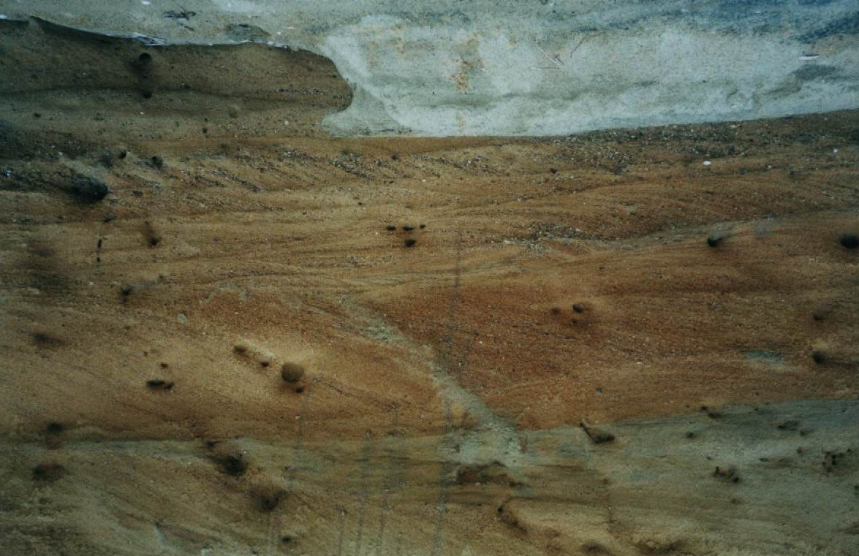
CROSSBEDDINGS
CURRENT DIRECTION
Cross-bedding
Bedding

