Slide 1
MHY530E
Decision Making Techniques
Prof. Dr. Y. İlker TOPCU
www.ilkertopcu.net
www.linkedin.com/in/ilker-topcu/
twitter.com/yitopcu
facebook.com/yitopcu instagram.com/yitopcu

Slide 2
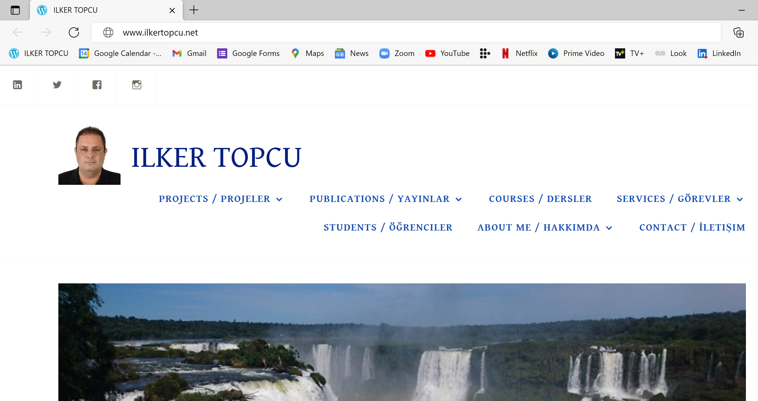

Slide 3
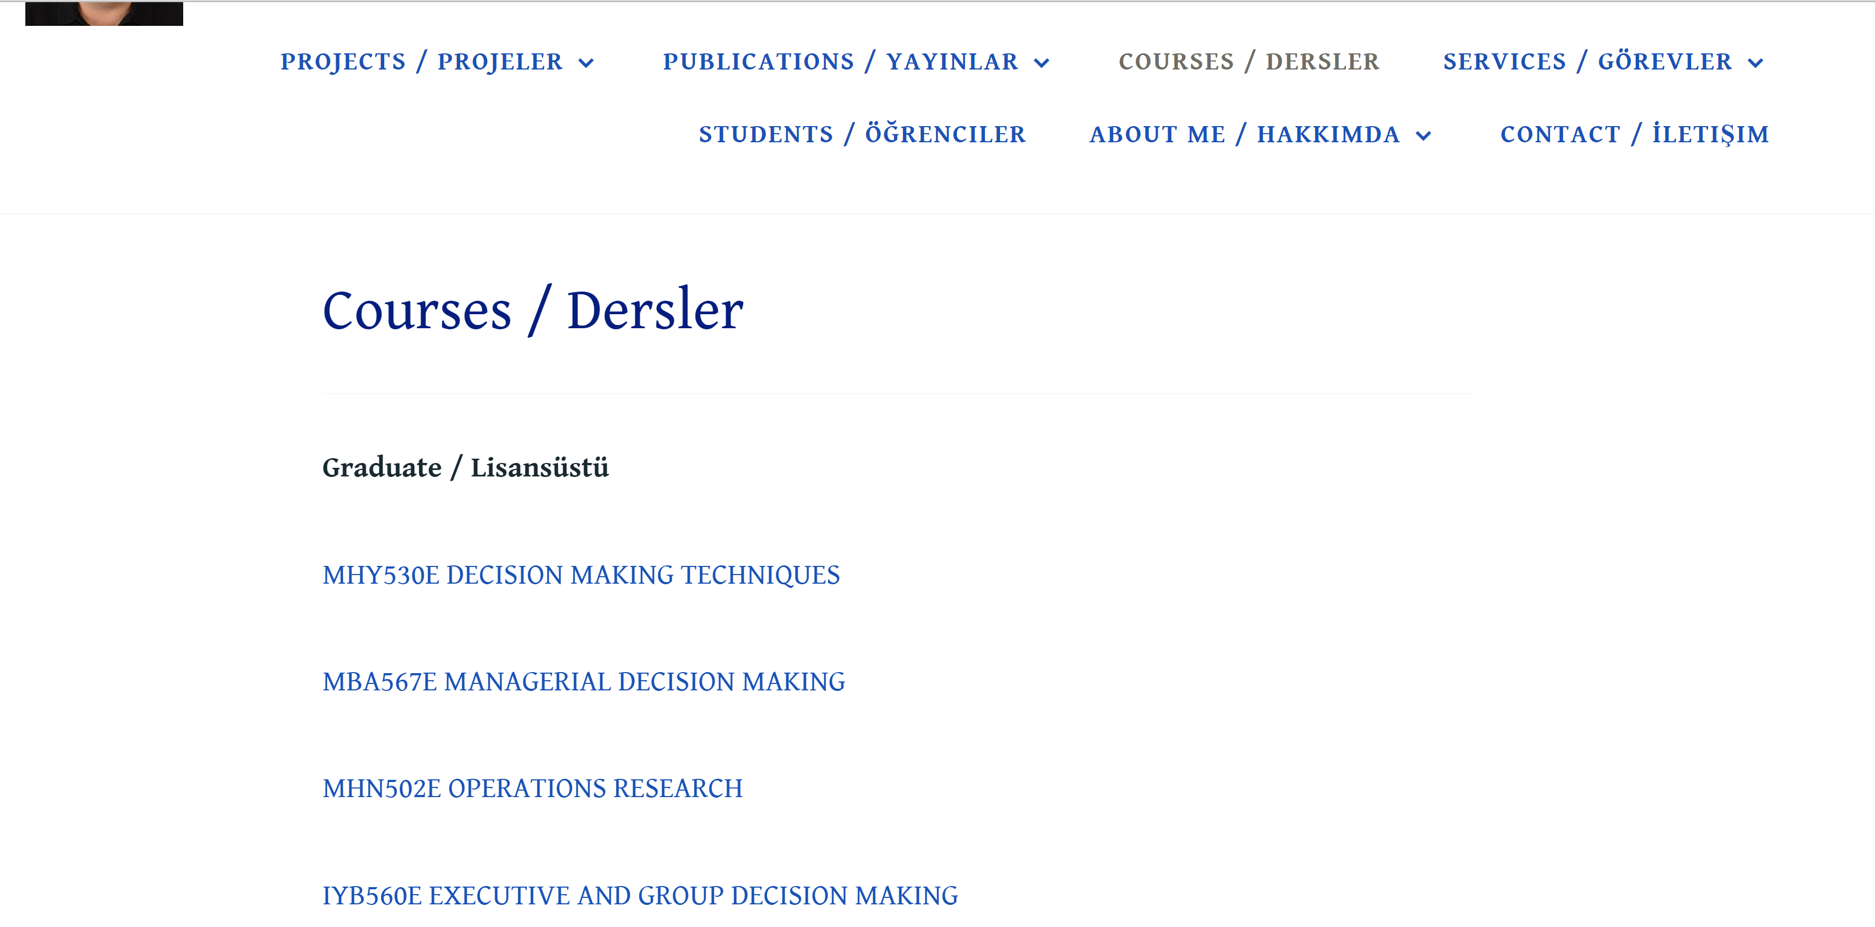

Slide 4
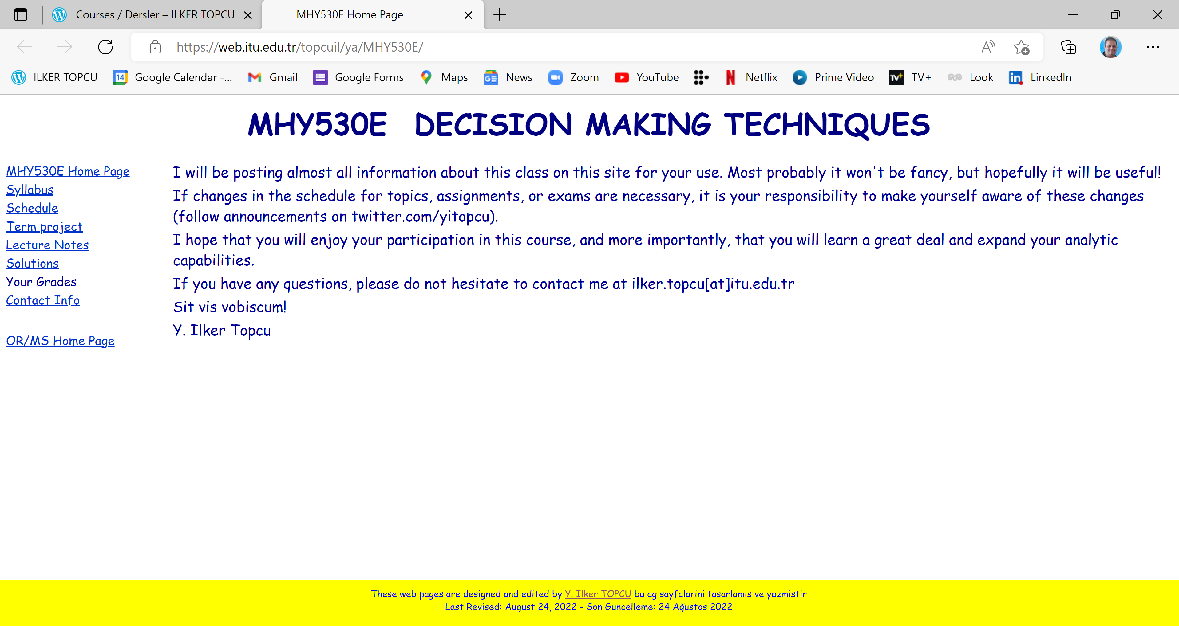

Slide 5
Course Information
Credits: 3+0
ECTS Credits: 7.5
Type: Elective
Language: English
Web site: web.itu.edu.tr/topcuil/ya/MHY530E

Slide 6
Course description
Multiple Criteria Decision Making
  Structuring the problem (Cognitive Mapping, Fuzzy Cog. Map.)
  Constructing the model (Normalization, Prioritiz’n, Conjoint)
  Analyzing the problem
    Analytic Hierarchy Process / Analytic Network Process
    Elementary methods
    MAVT, SMARTS, SAW, WP, TOPSIS
    Outranking methods (PROMETHEE, ELECTRE)
Group decision making (Social choice)
  Decision analysis
  Decision tables / payoff matrices
  Utility theory
  Decision trees

Slide 7
Course objectives
to provide students practical techniques and decision support tools those help them to solve decision problems
to enable students to integrate judgments with other types of information in a logical and defensible manner
to improve students’ decision making skills, their ability to analyze problems systematically, and their confidence in their own decision making

Slide 8
Course learning outcomes
Students who pass the course gain knowledge, skill and competency in the following subjects:
finding (choosing, ranking, or classifying) the best alternative for making a decision
using a range of decision making techniques to improve the effectiveness of their decision making
identifying common errors and traps that prevent them from making effective decisions

Slide 9
References
Books
Thakkar J.J. 2021. Multi-Criteria Decision Making. Springer, Singapore.
Bozorg-Haddad O., Zolghadr-Asli B., Loáiciga H.A. 2021. A handbook on multi-attribute decision-making methods. Wiley, New Jersey.
Topcu Y.I., Özaydin Ö., Kabak Ö., Önsel Ekici Ş. 2021. Multiple Criteria Decision Making - Beyond the Information Age. Springer, Cham.
Taylor B.W. 2019. Introduction to Management Science. 13th edition, Pearson Education Inc., New Jersey.
Render B., Stair Jr R.M., and Hanna M.E. 2018. Quantitative Analysis for Management. 13th edition, Pearson Education Inc., New Jersey.
Balakrishnan N., Render B., Stair R.M. Jr. 2017. Managerial Decision Modeling with Spreadsheets. 4th Edition, Prentice Hall, New Jersey.
Goodwin P. and Wright G. 2014. Decision Analysis for Management Judgment. 5th edition, John Wiley & Sons, New York.
Saaty T.L. and Vargas L.G. 2013. Decision Making with the Analytic Network Process. 2nd edition, Springer, New York.
Saaty T.L. 2005. Theory and Applications of the Analytic Network Process. RWS Publ., Pittsburgh.

Slide 10
References
Books
Parnell G.S., Bresnick T.A., Tani S.N., and Johnson E.R. 2013. Handbook of Decision Analysis. Wiley, New Jersey.
Kahneman D. 2013. Thinking, Fast and Slow. Farrar, Straus and Giroux, New York.
Krogerus M. and Tschappeler R. 2012. The Decision Book: 50 Models for Strategic Thinking. W. W. Norton & Co., London.
Ishizaka A. and Nemery P. 2013. Multi-criteria Decision Analysis: Methods and Software. Wiley, West Sussex.
Bazerman M.H. and Moore D.A. 2012. Judgment in Managerial Decision Making. 8th edition, Wiley, New York.
Koksalan M., Wallenius J., and Zionts S. 2011. Multiple Criteria Decision Making: From Early History to the 21st Century. World Scientific Publishing Company, New Jersey.
Keeney R.L. 2009. Value Focused Thinking: A Path to Creative Decision Making. Harvard University Press, London.

Slide 11
References
Web site of the course
Up-to-date lecture notes and supplements
Solutions to exams and homework
Web sites of other courses

Slide 12
Assessment Criteria
Final exam (30%), 2 Midterm exams (40%),
Term project (30%)
Exams will be either “take home” or “open book”

Slide 13
Exams
Midterm exam I
November 15
Midterm exam II
December 27
Final exam
TBA

Slide 14
Term Project
Group work (maximum 3 students)
  to constitute groups for term projects, you may use "message board" at ninova to communicate with your peers.
Structuring, modeling, and analyzing a multicriteria decision making problem in one of the given application areas.
A term project report in journal paper format
  can be submitted to an appropriate journal (if possible and if you wish) after some adjustments that will be made by us.

Slide 15
Term Project
IMPORTANT DATES
Deadline for submissions:
proposal: October 25
literature review: November 22
final report: January 3
Presentations: January 3

Slide 16
Cheating and Plagiarism
Do not!
Studying together to understand the material is fine, but the work you hand in is to be your own.
No cheating will be tolerated: A letter grade of F will be given!

Slide 17
Schedule

Slide 18
Bio
Professor at Industrial Engineering department, ITU (2011- )
Visiting Professor at The Joseph M. Katz Graduate School of Business, University of Pittsburgh (2018-2019)
Ph.D. in ITU Engineering Management program (2000)
Visiting Researcher at Centre for Decision Research of Leeds University Business School (1998-1999)
Research interests
  Decision Analysis, Multi Criteria Decision Making, Group Decision Making
  Operations Research / Management Science
  Logistics Management, Ethics in OR, Business Ethics, Transp’n, Energy, Bidding and Tender Systems, Scheduling

Slide 19
Contact
Phone/WhatsApp
(532) 355 5045
Web site
www.ilkertopcu.net, www.linkedin.com/in/ilker-topcu/
twitter.com/yitopcu, facebook.com/yitopcu, instagram.com/yitopcu
E-mail address
ilker.topcu@itu.edu.tr

