Slide 1
MHN502E
Operations Research I
Prof. Dr. Y. İlker TOPCU
www.ilkertopcu.net
www.linkedin.com/in/ilker-topcu/
twitter.com/yitopcu
facebook.com/yitopcu instagram.com/yitopcu

Slide 2
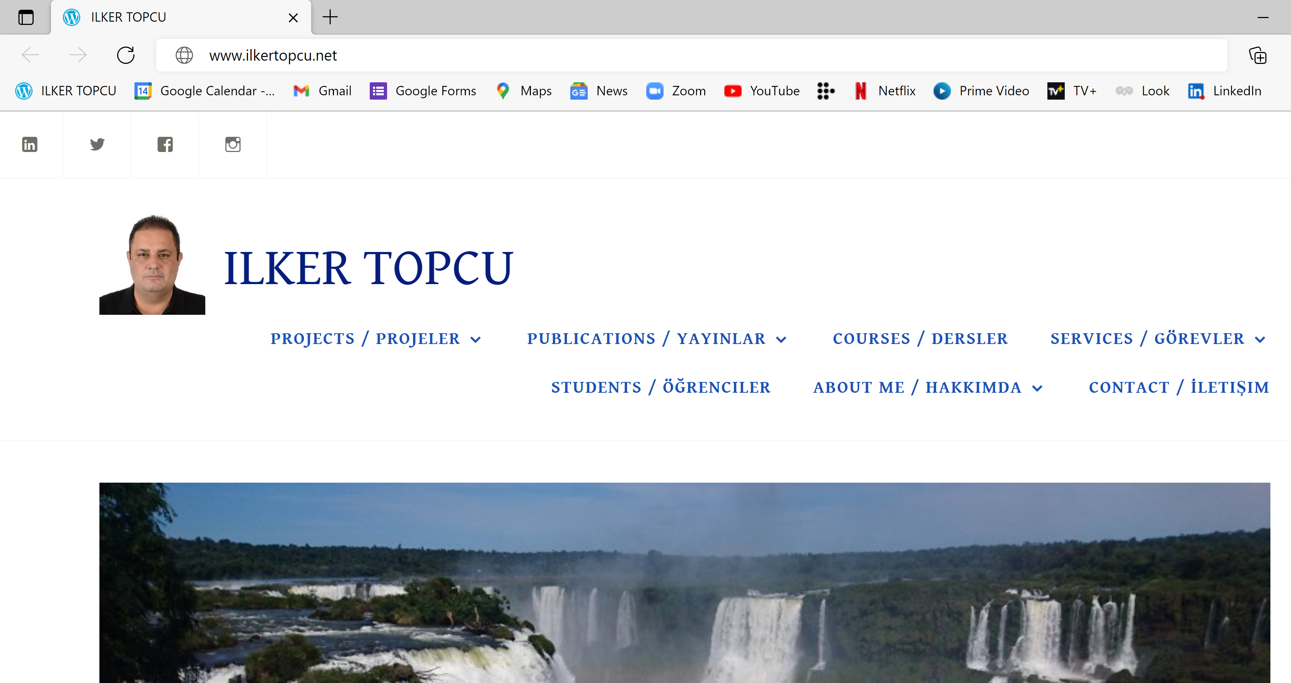

Slide 3
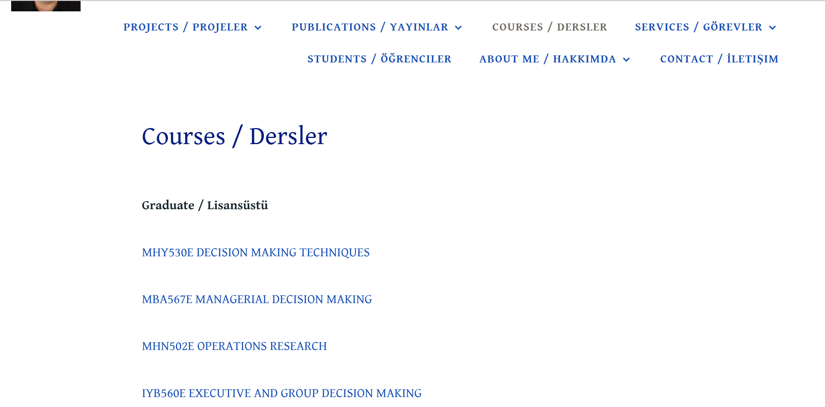

Slide 4
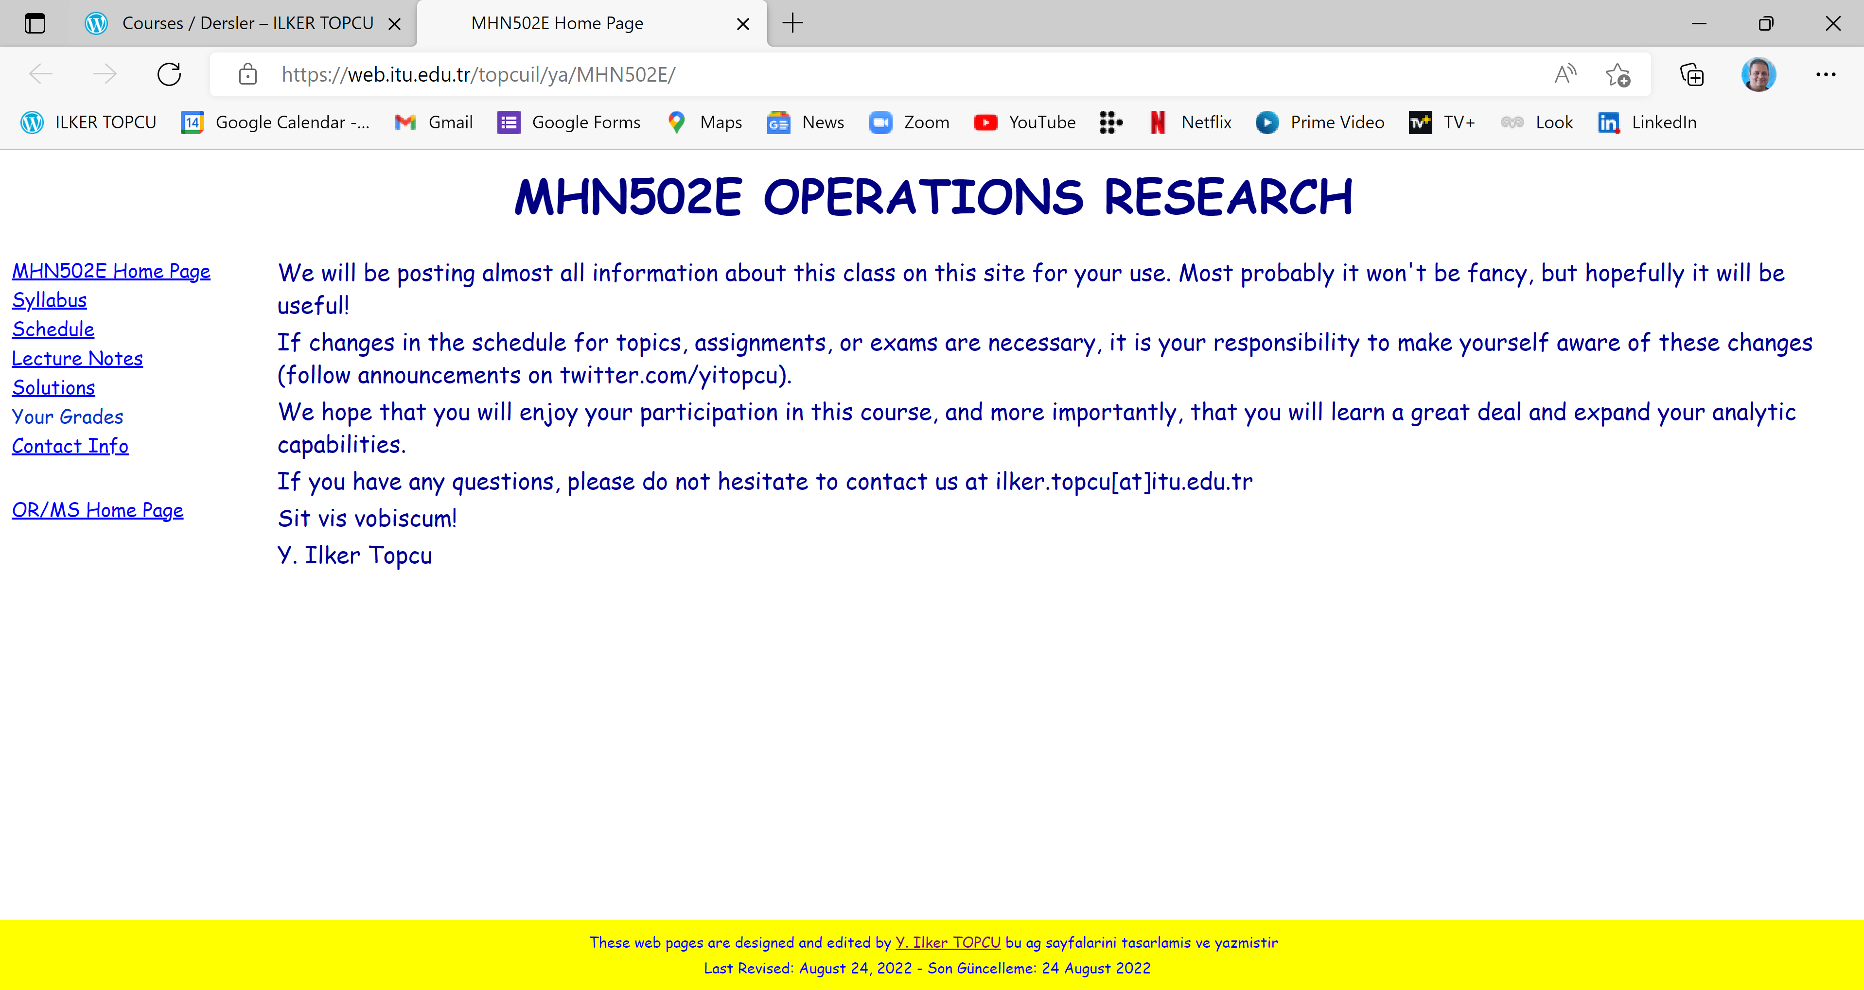

Slide 5
Course Information
Credits: 3+0
ECTS Credits: 7.5
Type: Compulsory
Language: English
Web site: web.itu.edu.tr/topcuil/ya/MHN502E

Slide 6
Course description
Decision making, Model building, Modeling philosophy
Linear programming
Graphical solution, Simplex algorithm, M method
Lindo and Excel solver
Duality, Sensitivity analysis
Transportation models and solving methods, Transshipment, Assignment
Integer programming
Branch and Bound, Cutting planes
Combinatorial optimization

Slide 7
Course objectives
To use different mathematical modeling techniques utilizing Operations Research (OR) methodology
To learn various methods that are used for quantitative decision making
To find optimal solutions to problems

Slide 8
Course learning outcomes
Students who pass the course will be able to
use different mathematical modeling techniques
solve a problem modeled with LP
comprehend the solution of an LP model
understand the sensitivity of a solution to the changes at the parameters of the problem
use some computer softwares to model, solve and analyze a linear model
formulate and solve IP problems
solve and analyze transportation and assignment problems with related methods

Slide 9
References
Text book
Winston W.L. (2004) “Operations Research: Applications and Algorithms”, Brooks/Cole – Thomson Learning
Web site of the course
Up-to-date lecture notes and supplements
Solutions to exams and homework
Previous exam questions
Books
“Operations Research”, "Practical Management Science", "Introduction to Management Science“, "Quantitative Analysis for Management”, "Optimization in Operations Research", "Introduction to Mathematical Programming“
Online courses, video recordings, and web sites of other courses

Slide 10
Suggested Videos
The right match: A short documentary https://www.youtube.com/watch?v=ttMQECKQ3DQ
Patrick Blackett | Draw my life (The OR Society) https://www.youtube.com/watch?v=jg5IQ5Hf2G0
Operational Research 'ORigin Story' (The OR Society) https://www.youtube.com/watch?v=ILWbaWrjgU4
What is Operational Research? – Full feature (The OR Society) https://www.youtube.com/watch?v=0oMVVx81kCs
Bright Future, Big Opportunities in O.R. and Analytics (INFORMS) https://www.youtube.com/watch?v=9-MITCoka-Q
O.R. & Analytics: Saving Lives and Money, Solving Problems (INFORMS) https://www.youtube.com/watch?v=KkVDcwzs6Ik
INFORMS O.R. and Analytics Impact (INFORMS) https://www.youtube.com/watch?v=lq0B6wnAbk0
2021 Edelman Winner: UN World Food Programme (INFORMS) https://www.youtube.com/watch?v=wdEcVj5LTGg

Slide 11
Assessment
Midterm Exam 1 30%
Midterm Exam 2 30%
Final exam 40%

Slide 12
Cheating and Plagiarism
Do not!
Studying together to understand the material is fine, but the work you hand in is to be your own.
No cheating will be tolerated: A letter grade of F will be given!

Slide 13
Midterm Exams
Individual take home assignments
Midterm Exam 1
Topics covered in the first 5 weeks
Date: November 6th
Midterm Exam 2
Topics covered after the 6th week
Date: December 11th

Slide 14
Final Exam
Individual in-person assignment
All topics covered
Date: December 18th

Slide 15
Schedule

Slide 16
Bio
Professor at Industrial Engineering department, ITU (2011- )
Visiting Professor at The Joseph M. Katz Graduate School of Business, University of Pittsburgh (2018-2019)
Ph.D. in ITU Engineering Management program (2000)
Visiting Researcher at Centre for Decision Research of Leeds University Business School (1998-1999)
Research interests
  Decision Analysis, Multi Criteria Decision Making, Group Decision Making
  Operations Research / Management Science
  Logistics Management, Ethics in OR, Business Ethics, Transp’n, Energy, Bidding and Tender Systems, Scheduling

Slide 17
Contact
Phone/WhatsApp
(532) 355 5045
Web site
www.ilkertopcu.net, www.linkedin.com/in/ilker-topcu/
twitter.com/yitopcu, facebook.com/yitopcu, instagram.com/yitopcu
E-mail address
ilker.topcu@itu.edu.tr

