Slide 1
IYB560E EXECUTIVE AND GROUP DECISION MAKING
Prof. Dr. Y. İlker TOPCU
www.ilkertopcu.net
www.linkedin.com/in/ilker-topcu twitter.com/yitopcu
facebook.com/yitopcu instagram.com/yitopcu

Slide 2
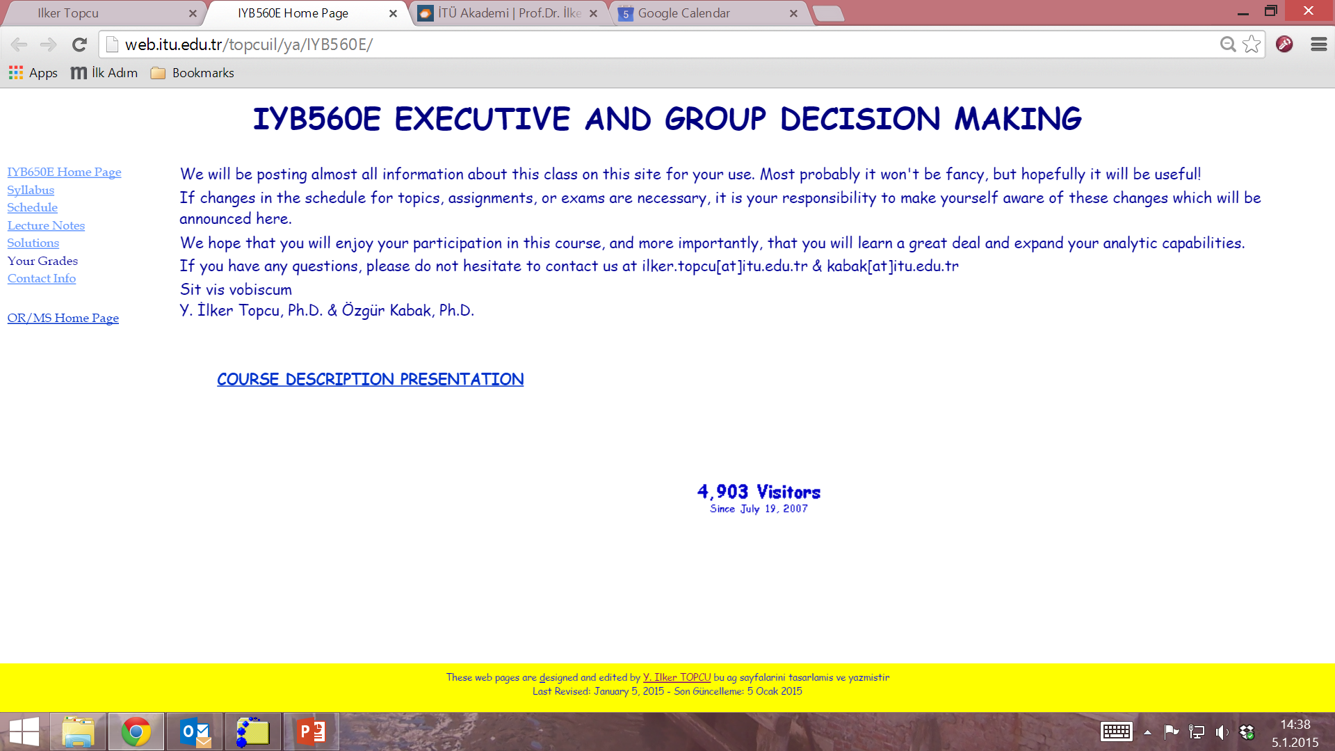

Slide 3
Course information
Credits: 3+0
ECTS Credits: 7
Type: Compulsory
Language: English
Web site: web.itu.edu.tr/topcuil/ya/IYB560E

Slide 4
Course description
Decision analysis
Decision tables / payoff matrices
Decision trees
Multiple Criteria Decision Making
Constructing the decision model
Analyzing the problem
Elementary methods
SAW, WP, TOPSIS
Analytic Hierarchy Process
Analytic Network Process
Group decision making
Voting methods
Multi-attribute group decision making

Slide 5
Course objectives
to provide students practical techniques and decision support tools those help them to solve decision problems
to enable students to integrate judgments with other types of information in a logical and defensible manner
to improve students’ decision making skills, their ability to analyze problems systematically, and their confidence in their own decision making

Slide 6
Course learning outcomes
Students who pass the course gain knowledge, skill and competency in the following subjects:
identifying common errors and traps that prevent them from making effective decisions,
learning how decision making process takes place,
using a range of decision making techniques to improve the effectiveness of their decision making
finding (choosing, ranking, or classifying) the comprimise alternative for making a decision

Slide 7
References
Lecture notes and supplements at the website of the course
Books
Thakkar J.J. 2021. Multi-Criteria Decision Making. Springer, Singapore.
Bozorg-Haddad O., Zolghadr-Asli B., Loáiciga H.A. 2021. A handbook on multi-attribute decision-making methods. Wiley, New Jersey.
Topcu Y.I., Özaydin Ö., Kabak Ö., Önsel Ekici Ş. 2021. Multiple Criteria Decision Making - Beyond the Information Age. Springer, Cham.
Taylor B.W. 2019. Introduction to Management Science. 13th edition, Pearson Education Inc., New Jersey.
Render B., Stair Jr R.M., and Hanna M.E. 2018. Quantitative Analysis for Management. 13th edition, Pearson Education Inc., New Jersey.
Goodwin P. and Wright G. 2014. Decision Analysis for Management Judgment. 5th edition, Wiley, New York.
Saaty T.L. and Vargas L.G. 2013. Decision Making with the Analytic Network Process. 2nd edition, Springer, New York.
The websites of other courses

Slide 8
Assessment Criteria
Final exam (40%)
2 Midterm Exams (60%)

Slide 9
Assessments
Midterm Exam 1
February 11
Midterm Exam 2
March 11
Final exam
April 8

Slide 10
Cheating and Plagiarism
Do not!
Studying together to understand the material is fine, but the work you hand in is to be your own.
No cheating will be tolerated: A letter grade of F will be given!

Slide 11
Schedule

Slide 12
Prof. Dr. Y. İlker Topcu
Phone: (532) 355 5045 mobile
www.ilkertopcu.net
www.linkedin.com/in/ilker-topcu/, twitter.com/yitopcu,
facebook.com/yitopcu, instagram.com/yitopcu
E-mail address: ilker.topcu@itu.edu.tr

Slide 13
Professor at Industrial Engineering department, ITU (2011- )
Visiting Professor at The Joseph M. Katz Graduate School of Business, University of Pittsburgh (2018-2019)
Ph.D. in ITU Engineering Management program (2000)
Visiting Researcher at Centre for Decision Research of Leeds University Business School (1998-1999)
Research interests
Decision Analysis, Multi Criteria Decision Making, Group Decision Making
Operations Research / Management Science
Logistics Management, Ethics in OR, Business Ethics, Transp’n, Energy, Bidding and Tender Systems, Scheduling

