Slide 1
IYB560E EXECUTIVE AND GROUP DECISION MAKING
Prof. Dr. Y. İlker TOPCU
www.ilkertopcu.net
www.linkedin.com/in/ilker-topcu/ twitter.com/yitopcu
facebook.com/yitopcu instagram.com/yitopcu
Prof. Dr. Özgür KABAK
web.itu.edu.tr/kabak/

Slide 2
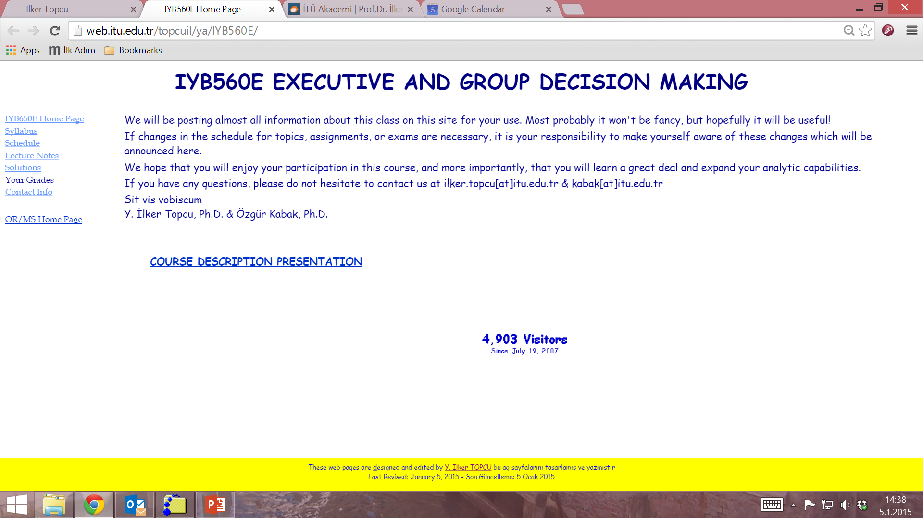

Slide 3
Course information
Credits: 3+0
ECTS Credits: 7
Type: Compulsory
Language: English
Web site: web.itu.edu.tr/topcuil/ya/IYB560E

Slide 4
Course description
Decision analysis
Decision tables / payoff matrices
Decision trees
Multiple Criteria Decision Making
Constructing the decision model
Analyzing the problem
Elementary methods
SAW, WP, TOPSIS
Analytic Hierarchy Process
Analytic Network Process
Group decision making
Voting methods
Multi-attribute group decision making

Slide 5
Course objectives
to provide students practical techniques and decision support tools those help them to solve decision problems
to enable students to integrate judgments with other types of information in a logical and defensible manner
to improve students’ decision making skills, their ability to analyze problems systematically, and their confidence in their own decision making

Slide 6
Course learning outcomes
Students who pass the course gain knowledge, skill and competency in the following subjects:
identifying common errors and traps that prevent them from making effective decisions,
learning how decision making process takes place,
using a range of decision making techniques to improve the effectiveness of their decision making
finding (choosing, ranking, or classifying) the comprimise alternative for making a decision

Slide 7
References
Lecture notes and supplements at the website of the course
Books
Thakkar J.J. 2021. Multi-Criteria Decision Making. Springer, Singapore.
Bozorg-Haddad O., Zolghadr-Asli B., Loáiciga H.A. 2021. A handbook on multi-attribute decision-making methods. Wiley, New Jersey.
Topcu Y.I., Özaydin Ö., Kabak Ö., Önsel Ekici Ş. 2021. Multiple Criteria Decision Making - Beyond the Information Age. Springer, Cham.
Taylor B.W. 2019. Introduction to Management Science. 13th edition, Pearson Education Inc., New Jersey.
Render B., Stair Jr R.M., and Hanna M.E. 2018. Quantitative Analysis for Management. 13th edition, Pearson Education Inc., New Jersey.
Goodwin P. and Wright G. 2014. Decision Analysis for Management Judgment. 5th edition, Wiley, New York.
Saaty T.L. and Vargas L.G. 2013. Decision Making with the Analytic Network Process. 2nd edition, Springer, New York.
The websites of other courses

Slide 8
Assessment Criteria
Final exam (30%)
Term Project (%30)
2 Homework Assignments (40%)

Slide 9
Assessments
Homework 1
January 31 – February 7
Homework 2
February 21 – February 28
Term Project
March 27
Final exam
April 3

Slide 10
Term Project
Structuring, modeling, and analyzing a non-personal multiple criteria decision making problem.
A report will be submitted and a presentation will be made.
Report and presentation content
1 - Problem Definition
2 – Identification of alternatives and criteria
3 – Construction of the decision matrix / hierarchy
4 – Determination of the criteria importance
5 – Analysis of the problem
5.1 Using an elementary method
5.2 Using a value-based method
6 – Sensitivity Analysis
7 – Final evaluation and recommendation

Slide 11
Cheating and Plagiarism
Do not!
Studying together to understand the material is fine, but the work you hand in is to be your own.
No cheating will be tolerated: A letter grade of F will be given!

Slide 12
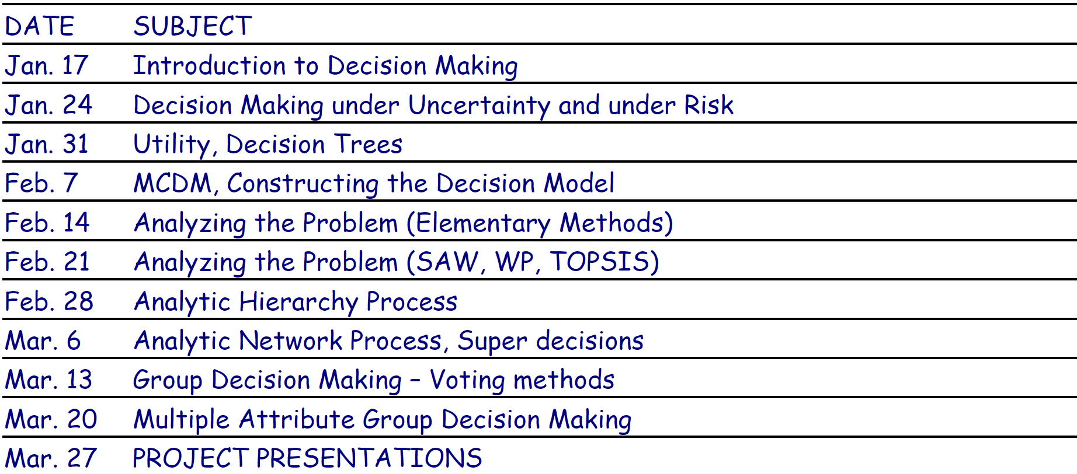
Schedule

Slide 13
Prof. Dr. Özgür Kabak
Phone
(212) 293 1300 /2073 secretary
Web site
web.itu.edu.tr/kabak/
E-mail address
kabak@itu.edu.tr

Slide 14
Professor at Industrial Engineering department of ITU (2021- )
Post-doc studies at Belgium Nuclear Research Centre (SCK.CEN) (2009-2010)
A fuzzy multi attribute decision making approach for nuclear safeguards information management
Ph.D. in ITU Industrial Engineering programme (2008)
Modeling supply chain network using possibilistic linear programming and an application
Research interests
Operations Research (Mathematical programming)
Modeling Complex systems
Fuzzy decision making

Slide 15
Prof. Dr. Y. İlker Topcu
Phone: (532) 355 5045 mobile
www.ilkertopcu.net
www.linkedin.com/in/ilker-topcu/ twitter.com/yitopcu,
facebook.com/yitopcu, instagram.com/yitopcu
E-mail address: ilker.topcu@itu.edu.tr

Slide 16
Professor at Industrial Engineering department, ITU (2011- )
Visiting Professor at The Joseph M. Katz Graduate School of Business, University of Pittsburgh (2018-2019)
Ph.D. in ITU Engineering Management program (2000)
Visiting Researcher at Centre for Decision Research of Leeds University Business School (1998-1999)
Research interests
Decision Analysis, Multi Criteria Decision Making, Group Decision Making
Operations Research / Management Science
Logistics Management, Ethics in OR, Business Ethics, Transp’n, Energy, Bidding and Tender Systems, Scheduling

