Slide 1

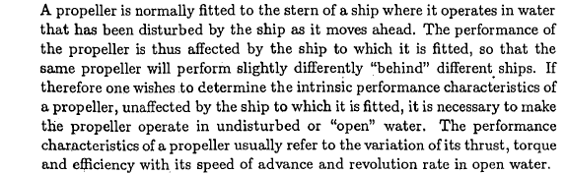

Slide 2
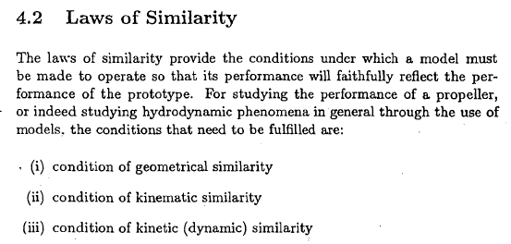

Slide 3
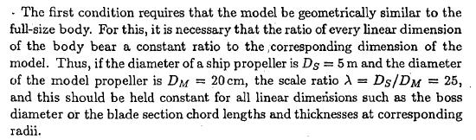
Geometrical Similarity

Slide 4
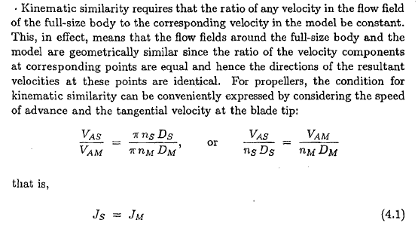
Kinematic Similarity
Advance Coefficient

Slide 5
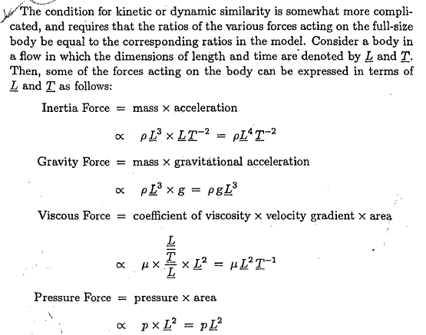
Kinetic (Dynamic) Similarity

Slide 6
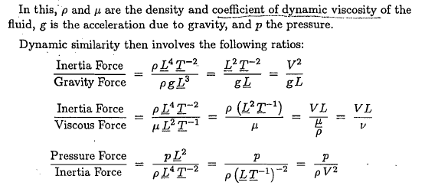

Slide 7
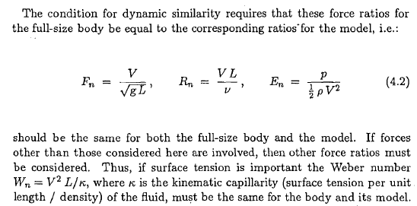
Inertia F. to gravity F.
Froude Number
Inertia F. to viscous F.
Reynolds Number
Pressure F. to Inertia F.
Pressure Coefficient
Euler Number

Slide 8
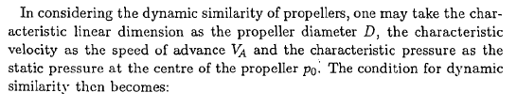
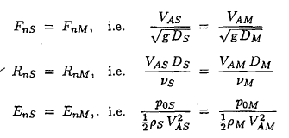
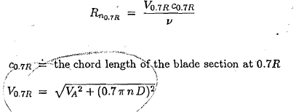
Reynolds Number of Propeller

Slide 9
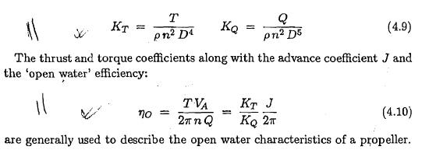
Dimensional Analysis result in Open Water Characteristics

Slide 10
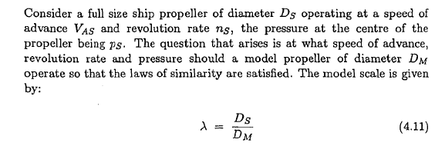

Laws of Similarity in Practice
Can we do this ??

Slide 11
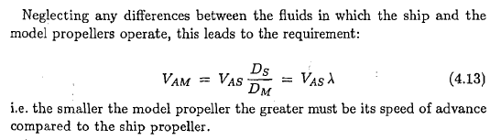
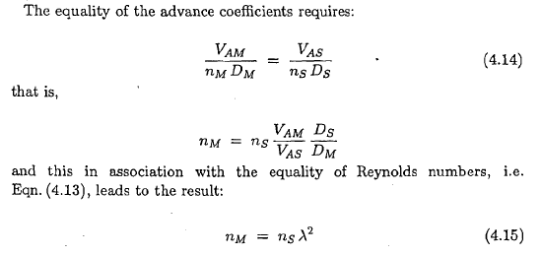
Reynolds Number Equality
Equality of Advance Coefficients

Slide 12
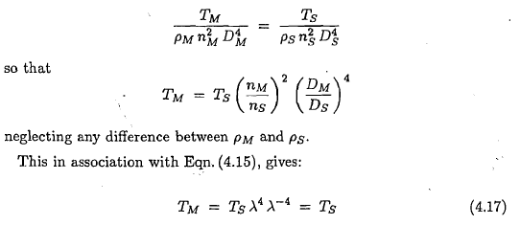
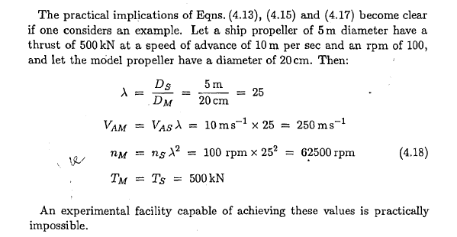
Reynolds Number & Advance Coefficient & Thrust Coefficient are Equal

Slide 13
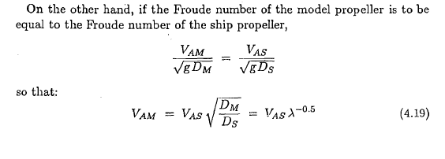
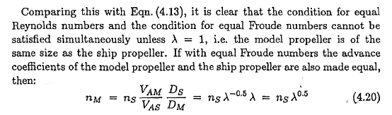
Froude Number Equality

Slide 14
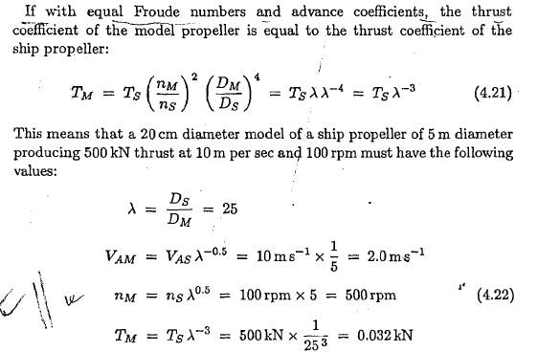
Froude Number & Advance Coefficient & Thrust Coefficient are Equal

Slide 15
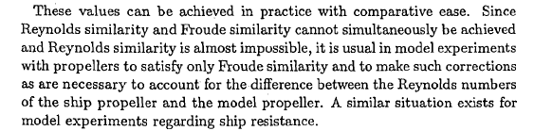
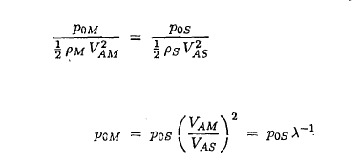

Slide 16
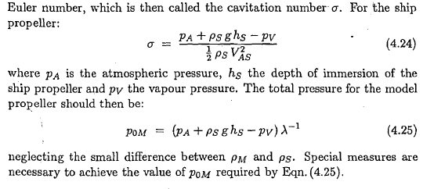

Slide 17
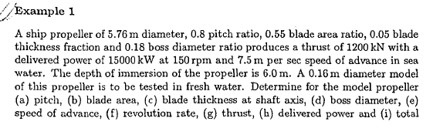


Slide 18
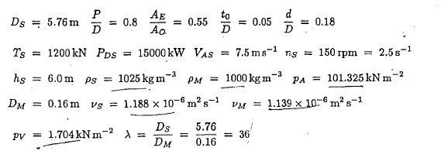

Slide 19
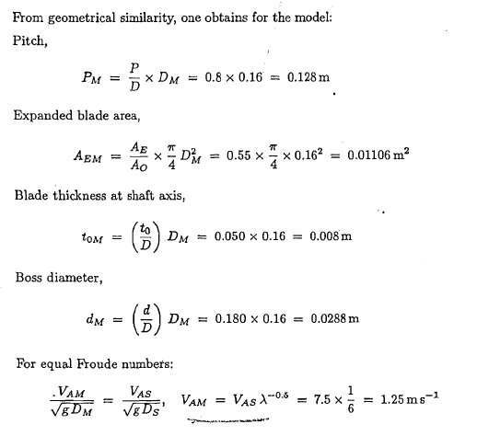
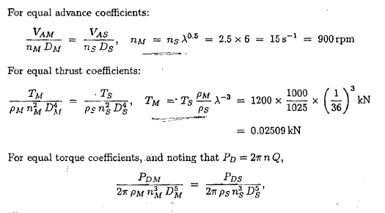

Slide 20
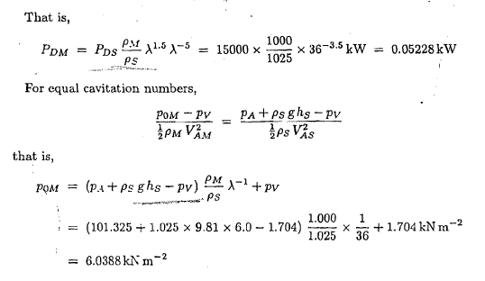
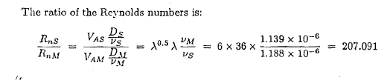

Slide 21


Very important !!!!!!!!!!

Slide 22
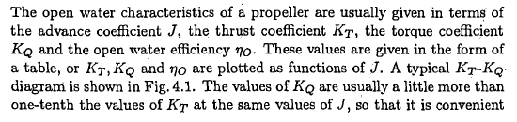
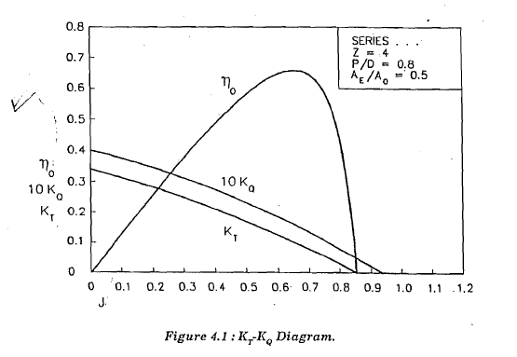
Open Water Characteristics

Slide 23
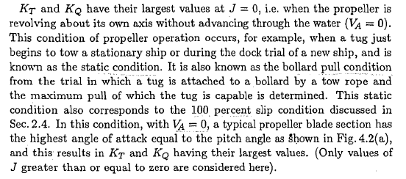

Slide 24
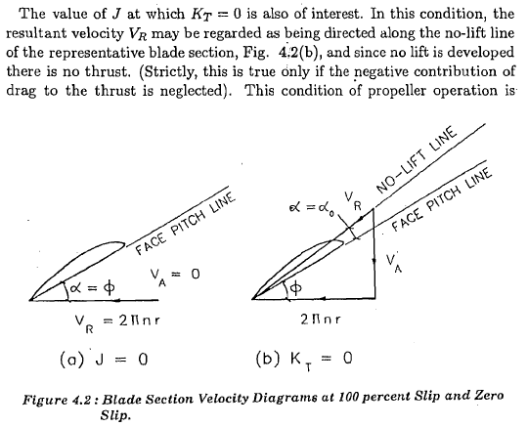

Slide 25
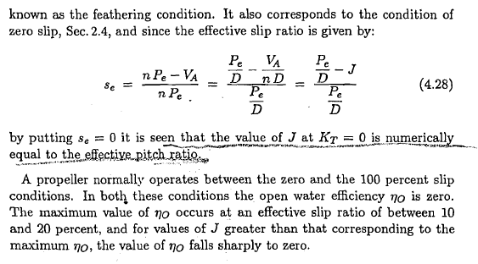
Value of J @ K_{t}=0.0 condition

Slide 26
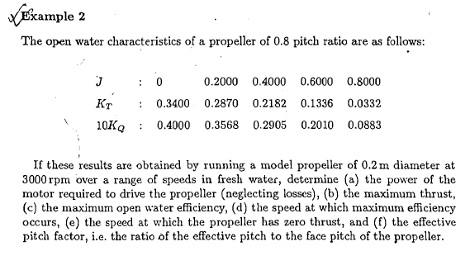

Slide 27
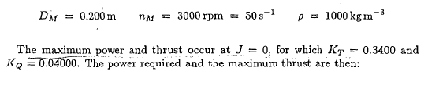
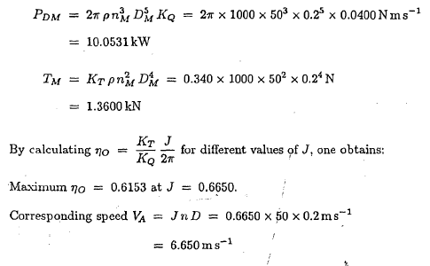
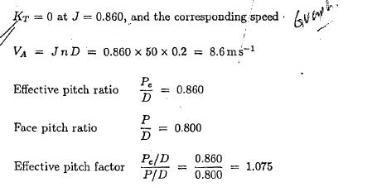

Slide 28
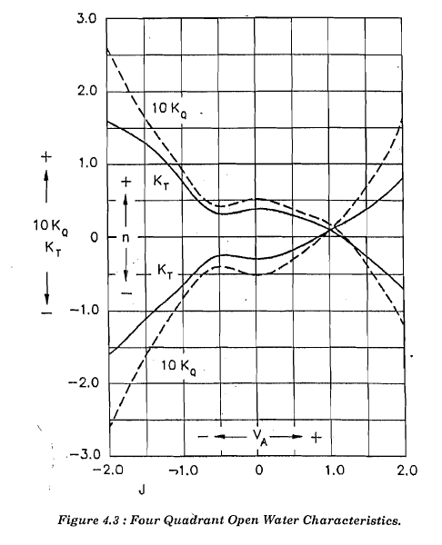
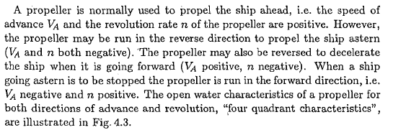

Slide 29
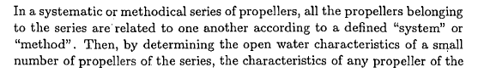
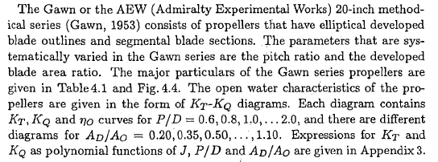
Methodical Propeller Series – Standard Series
Gawn Series

Slide 30
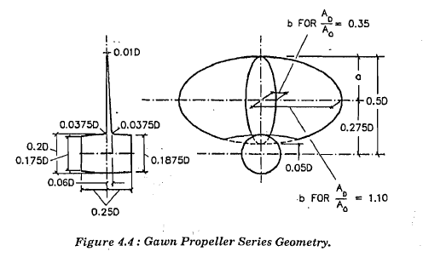
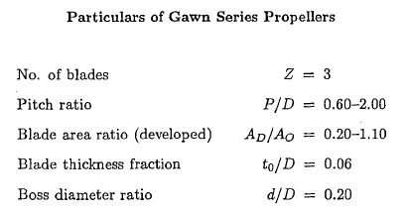
Gawn Series

Slide 31

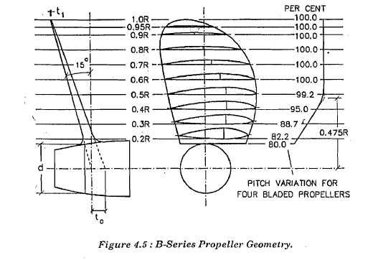
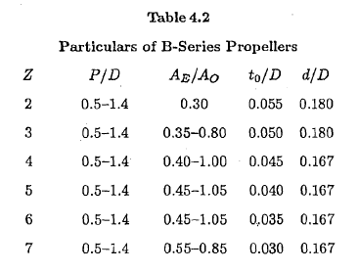
B / Wageningen / Marin / Troost / NSMB-B Series

Slide 32
Propeller Series – Wageningen B
Blades : 2-7
Pitch Ratio : 0.60~1.40 (Four bladed propeller has no constant pitch distribution)
Area Ratio : 0.30~1.05
Skew Angles : 0º>
Section Type : Original
Remark : Most widely used
propeller series.
Suitable for most application.

Slide 33
Propeller Series – Au Series
Blades : 4-7
Pitch Ratio : 0.50~1.20
Area Ratio : 0.70~0.758
Skew Angles : 0º>
Section Type : AU type
Remark : Complemantary series of Wageningen B Series

Slide 34
Propeller Series – Gawn Series
Blades : 3
Pitch Ratio : 0.40~2.00
Area Ratio : 0.20~1.100
Skew Angles : 0º>
Section Type : Circular
Remark :

Slide 35
Propeller Series – Ma Series (Lindgren Series)
Blades : 3, 5
Pitch Ratio : 1.00~1.454
Area Ratio : 0.75~1.20
Skew Angles : 0º>
Section Type : Circular

Slide 36
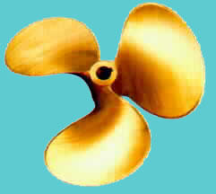

Propeller Series – KCA Series
Blades : 3,4,5
Pitch Ratio : 0.60~2.00
Area Ratio : 0.20~1.10
Skew Angles : 0º>
Section Type : Ogival
Remark : Most widely use propeller series.
Suitable for most application.

Slide 37
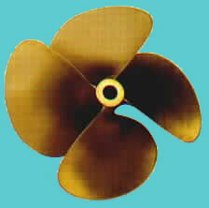
Propeller Series – Skew KCA Series
Blades : 3,4,5
Pitch Ratio : 0.60~2.00
Area Ratio : 0.50~1.10
Skew Angles : 25º , 30º , 35º
Section Type : Ogival
Remark : Modified from
standard KCA series for
smooth application.
Suitable for most application.

Slide 38
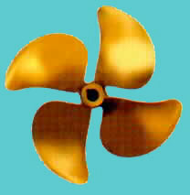

Propeller Series – NR Series
Blades : 3, 4, 5
Pitch Ratio : 1.00~2.00
Area Ratio : 0.50~1.00
Skew Angles : 25º , 30º
Section Type : Crescent
Remark : Suitable for higher
speed range in trans-cavitating
application.

Slide 39
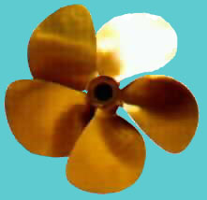

Propeller Series – NACA-Series
Blades : 4,5,6,7
Pitch Ratio : 0.80~1.60
Area Ratio : 0.50~1.40
Skew Angles : According to design
Section Type : Airfoil
Remark : Theoretical design propeller series.

Slide 40
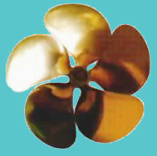
Propeller Series – New Foil Series
Blades : 3,4,5
Pitch Ration : 0.80~1.60
Area Ration : 0.50~1.40
Skew Angles : According to design
Section Type : New Foil
Remark : Theoretical design propeller series.

Slide 41


Propeller Series – Ka Series
Blades : 3, 4, 5
Pitch Ratio : 0.60~1.60
Area Ratio : 0.55~0.75
Skew Angles : 0⁰,Skew available
Section Type : Airfoil
Remark : Suitable for
accelerating nozzle
propellers and bow or stern
thrusters.

Slide 42
Propeller Selection

Slide 43
Contents
Case 1: Optimum rotation rate for a given diameter
Case 2: Optimum diameter for a given rotation rate
Case 3: Optimum propeller for given power and rate
Case 4: Maximum bollard pull
Case 5: Existing propeller
Viscous Effects – ITTC Analysis Procedure

Slide 44
Case 1: Optimum Rotation Rate for a Given Diameter
A common problem for the propeller is the design of a propeller when the required propeller thrust is known and the propeller diameter is known.
The advance velocity of a propeller can be estimated from the ship speed and the wake fraction.
The unknowns are the required power and especially the rate of rotation.
The latter is important for the choice of the engine or for the choice of the gear ratio.

Slide 45
Suppose that a four-bladed propeller is chosen. In that case the following data are known:
  The propeller thrust T =1393 kN.
  The propeller diameter D = 7 m.
  The advance velocity V_{a} = 8.65 m/s.
  The density of water ρ = 1025 kg/m³.
  The number of blades Z = 4.
Estimate the required area ratio to be 0.55. The diagram to be used is that of the B 4.55 series.
The thrust and diameter are known but the rotation rate is not.

Slide 46
This means that the parameters K_{t} and J cannot be calculated yet.
However, the parameters K_{T}/J² can be calculated because it does not contain the rotation rate:
K_{T}/J² has to be found from variation of the pitch ratio.

Slide 47
By starting with a pitch ratio of 0.8 the following search is possible
i P/D J Kt 10Kq eta0 Bp delta
---|-------|-------|--------|--------|--------|------------|----------|
31 0.800 0.595 0.1310 0.1951 0.6356 16.9452 170.3291
41 0.900 0.648 0.1557 0.2480 0.6478 15.3963 156.2336
46 0.950 0.674 0.1684 0.2777 0.6503 14.7781 150.2568
51 1.000 0.699 0.1811 0.3095 0.6512 14.2379 144.8587
61 1.100 0.747 0.2071 0.3793 0.6493 13.3371 135.4951
71 1.200 0.793 0.2333 0.4568 0.6448 12.6087 127.6514
---|-------|-------|--------|--------|--------|-----------|-----------|
WAGENINGEN B SERISI
SECILEN PERVANE = 46. PERVANEDIR
P/D=0.950
J= 0.674 Kt= 0.168 10Kq= 0.278 eta= 0.650
Bp= 14.7781 delta= 150.2568
T= 1393.00 kN Va= 8.650 m/s RHO = 1025.0 kg/m3
Z = 4. EAR = 0.550 D = 7.000 m
RPS= 1.834 dev/san RPM= 110.01 TORK=1608.316 kNm Pd=18528.5 kW

Slide 48
After running the program, the conclusion is that the optimum efficiency can be reached with a pitch ratio of 0.95.
The optimum efficiency is 0.650. The advance ratio J is 0.699 and from this the required rotation rate can be derived:
The required power to propel ship can be derived from the torque coefficient K_{Q}=0.0278. The torque is found to be
The power to be delivered to the propeller is therefore
These data can be used to find a suitable engine

Slide 49
Case 2: Optimum diameter for a given rotation rate
When the optimum rate of case 1 is chosen the question can be posed if the diameter of 7 meters was the optimum diameter.
The optimum diameter can be calculated in a similar way as the optimum rotation rate, but now the value of K_{T}/J⁴ can be calculated because the diameter is absent in the parameter

Slide 50
The optimum pitch ratio can again be found by iteration:
---|-------|-------|--------|--------|--------|------------|----------|
i P/D J Kt 10Kq eta0 Bp delta
---|-------|-------|--------|--------|--------|------------|----------|
34 0.830 0.631 0.1294 0.2001 0.6497 14.7837 160.4543
35 0.840 0.635 0.1326 0.2060 0.6506 14.7737 159.4914
36 0.850 0.639 0.1358 0.2119 0.6513 14.7657 158.5511
41 0.900 0.657 0.1519 0.2434 0.6524 14.7529 154.1675
51 1.000 0.690 0.1851 0.3148 0.6459 14.8266 146.7318
71 1.200 0.747 0.2535 0.4886 0.6166 15.1745 135.6321
81 1.300 0.771 0.2880 0.5883 0.6007 15.3752 131.3755
91 1.400 0.793 0.3225 0.6936 0.5867 15.5564 127.7158
---|-------|-------|--------|--------|--------|-----------|-----------|
WAGENINGEN B SERISI
SECILEN PERVANE = 35. PERVANEDIR
P/D=0.840
J= 0.635 Kt= 0.133 10Kq= 0.206 eta= 0.651
Bp= 14.7737 delta= 159.4914
T= 1393.00 kN Va= 8.650 m/s RHO = 1025.0 kg/m3
Z = 4. EAR = 0.550 D = 7.431 m
RPS= 1.833 dev/san RPM= 110.00 TORK=1607.891 kNm Pd=18521.6 kW

Slide 51
The optimum efficiency remains almost the same 0.65, but the pitch ratio is different.
The diameter corresponding to the design is found from the advance ratio J=0.635:
As a result of this optimization at a given rotation rate the diameter will always increase.

Slide 52
Case 3: Optimum propeller for given power and rate
It is quite common to start the design from the available engine power.
In that case the engine will develop a certain power at a given rotation rate.
The ship speed is assumed to be known.

Slide 53
Assume the following data are known for a fast petrol boat:
  Power P_{D} = 440 kW
  Advance velocity V_{a}=14.42 m/sec (28 knots)
  Rotation rate RPM = 720 (12 Hz or RPS)
  Blade number Z=5
  Blade area ratio EAR=0.75.
The parameter to be used in this case is K_{Q}/J⁵ since in this parameter the power and the rotation rate are present and the diameter is eliminated.

Slide 54
The value of this parameter in the example is
In the program the optimum pitch ratio is found from an iteration
---|-------|-------|--------|--------|--------|------------|-----------|
i P/D J Kt 10Kq eta0 Bp delta
---|-------|-------|--------|--------|--------|------------|-----------|
51 1.000 0.965 0.0506 0.1322 0.5879 4.1538 104.9130
71 1.200 1.085 0.0980 0.2369 0.7144 4.1538 93.3631
81 1.300 1.141 0.1237 0.3046 0.7373 4.1538 88.7839
86 1.350 1.167 0.1371 0.3422 0.7445 4.1538 86.7411
87 1.360 1.173 0.1398 0.3500 0.7458 4.1538 86.3510
88 1.370 1.178 0.1426 0.3579 0.7470 4.1538 85.9669
89 1.380 1.183 0.1454 0.3659 0.7482 4.1538 85.5887
90 1.390 1.188 0.1481 0.3739 0.7493 4.1538 85.2163
91 1.400 1.193 0.1509 0.3821 0.7505 4.1538 84.8499
---|-------|-------|--------|--------|--------|------------|-----------|
WAGENINGEN B SERISI
SECILEN PERVANE = 91. PERVANEDIR
P/D=1.400
J= 1.193 Kt= 0.151 10Kq= 0.382 eta= 0.750
Bp= 4.1538 delta= 84.8499
T= 22.90 kN Va= 14.420 m/s RHO = 1025.0 kg/m3
Z = 5. EAR = 0.750 D = 1.007 m
RPS= 12.000 dev/san RPM= 720.00 TORK= 5.836 kNm Pd= 440.0 kW

Slide 55
In this case the limit in pitch ratio is the optimum value.
It is not advisable to extrapolate outside the bounds of the diagrams, so the pitch ratio of 1.4 should be used.
In this case the diameter can again be found from the J value J=1.193:
A diameter of 1 meter should be used.
This efficiency is high because the propeller loading is extremely low.
In this case the speed was prescribed.
In practice, a resistance curve is known, from which the required thrust as a function of speed can be derived.
In the above example the delivered thrust can be found from the thrust coefficient K_{T}=0.153.

Slide 56
When the delivered thrust is not in accordance with the ship resistance the same calculation should be carried out for a different speed.
The actual speed will the be found from an interpolation between the resistance curve and the curve of delivered thrust.
It can be checked if the blade area ratio is not too small from this diameter.
Assume the shaft immersion to be 1 meter. From Keller’s formula the minimum blade area ratio is found to be
The chosen blade area ratio of 0.75 therefore is too large.

Slide 57
Case 4: Maximum bollard pull
Consider a tug with an engine which delivers 800kW at 180 RPM.
The propeller is directly coupled, so the rotation rate of the engine is that of the propeller.
What is the maximum bollard pull which can be obtained?

Slide 58
Again the blade area ratio and the number of blades should be chosen first.
Take a 4-bladed propeller with a EAR=1.
In the Bollard pull condition the parameter K_{Q}/J⁵ is useless because at J=0 it become infinity.
In this case the diameter is directly varied.
It is unavoidable to calculate K_{Q} value at every diameter which is tried.

Slide 59
The following table can be obtained:
The value of pitch ratio is found from the B4-100 diagrams by iterating P/D at J=0 until the required torque coefficient is reached.
---|-------|--------|-------|--------|---------|
i D 10Kq P/D Kt T
---|-------|--------|-------|--------|---------|
1 2.000 1.4374 1.369 0.7166 105767.
2 2.500 0.4711 0.800 0.3759 135464.
3 3.000 0.1887 0.519 0.1977 147727.
---|-------|--------|-------|--------|---------|
WAGENINGEN B SERISI
SECILEN PERVANE =
P/D=0.800 Kt= 0.376 10Kq= 0.471
RPS= 3.000 RPM=180.000 T= 135.464 kN D= 2.500 m
Z= 4 EAR=1.000
RHO = 1025.0 kg/m3
TORK= 42.440 kNm Pd= 800.0 kW

Slide 60
Some typical guidelines are:
Good bollard performance is often found with propeller at about P/D=0.6
Typical speed is 3-4 knots for continuous towing, and 9-12 knots at free-run (case 1).
Efficient bollard operation should produce about 130 N of thrust per engine brake horse power.
Use equilibrium-torque towing analysis to provide achievable thrust at bollard.

Slide 61
Case 5: Existing propeller
If a propeller and operating conditions exist the program calculates the performance of the propeller behind ship condition including viscous scale effects.
In the extrapolation to full scale case, the method of ITTC 78 is used.

Slide 62
The sample output for this case is:
---|-------|--------|---------|--------|------------|------------|
i J Kt 10Kq eta0 Bp delta
---|-------|--------|---------|--------|------------|------------|
1 0.050 0.4402 0.6610 0.0530 15207.6494 2025.3160
2 0.100 0.4250 0.6413 0.1055 2648.1819 1012.6580
3 0.150 0.4088 0.6203 0.1573 945.1010 675.1053
4 0.200 0.3915 0.5979 0.2084 452.0052 506.3290
5 0.250 0.3733 0.5742 0.2587 253.5594 405.0632
6 0.300 0.3543 0.5492 0.3080 157.2072 337.5526
7 0.350 0.3344 0.5231 0.3562 104.3533 289.3308
8 0.400 0.3138 0.4958 0.4030 72.7588 253.1645
9 0.450 0.2925 0.4674 0.4483 52.6262 225.0351
10 0.500 0.2706 0.4380 0.4917 39.1471 202.5316
11 0.550 0.2481 0.4076 0.5329 29.7587 184.1196
12 0.600 0.2251 0.3763 0.5713 23.0043 168.7763
13 0.650 0.2017 0.3442 0.6062 18.0107 155.7935
14 0.700 0.1779 0.3113 0.6366 14.2314 144.6654
15 0.750 0.1537 0.2777 0.6609 11.3112 135.0210
16 0.800 0.1293 0.2434 0.6766 9.0114 126.5822
17 0.850 0.1047 0.2084 0.6796 7.1668 119.1362
18 0.900 0.0799 0.1729 0.6622 5.6589 112.5175
19 0.950 0.0551 0.1369 0.6084 4.3991 106.5956
20 1.000 0.0302 0.1005 0.4789 3.3153 101.2658
21 1.050 0.0054 0.0637 0.1424 2.3363 96.4436
---|-------|--------|---------|--------|------------|------------|
WAGENINGEN B SERISI
T= 38637.82 kN Va= 6.680 m/s RHO = 1025.0 kg/m3
Z = 4. EAR = 0.700 D = 3.500 m
P/D=1.000
J= 0.939 Kt= 0.061 10Kq= 0.145 eta= 0.625
Bp= 4.6636 delta= 107.8797
RPS= 2.033 dev/san RPM= 122.00 TORK= 32.311 kNm Pd= 412.8 kW
TAM OLCEGE EKTRAPOLASYONDA
ITTC78 VISKOZ DUZELTME YONTEMI KULLANILMISTIR

Slide 63
Viscous Effects – ITTC Analysis Procedure
Model propeller size : 24 cm
Model and full scale drag coefficients
Rn_{0.75R} must not be lower
2×10⁵ during open water tests

Slide 64
Calculation of propeller characteristics:
Full-scale propeller characteristics:
Since C_{DM} in general is larger than C_{DS} , the full-scale K_{Q} at given advance ratio is lower and K_{T} is slightly higher than in the model case

