Slide 1
Propeller Design

Slide 2
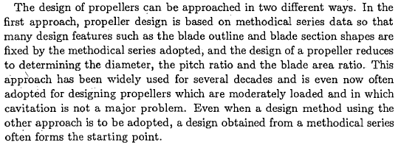

Slide 4
General Considerations in Propeller Design-1
Propeller Rpm:
Determined by the propulsion plant.
Resonance risk with the natural frequencies of vibration of the hull and shafting system
High rpm may increase propeller cavitation risk
Low rpm results in large propeller diameter (high effiecency)
Number of blades:
The larger number of blades the smaller is the exciting force per blade.
The smaller number of blades the greater is the opt,mum propeller diameter (higher efficiency but heavier propeller)
Pitch ratio:
Governs the power that it will absorb in given operating conditions
Blade area ratio:
Considerations of cavitation.
Propeller Diameter:
Clearances are important

Slide 5
General Considerations in Propeller Design-2
Aft Rake:
Increase the clearances between the hull and the propeller tips and leading edges.
Results in higher efficiency
But causes an increase in the bending moment due to the centrifugal forces since requiring thicker blades (lower efficiency)
Slow running propellers may have a rake aft up to 15 degrees, but in high rpms aft rake is best avoided
Skewback:
Results in a lower magnitude of unstready forces generated by the propeller in circumferentially varying wake.
Heavily skewed blades have low backing efficiencies, are difficult to manufacture and require special strength considerations.
The radial distribution of loading:
The variation of circulation with Radius upon which the radial distribution of thrust.
İs normally made optimum for the given average wake at each Radius.
May be decrease towards the blade tips to reduce cavitation, blade stress and propeller induced hull vibration.

Slide 6
General Considerations in Propeller Design-3
The shape of expanded blade outline:
İs chosen in accordance with the radial load distribution.
The higher the load the greater the blade width (limit the cavitation)
Narrow blade tips result in increase in propeller efficiency but also a greater risk of harmful cavitation.
Blade Sections:
Naca16, Naca66 sections with a=0.8 and a=1.0 mean lines are used.

Slide 7
The Propeller Design using Methodical Series Data
May be used to design both free running and towing duty propellers
The MARIN-B Series is widely used for propeller design because it has excellent performance characteristics, particularly for moderate loadings.
For heavily loaded propellers used in high speed case, the Gawn Series may be preferred. (segmental blade sections, less cavitation risk)

Slide 9
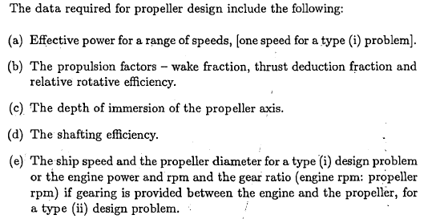

Slide 11
The Output will be
HESAPLARDA WAGENINGEN B SERISI KULLANILMISTIR
SECILEN PERVANE = 50. PERVANEDIR
P/D= .990
J= .791 Kt= .144 10Kq= .266 eta= .683
Bp= 9.6915 delta= 128.0115
T= 484.29 kN Va= 8.230 m/s RHO = 1025.0 kg/m3
Z = 5. EAR = .550 D = 5.500 m
Vtip= 32.69 m/s
RPS= 1.892 dev/san RPM= 113.50 TORK= 491.217 kNm Pd= 5838.4 kW
TAM OLCEGE EKSTRAPOLASYONDA
VISKOZ DUZELTME YAPILMAMISTIR
Therefore Option 1 can ve used in Program ‘Propcalc’
Data line

Slide 12
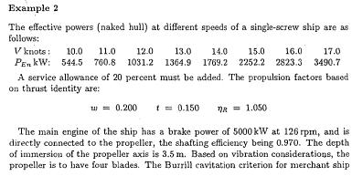
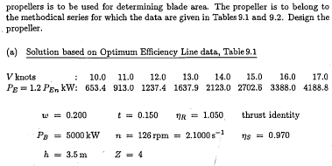

Slide 13
The design will be carried on 16 knots of speed. Therefore Option 2 can be used
Pervane Karakteristikleri - Kt/J^4 = 1.109
---|-------|-------|--------|--------|--------|------------|----------|
i P/D J Kt 10Kq eta0 Bp delta
---|-------|-------|--------|--------|--------|------------|----------|
1 .500 .456 .0481 .0757 .4607 20.4646 221.9395
32 .810 .593 .1367 .2035 .6336 17.4500 170.8904
33 .820 .596 .1400 .2094 .6341 17.4429 169.8783
34 .830 .600 .1433 .2155 .6345 17.4380 168.8901
91 1.400 .745 .3419 .7281 .5569 18.6132 135.8922
---|-------|-------|--------|--------|--------|----- ------|-----------|
HESAPLARDA WAGENINGEN B SERISI KULLANILMISTIR
SECILEN PERVANE = 33. PERVANEDIR
P/D= .820
J= .596 Kt= .140 10Kq= .209 eta= .634
Bp= 17.4429 delta= 169.8783
T= 484.22 kN Va= 6.584 m/s RHO = 1025.0 kg/m3
Z = 4. EAR = .550 D = 5.260 m
RPS= 2.100 dev/san RPM= 126.00 TORK= 381.024 kNm Pd= 5027.5 kW
TAM OLCEGE EKSTRAPOLASYONDA
VISKOZ DUZELTME YAPILMAMISTIR

Slide 14
CAVITATION CHECK ACCORDING TO SUGGESTIONS UPPER LIMITS OF THE BURRIL’S MERCHANT SHIPS
Since AE/A0=0.482 is less than the value 0.55, cavitation is OK.
Actually the EAR should be reduced to that value and whole calculation is repeated.

Slide 15
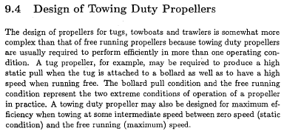
Multi-speed gearbox can be used
CPP can be used

Slide 16
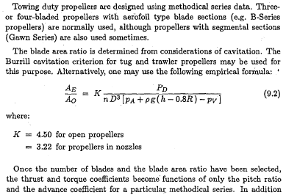

Slide 17
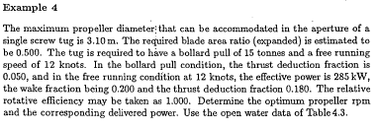
The following output is obtained
Pervane Karakteristikleri - Kt/J^2 = 0.234
i P/D J Kt 10Kq eta0 Bp delta
---|-------|-------|--------|--------|--------|------------|---------|
1 0.500 0.460 0.0495 0.0768 0.4716 20.1862 220.1225
11 0.600 0.530 0.0658 0.0996 0.5575 16.0997 190.8884
90 1.390 0.995 0.2315 0.5230 0.7013 7.6505 101.7378
91 1.400 1.000 0.2339 0.5305 0.7018 7.6101 101.2312
---|-------|-------|--------|--------|--------|----- ------|-----------|
HESAPLARDA WAGENINGEN B SERISI KULLANILMISTIR
SECILEN PERVANE = 90. PERVANEDIR
P/D=1.390
J= 0.995 Kt= 0.232 10Kq= 0.523 eta= 0.701
Bp= 7.6505 delta= 101.7378
T= 56.13 kN Va= 4.938 m/s RHO = 1025.0 kg/m3
Z = 4. EAR = 0.500 D = 3.100 m
Vtip= 15.59 m/s
RPS= 1.600 dev/san RPM= 96.02 TORK= 39.303 kNm Pd= 395.2 kW
TAM OLCEGE EKSTRAPOLASYONDA
VISKOZ DUZELTME YAPILMAMISTIR
The pitch ratio P/D=1.39 is impossible for the Bollard Pull Condition due to the cavitation risk. Instead of this P/D=0.51 is used.
Therefore the program can be run for the first option to determine optimum RPM for D=3.1 m diameter with the data

Slide 18
Therefore the program can be run for the Bollard Pull option to satisfy 15 tons of Static Bollard Pull for D=3.1 m diameter with the following data
As a result 880kW@180RPM engine data with the propeller D=3.1 m in diameter and P/D=0.6 pitch ratio is enough for satisfying both free running and bollard conditions at the same time.
The program is runned again with the following data
Therefore one obtain the following output which contains «error»
Pervane Karakteristikleri
---|-------|--------|-------|--------|---------|
i D(m) 10Kq P/D Kt T(N)
---|-------|--------|-------|--------|---------|
Yaricap D= 3.100 m
Kq=0.0105 ICIN P/D HESABI MEVCUT PERVANE ICIN MUMKUN DEGIL
874.2 < DHP= 521.0 kW< 5321.0
araliginda olmalidir. Datayi buna gore duzenleyin
Pervane Karakteristikleri
---|-------|--------|---------|--------|------------|------------|
i J Kt 10Kq eta0 Bp delta
---|-------|--------|---------|--------|------------|------------|
1 0.050 0.2329 0.2262 0.0819 8896.8486 2025.3160
3 0.100 0.2194 0.2162 0.1615 1537.6758 1012.6580
7 0.200 0.1894 0.1943 0.3102 257.6870 506.3289
11 0.300 0.1556 0.1695 0.4383 87.3437 337.5526
15 0.400 0.1186 0.1415 0.5333 38.8759 253.1645
19 0.500 0.0785 0.1100 0.5681 19.6169 202.5316
23 0.600 0.0359 0.0745 0.4595 10.2379 168.7763
26 0.675 0.0024 0.0452 0.0568 5.9394 150.0234
---|-------|--------|---------|--------|------------|------------|
HESAPLARDA WAGENINGEN B SERISI KULLANILMISTIR
Z = 4 EAR = 0.500 P/D = 0.600
TAM OLCEGE EKSTRAPOLASYONDA
VISKOZ DUZELTME YAPILMAMISTIR
Therefore the second trial is carried on 880 kW engine power and 180 RPM rotation rate with the following data
Pervane Karakteristikleri
---|-------|--------|-------|--------|---------|
i D(m) 10Kq P/D Kt T(N)
---|-------|--------|-------|--------|---------|
1 3.100 0.1767 0.502 0.2020 172133.
2 3.100 0.1767 0.502 0.2020 172133.
3 3.100 0.1767 0.502 0.2020 172133.
---|-------|--------|-------|--------|---------|
17.5 tons of Bollard Performance is obtained for P/D=0.502 pitch ratio (17.5=172133/(1000*9.81))

Slide 19
As a result 2.61*60=157 RPM rotation rate yields to 15 tons of Bollard Pull with 753 kW engine power.

