Slide 1
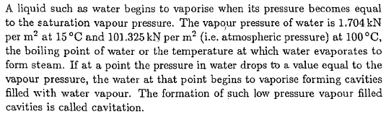
Propeller Cavitation
The Phenomenon of Cavitation

Slide 2
Cavitation is a general fluid mechanics phenomenon which can occur whenever a liquid used in a machine which induces pressure and velocity fluctuations in the fluid (e.g. Pumps, turbines, propellers, bearings,..)
When cavitation occurs the liquid changes its phase into vapor at certain flow region where local pressure is very low due to the high local velocities
There are two types of vaporization: Vaporization by increasing temperature (boiling)
Vaporization under nearly constant temperature due to reduced pressure (i.e. cold boiling)
The cold boiling process and hence cavitation depends on the purity of water.
If water contains a significant amount of dissolved air, hence as the pressure decreases the air comes out of the solution and forms cavities in which the pressure will be greater then the “vapor pressure”.

Slide 3
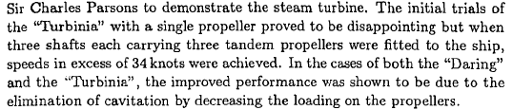
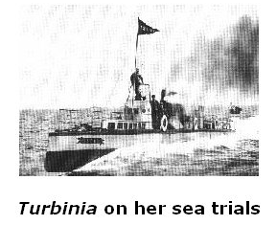
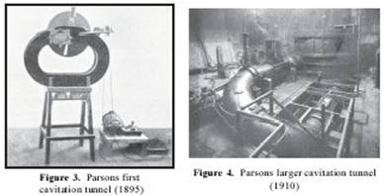
This small tunnel is still kept in working order at the Marine Technology Dept. of Newcastle Univ.
Parsons also constructed a larger tunnel 15 years later in which he could test 12” diameter propeller model

Slide 4
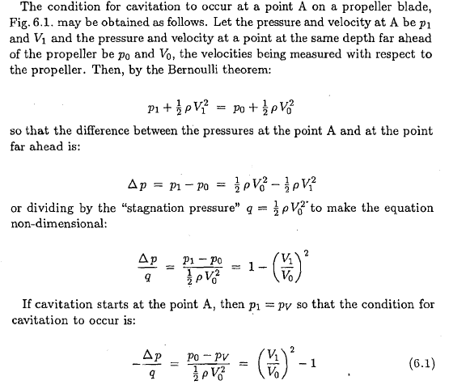
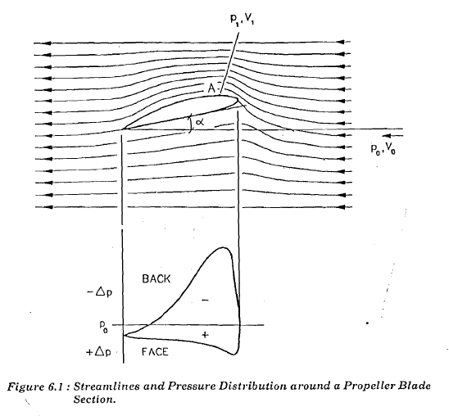

Slide 5
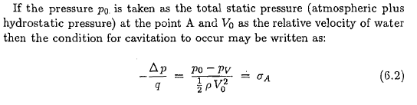
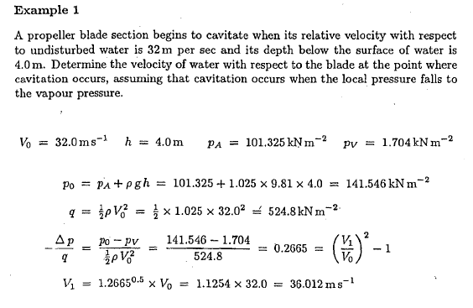
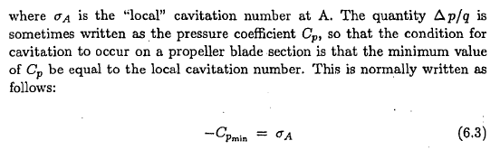

Slide 6
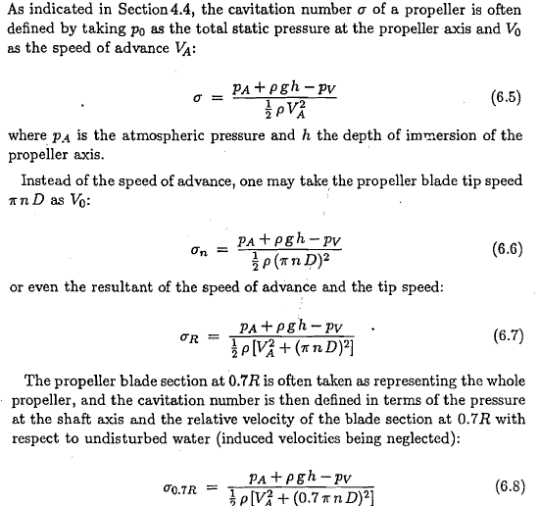
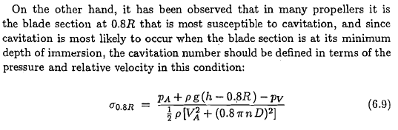
Cavitation Number

Slide 7
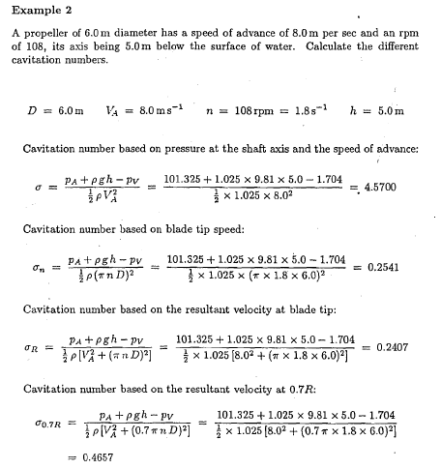

Slide 8
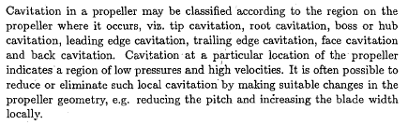
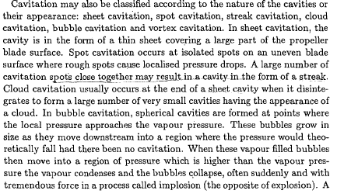
Types of Cavitation

Slide 9
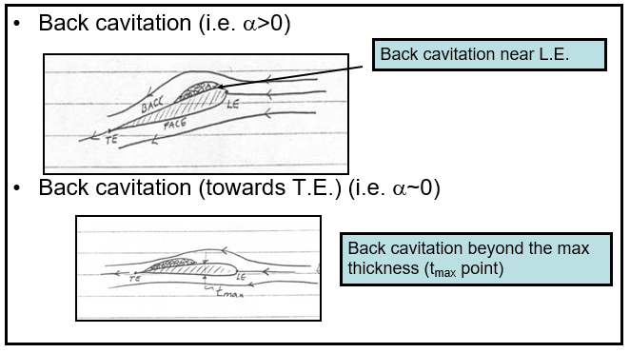
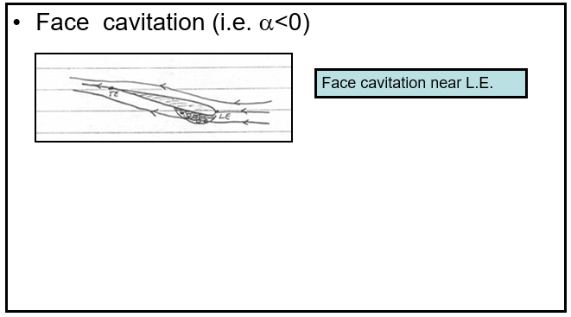
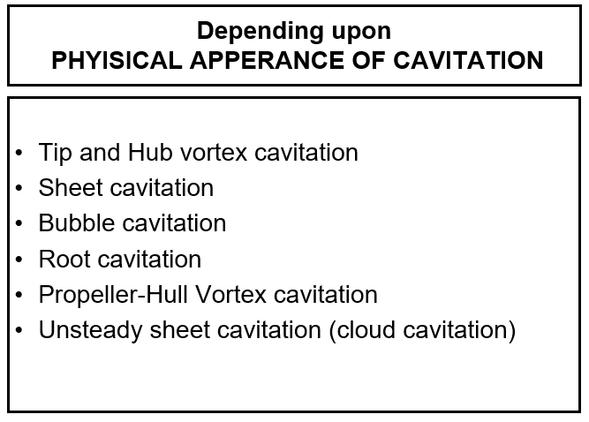
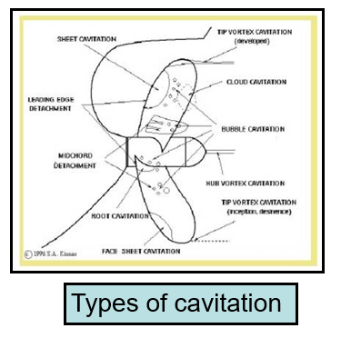

Slide 10
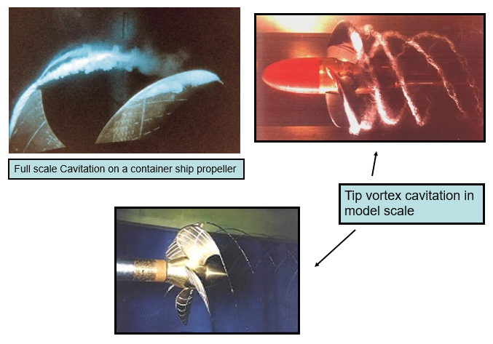

Slide 11
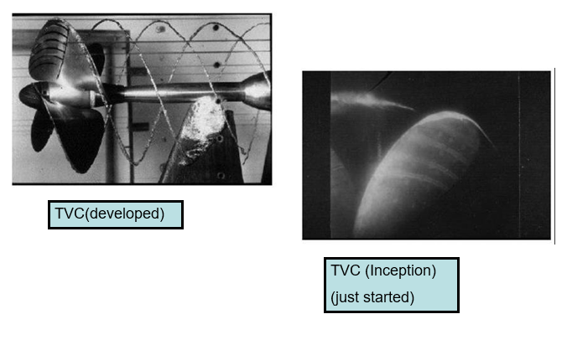

Slide 12
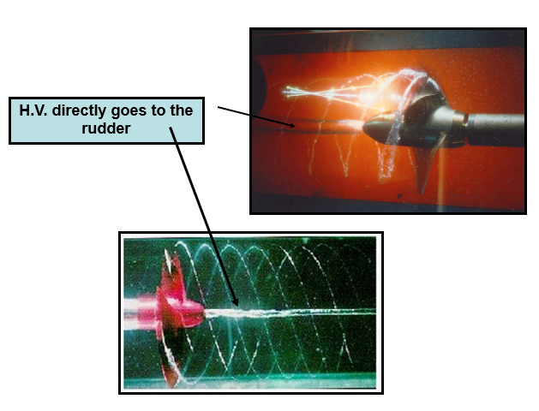
Hub Vortex Cavitation

Slide 13
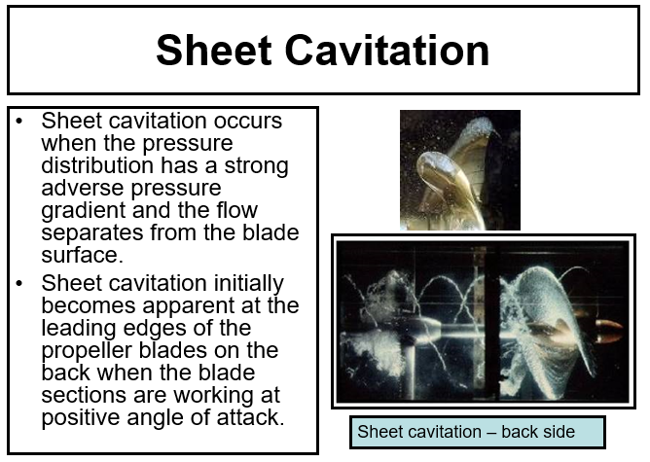

Slide 14
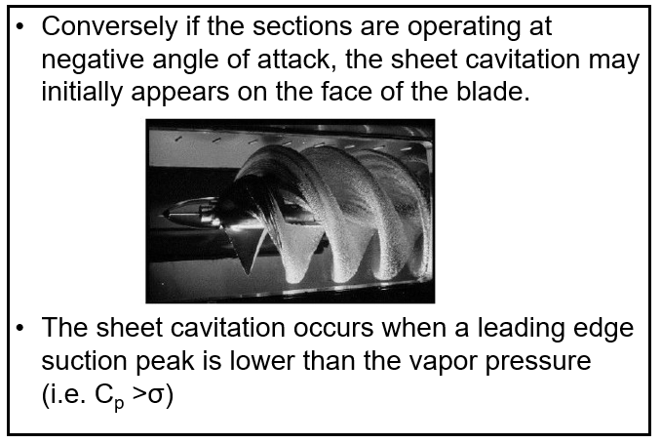
Face Cavitation

Slide 15
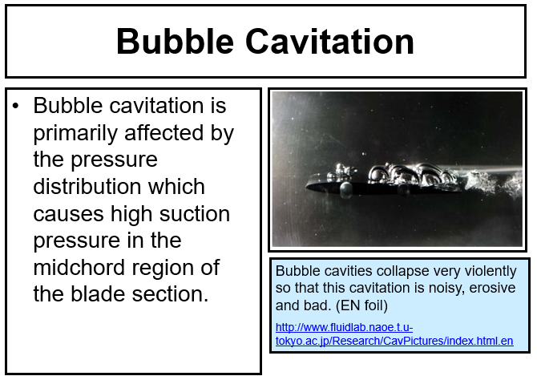
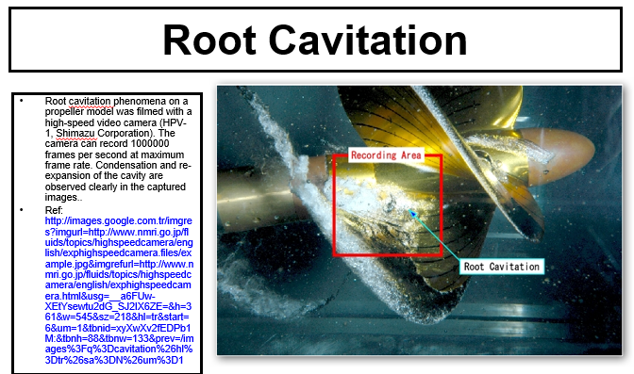
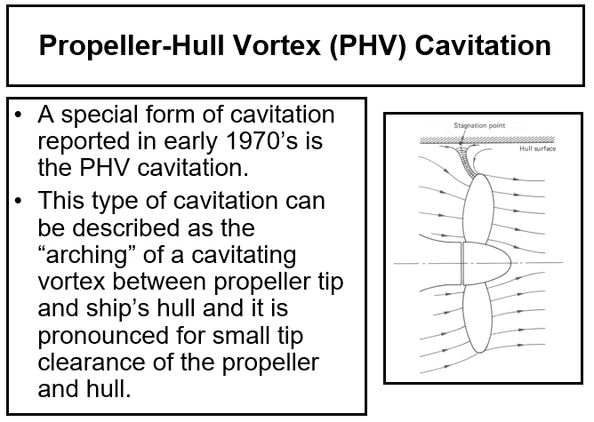
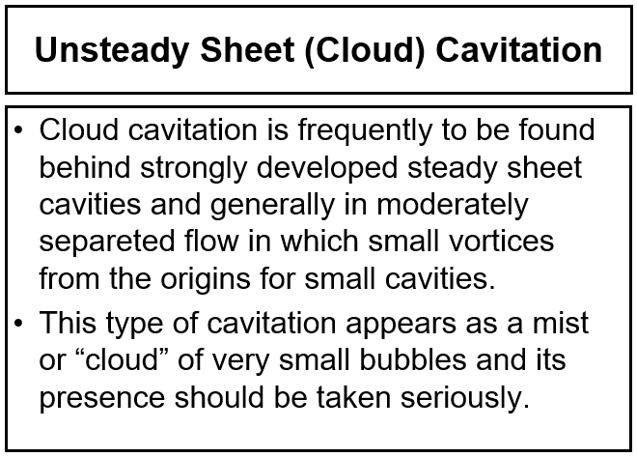

Slide 16
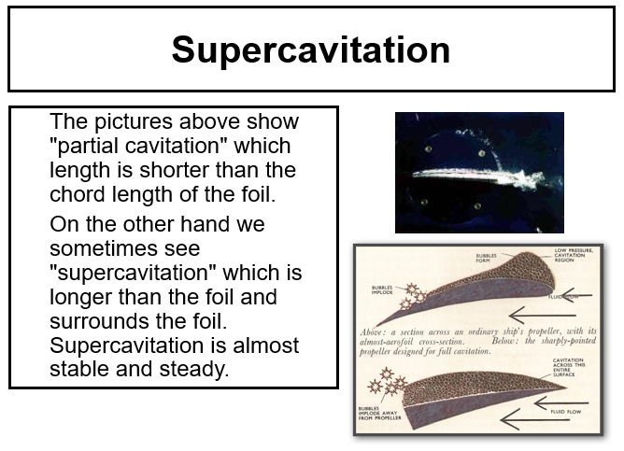

Slide 17
Effects of Cavitation on Propellers
Cavitation phenomenon can happen any part of a ship hull where the local pressures are very low.
The propeller itself is the greater source of cavitation.
When cavitation occurs depending upon its extend and severity, the propeller may suffer from
  Performance breakdown
  Noise , Vibration , Erosion

Slide 18
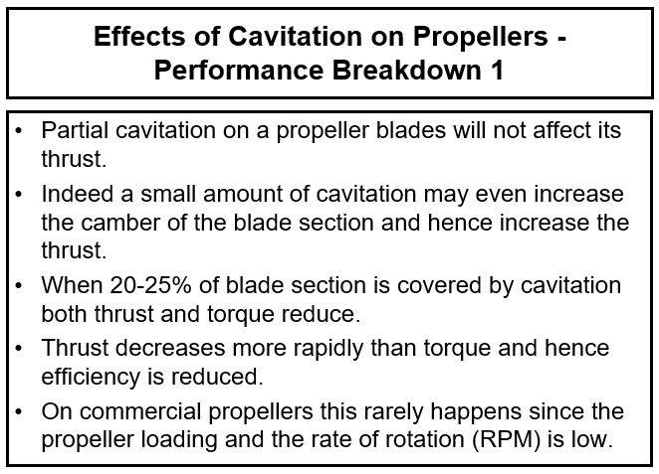
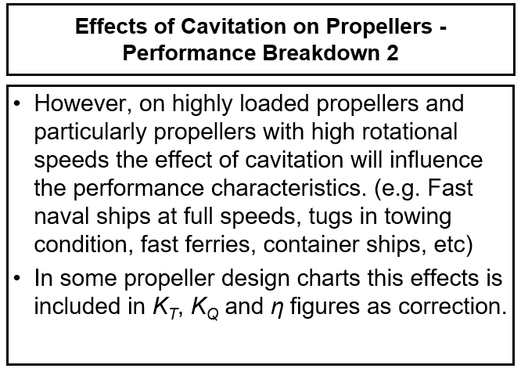
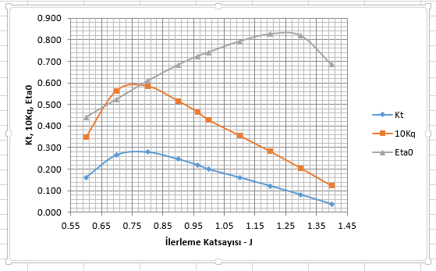
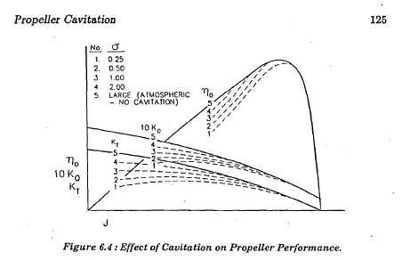

Slide 19
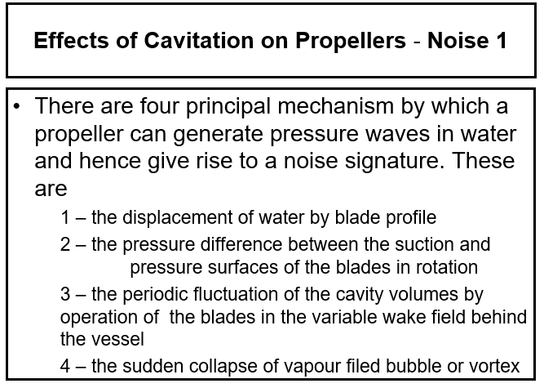
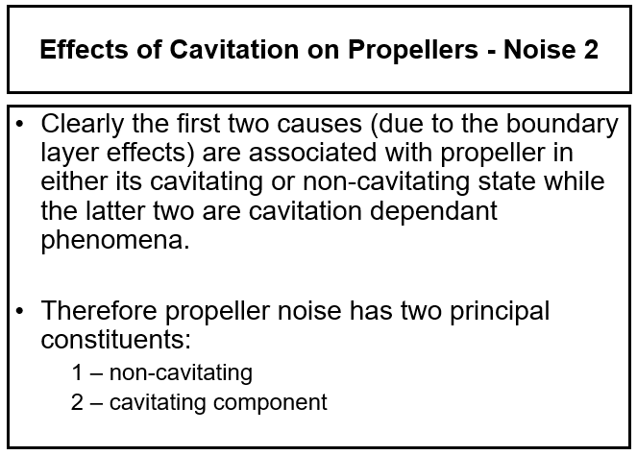

Slide 20
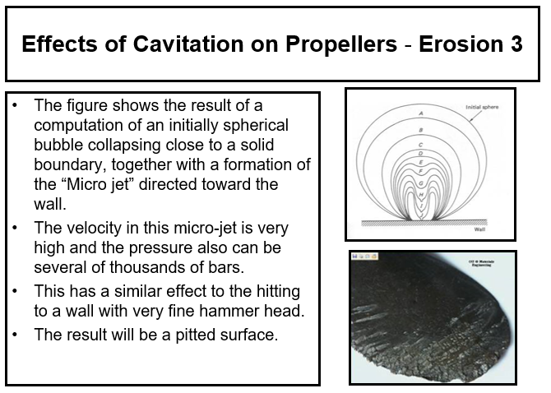
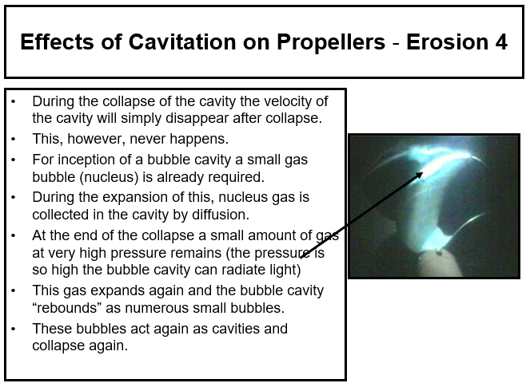

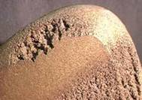

Slide 21
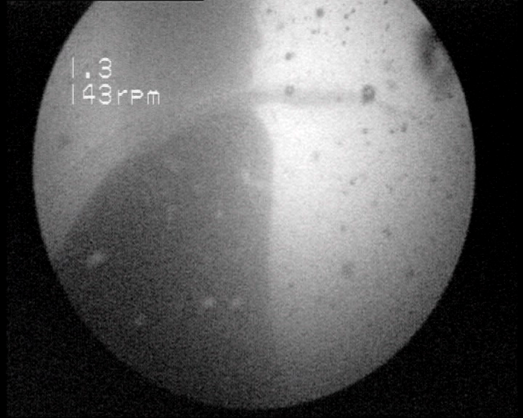
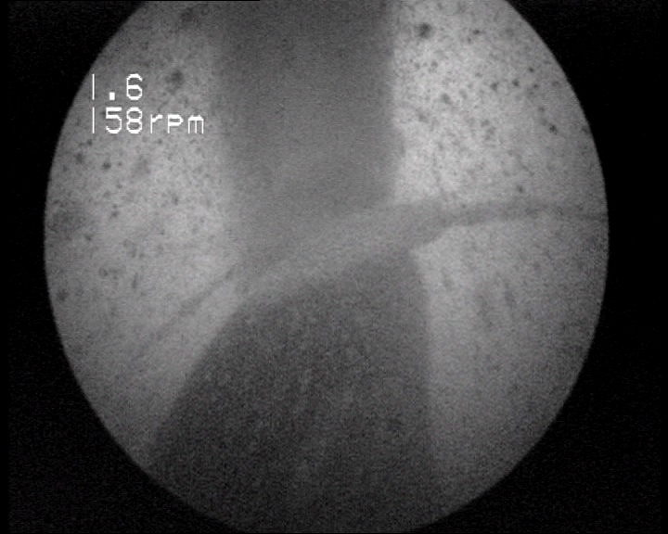
Examples of Full Scale Cavitation

Slide 22
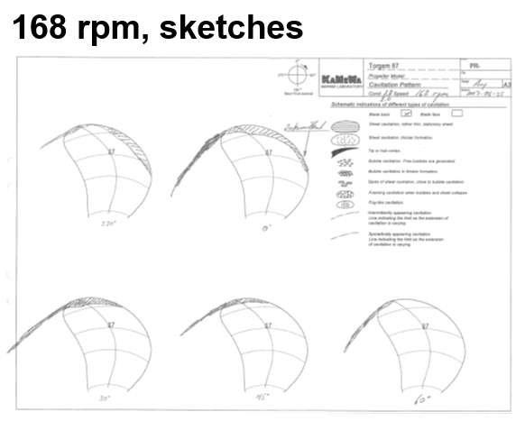
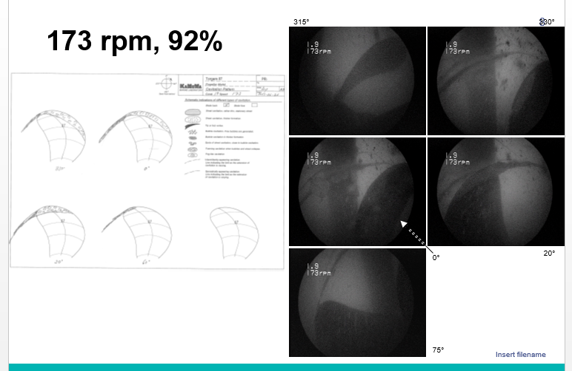
Cavitation Reporting

Slide 23
Cavitation Calculation

Slide 24
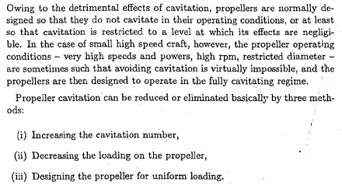
Preventation of Cavitation

Slide 25
Preventation of Cavitation

Slide 26
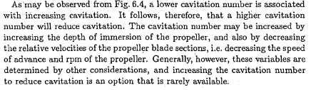


Slide 27
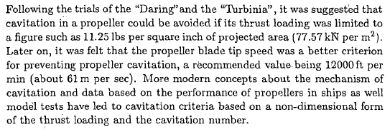
Cavitation Criteria
T/A_{p}=77.57 kPa (11.25 lbf/in²)
Tip Speed=61 m/s (=πnD)

Slide 28
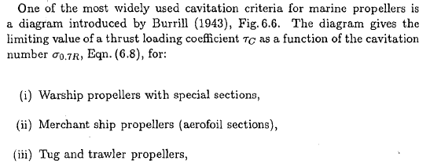
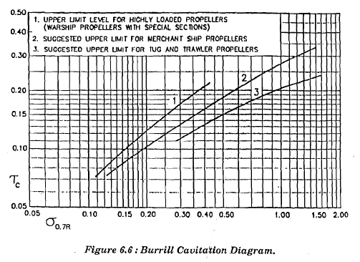
Burrill and Keller Criteron

Slide 29
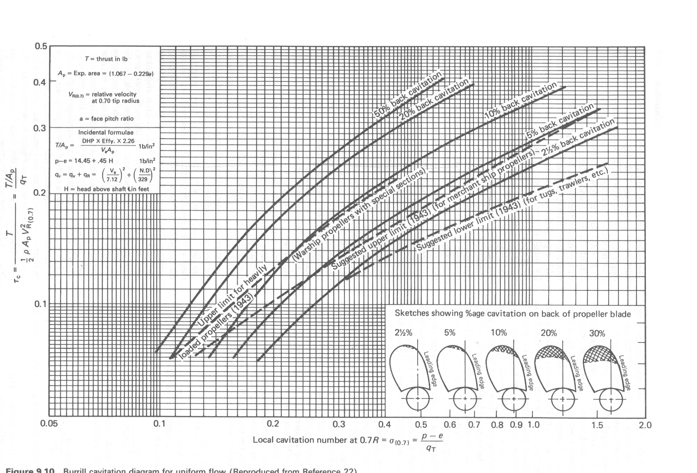
Permissible level of back cavitation

Slide 30
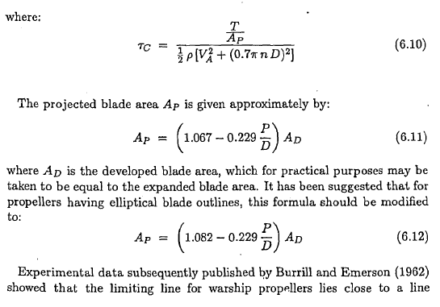

Slide 31
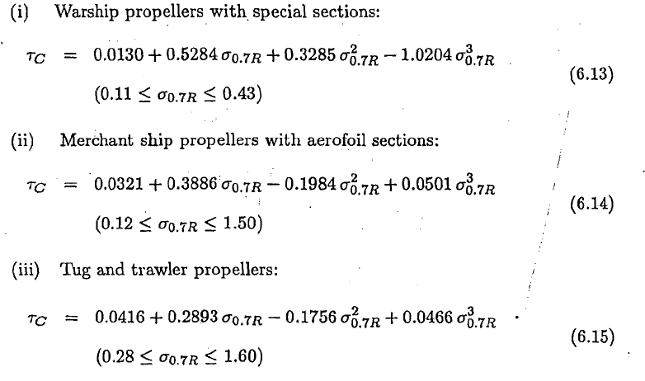

Slide 32
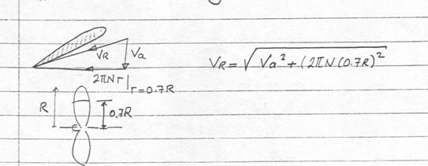

Slide 33


Slide 34
In using Burrill’s diagram from the value of τ_{c} read off from the diagram the projected area for the propeller can be calculated from the following;
To derive the expanded area from the projected area, Burrill provides the emprical realtionship which is valid for conventional propeller forms only;
Expanded blade area ratio - EAR

Slide 35
KELLER’s Criteria
The alternative blade area estimation is the Keller Formula
Where
  P₀ is the static pressure at the shaft Center Line in Pa
  P_{V} is the vapor pressure in Pa (~1700 N/m²)
  T is the propeller thrust (N)
  Z is the blade number
  D is the propeller diameter in meters

Slide 36



Slide 37



