Slide 1
3-Model-Ship Extrapolation
4.1 Practical Scaling Methods
When predicting ship power by the use of model tests, the resistance test results have to be scaled, or extrapolated, from model to ship.
There are two main methods of extrapolation, one due to Froude which was introduced in the 1870s
The other due to Hughes introduced in the 1950s and later adopted by the International Towing Tank Conference (ITTC).

Slide 2
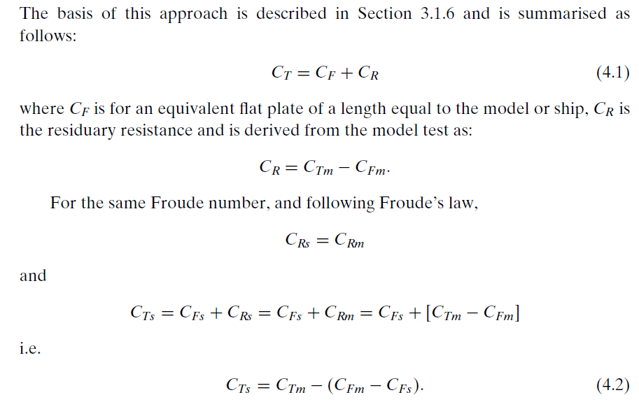
Traditional Approach: Froude

Slide 3
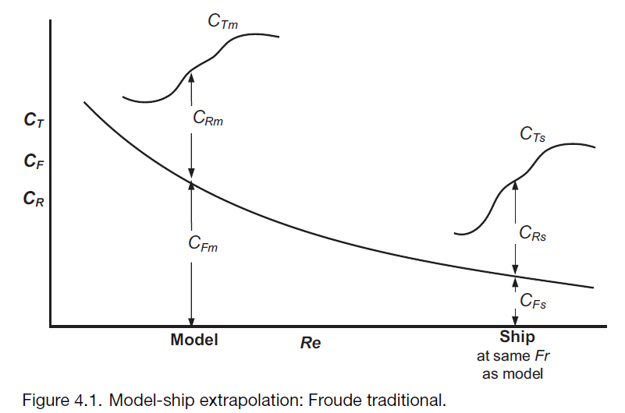
.
Problem: Reynolds numbers are different

Slide 4
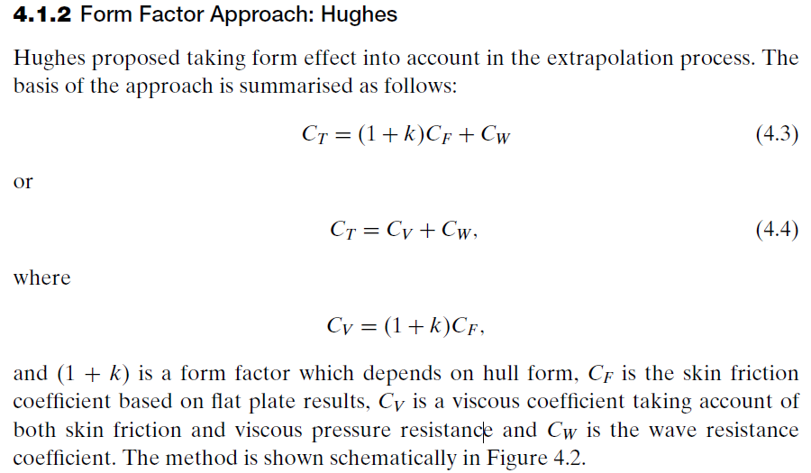
.

Slide 5
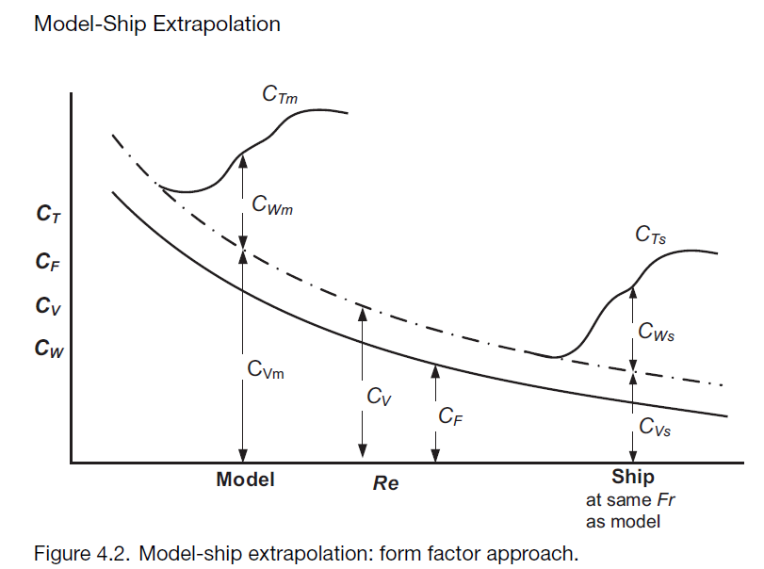
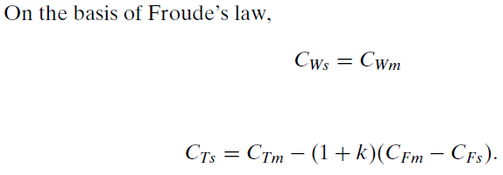
.
This method is recommended by ITTC and is the one adopted by most naval
architects.
A form factor approach may not be applied for some high-speed craft
and for yachts.

Slide 6
The form factor (1 + k) depends on the hull form and may be derived from low-speed tests when, at low Fr, wave resistance C_{W} tends to zero and (1 + k) = C_{Tm}/C_{Fm}. This and other methods of obtaining the form factor are described in next sections

Slide 7
It is worth emphasizing the fundamental difference between the two scaling methods described.
Froude assumes that all resistance in excess of C_{F} (the residuary resistance C_{R}) scales according to Froude’s law, that is, as displacement at the same Froude number.
This is not physically correct because the viscous pressure (form) drag included within C_{R} should scale according to Reynolds’ law.
Hughes assumes that the total viscous resistance (friction and form) scales according to Reynolds’ law.
This also is not entirely correct as the viscous resistance interferes with the wave resistance which is Froude number dependent.
The form factor method (Hughes) is, however, much closer to the actual physical breakdown of components than Froude’s approach and is the method now generally adopted.

Slide 8
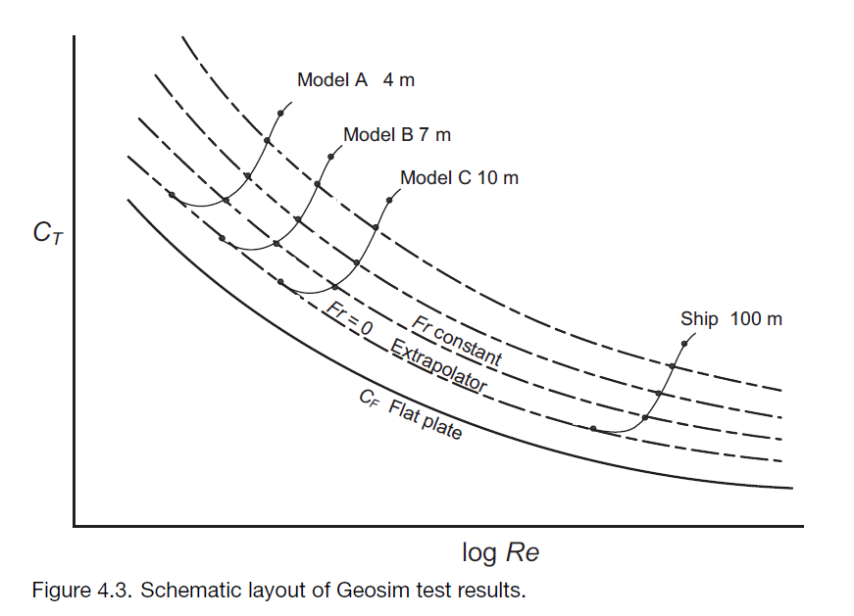
.

Slide 9
Flat Plate Friction Formulae
The level and slope of the skin friction line is fundamental to the extrapolation of resistance data from model to ship, as discussed in Section 4.1.
The following sections outline the principal skin friction lines employed in ship resistance work.

Slide 10
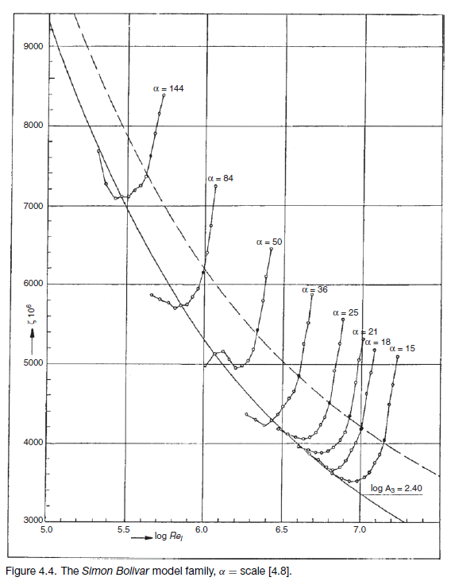
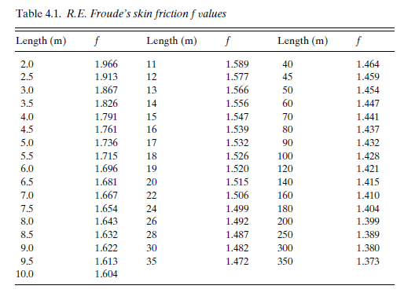
.

Slide 11
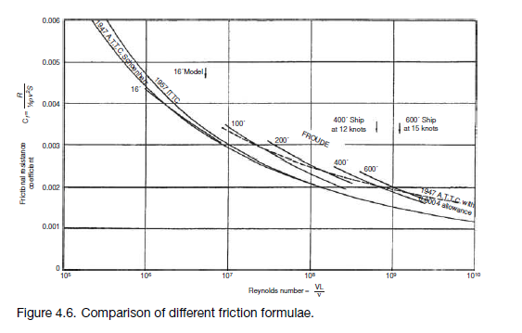
.

Slide 12
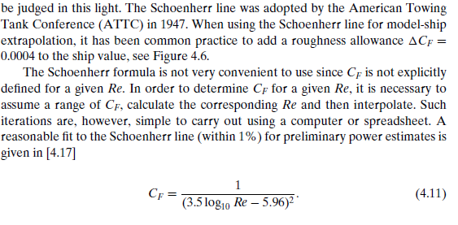
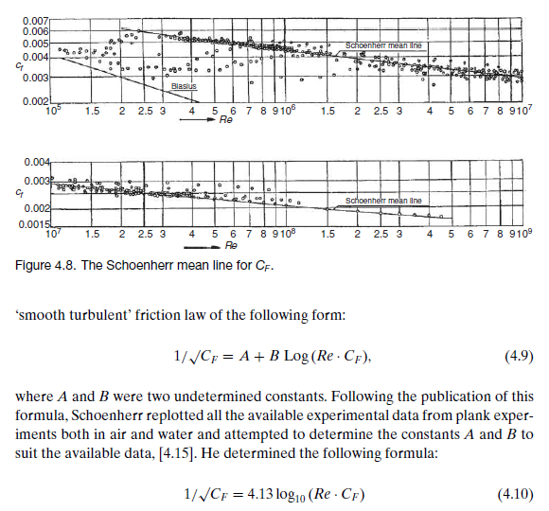
.

Slide 13
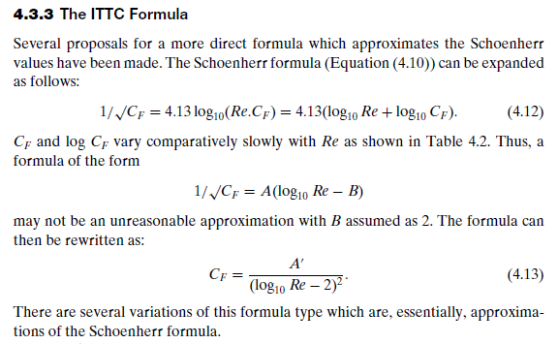
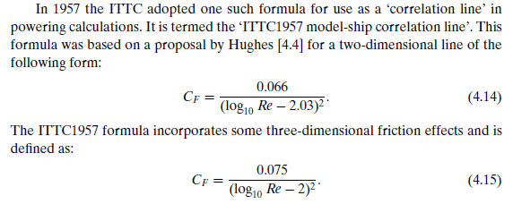
.

Slide 14
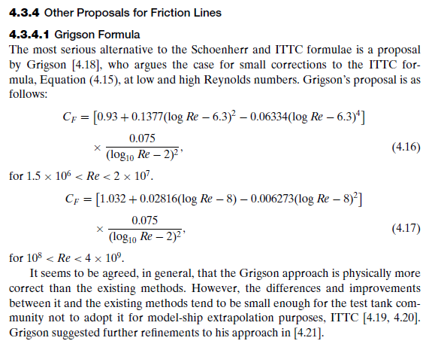
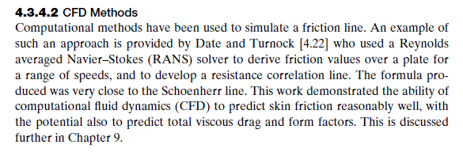
.

Slide 15
Derivation of Form Factor (1 + k)
It is clear that the size of the form factor has a direct influence on the model to ship extrapolation process and the size of the ship resistance estimate.
These changes occur because of the change in the proportion of viscous to wave resistance components, i.e. Re and Fr dependency.
For example, when extrapolating model resistance to full scale, an increase in derived (or assumed) model (1 + k) will result in a decrease in C_{W} and a decrease in the estimated full-scale resistance.
Methods of estimating (1+ k) include experimental, numerical and empirical

Slide 16
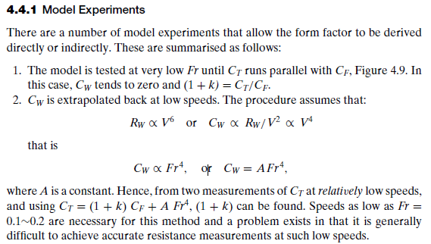
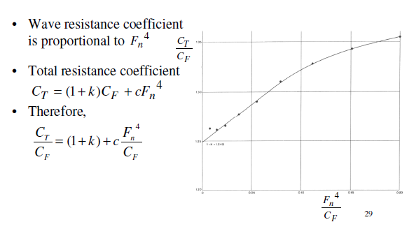
.

Slide 17
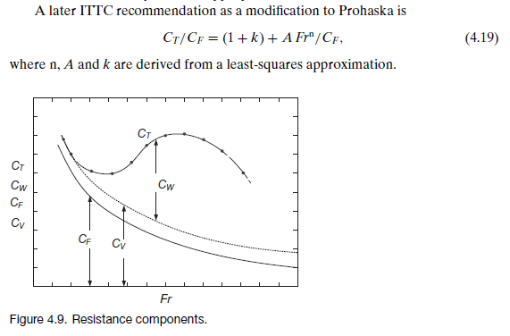
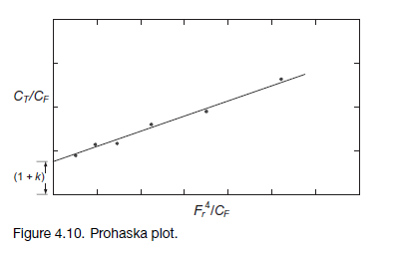
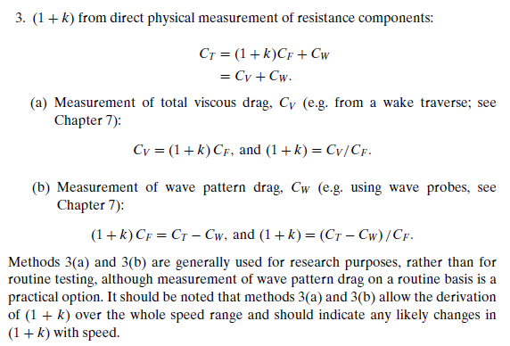
.

Slide 18
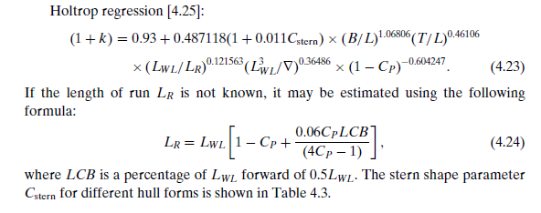
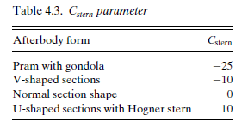
Empirical Methods for(1 + k)
Several investigators have developed empirical formulae for (1 + k) based on model test results.
The following are some examples which may be used for practical powering purposes.

Slide 19



