Slide 1
2-Propulsive Power
2.1 Components of Propulsive Power
During the course of designing a ship it is necessary to estimate the power required to propel the ship at a particular speed. This allows estimates to be made of:
(a) Machinery masses, which are a function of the installed power, and
(b) The expected fuel consumption and tank capacities.

Slide 2
The power estimate for a new design is obtained by comparison with an existing similar vessel or from model tests.
In either case it is necessary to derive a power estimate for one size of craft from the power requirement of a different size of craft.
That is, it is necessary to be able to scale powering estimates.
The different components of the powering problem scale in different ways and it is therefore necessary to estimate each component separately and apply the correct scaling laws to each.

Slide 3
One fundamental division in conventional powering methods is to distinguish between the effective power required to drive the ship and the power delivered to the propulsion unit(s).
The power delivered to the propulsion unit exceeds the effective power by virtue of the efficiency of the propulsion unit being less than 100%.

Slide 4
Ship power predictions are made either by
(1) Model experiments and extrapolation, or
(2) Use of standard series data (hull resistance series and propeller series), or
(3) Theoretical (e.g. components of resistance and propeller design).
(4) A mixture of (1) and (2) or (1), (2) and (3).

Slide 5
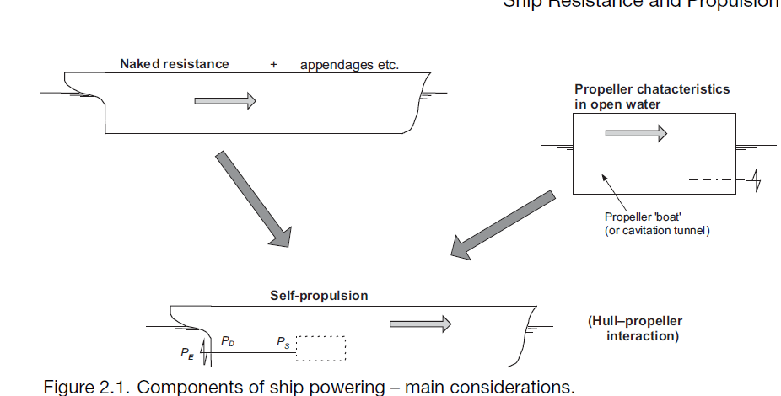
Propulsion Systems
When making power estimates it is necessary to have an understanding of the performance characteristics of the chosen propulsion system, as these determine the operation and overall efficiency of the propulsion unit.

Slide 6
A fundamental requirement of any ship propulsion system is the efficient conversion of the power (P) available from the main propulsion engine(s) [prime mover] into useful thrust (T) to propel the ship at the required speed (V),
There are several forms of main propulsion engines including:
Diesel.
Gas turbine.
Steam turbine.
Electric.
(And variants / combinations of these).

Slide 7
Various propulsors (generally variants of a propeller) which convert the power into useful thrust, including:
Propeller, fixed pitch (FP).
Propeller, controllable pitch (CP).
Ducted propeller.
Waterjet.
Azimuthing podded units.
(And variants of these).

Slide 8
Each type of propulsion engine and propulsor has its own advantages and disadvantages, and applications and limitations, including such fundamental attributes as size, cost and efficiency.
All of the these propulsion options are in current use and the choice of a particular propulsion engine and propulsor will depend on the ship type and its design and operational requirements.
Propulsors and propulsion machinery are described in Chapters 11 and 13.

Slide 9
Each type of propulsion engine and propulsor has its own advantages and disadvantages, and applications and limitations, including such fundamental attributes as size, cost and efficiency.
All of the these propulsion options are in current use and the choice of a particular propulsion engine and propulsor will depend on the ship type and its design and operational requirements.
Propulsors and propulsion machinery are described in Chapters 11 and 13.

Slide 10
The overall assessment of the marine propulsion system for a particular vessel will therefore require:
(1) A knowledge of the required thrust (T) at a speed (V), and its conversion into required power (P),
(2) A knowledge and assessment of the physical properties and efficiencies of the available propulsion engines,
(3) The assessment of the various propulsors and engine-propulsor layouts.

Slide 11
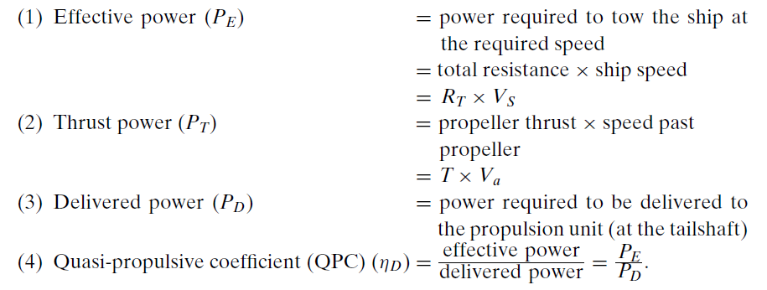
Definitions
.

Slide 12
.

Slide 13
The QPC depends primarily upon the efficiency of the propulsion device, but also depends on the interaction of the propulsion device and the hull.
The required power margin for fouling and weather will depend on the areas of operation and likely sea conditions and will typically be between 15% and 30% of installed power

Slide 14
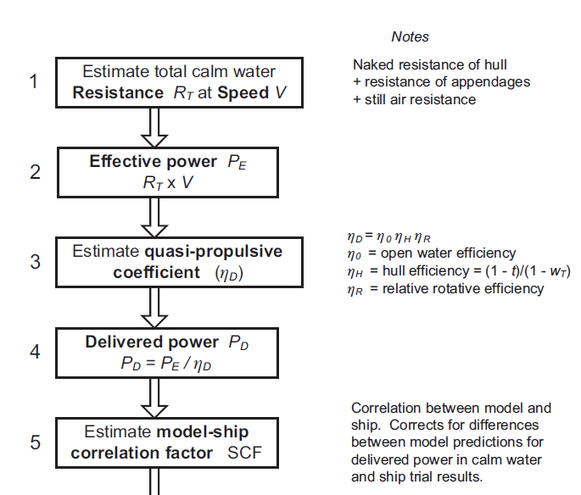
.

Slide 15
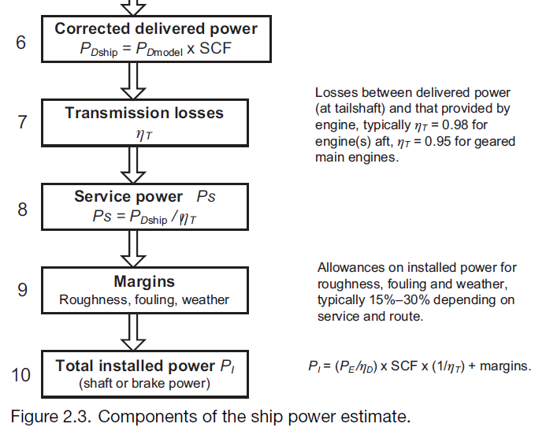
.

Slide 16
Components of the Ship Power Estimate
The total calm water resistance is made up of the hull naked resistance, together with the resistance of appendages and the air resistance.
The propeller quasi-propulsive coefficient (QPC), or η_{D}, is made up of the open water η₀, hull η_{H} and relative rotative η_{R} efficiencies.
The hull efficiency is derived as η_{H} =(1 − t)/(1 − w_{T}), where t is the thrust deduction factor and w_{T} is the wake fraction.

Slide 17
For clarity, the model-ship correlation allowance is included as a single-ship correlation factor, SCF, applied to the overall delivered power.
Transmission losses, T, between the engine and tailshaft/propeller are typically about η_{T} = 0.98 for direct drive engines aft, and η_{T} = 0.95 for transmission via a gearbox.
The margins in stage 9 account for the increase in resistance, hence power, due to roughness, fouling and weather.
They are derived in a scientific manner for the purpose of installing propulsion machinery with an adequate reserve of power.
The total installed power, P_{I}, will typically relate to the MCR (maximum continuous rating) or CSR (continuous service rating) of the main propulsion engine, depending on the practice of the ship operator.

Slide 19
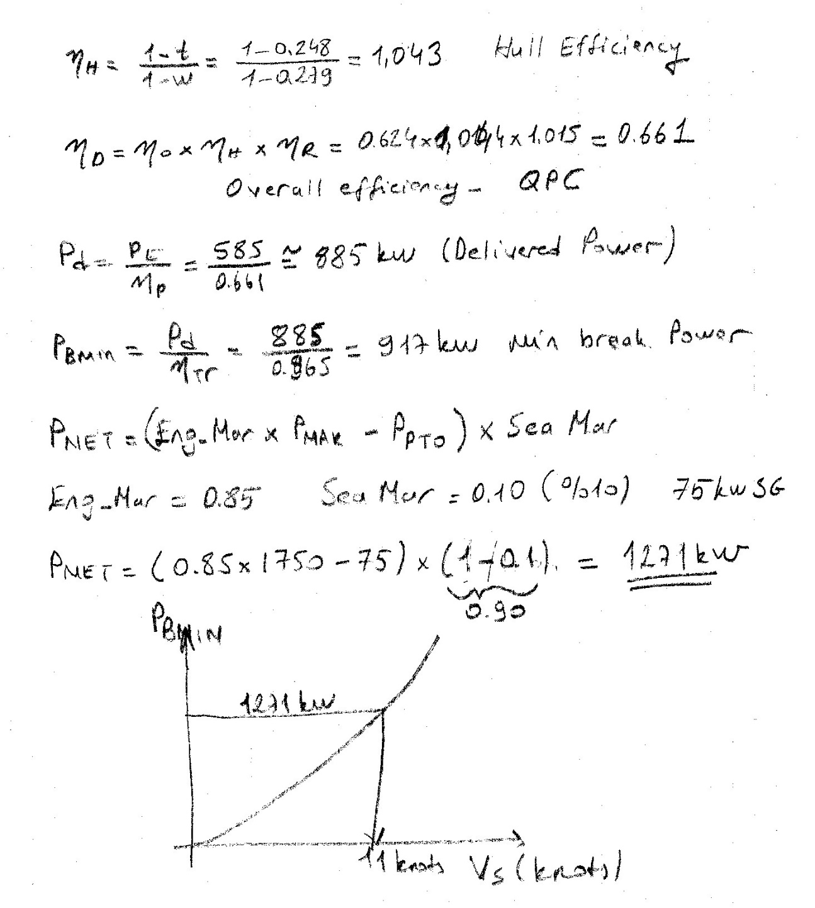
Application for determining the speed achieved under margins
Engine Margin = 85%
Sea Margin = %10
Shaft&RG Loss = %4.5
Shaft Generator – SG - Ppto = 75 kW

