Slide 1

CS105
Introduction to Object-Oriented Programming
Prof. Dr. Nizamettin AYDIN
naydin@itu.edu.tr
nizamettin.aydin@ozyegin.edu.tr

Slide 2
Classes

Slide 3
Outline
Class example - Bank Account
Depositing Money
Account Class
Bank Account – version 1
Printing Class Variables
Object Functionality
Bank Account – version 2
Bank Account – version 3

Slide 4
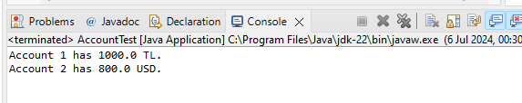
Class example - Bank Account
public class AccountTest {
public static void main(String[] args) {
int account1ID = 1;
double account1Balance = 1000;
String account1Currency = "TL";
int account2ID = 2;
double account2Balance = 800;
String account2Currency = "USD";
System.out.println("Account " + account1ID
+ " has " + account1Balance + " "
+ account1Currency + ".");
System.out.println("Account " + account2ID
+ " has " + account2Balance + " "
+ account2Currency + ".");
}
}

Slide 5
Depositing Money
// Deposit 50 TL into account 1
account1Balance = account1Balance + 50;
// Deposit 300 USD into account 2
account2Balance = account2Balance + 300;
Before:
After:
account1Balance
1000
account2Balance
800
account1Balance
1050
account2Balance
1100

Slide 6
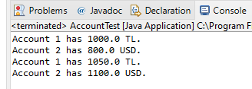
Printing Account Details
System.out.println("Account " + account1ID
+ " has " + account1Balance + " "
+ account1Currency + ".");
System.out.println("Account " + account2ID
+ " has " + account2Balance + " "
+ account2Currency + ".");
// Deposit 50 TL into account 1
account1Balance = account1Balance + 50;
// Deposit 300 USD into account 2
account2Balance = account2Balance + 300;
System.out.println("Account " + account1ID
+ " has " + account1Balance + " "
+ account1Currency + ".");
System.out.println("Account " + account2ID +
" has " + account2Balance + " " +
account2Currency + ".");

Slide 7
Account Class
Each account has an ID, balance and currency.
  These can be thought as attributes of an account.
Can we have an account object which holds all these necessary data together?
public class Account {
int number;
double balance;
String currency;
}
These are called member variables of the class or fields.
They are also referred to as instance variables.

Slide 8
Bank Account – version 1
Account.java
This is the class which provides the specifics of the Account object
public class Account {
int number;
double balance;
String currency;
}
Account account1 = new Account();
account1.number = 1;
account1.balance = 100;
account1.currency = "TL";
Account account2 = new Account();
account2.number = 2;
account2.balance = 200;
account2.currency = "USD";
AccountTest.java
In here, we have
two Account objects:
account1 and
account2

Slide 9
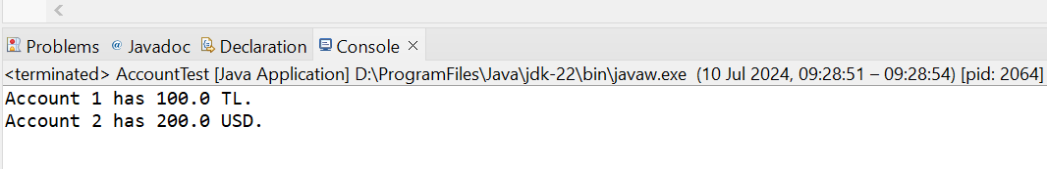
Printing Class Variables
System.out.println("Account " + account1.number
+ " has " + account1.balance
+ " " + account1.currency + ".");
System.out.println("Account " + account2.number
+ " has " + account2.balance
+ " " + account2.currency + ".");

Slide 10
What will be the output?
System.out.println("Account " + account1.number
+ " has " + account1.balance
+ " " + account1.currency + ".");
System.out.println("Account " + account2.number
+ " has " + account2.balance
+ " " + account2.currency + ".");
// Deposit 50 TL into account 1
account1.balance = account1.balance + 50;
// Deposit 300 USD into account 2
account2.balance = account2.balance + 300;
System.out.println("Account " + account1.number
+ " has " + account1.balance
+ " " + account1.currency + ".");
System.out.println("Account " + account2.number
+ " has " + account2.balance
+ " " + account2.currency + ".");

Slide 11
Object Functionality
Depositing money to an account is actually a functionality of an account.
  All accounts can be deposited some amounts of money
How can we make depositing money a functionality of account object?
  By defining it as a member function…

Slide 12
Bank Account – version 2
public class Account {
int number;
double balance;
String currency;
public void deposit(double d) {
balance = balance + d;
}
}

Slide 13
deposit member function
Before deposit member function
// Deposit 50 TL into account 1
account1.balance = account1.balance + 50;
// Deposit 300 USD into account 2
account2.balance = account2.balance + 300;
After deposit member function
// Deposit 50 TL into account 1
account1.deposit(50);
// Deposit 300 USD into account 2
account2.deposit(300);

Slide 14
Class
We have written our first class!
public class Account {
int number;
double balance;
String currency;
public void deposit(double d) {
balance = balance + d;
}
}
member variables or instance variables
Member Functions

Slide 15
From last lecture…
Our proposed programs need to match to the problem we are trying to solve
  In the problem, what are the real-world objects?
    what kind of data do they hold? (attributes)
    what kind of functionalities they have? (behavior)
  Solve the problem in terms of these objects
    Objects in the real world ~ Objects in our programs
    Low representational gap
The object oriented programming

Slide 16
Class
We have written our first class!
public class Account {
int number;
double balance;
String currency;
public void deposit(double d) {
balance = balance + d;
}
}
member variables or instance variables
attributes
member functions
behaviors

Slide 17
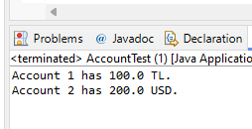
Objects
We have also used this class to create objects!
public class AccountTest {
public static void main(String[] args) {
Account account1 = new Account();
account1.number = 1;
account1.balance = 100;
account1.currency = "TL";
Account account2 = new Account();
account2.number = 2;
account2.balance = 200;
account2.currency = "USD";
System.out.println("Account " + account1.number
+ " has " + account1.balance
+ " " + account1.currency + ".");
System.out.println("Account " + account2.number
+ " has " + account2.balance
+ " " + account2.currency + ".");
}
}

Slide 18
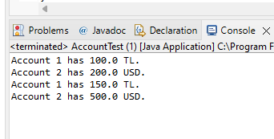
Objects
public class AccountTest {
public static void main(String[] args) {
Account account1 = new Account();
account1.number = 1;
account1.balance = 100;
account1.currency = "TL";
Account account2 = new Account();
account2.number = 2;
account2.balance = 200;
account2.currency = "USD";
System.out.println("Account " + account1.number
+ " has " + account1.balance
+ " " + account1.currency + ".");
System.out.println("Account " + account2.number
+ " has " + account2.balance
+ " " + account2.currency + ".");
// Deposit 50 TL into account 1
account1.deposit(50);
// Deposit 300 USD into account 2
account2.deposit(300);
System.out.println("Account " + account1.number
+ " has " + account1.balance
+ " " + account1.currency + ".");
System.out.println("Account " + account2.number
+ " has " + account2.balance
+ " " + account2.currency + ".");
}
}

Slide 19
Report Account Information
System.out.println("Account " + account1.number
+ " has " + account1.balance
+ " " + account1.currency + ".");
System.out.println("Account " + account2.number
+ " has " + account2.balance
+ " " + account2.currency + ".");
// Deposit 50 TL into account 1
account1.deposit(50);
// Deposit 300 USD into account 2
account2.deposit(300);
System.out.println("Account " + account1.number
+ " has " + account1.balance
+ " " + account1.currency + ".");
System.out.println("Account " + account2.number
+ " has " + account2.balance
+ " " + account2.currency + ".");
Reporting its information can be a functionality of accounts.
  report member function!
  How can we fix this?

Slide 20
Bank Account – version 3
report member function!
public class Account {
int number;
double balance;
String currency;
public void deposit(double d) {
balance = balance + d;
}
public void report() {
System.out.println("Account " + number
+ " has " + balance
+ " " + currency + ".");
}
}

Slide 21
Bank Account – version 3
report member function!
System.out.println("Account " + account1.number
+ " has " + account1.balance
+ " " + account1.currency + ".");
System.out.println("Account " + account2.number
+ " has " + account2.balance
+ " " + account2.currency + ".");
public void report() {
System.out.println("Account " + number
+ " has " + balance
+ " " + currency + ".");
}
}

Slide 22
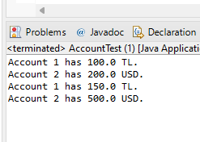
Bank Account – version 3
public class AccountTest {
public static void main(String[] args) {
Account account1 = new Account();
account1.number = 1;
account1.balance = 100;
account1.currency = "TL";
Account account2 = new Account();
account2.number = 2;
account2.balance = 200;
account2.currency = "USD";
account1.report();
account2.report();
// Deposit 50 TL into account 1
account1.deposit(50);
// Deposit 300 USD into account 2
account2.deposit(300);
account1.report();
account2.report();
}
}

Slide 23
Any Questions?

