Slide 1

CS105
Introduction to Object-Oriented Programming
Prof. Dr. Nizamettin AYDIN
naydin@itu.edu.tr
nizamettin.aydin@ozyegin.edu.tr

Slide 2
Class Diagrams

Slide 3
Outline
UML (Unified Modeling Language)
  Goals of UML
  Characteristics of UML
Conceptual Modelling
Uses for UML
UML Class Diagram
  Purpose of Class Diagrams
  Benefits of Class Diagrams
Vital components of a Class Diagram
Relationships between classes
Class Diagram Examples

Slide 4
UML (Unified Modeling Language)
a standardized general-purpose, graphical modeling language in the field of Software Engineering.
used to specify, visualize, construct, and document the artifacts (major elements) of the software system.
helps in designing and characterizing, especially those software systems that incorporate the concept of Object orientation.
describes the working of both the software and hardware systems.

Slide 5
Goals of UML
Since it is a general-purpose modeling language, it can be utilized by all the modelers.
UML came into existence after the introduction of object-oriented concepts to systemize and consolidate the object-oriented development, due to the absence of standard methods at that time.
The UML diagrams are made for business users, developers, ordinary people, or anyone who is looking forward to understand the system, such that the system can be software or non-software.
UML is a simple modeling approach that is used to model all the practical systems.

Slide 6
Characteristics of UML
The UML has the following features:
It is a generalized modeling language.
It is distinct from other programming languages like C++, Python, etc.
It is interrelated to object-oriented analysis and design.
It is used to visualize the workflow of the system.
It is a pictorial language, used to generate powerful modeling artifacts.

Slide 7
Conceptual Modeling
A conceptual model is composed of several interrelated concepts
makes it easy to understand the objects and how they interact with each other.
This is the first step before drawing UML diagrams.
Following are some object-oriented concepts that are needed to begin with UML:

Slide 8
Conceptual Modeling
Following are some object-oriented concepts that are needed to begin with UML:
  Object:
    An object is a real world entity.
    There are many objects present within a single system.
    It is a fundamental building block of UML.
  Class:
    a software blueprint for objects, which means that it defines the variables and methods common to all the objects of a particular type.
  Abstraction:
    the process of portraying the essential characteristics of an object to the users while hiding the irrelevant information.
    Basically, it is used to envision the functioning of an object.
  Inheritance:
    the process of deriving a new class from the existing ones.
  Polymorphism:
    a mechanism of representing objects having multiple forms used for different purposes.
  Encapsulation:
    binds the data and the object together as a single unit, enabling tight coupling between them.

Slide 9
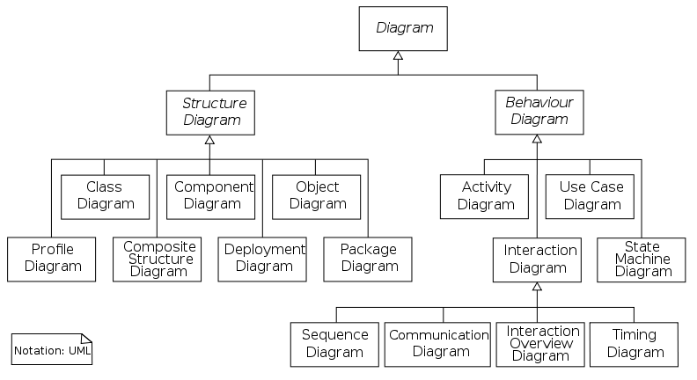
UML Diagrams

Slide 10
Uses for UML
As a sketch:
  to communicate aspects of system
    forward design: doing UML before coding
    backward design: doing UML after coding as documentation
    often done on whiteboard or paper
    used to get rough selective ideas
As a blueprint:
  a complete design to be implemented
    sometimes done with CASE (Computer-Aided Software Engineering) tools
As a programming language:
  with the right tools, code can be auto-generated and executed from UML
    only good if this is faster than coding in a "real" language

Slide 11
UML Class Diagram
What is a UML class diagram?
  a picture of the classes in an OO system, their fields and methods, and connections between the classes that interact or inherit from each other.
    shows the attributes, classes, functions, and relationships to give an overview of the software system.
    constitutes class names, attributes, and functions in a separate compartment that helps in software development.
What are some things that are not represented in a UML class diagram?
  details of how the classes interact with each other
  algorithmic details;
    how a particular behavior is implemented

Slide 12
Purpose of Class Diagrams
to build a static view of an application.
  It is the only diagram that is widely used for construction, and it can be mapped with object-oriented languages.
  It is one of the most popular UML diagrams.
Following are the purpose of class diagrams given below:
  It analyses and designs a static view of an application.
  It describes the major responsibilities of a system.
  It is a base for component and deployment diagrams.
  It incorporates forward and reverse engineering.

Slide 13
Benefits of Class Diagrams
It can represent the object model for complex systems.
It reduces the maintenance time by providing an overview of how an application is structured before coding.
It provides a general schematic of an application for better understanding.
It represents a detailed chart by highlighting the desired code, which is to be programmed.
It is helpful for the stakeholders and the developers.

Slide 14
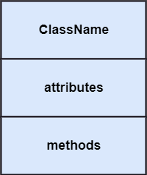
Vital components of a Class Diagram
The class diagram is made up of three sections:
  Upper Section:
    encompasses the name of the class.
      A class is a representation of similar objects
      that shares the same relationships, attributes,
      operations, and semantics.
    rules that should be taken into account while
    representing a class:
      Capitalize the initial letter of the class name.
      Place the class name in the center of the upper section.
      A class name must be written in bold format.
      The name of the abstract class should be written in italics format.

Slide 15
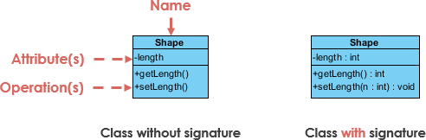
Vital components of a Class Diagram
The class diagram is made up of three sections:
  Middle Section:
    constitutes the attributes, which describe
    the quality of the class.
    visibility name : type [count] = default_value
    The attributes have the following characteristics:
      The attributes are written along with its visibility
      factors, which are
        public (+), private (-), protected (#), and
        package/default (~), derived (/).
          derived attribute: not stored, but can be computed from other attribute values
      The accessibility of an attribute class is illustrated by the visibility factors.
      A meaningful name should be assigned to the attribute, which will explain its usage inside the class.
        underline static attributes
      attribute example:
        - balance : double = 0.00

Slide 16
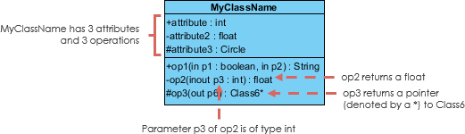
Vital components of a Class Diagram
The class diagram is made up of three sections:
  Lower Section:
    The lower section contain methods or operations.
    visibility name (parameters) : return_type
        underline static methods
      method example:
      + distance(p1: Point, p2: Point): double
    The methods are represented in the form of a list,
    where each method is written in a single line.
    omit return_type on constructors and when return
    type is void
    It demonstrates how a
    class interacts with
    data.

Slide 17
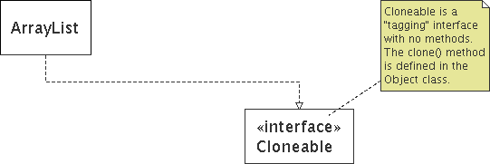
Comments
represented as a folded note, attached to the appropriate class/method/etc by a dashed line

Slide 18
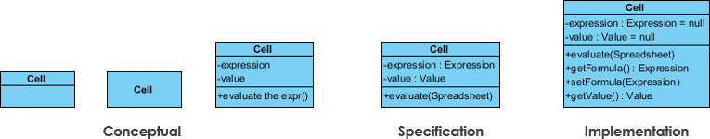
Perspectives of Class Diagram
The choice of perspective depends on how far along you are in the development process.
A diagram can be interpreted from various perspectives:
  Conceptual:
    represents the concepts in the domain
  Specification:
    focus is on the interfaces of Abstract Data Type (ADTs) in the software
  Implementation:
    describes how classes will implement their interfaces
the class name is the only mandatory information

Slide 19
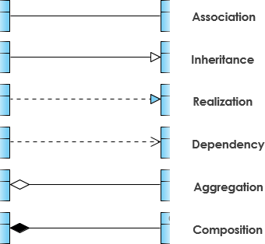
Relationships between classes
A class may be involved in one or more relationships with other classes.
A relationship can be one of the following types:

Slide 20
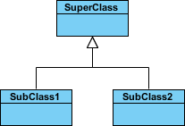
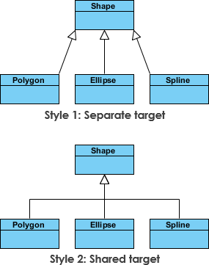
Relationships between classes
Generalization (Inheritance):
  a relationship between a parent class (superclass) and a child class (subclass).
  Represents an "is-a" relationship.
  An abstract class name is shown in italics.
  inheritance between classes
    The child class is inherited from the parent class.
      SubClass1 and SubClass2 are specializations of SuperClass
    inheritance example with two styles.
      they are semantically equivalent.

Slide 21

Relationships between Classes
Association:
  describes a static or physical connection between two or more objects.
  depicts how many objects are there in the relationship.
  a usage relationship
    aggregation
    Composition
    dependency
  For example, a department is associated with the college.

Slide 22

Relationships between Classes
Association:
  Simple association
    A structural link between two peer classes.
    There is an association between Class1 and Class2
      The figure below shows an example of simple association.
        There is an association that connects the <<control>> class Class1 and <<boundary>> class Class2.
          The relationship is displayed as a solid line connecting the two classes.

Slide 23
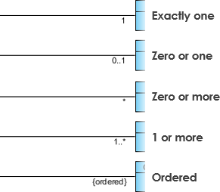
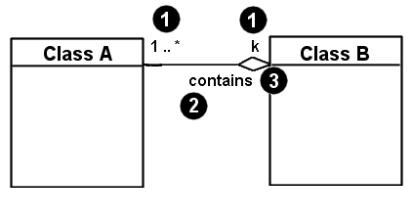
Relationships between Classes
Association:
  Multiplicity (Cardinality)
    expressed in terms of:
      one to one
      one to many
      many to many
Associational (usage) relationships
  1. multiplicity (how many are used)
    * ⇒ 0, 1, or more
    1 ⇒ 1 exactly
    2..4 ⇒ between 2 and 4, inclusive
    3..* ⇒ 3 or more
  2. name (what relationship the objects have)
  3. navigability (direction)

Slide 24
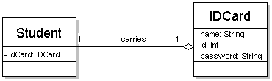
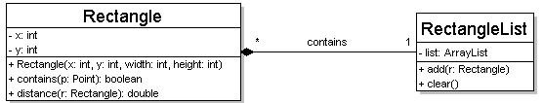
Multiplicity of associations
one-to-one
  each student must carry exactly one ID card
one-to-many
  one rectangle list can contain many rectangles

Slide 25


Relationships between Classes
Association:
  Aggregation
    A special type of association.
    It represents an “is part of" relationship.
      Class2 is part of Class1.
      Many instances (denoted by the *) of Class2 can be associated with Class1.
      Objects of Class1 and Class2 have separate lifetimes.
        The figure below shows an example of aggregation.
          The relationship is displayed as a solid line with a unfilled diamond at the association end, which is connected to the class that represents the aggregate.
The company encompasses a number of employees, and even if one employee resigns, the company still exists.

Slide 26


Relationships between Classes
Association:
  Composition
    A stronger version of aggregation,
      where parts are destroyed when the whole is destroyed
      Objects of Class2 live and die with Class1
      Class2 cannot stand by itself.
    It represents an "is entirely made of" relationship.
        The figure below shows an example of composition.
          The relationship is displayed as a solid line with a filled diamond at the association end, which is connected to the class that represents the whole or composite.
A contact book consists of multiple contacts, and if you delete the contact book, all the contacts will be lost.

Slide 27


Relationships between Classes
Association:
  Dependency
    A special type of association that forms a weaker relationship.
      symbolized by a dotted line
    A semantic relationship between two or more classes,
      where a change in one class cause changes in another class,
        but not the other way around
        The figure below shows an example of dependency.
          The relationship is displayed as a dashed line with an open arrow.
The Person class might have a hasRead method with a Book parameter that returns true if the person has read the book (perhaps by checking some database).

Slide 28
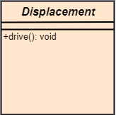
Abstract Classes
In the abstract class, no objects can be a direct entity of the abstract class.
can neither be declared nor be instantiated.
  It is used to find the functionalities across the classes.
written in italics.
It is best to use the abstract class with multiple objects.
    Assume that we have an abstract class named
    displacement with a method declared inside it,
    and that method will be called as a drive ().
      This abstract class method can be
      implemented by any object, for example, car,
      bike, scooter, cycle, etc.

Slide 29
How to draw a Class Diagram?
The class diagram is used most widely to construct software applications.
  It not only represents a static view of the system but also all the major aspects of an application.
  A collection of class diagrams as a whole represents a system.
Key points to keep in mind while drawing a class diagram:
  Give a meaningful name to the class diagram.
  Objects and their relationships should be acknowledged in advance.
  Attributes and methods of each class must be known.
  A minimum number of desired properties should be specified
    more number of the unwanted property will lead to a complex diagram.
  Notes can be used as and when required by the developer to describe the aspects of a diagram.
  The diagrams should be redrawn and reworked as many times to make it correct before producing its final version.

Slide 30
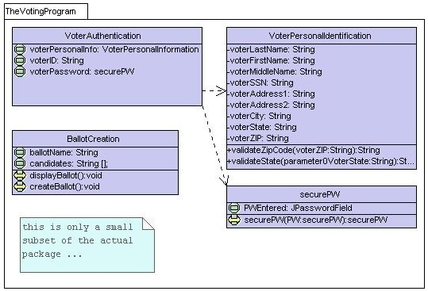
Class Diagram Example: Voting Program

Slide 31
Class Diagram Example: Rental System
Multiplicity
Customer
1
Simple
Aggregation
Class
Abstract
Class
Rental Invoice
Rental Item
1..*
1
0..1
Composition
Simple
Association
Generalization
Checkout Screen
DVD Movie
VHS Movie
Video Game

Slide 32
Class Diagram Example: Student Record
StudentBody
Student
1
100
- firstName : String
- lastName : String
- homeAddress : Address
- schoolAddress : Address
+ main (args : String[])
+ toString() : String
Address
- streetAddress : String
- city : String
- state : String
- zipCode : long
+ toString() : String

Slide 33
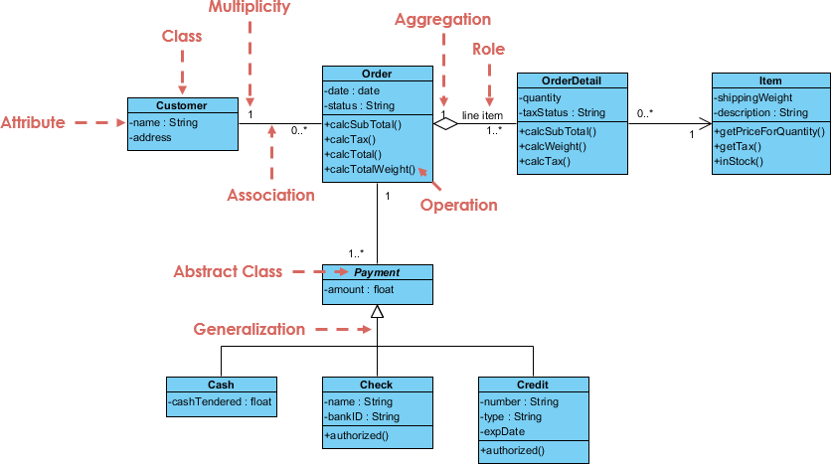
Class Diagram Example: Order System

Slide 34
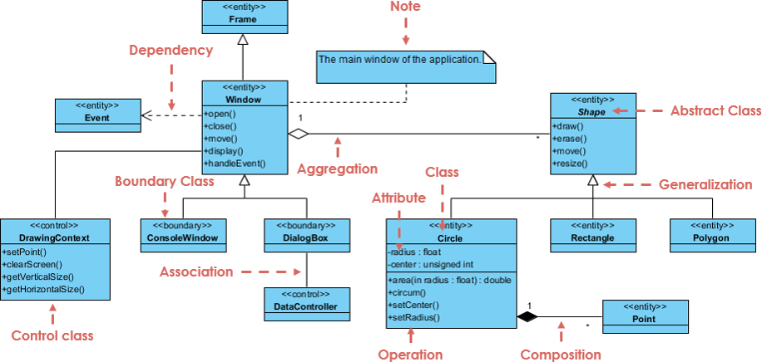
Class Diagram Example: GUI
A class diagram may also have notes attached to classes or relationships.

Slide 35
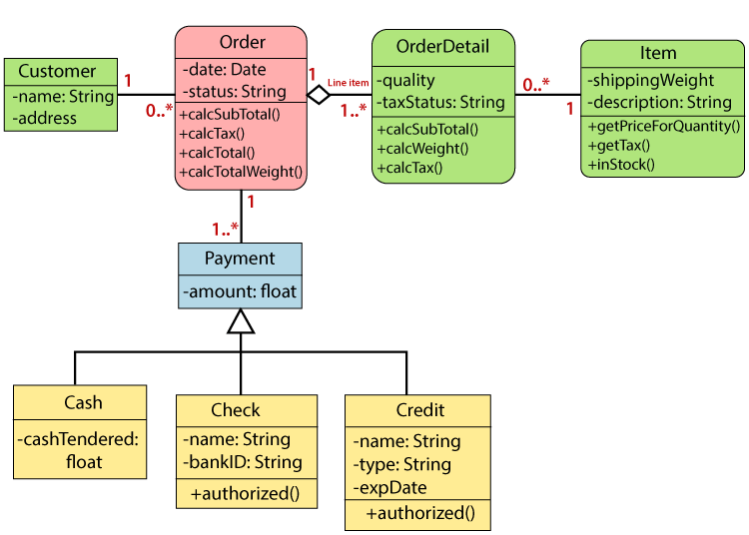
Class Diagram Example: Sales Order System

Slide 36
Tools for creating UML diagrams
ClickUp
  https://clickup.com/
Violet
  http://horstmann.com/violet/
Rational Rose
  https://www.ibm.com/support/pages/ibm-rational-rose-enterprise-7004-ifix001
Visual Paradigm UML Suite
  http://www.visual-paradigm.com/
SmartDraw
  https://www.smartdraw.com/
EdrawMax
  https://www.edrawsoft.com/
Lucidchartx
  https://www.lucidchart.com/
  ⁞
    there are many others, but most are commercial

Slide 37
Any Questions?

