Slide 1
CS105
Introduction to Object-Oriented Programming
Prof. Dr. Nizamettin AYDIN
naydin@itu.edu.tr
nizamettin.aydin@ozyegin.edu.tr

Slide 2
Abstract Classes and Interfaces

Slide 3
Outline
Shapes
Inheritance
Abstract Classes
Abstract and Concrete Classes
Abstract Functions
Interface
Adapter Class
instanceof operator

Slide 4
Shapes
Let’s implement classes for shapes
Rectangle
Circle
etc.
What is common in all these shapes?
x and y coordinates that hints about the location of the shape.

Slide 5
Shapes
(x,y) coordinate
In circle we hold an additional radius, in rectangle we have height and width.
(x,y) r
h
(x,y) w

Slide 6
Inheritance
We can have a shape class.
Other shapes can inherit from the shape class.
Shape
Circle
Rectangle

Slide 7
Sometimes a class should define a method that logically belongs in the class, but that class cannot specify how to implement the method.
For instance:
Every shape has an area.
Logically, every shape should have a getArea method.
But ...

Slide 8
Every shape has an area.
Logically, every shape should have a getArea method.
But, the area of every shape is calculated differently.
Area of Circle = pow(radius, 2) × pi
Area of Rectangle = height × width
There is not any implementation of getArea method in the Shape class that is correct for all subclasses of Shape.
Therefore, we need to enforce the subclasses of Shape to implement the getArea method.

Slide 9
Abstract Classes
At this point
Every shape has an area.
But there is not a possible way to implement the getArea method in the Shape class.
Therefore, maybe we should not let the instantiation of a Shape object, even when we have the Shape class.
instantiate: create a new instance
Can we?
Yes we can, with use of abstract classes.
Classes that cannot be used to instantiate objects are abstract classes.

Slide 10
Abstract and Concrete Classes
Classes that cannot be used to instantiate objects are abstract classes.
Classes that can be used to instantiate objects are concrete classes.
Concrete class is the default class.

Slide 11
Abstract Classes
Classes that cannot be used to instantiate objects are abstract classes.
They are used as super-classes during inheritance and provide common attributes and behaviors to its sub-classes.

Slide 12
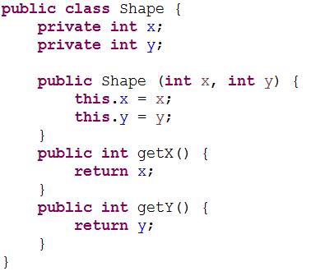
Shape Class (Concrete)

Slide 13
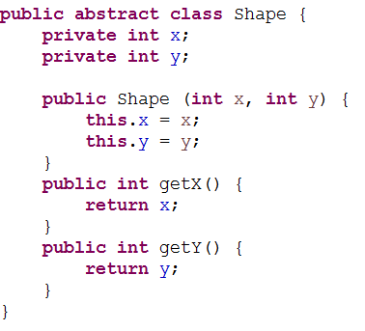
Shape Class (Abstract)
You make a class abstract by declaring it with keyword abstract.

Slide 14
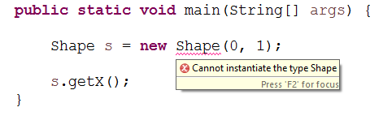
Shape Class (Abstract)

Slide 15
Abstract Classes
Abstract classes are incomplete.
Their sub-classes can complete these incomplete parts and become concrete classes.
If they don’t, sub-classes will be also abstract.
What do we mean by incomplete?
Remember the getArea() function.

Slide 16
Abstract Functions
A method that has been declared but not implemented is an abstract function.
The keyword abstract needs to be used.
The body of the method is missing.
incomplete function
Constructors and static methods cannot be abstract.

Slide 17
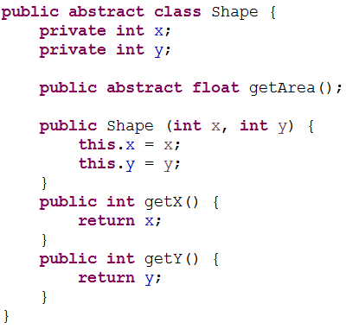
Shape Class (Abstract)

Slide 18
Abstract Classes
A class which contains at least one abstract function is an abstract class and must be declared abstract.
A class can still be an abstract class even if it does not contain any abstract methods but contain the abstract keyword.
Concrete classes provide implementations of every method they declare.
A concrete sub-class needs to implement all the abstract methods inherited from the abstract super-class.

Slide 19
Abstract Classes
When inheriting from an abstract class
If the sub-class implements all the inherited abstract methods, it can be instantiated
If the subclass does not implement all the inherited abstract methods, it too must be abstract.

Slide 20
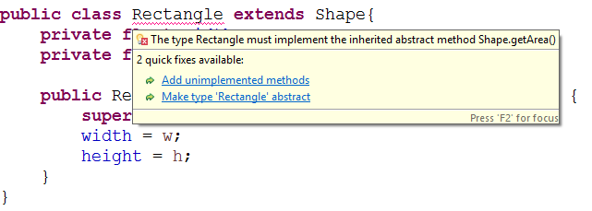
Circle and Rectangle Classes
Inheriting from abstract Shape class.

Slide 21
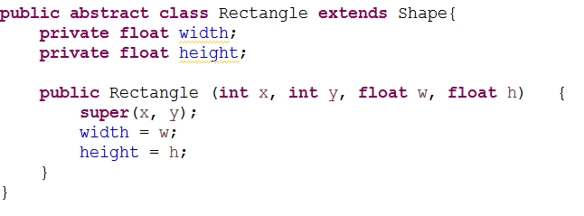
Circle and Rectangle Classes
Inheriting from abstract Shape class.
One solution is to make Rectangle class abstract as well

Slide 22
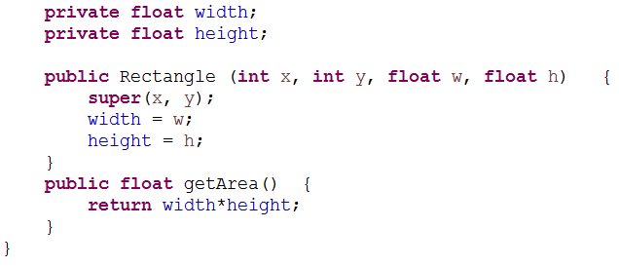
Circle and Rectangle Classes
Inheriting from abstract Shape class.
The other solution is to implement the getArea method.

Slide 23
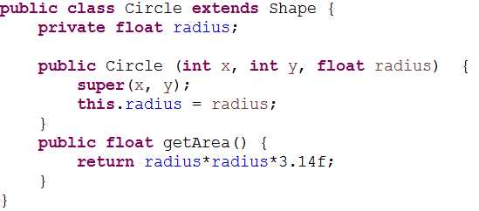
Circle and Rectangle Classes
Inheriting from abstract Shape class.
Same for the circle class..

Slide 24
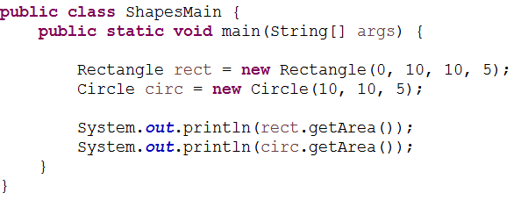
Using Shapes

Slide 25
Quick Note
Not all hierarchies contain abstract classes.
Not all super-classes needs to be abstract.

Slide 26
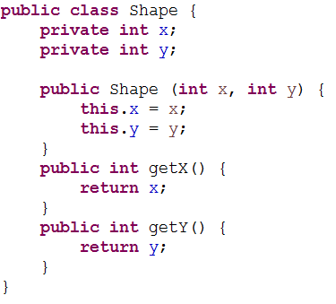
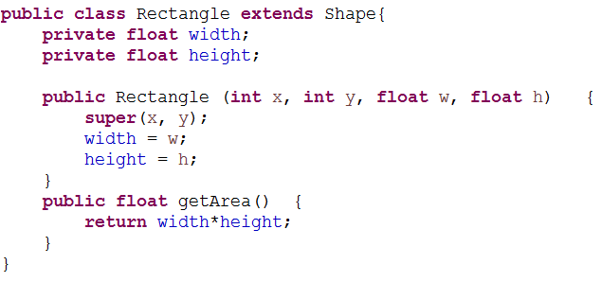
Remember the last class
We have the following classes:
Shape is not abstract

Slide 27
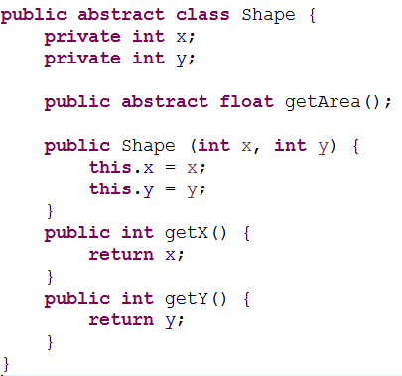
Remember the last class
When Shape is abstract, we don’t get that compiler error.
Why?

Slide 28
Remember the last class
When Shape is abstract, we don’t get that compiler error.
Why?
getArea method has been declared in Shape class
Any object that Shape can refer to needs to implement this getArea method in order to be instantiated.

Slide 29
There are things we cannot do with abstract classes.
Lets see interfaces...

Slide 30
Interface
Interfaces offer a capability requiring that unrelated classes implement a set of common methods
An interface only declares the public behaviors of a class but does not implement them.
Based on this definition, in an interface
All methods are implicitly public
All methods are implicitly abstract
There are not any concrete methods
There are not any attributes
It does not contain any class instance
It can contain constants (final variables)

Slide 31
Example interface
Use the keyword interface
Can we instantiate an interface?
No.
Actually an interface is a very abstract class
None of its methods are implemented
All methods are abstract

Slide 32
When do you need an interface?
You would write an interface when you want classes of various types to all have a certain set of capabilities (behaviors).
You can write methods that work for more than one kind of class.
Very common in GUI implementations.
interface KeyListener {
public void keyPressed(KeyEvent e);
public void keyReleased(KeyEvent e);
public void keyTyped(KeyEvent e);
}

Slide 33
Interface
A class can extend a class.
A class can implement an interface.

Slide 34
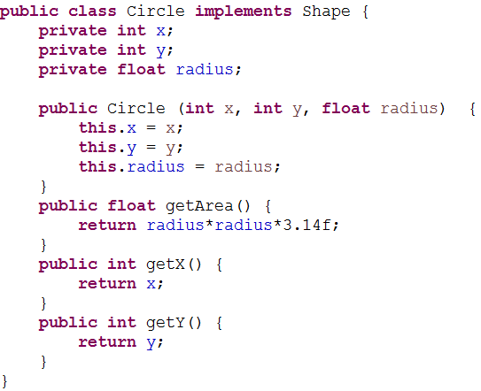

Slide 35
Interface
A class can only extend one class.
A class can implement multiple interfaces.
This lets the class fill multiple “roles”
In writing Applets, it is common to have one class implement several different listeners
Example:
class MyApplet extends Applet implements ActionListener, KeyListener { ... }

Slide 36
When a class implements an interface, the class needs to implement all the declared methods of the interface.
If all the declared methods are not implemented, then the class becomes an abstract class.
At this point, we need to use the keyword abstract

Slide 38
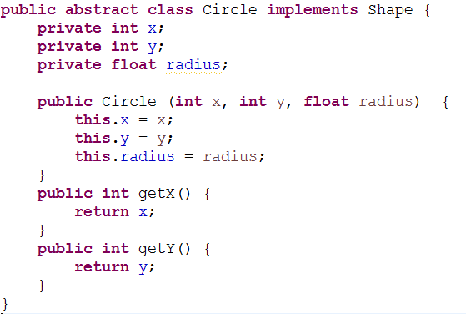

Slide 39
You can even extend an interface (to add methods):

Slide 40
Interface
You can even extend an interface (to add methods):
interface KeyListener { public void keyPressed(KeyEvent e); public void keyReleased(KeyEvent e); public void keyTyped(KeyEvent e); }
interface FunkyKeyListener extends KeyListener {
public void funkykeyEvent(KeyEvent e);
}

Slide 41
Interface
When you implement an interface, you need to implement all the declared functions.
There can be a lot of methods
interface KeyListener { public void keyPressed(KeyEvent e); public void keyReleased(KeyEvent e); public void keyTyped(KeyEvent e); }
What if you only care about a couple of these methods, not all?

Slide 42
Adapter Class
An adapter class implements an interface and provides empty method bodies
class KeyAdapter implements KeyListener { public void keyPressed(KeyEvent e) { }; public void keyReleased(KeyEvent e) { }; public void keyTyped(KeyEvent e) { };
}
You can override only the methods you care about
This isn’t elegant, but it does work
Java provides a number of adapter classes

Slide 43
Example…
With interface you can write methods that work with more than one class
interface RuleSet {
boolean isLegal(Move m, Board b); void makeMove(Move m);
}
Every class that implements RuleSet must have these methods

Slide 44
…Example…
class CheckersRules implements RuleSet { public boolean isLegal(Move m, Board b) { ... } public void makeMove(Move m) { ... } }
class ChessRules implements RuleSet {
public boolean isLegal(Move m, Board b) { ... } public void makeMove(Move m) { ... } }

Slide 45
…Example
Is this a legal statement?
RuleSet rulesOfThisGame = new ChessRules();
This assignment is legal because a rulesOfThisGame object is a RuleSet object.
Is this a legal statement?
if (rulesOfThisGame.isLegal(m, b)) { rulesOfThisGame.makeMove(m);
}
This statement is legal because, whatever kind of RuleSet object rulesOfThisGame is, it must have isLegal and makeMove methods

Slide 46
instanceof operator
instanceof is a keyword that tells you whether a variable “is a” member of a class or interface
class Dog extends Animal implements Pet {...}
Animal fido = new Dog();
Are these true or false?
fido instanceof Dog
fido instanceof Animal
fido instanceof Pet

Slide 47
Vocabulary …
abstract method
a method which is declared but not defined (it has no method body)
abstract class
a class which either (1) contains abstract methods, or (2) has been declared abstract
Instantiate
to create an instance (object) of a class
Interface
Similar to a class, but contains only abstract methods (and possibly constants)

Slide 48
…Vocabulary
Adapter class
A class that implements an interface but has only empty method bodies
Final methods
methods that cannot be overridden
all private or static methods are implicitly final
Static (early) binding
Binding occurs during compile time
Uses reference type during binding
Dynamic (late) binding
Binding occurs during run time
Uses object type during binding

Slide 49
Any Questions?

