Slide 1
CS105
Introduction to Object-Oriented Programming
Prof. Dr. Nizamettin AYDIN
naydin@itu.edu.tr
nizamettin.aydin@ozyegin.edu.tr

Slide 2
Inheritance and Polymorphism

Slide 3
Outline
more benefits of inheritance
Reference and Object
Inheritance
Polymorphism
Compile Time vs. Runtime
Casting
Final method
Static vs. Dynamic Binding

Slide 4
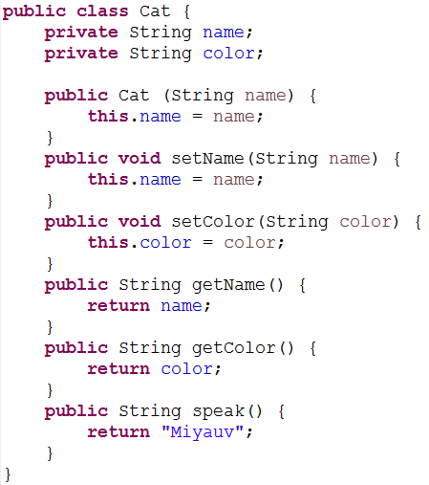
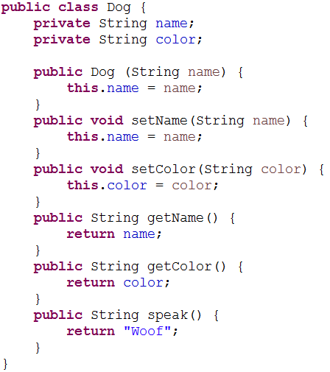
more benefits of inheritance
Assume that we have an animal farm with different types of animals and we don’t know inheritance

Slide 5
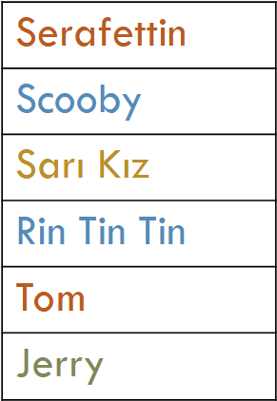
Assume that we have an animal farm with different types of animals and we don’t know inheritance.
Can we store all these different animal types in one data structure, like an array?
Dog
Cat
Cow
Mouse

Slide 6
Assume that we have an animal farm with different types of animals and we don’t know inheritance.
Can we store all these different animal types in one data structure, like an array?
An array needs to hold objects of same type!
Dog
Cat
Cow
Mouse

Slide 7
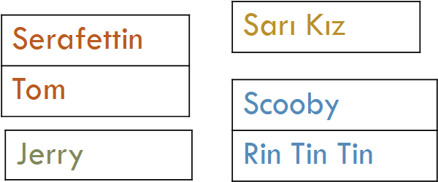
Assume that we have an animal farm with different types of animals and we don’t know inheritance.
Can we store all these different animal types in one data structure, like an array?
An array needs to hold objects of same type!
Dog
Cat
Cow
Mouse

Slide 8
Inheritance gives us the ability to store all animals in one data structure.
A cat/dog/cow/mouse is an Animal

Slide 9
Reference and Object
Reference Object
Animal is an animal

Slide 10
Reference and Object
Reference Object
Are these statements legal?
Cat is a cat
Dog is a dog
Both of them are legal statements.

Slide 11
Reference and Object
Reference Object
Are these statements legal?
Can an animal reference point to a cat/dog object?
Cat is an animal
Dog is an animal
Both of them are legal statements.

Slide 12
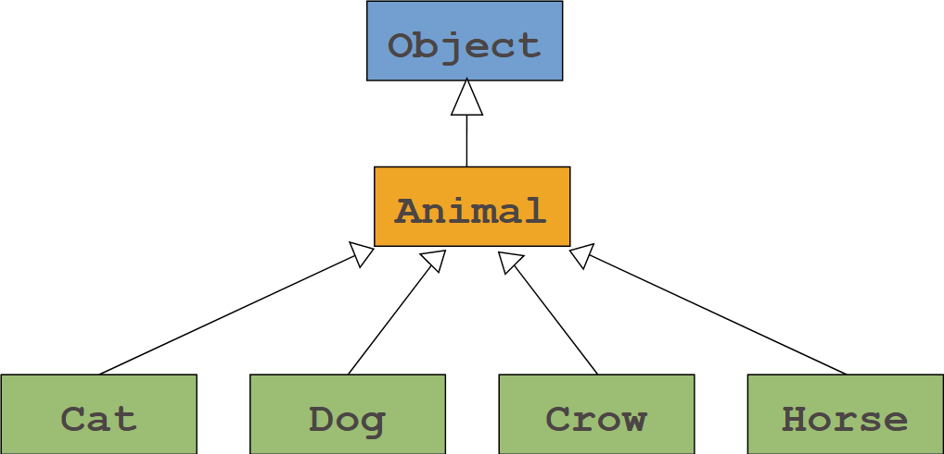
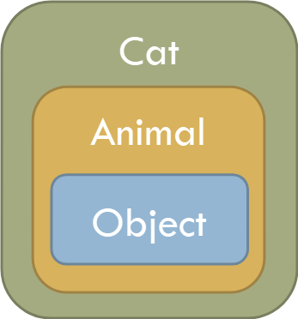

Slide 13
Inheritance
Therefore we can keep all animal types in one single data structure.
An animal array can store an animal object and other animal types (cat, dog etc.).

Slide 14
Reference and Object
Reference Object
Is this a legal statement?
Not a legal statement
Not all animals is a cat.
An animal may not have all the capabilities of a cat.
Cats can jump but not all animals can.

Slide 15
Reference and Object
Reference Object
Is this a legal statement?
Cat is an object.
This is a legal statement.

Slide 16
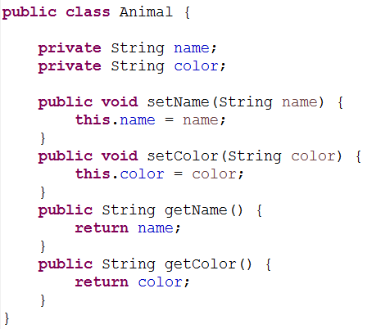
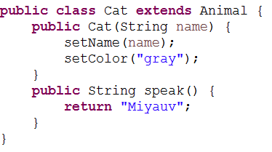
Are these statements valid?
An animal reference can refer to a cat object.
All cats are animal.

Slide 17
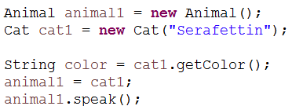
Are these statements valid?
animal1 is an animal reference
Compiler knows the reference type but not the object type

Slide 18
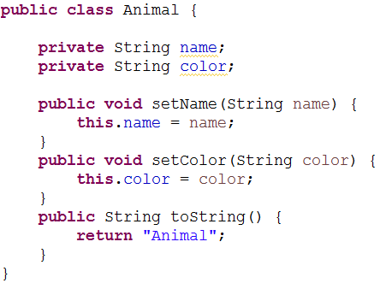
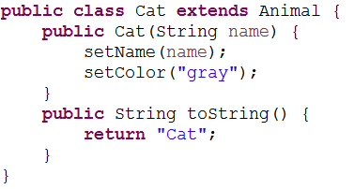
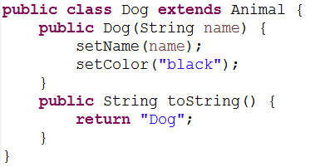
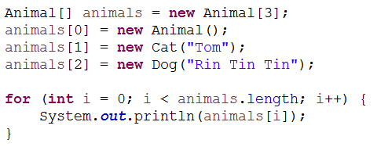
What is the output?

Slide 19
Polymorphism
Polymorphism
Helps build extensible systems
Programs generically process objects as superclass objects
Can add classes to systems easily
Classes must be part of generically processed hierarchy
Polymorphism gives us the capability to call the right method.

Slide 21
Compile Time vs. Runtime
What does compiler do?
Compiler interprets our code
Then what happens in runtime?
At runtime, the environment executes the interpreted code
There are two steps of our programs:
Compiler time
Runtime
Compile time decisions are based on reference type
Run time decisions are based on object type

Slide 22
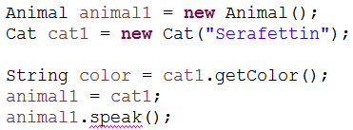
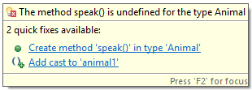
Compiler
Only knows about the reference type.
When a method is called, it looks for that method inside that particular reference type class.

Slide 23
Run time
At run time, the exact run time object is used to find where a method belongs to.
The method used needs to match with the signature of the actual method.
Example in the next slide...

Slide 24
toString() method
The method signatures match

Slide 25
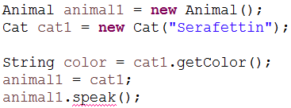
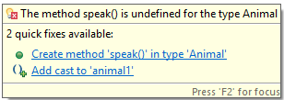
Is there a way to fix this?
Lets assume that animal1 will always refer to a cat object.

Slide 26
It is possible with explicit casting

Slide 27
Casting
Widening
Automatic type promotion (from int to double)
Super-class reference = sub-class object;
Narrowing
Explicit casting (from double to int)
Sub-class reference = (subclass) super-class reference;

Slide 28
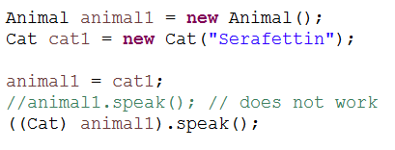
Casting
Compiler will search for speak method inside the cat class.

Slide 29
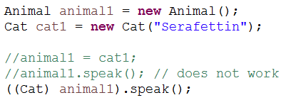
Casting
What do you think will happen at this point?

Slide 30
Casting
We won’t get a compiler error, relax
It will be worse, we will get a run time error

Slide 31
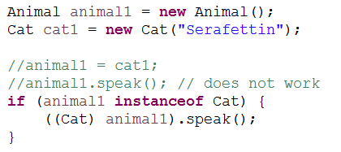
Casting
We need to make sure that we don’t cast wrong.
How?
By doing run time type check
instanceof operator
Checks whether there is an is a relationship

Slide 32
Final method
A method in the super class that cannot be overridden in a subclass.
Any idea which methods can be final?
Methods that are declared private are implicitly final, because it’s not possible to override them in a subclass.
Methods that are declared static are implicitly final.

Slide 33
Static vs. Dynamic Binding
A final method’s declaration can never change,
so all sub classes use the same method implementation, and calls to final methods are resolved at compile time—
this is known as static (early) binding.
Dynamic (late) binding: methods to be executed are determined in run time,
depending on the object type.

Slide 34
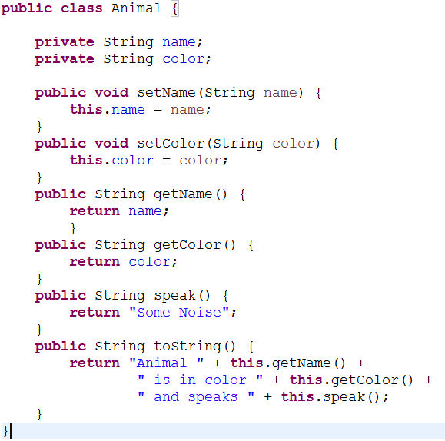
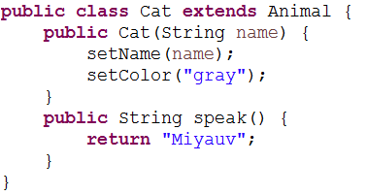
What is the output?

Slide 35
What is the output?

Slide 36
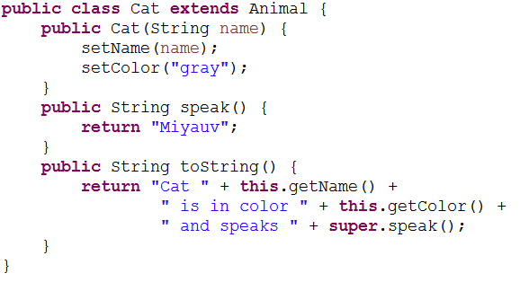
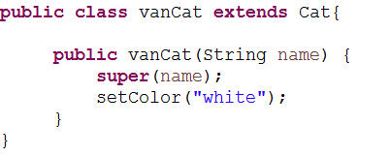
What is the output?

Slide 37
Call to the super.someMethod() get bound at compile time.
Call to the this.someMethod() get bound at run time.

Slide 38
Any Questions?

