Slide 1

CS105
Introduction to Object-Oriented Programming
Prof. Dr. Nizamettin AYDIN
naydin@itu.edu.tr
nizamettin.aydin@ozyegin.edu.tr

Slide 2
Inheritance

Slide 3
Outline
Inheritance Hierarchies
Inheritance
protected Members
Class Hierarchy
Extending from Object Class
Derived Classes
Constructors
super();
Constructor Call
Overriding (Overwriting)
Overloading vs. Overriding

Slide 4
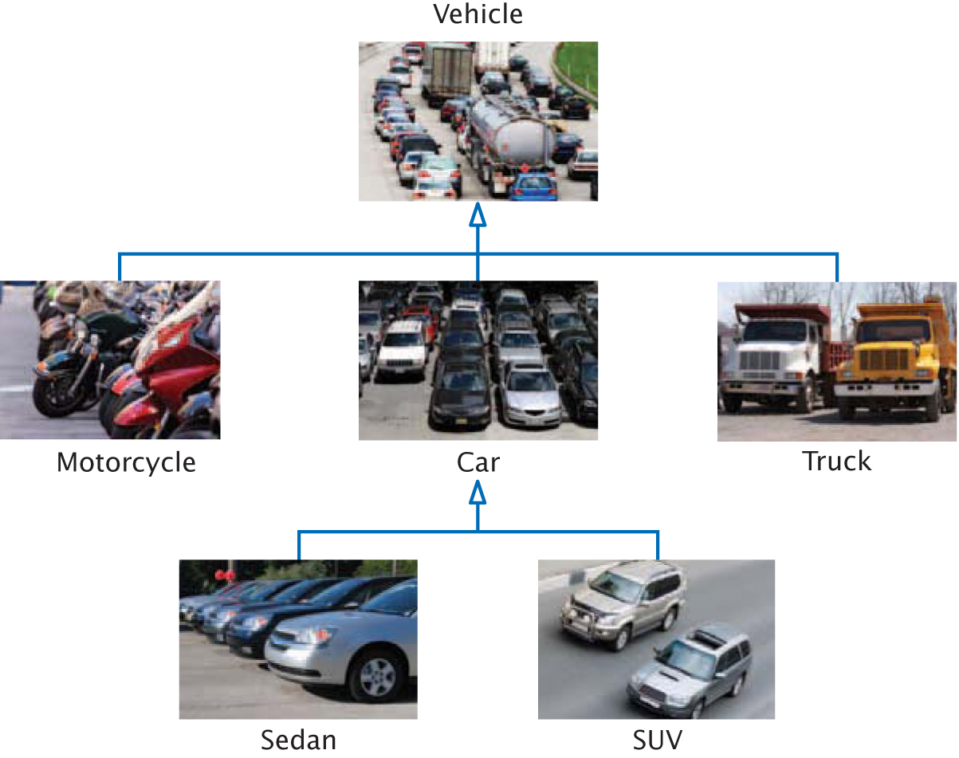
Inheritance Hierarchies

Slide 5
Inheritance
In object-oriented design, inheritance is a relationship between
  a more general class (called the base class)
  and
  a more specialized class (called the derived class).
Classes are created from existing ones
  Absorbing attributes and behaviors
    The derived class inherits data and behavior from the base class.
    Adding new capabilities
Software reusability
Every car (in previous slide) is a vehicle.
IS-A
  denotes inheritance.

Slide 6
Inheritance
The IS-A Relationship
  All Cars are Vehicles.
  All Motorcycles are Vehicles.
  All Sedans are Vehicles.
Vehicles is the base class.
Car is a derived class.
Truck derives from Vehicle

Slide 7
Inheritance
Everything about being a Vehicle is inherited by Cars and Trucks and SUVs.
Those things specific to Cars are only inherited by Sedans and SUVs.

Slide 8
Inheritance
The Substitution Principle:
The substitution principle states that you can always use a derived-class object when a base-class object is expected.
Suppose we have an algorithm or function that manipulates a Vehicle object.
Since a car IS-A vehicle, we can supply a Car object to such an algorithm or function, and it will work correctly.

Slide 9
Inheritance
Superclasses and Subclasses
“Is a” Relationship
  Object “is an” object of another class
    Rectangle “is a” quadrilateral
      Class Rectangle inherits from class Quadrilateral
  Form tree-like hierarchical structures
Superclass | Subclasses
Student | GraduateStudent UndergraduateStudent
Shape | Circle Triangle Rectangle
Loan | CarLoan HomeImprovementLoan MortgageLoan
Employee | FacultyMember StaffMember
Account | CheckingAccount SavingsAccount
Some simple inheritance examples in which the subclass “is a” superclass.

Slide 10
Inheritance
An inheritance hierarchy for university CommunityMembers.
CommunityMember is a direct superclass of Employee
CommunityMember is an indirect superclass of Faculty

Slide 11
Inheritance
A portion of a Shape class hierarchy.

Slide 12
protected Members
protected access members
  Between public and private in protection
  Accessed only by
    Superclass methods
    Subclass methods
    Methods of classes in same package
      package access
Relationship between Superclass and Subclass Objects:
Subclass object
  can be treated as superclass object
    Reverse is not true
      Shape is not always a Circle
  Every class implicitly extends java.lang.Object
    Unless specified otherwise in class definition’s first line

Slide 13
1 // Fig. 9.4: Point.java
2 // Definition of class Point
3
4 public class Point {
5 protected int x, y; // coordinates of Point
6
7 // No-argument constructor
8 public Point()
9 {
10 // implicit call to superclass constructor occurs here
11 setPoint( 0, 0 );
12 }
13
14 // constructor
15 public Point( int xCoordinate, int yCoordinate )
16 {
17 // implicit call to superclass constructor occurs here
18 setPoint( xCoordinate, yCoordinate );
19 }
20
21 // set x and y coordinates of Point
22 public void setPoint( int xCoordinate, int yCoordinate )
23 {
24 x = xCoordinate;
25 y = yCoordinate;
26 }
27
28 // get x coordinate
29 public int getX()
30 {
31 return x;
32 }
33
protected members prevent clients from direct access (unless clients are Point subclasses or are in same package)
Point.java
Line 5
protected members prevent clients from direct access (unless clients are Point subclasses or are in same package)

Slide 14
34 // get y coordinate
35 public int getY()
36 {
37 return y;
38 }
39
40 // convert into a String representation
41 public String toString()
42 {
43 return "[" + x + ", " + y + "]";
44 }
45
46 } // end class Point
Point.java

Slide 15
1 // Fig. 9.5: Circle.java
2 // Definition of class Circle
3
4 public class Circle extends Point { // inherits from Point
5 protected double radius;
6
7 // no-argument constructor
8 public Circle()
9 {
10 // implicit call to superclass constructor occurs here
11 setRadius( 0 );
12 }
13
14 // constructor
15 public Circle( double circleRadius, int xCoordinate,
16 int yCoordinate )
17 {
18 // call superclass constructor to set coordinates
19 super( xCoordinate, yCoordinate );
20
21 // set radius
22 setRadius( circleRadius );
23 }
24
25 // set radius of Circle
26 public void setRadius( double circleRadius )
27 {
28 radius = ( circleRadius >= 0.0 ? circleRadius : 0.0 );
29 }
30
Circle.java
Line 4
Circle is a Point subclass
Line 4
Circle inherits Point’s protected variables and public methods (except for constuctor)
Line 10
Implicit call to Point constructor
Line 19
Explicit call to Point constructor using super
Circle is a Point subclass
Circle inherits Point’s protected variables and public methods (except for constuctor)
Implicit call to Point constructor
Explicit call to Point constructor using super

Slide 16
31 // get radius of Circle
32 public double getRadius()
33 {
34 return radius;
35 }
36
37 // calculate area of Circle
38 public double area()
39 {
40 return Math.PI * radius * radius;
41 }
42
43 // convert the Circle to a String
44 public String toString()
45 {
46 return "Center = " + "[" + x + ", " + y + "]" +
47 "; Radius = " + radius;
48 }
49
50 } // end class Circle
Circle.java
Lines 44-48
Override method toString of class Point by using same signature
Override method toString of class Point by using same signature

Slide 17
1 // Fig. 9.6: InheritanceTest.java
2 // Demonstrating the "is a" relationship
3
4 // Java core packages
5 import java.text.DecimalFormat;
6
7 // Java extension packages
8 import javax.swing.JOptionPane;
9
10 public class InheritanceTest {
11
12 // test classes Point and Circle
13 public static void main( String args[] )
14 {
15 Point point1, point2;
16 Circle circle1, circle2;
17
18 point1 = new Point( 30, 50 );
19 circle1 = new Circle( 2.7, 120, 89 );
20
21 String output = "Point point1: " + point1.toString() +
22 "\nCircle circle1: " + circle1.toString();
23
24 // use "is a" relationship to refer to a Circle
25 // with a Point reference
26 point2 = circle1; // assigns Circle to a Point reference
27
28 output += "\n\nCircle circle1 (via point2 reference): " +
29 point2.toString();
30
31 // use downcasting (casting a superclass reference to a
32 // subclass data type) to assign point2 to circle2
33 circle2 = ( Circle ) point2;
34
InheritanceTest.java
Lines 18-19
Instantiate objects
Line 22
Circle invokes method toString
Line 26
Superclass object references subclass
Line 29
Point invokes Circle’s toString method
Line 33
Downcast Point to Circle
Instantiate Point and Circle objects
Circle invokes its overridden toString method
Superclass object can reference subclass object
Point still invokes Circle’s overridden toString method
Downcast Point to Circle

Slide 18
Circle invokes its overridden toString method
35 output += "\n\nCircle circle1 (via circle2): " +
36 circle2.toString();
37
38 DecimalFormat precision2 = new DecimalFormat( "0.00" );
39 output += "\nArea of c (via circle2): " +
40 precision2.format( circle2.area() );
41
42 // attempt to refer to Point object with Circle reference
43 if ( point1 instanceof Circle ) {
44 circle2 = ( Circle ) point1;
45 output += "\n\ncast successful";
46 }
47 else
48 output += "\n\npoint1 does not refer to a Circle";
49
50 JOptionPane.showMessageDialog( null, output,
51 "Demonstrating the \"is a\" relationship",
52 JOptionPane.INFORMATION_MESSAGE );
53
54 System.exit( 0 );
55 }
56
57 } // end class InheritanceTest
InheritanceTest.java
Line 36
Circle invokes its overridden toString method
Line 40
Circle invokes method area
Line 43
Use instanceof to determine if Point refers to Circle
Line 44
If Point refers to Circle, cast Point as Circle
Circle invokes method area
Use instanceof to determine if Point refers to Circle
If Point refers to Circle, cast Point as Circle

Slide 19
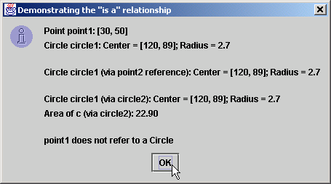
Assigning subclass references to superclass references

Slide 21
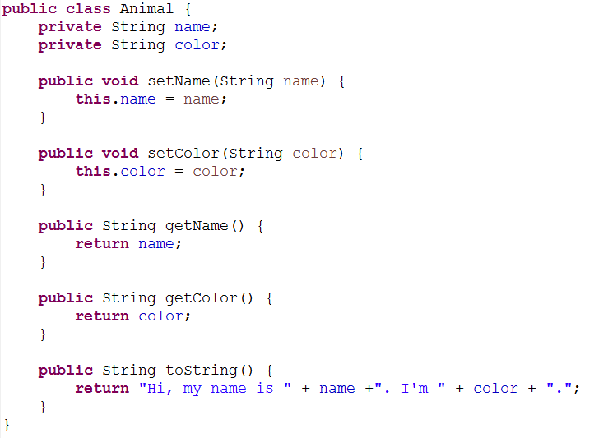
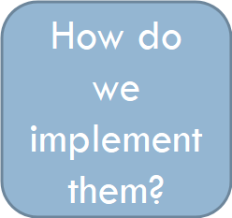
Animal Class
Assume that we have an animal class
  Attributes
    Name
    Color
  Behaviors
    Speak
    Do they all speak the same way?
      Dogs bark
      Cats meow
      Cows moo
      Ducks quack
      ....

Slide 22
Different type of animals
We will talk about two bad solutions:
  First way:
    Inside the same class
  Second way:
    Writing a different class

Slide 23
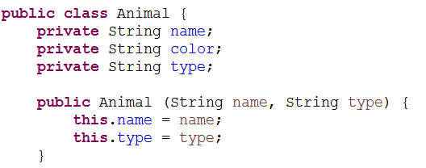
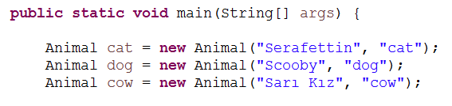
First Way – Inside the same class
Need to hold an additional attribute:
  Type of the animal
Main:

Slide 24
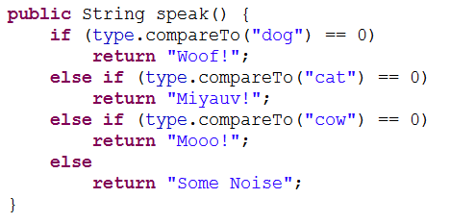
First Way – Inside the same class
Speak function
  Check the type of the animal and speak accordingly

Slide 25
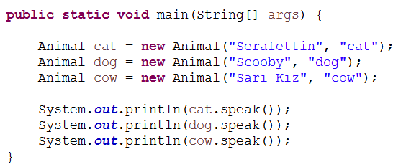

First Way – Inside the same class
Main:

Slide 26

First Way – Problem 1
Many dog types, all bark differently
  Loudness
  Pace
  ...
Do we need to
define another dog
type variable?

Slide 27
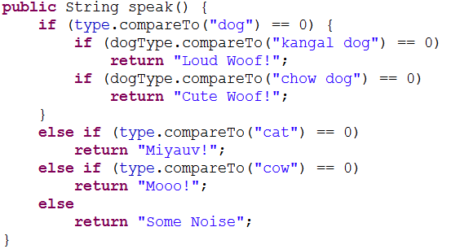

First Way – Problem 1
Many dog types, all bark differently
  Loudness
  Pace
  ...

Slide 28



First Way – Problem 2
Jumping is behavior of some animals
cat, dog can jump but not the fish...
In main, we should not call jump for fish, but right now we can as follows:

Slide 29
Different type of animals
We will talk about two bad solutions:
  First way:
    Inside the same class
  Second way:
    Writing a different class
Second way: Class for each type
  We will have individual classes for each animal.

Slide 30
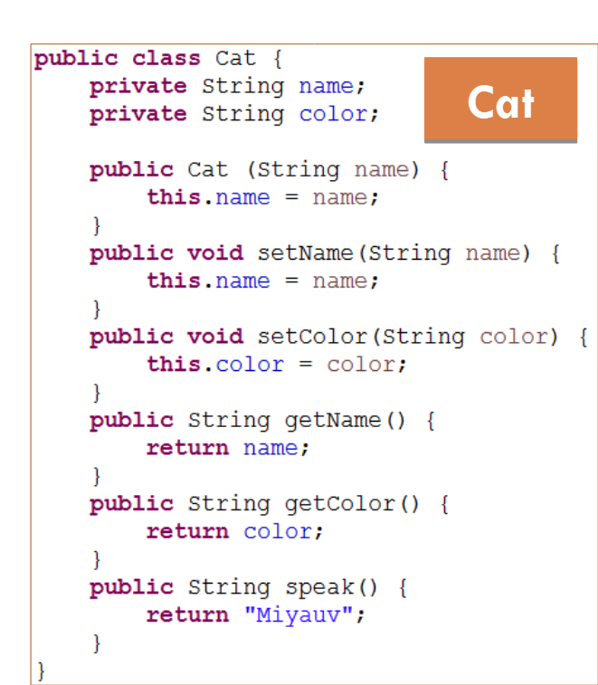
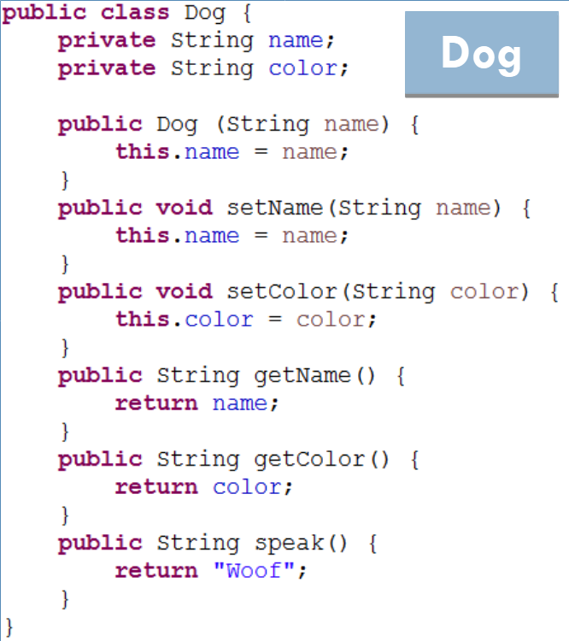
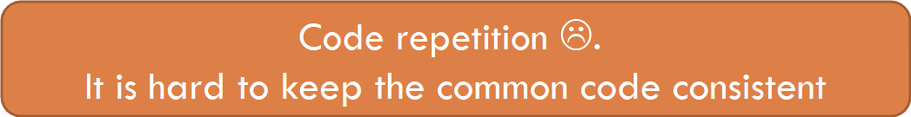
Second way: Class for each type

Slide 31

Different type of animals
We will talk about two bad solutions:
  First way:
    Inside the same class
  Second way:
    Writing a different class
A good solution is to use inheritance
  Keep the common attributes and functionalities in one class
  Split only the different attributes and functionalities in different classes.

Slide 32
Inheritance
A class can inherit some of its attibutes and behaviors from another class.
A derived class inherits from the base class.
A sub class inherits from/extends the super class.
Keep the common attributes and functionalities in one class
  Animal class
    name and color
    setter and getter functions
Split only the different attributes and functionalities in different classes.
  Cat, dog, cow ... classes
    speak, jump function

Slide 33
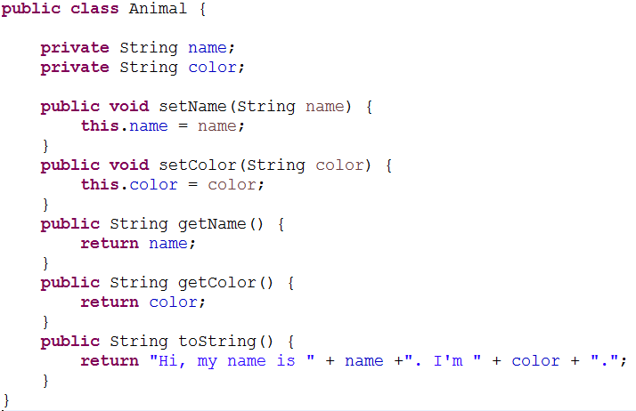
Animal Class

Slide 34
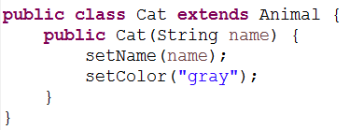
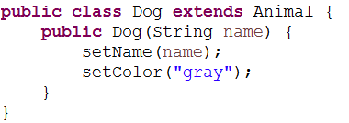
Cat and Dog Classes
inherits from

Slide 35
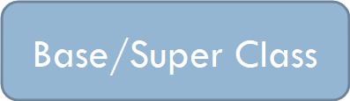
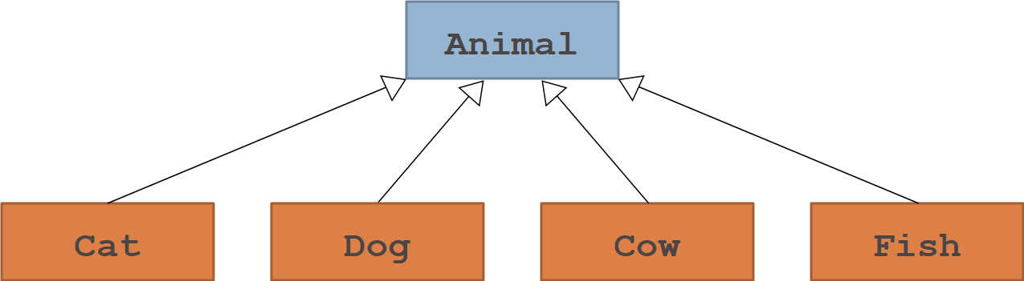
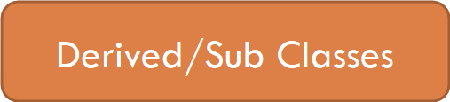
Class Hierarchy
Classes in Java form hierarchies.
Animal class represent all animal objects.
The four subclasses correspond to particular animal type object.

Slide 36
Class Hierarchy
This class diagram shows that Cat, Dog, Cow and Fish is also an Animal but the inverse is NOT TRUE.
Any animal is not a Cat, any Animal is not a Dog, etc.

Slide 37
Class Hierarchy
Can the Animal class be also a derived class?
When you define a new class in Java, that class automatically inherits the behavior of its superclass.
If no superclass is defined, by default, the class will inherit from the Object class.

Slide 38
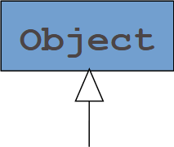
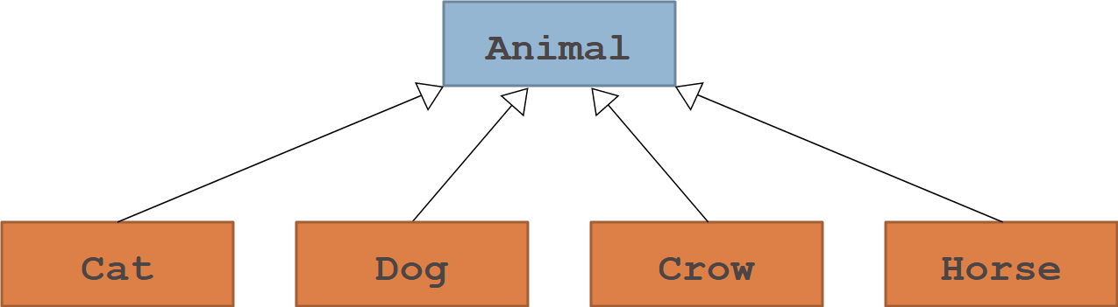
Class Hierarchy

Slide 39


Extending from Object Class
is the same as
The extends clause on the header line specifies the name of the superclass.
If the extends clause is missing, the new class becomes a direct subclass of Object, which is the root of Java’s class hierarchy.

Slide 40
Class Hierarchy
Except for the class named Object that stands at the top of the hierarchy, every class in Java is a subclass of some other class.

Slide 41
Lets get back to our Animal class

Slide 42
Derived Classes
Instead of calling the set methods can we just modify the name and color directly?

Slide 43
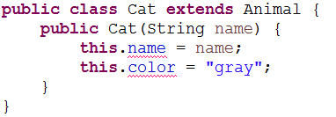
Derived Classes
What is the problem?

Slide 44

Derived Classes
The name and color is private therefore cannot be accessed from the derived/sub class Cat.
Therefore we need to use the getters and setters method to reach these private class instances.

Slide 45
What is inherited?
All class instances and functions of the base/super class are inherited.
But not all of them are visible from the sub class
  Public and protected ones are visible
  Default and private ones are NOT visible
    Please note that default ones are visible if they are in the same package.
  These can be accessed only through getter and setter functions.

Slide 46
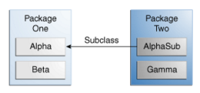
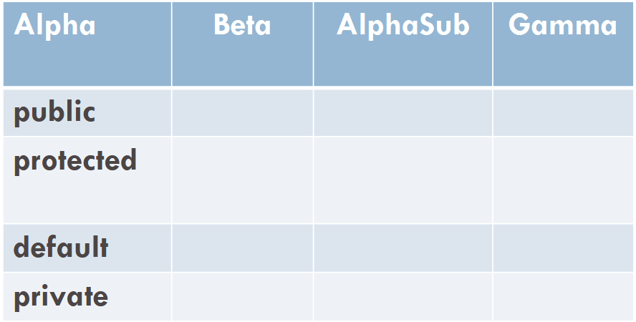
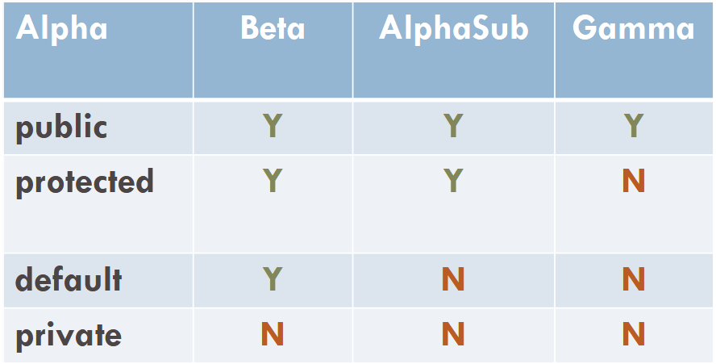
Remember Visibility

Slide 47
Lets get back to our Animal class

Slide 48
Constructors
What happens inside this constructor?
Initially the default constructor of the super class is called by compiler.
Whenever you create an object of an extended class, Java must call some constructor for the super class object to ensure that its structure is correctly initialized.

Slide 49
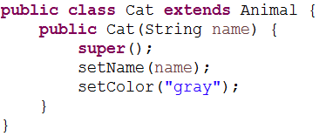
Constructors
Below two are the same!

Slide 50
super();
Similar to this();
this(arg); // same class constructor call
super(arg); // super class constructor call
Both of these need to be used in the first line of the constructor.
If not, then default super() will be included by compiler

Slide 51
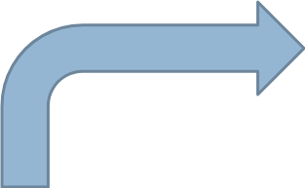
Constructor Call

Slide 52

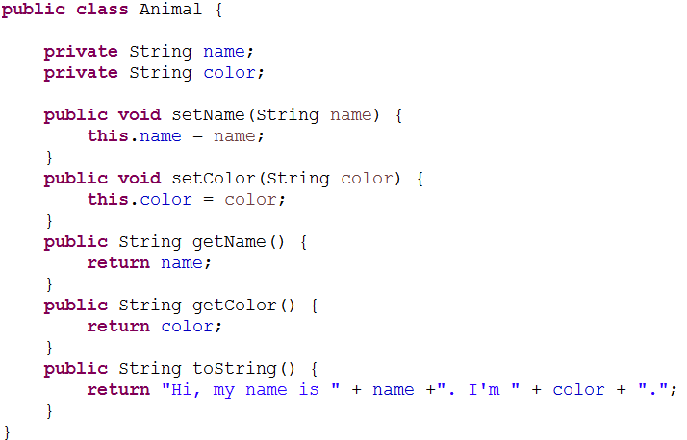
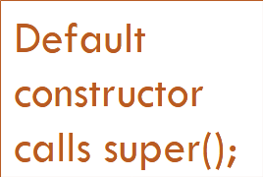
Constructor Call

Slide 53
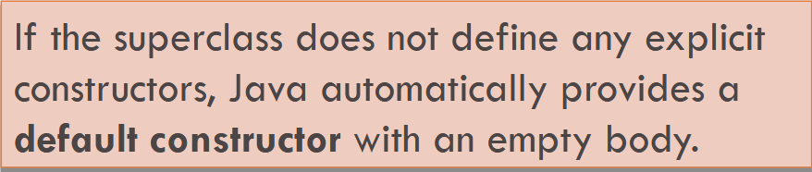
Constructor Call

Slide 54
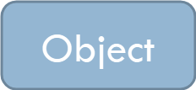
Constructor Call

Slide 55
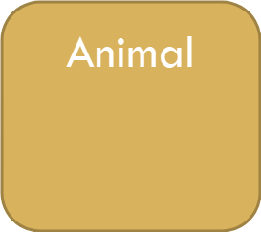

Constructor Call

Slide 56
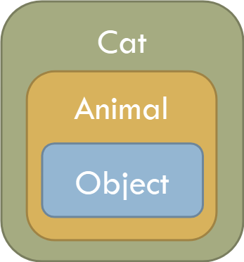
Constructor Call

Slide 57
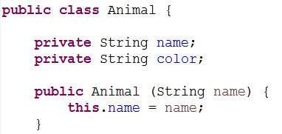
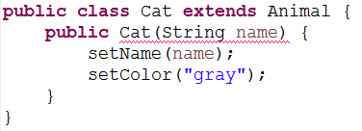
Explicit Animal Constructor
Lets have an explicit Animal constructor

Slide 58
Explicit Animal Constructor
Lets have an explicit Animal constructor

Slide 59
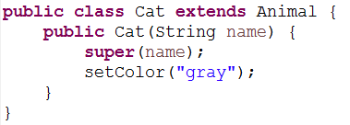

Slide 60
Constructor Calls
Java therefore invokes the superclass constructor in one of the following ways:
  Classes that begin with an explicit call to this invoke one of the other constructors for this class, delegating responsibility to that constructor for making sure that the superclass constructor gets called.
  Classes that begin with a call to super invoke the constructor in the super class that matches the argument list provided.
  Classes that begin with no call to either super or this invoke the default super class constructor with no arguments.

Slide 61
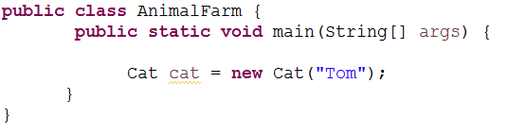
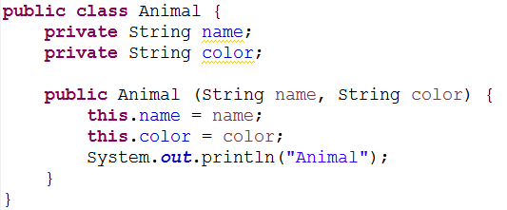
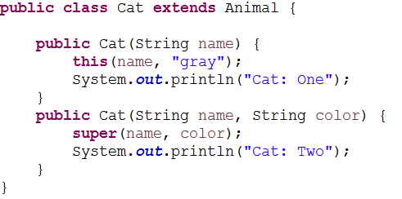

Example
What is the output?

Slide 62
Lets implement some functions
Animals speak differently, so speak function needs to be implemented differently.
In animal class we don’t have a speak() function

Slide 63
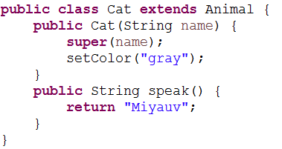
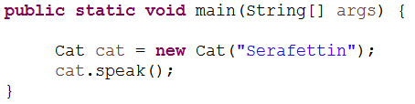
Cat Class
Speak function implemented within the Cat class.

Slide 64
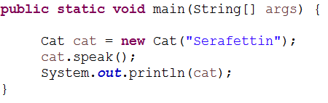

toString method
Can we call the toString method from a cat object?
Yes, we can.
What will be the output?

Slide 65
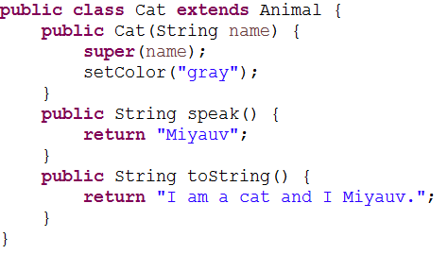
toString method
Can the Cat class has its own toString function?

Slide 66
Overriding (Overwriting)
Yes, it can.
  It is called function overriding.
A subclass may redefine a method that is defined by a superclass.
  In this case, it is said that the subclass overrides the method.
When one class extends another, the subclass is allowed to override method definitions in its superclass.
Whenever you invoke that method on an instance of the extended class, Java chooses the new version of the method provided by that class and not the original version provided by the superclass.
The decision about which version of a method to use is always made on the basis of what the type of object in fact is (run-time) and not on what it happens to be declared as at that point in the code (compile-time).

Slide 67

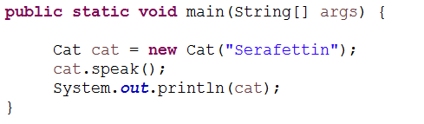
What will be the output?

Slide 68

toString method
Cat is still an animal.
How can I print animal representation as well as the cat representation?
How can I print out the following from the above main?

Slide 69
If you need to invoke the original version of a method, you can do so by using the keyword super as a receiver.
For example, if you needed to call the original version of an init method as specified by the superclass, you could call

Slide 70
Overloading vs. Overriding
What is the difference between these two?
Overloading
  Same class has the same function name but with different parameters.
Overriding
  Subclass has the same function signature (name and parameters) with the superclass

Slide 71
toString method in Animal Class
Is toString an overriding function or not?
  Yes, it overrides the toString method of the Object class

Slide 72
Any Questions?

