Slide 1

CS105
Introduction to Object-Oriented Programming
Prof. Dr. Nizamettin AYDIN
naydin@itu.edu.tr
nizamettin.aydin@ozyegin.edu.tr

Slide 2
ArrayList

Slide 3
Outline
Arrays
Declaring and Allocating Arrays
Allocating an Array and Initializing Its Elements
Using an Initializer List to Initialize Elements of an Array
Calculating the Value to Store in Each Array Element
Summing the Elements of an Array
Using Histograms to Display Array Data Graphically
Using the Elements of an Array as Counters
Using Arrays to Analyze Survey Results
Passing Arrays to Methods
The ArrayList Class
The ArrayList Class

Slide 4
Arrays
Array
  Group of contiguous memory locations
  Each memory location has same name
  Each memory location has same type
    A 12-element array.
c[ 0 ]
-45
6
0
72
1543
-89
0
62
-3
1
6453
78
c[ 1 ]
c[ 2 ]
c[ 3 ]
Name of array (Note
that all elements of
this array have the
same name, c)
c[ 4 ]
c[ 5 ]
c[ 6 ]
c[ 7 ]
c[ 8 ]
Position number (index
of subscript) of the
element within array c
c[ 9 ]
c[ 10 ]
c[ 11 ]

Slide 5
Arrays
Subscript
  Also called an index
  Position number in square brackets
  Must be integer or integer expression
  a = 5;
  b = 6;
  c[ a + b ] += 2;
    Adds 2 to c[ 11 ]
    Subscripted array name is an lvalue
Examine array c
  c is the array name
  c.length accesses array c’s length
  c has 12 elements ( c[0], c[1], … c[11] )
    The value of c[0] is –45
    The brackets ([]) are in highest level of precedence in Java

Slide 6
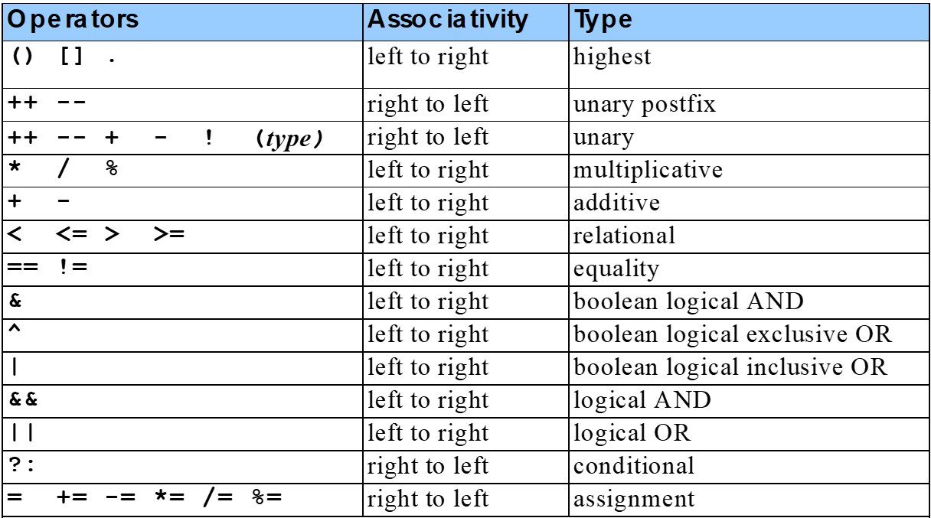
Arrays
Precedence and associavity of the operators

Slide 7
Declaring and Allocating Arrays
Declaring and Allocating arrays
  Arrays are objects that occupy memory
  Allocated dynamically with operator new
    int c[] = new int[ 12 ];
      Equivalent to
      int c[]; // declare array
      c = new int[ 12 ]; // allocate array
    We can allocate arrays of objects too
      String b[] = new String[ 100 ];

Slide 8
Allocating an Array and Initializing Its Elements
1 // Fig. 7.3: InitArray.java
2 // Creating an array.
3
4 // Java extension packages
5 import javax.swing.*;
6
7 public class InitArray {
8
9 // main method begins execution of Java application
10 public static void main( String args[] )
11 {
12 int array[]; // declare reference to an array
13
14 array = new int[ 10 ]; // dynamically allocate array
15
16 String output = "Subscript\tValue\n";
17
18 // append each array element's value to String output
19 for ( int counter = 0; counter < array.length; counter++ )
20 output += counter + "\t" + array[ counter ] + "\n";
21
22 JTextArea outputArea = new JTextArea();
23 outputArea.setText( output );
24
25 JOptionPane.showMessageDialog( null, outputArea,
26 "Initializing an Array of int Values",
27 JOptionPane.INFORMATION_MESSAGE );
28
29 System.exit( 0 );
30 }
31 }
Declare array as an array of ints
InitArray.java
Line 12
Declare array as an array of ints
Line 14
Allocate 10 ints for array; each int is initialized to 0 by default
Line 19
array.length returns length of array
Line 20
array[counter] returns int associated with index in array
Allocate 10 ints for array; each int is initialized to 0 by default
array.length returns length of array
array[counter] returns int associated with index in array

Slide 9
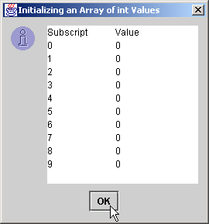
Allocating an Array and Initializing Its Elements
Each int is initialized to 0 by default

Slide 10
Using an Initializer List to Initialize Elements of an Array
Initialize array elements
  Use initializer list
    Items enclosed in braces ({})
    Items in list separated by commas
    int n[] = { 10, 20, 30, 40, 50 };
      Creates a five-element array
      Subscripts of 0, 1, 2, 3, 4
  Do not need operator new

Slide 11
Using an Initializer List to Initialize Elements of an Array
1 // Fig. 7.4: InitArray.java
2 // Initializing an array with a declaration.
3
4 // Java extension packages
5 import javax.swing.*;
6
7 public class InitArray {
8
9 // main method begins execution of Java application
10 public static void main( String args[] )
11 {
12 // initializer list specifies number of elements and
13 // value for each element
14 int array[] = { 32, 27, 64, 18, 95, 14, 90, 70, 60, 37 };
15
16 String output = "Subscript\tValue\n";
17
18 // append each array element's value to String output
19 for ( int counter = 0; counter < array.length; counter++ )
20 output += counter + "\t" + array[ counter ] + "\n";
21
22 JTextArea outputArea = new JTextArea();
23 outputArea.setText( output );
24
25 JOptionPane.showMessageDialog( null, outputArea,
26 "Initializing an Array with a Declaration",
27 JOptionPane.INFORMATION_MESSAGE );
28
29 System.exit( 0 );
30 }
31 }
Declare array as an array of ints
InitArray.java
Line 14
Declare array as an array of ints
Line 14
Compiler uses initializer list to allocate array
Compiler uses initializer list to allocate array

Slide 12
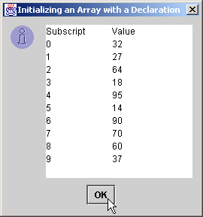
Using an Initializer List to Initialize Elements of an Array
Each array element corresponds to element in initializer list

Slide 13
Calculating the Value to Store in Each Array Element
Calculate value stored in each array element
  Initialize elements of 10-element array to even integers

Slide 14
1 // Fig. 7.5: InitArray.java
2 // Initialize array with the even integers from 2 to 20.
3
4 // Java extension packages
5 import javax.swing.*;
6
7 public class InitArray {
8
9 // main method begins execution of Java application
10 public static void main( String args[] )
11 {
12 final int ARRAY_SIZE = 10;
13 int array[]; // reference to int array
14
15 array = new int[ ARRAY_SIZE ]; // allocate array
16
17 // calculate value for each array element
18 for ( int counter = 0; counter < array.length; counter++ )
19 array[ counter ] = 2 + 2 * counter;
20
21 String output = "Subscript\tValue\n";
22
23 for ( int counter = 0; counter < array.length; counter++ )
24 output += counter + "\t" + array[ counter ] + "\n";
25
26 JTextArea outputArea = new JTextArea();
27 outputArea.setText( output );
28
29 JOptionPane.showMessageDialog( null, outputArea,
30 "Initializing to Even Numbers from 2 to 20",
31 JOptionPane.INFORMATION_MESSAGE );
32
33 System.exit( 0 );
34 }
35 }
Declare array as an array of ints
InitArray.java
Line 13
Declare array as an array of ints
Line 15
Allocate 10 ints for array
Line 19
Use array subscript to assign array value
Allocate 10 ints for array
Use array subscript to assign array value

Slide 15
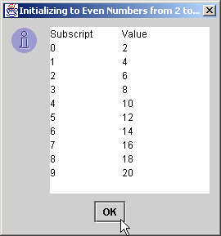
Calculating the Value to Store in Each Array Element

Slide 16
Summing the Elements of an Array
Array elements
  Can represent a series of values
    We can sum these values

Slide 17
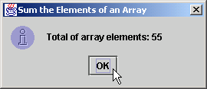
1 // Fig. 7.6: SumArray.java
2 // Total the values of the elements of an array.
3
4 // Java extension packages
5 import javax.swing.*;
6
7 public class SumArray {
8
9 // main method begins execution of Java application
10 public static void main( String args[] )
11 {
12 int array[] = { 1, 2, 3, 4, 5, 6, 7, 8, 9, 10 };
13 int total = 0;
14
15 // add each element's value to total
16 for ( int counter = 0; counter < array.length; counter++ )
17 total += array[ counter ];
18
19 JOptionPane.showMessageDialog( null,
20 "Total of array elements: " + total,
21 "Sum the Elements of an Array",
22 JOptionPane.INFORMATION_MESSAGE );
23
24 System.exit( 0 );
25 }
26 }
SumArray.java
Line 12
Declare array with initializer list
Line 17
Sum all array values
Declare array with initializer list
Sum all array values

Slide 18
Using Histograms to Display Array Data Graphically
Present array values graphically
  Histogram
    Plot each numeric value as bar of asterisks (*)

Slide 19
1 // Fig. 7.7: Histogram.java
2 // Histogram printing program.
3
4 // Java extension packages
5 import javax.swing.*;
6
7 public class Histogram {
8
9 // main method begins execution of Java application
10 public static void main( String args[] )
11 {
12 int array[] = { 19, 3, 15, 7, 11, 9, 13, 5, 17, 1 };
13
14 String output = "Element\tValue\tHistogram";
15
16 // for each array element, output a bar in histogram
17 for ( int counter = 0; counter < array.length; counter++ ) {
18 output +=
19 "\n" + counter + "\t" + array[ counter ] + "\t";
20
21 // print bar of asterisks
22 for ( int stars = 0; stars < array[ counter ]; stars++ )
23 output += "*";
24 }
25
26 JTextArea outputArea = new JTextArea();
27 outputArea.setText( output );
28
29 JOptionPane.showMessageDialog( null, outputArea,
30 "Histogram Printing Program",
31 JOptionPane.INFORMATION_MESSAGE );
32
33 System.exit( 0 );
34 }
35 }
Declare array with initializer list
Histogram.java
Line 12
Declare array with initializer list
Line 23
For each array element, print associated number of asterisks
For each array element, print associated number of asterisks

Slide 20
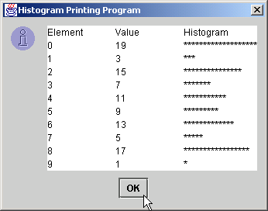
Using Histograms to Display Array Data Graphically

Slide 21
Using the Elements of an Array as Counters
Use series of counters to summarize data
  Array can store these counters

Slide 22
1 // Fig. 7.8: RollDie.java
2 // Roll a six-sided die 6000 times
3
4 // Java extension packages
5 import javax.swing.*;
6
7 public class RollDie {
8
9 // main method begins execution of Java application
10 public static void main( String args[] )
11 {
12 int face, frequency[] = new int[ 7 ];
13
14 // roll die 6000 times
15 for ( int roll = 1; roll <= 6000; roll++ ) {
16 face = 1 + ( int ) ( Math.random() * 6 );
17
18 // use face value as subscript for frequency array
19 ++frequency[ face ];
20 }
21
22 String output = "Face\tFrequency";
23
24 // append frequencies to String output
25 for ( face = 1; face < frequency.length; face++ )
26 output += "\n" + face + "\t" + frequency[ face ];
27
28 JTextArea outputArea = new JTextArea();
29 outputArea.setText( output );
30
31 JOptionPane.showMessageDialog( null, outputArea,
32 "Rolling a Die 6000 Times",
33 JOptionPane.INFORMATION_MESSAGE );
34
Declare frequency as array of 7 ints
RollDie.java
Line 12
Declare frequency as array of 7 ints
Lines 15-16
Generate 6000 random integers in range 1-6
Line 19
Increment frequency values at index associated with random number
Generate 6000 random integers in range 1-6
Increment frequency values at index associated with random number

Slide 23
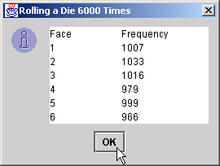
Using the Elements of an Array as Counters
35 System.exit( 0 );
36 }
37 }
RollDie.java

Slide 24
Using Arrays to Analyze Survey Results
Problem statement
  40 students rate the quality of food
    1-10 Rating scale: 1 mean awful, 10 means excellent
  Place 40 responses in array of integers
  Summarize results

Slide 25
1 // Fig. 7.9: StudentPoll.java
2 // Student poll program
3
4 // Java extension packages
5 import javax.swing.*;
6
7 public class StudentPoll {
8
9 // main method begins execution of Java application
10 public static void main( String args[] )
11 {
12 int responses[] = { 1, 2, 6, 4, 8, 5, 9, 7, 8, 10,
13 1, 6, 3, 8, 6, 10, 3, 8, 2, 7,
14 6, 5, 7, 6, 8, 6, 7, 5, 6, 6,
15 5, 6, 7, 5, 6, 4, 8, 6, 8, 10 };
16 int frequency[] = new int[ 11 ];
17
18 // for each answer, select value of an element of
19 // responses array and use that value as subscript in
20 // frequency array to determine element to increment
21 for ( int answer = 0; answer < responses.length; answer++ )
22 ++frequency[ responses[ answer ] ];
23
24 String output = "Rating\tFrequency\n";
25
26 // append frequencies to String output
27 for ( int rating = 1; rating < frequency.length; rating++ )
28 output += rating + "\t" + frequency[ rating ] + "\n";
29
30 JTextArea outputArea = new JTextArea();
31 outputArea.setText( output );
32
33 JOptionPane.showMessageDialog( null, outputArea,
34 "Student Poll Program",
35 JOptionPane.INFORMATION_MESSAGE );
Declare responses as array to store 40 responses
Declare frequency as array of 11 int and ignore the first element
StudentPoll.java
Lines 12-15
Declare responses as array to store 40 responses
Line 16
Declare frequency as array of 11 int and ignore the first element
Lines 21-22
For each response, increment frequency values at index associated with that response
For each response, increment frequency values at index associated with that response

Slide 26
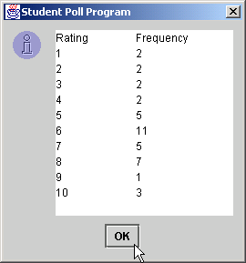
Using Arrays to Analyze Survey Results
36
37 System.exit( 0 );
38 }
39 }
StudentPoll.java

Slide 27
Using Arrays to Analyze Survey Results
Some additional points
  When looping through an array
    Subscript should never go below 0
    Subscript should be less than total number of array elements
  When invalid array reference occurs
    Java generates ArrayIndexOutOfBoundsException
      This is relevant to exception handling

Slide 28
Passing Arrays to Methods
To pass array argument to a method
  Specify array name without brackets
    Array hourlyTemperatures is declared as
  int hourlyTemperatures = new int[ 24 ];
  The method call
  modifyArray( hourlyTemperatures );
  Passes array hourlyTemperatures to method modifyArray

Slide 29
Passing Arrays to Methods
1 // Fig. 7.10: PassArray.java
2 // Passing arrays and individual array elements to methods
3
4 // Java core packages
5 import java.awt.Container;
6
7 // Java extension packages
8 import javax.swing.*;
9
10 public class PassArray extends JApplet {
11
12 // initialize applet
13 public void init()
14 {
15 JTextArea outputArea = new JTextArea();
16 Container container = getContentPane();
17 container.add( outputArea );
18
19 int array[] = { 1, 2, 3, 4, 5 };
20
21 String output =
22 "Effects of passing entire array by reference:\n" +
23 "The values of the original array are:\n";
24
25 // append original array elements to String output
26 for ( int counter = 0; counter < array.length; counter++ )
27 output += " " + array[ counter ];
28
29 modifyArray( array ); // array passed by reference
30
31 output += "\n\nThe values of the modified array are:\n";
32
33 // append modified array elements to String output
34 for ( int counter = 0; counter < array.length; counter++ )
35 output += " " + array[ counter ];
PassArray.java
Line 19
Declare 5-int array with initializer list
Line 29
Pass array by reference to method modifyArray
Declare 5-int array with initializer list
Pass array by reference to method modifyArray

Slide 30
Passing Arrays to Methods
36
37 output += "\n\nEffects of passing array " +
38 "element by value:\n" +
39 "a[3] before modifyElement: " + array[ 3 ];
40
41 // attempt to modify array[ 3 ]
42 modifyElement( array[ 3 ] );
43
44 output += "\na[3] after modifyElement: " + array[ 3 ];
45 outputArea.setText( output );
46
47 } // end method init
48
49 // multiply each element of an array by 2
50 public void modifyArray( int array2[] )
51 {
52 for ( int counter = 0; counter < array2.length; counter++ )
53 array2[ counter ] *= 2;
54 }
55
56 // multiply argument by 2
57 public void modifyElement( int element )
58 {
59 element *= 2;
60 }
61
62 } // end class PassArray
PassArray.java
Line 42
Pass array[3] by value to method modifyElement
Lines 50-54
Method modifyArray manipulates the array directly
Lines 57-60
Method modifyElement manipulates a primitive’s copy
Lines 59
The original primitive is left unmodified
Pass array[3] by value to method modifyElement
Method modifyArray manipulates the array directly
Method modifyElement manipulates a primitive’s copy
The original primitive is left unmodified

Slide 31
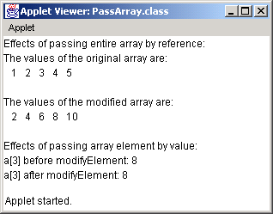
Passing Arrays to Methods
PassArray.java
The object passed-by-reference is modified
The primitive passed-by-value is unmodified
The object passed-by-reference is modified
The primitive passed-by-value is unmodified

Slide 32
The ArrayList Class
Arrays are conceptually important as a data structure,
  they are not used as much in Java as they are in most other languages.
The reason is that the java.util package includes a class called ArrayList that provides the standard array behavior along with other useful operations.
ArrayList is a Java class rather than a special form in the language.
  So, all operations on ArrayLists are indicated using method calls.
  For example,
    the most obvious differences include:
      You create a new ArrayList by calling the ArrayList constructor.
      You get the number of elements by calling the size method rather than by selecting a length field.
      You use the get and set methods to select individual elements.
      the most important methods in the
      The next slides summarize ArrayList class.
  The notation <T> indicates the base type.

Slide 33
Methods in the ArrayList Class
boolean add(<T> element)
  Adds a new element to the end of the ArrayList; the return value is always true.
void add(int index, <T> element)
  Inserts a new element into the ArrayList before the position specified by index.
<T> remove(int index)
  Removes the element at the specified position and returns that value.
boolean remove(<T> element)
  Removes the first instance of element, if it appears; returns true if a match is found.
void clear()
  Removes all elements from the ArrayList.
int size()
  Returns the number of elements in the ArrayList.
<T> get(int index)
  Returns the object at the specified index.
<T> set(int index, <T> value)
  Sets the element at the specified index to the new value and returns the old value.
  int indexOf(<T> value)
  Returns the index of the first occurrence of the specified value, or -1 if it does not appear.
boolean contains(<T> value)
  Returns true if the ArrayList contains the specified value.
boolean isEmpty()
  Returns true if the ArrayList contains no elements.

Slide 34
The ArrayList Class
int[] array1 = new int[5];
ArrayList<Integer> arrayList1 = new ArrayList<Integer>();
for(int i = 0; i < 5; i++) {
array1[i] = i;
}
for(int i = 0; i < 5; i++) {
// add a new element to the end of the list
arrayList1.add(i);
}

Slide 35
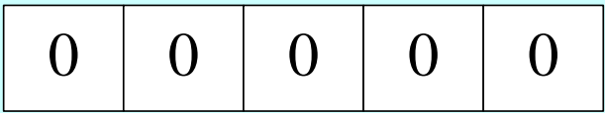
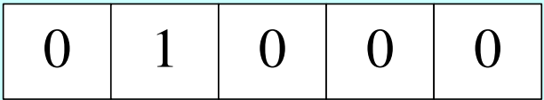
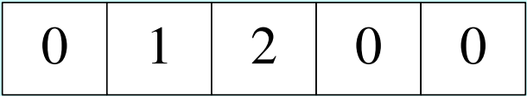
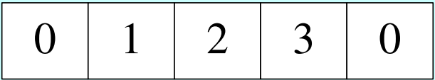
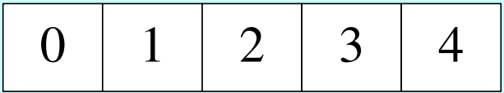
The ArrayList Class
int[] array1 = new int[5];
for(int i = 0; i < 5; i++) {
array1[i] = i;
}
i = 0 ➔ 0 0 0 0 0
i = 1 ➔ 0 1 0 0 0
i = 2 ➔ 0 1 2 0 0
i = 3 ➔ 0 1 2 3 0
i = 4 ➔ 0 1 2 3 4

Slide 36
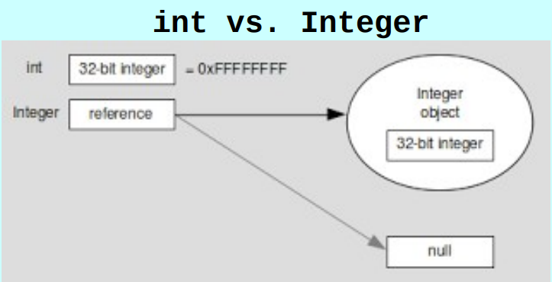
The ArrayList Class
ArrayList<Integer> arrayList1 = new ArrayList<Integer>();
for(int i = 0; i < 5; i++) {
// add a new element to the end of the list
arrayList1.add(i);
}
Java Collection classes do not accept primitive types.
  Instead they use
  wrapper classes.

Slide 37
The ArrayList Class
ArrayList<Integer> arrayList1 = new ArrayList<Integer>();
for(int i = 0; i < 5; i++) {
// add a new element to the end of the list
arrayList1.add(i);
}

Slide 38
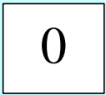
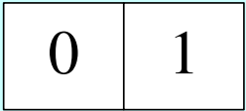
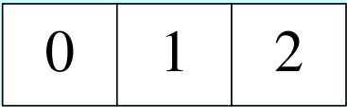
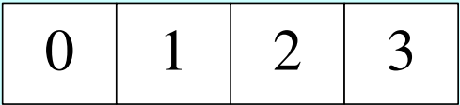
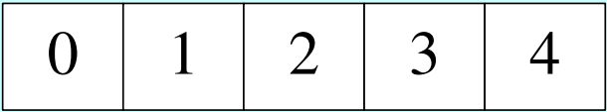
The ArrayList Class
ArrayList<Integer> arrayList1 = new ArrayList<Integer>();
for(int i = 0; i < 5; i++) {
// add a new element to the end of the list
arrayList1.add(i);
}
i = 0 ➔ 0
i = 1 ➔ 0 1
i = 2 ➔ 0 1 2
i = 3 ➔ 0 1 2 3
i = 4 ➔ 0 1 2 3 4

Slide 39
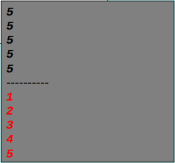
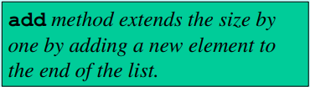
The ArrayList Class
int[] array1 = new int[5];
ArrayList<Integer> arrayList1 = new ArrayList<Integer>();
for(int i = 0; i < 5; i++) {
array1[i] = i;
println(array1.length);
}
for(int i = 0; i < 5; i++) {
// add a new element to the end of the list
arrayList1.add(i);
println(arrayList1.size());
}

Slide 40
The ArrayList Class
array[] = 42;
println(array[2]);
arrayList(2, 42);
println(arrayList.get(2));

Slide 41
The ArrayList Class
array[] = 42;
println(array[2]);
arrayList(2, 42);
println(arrayList.get(2));

Slide 42
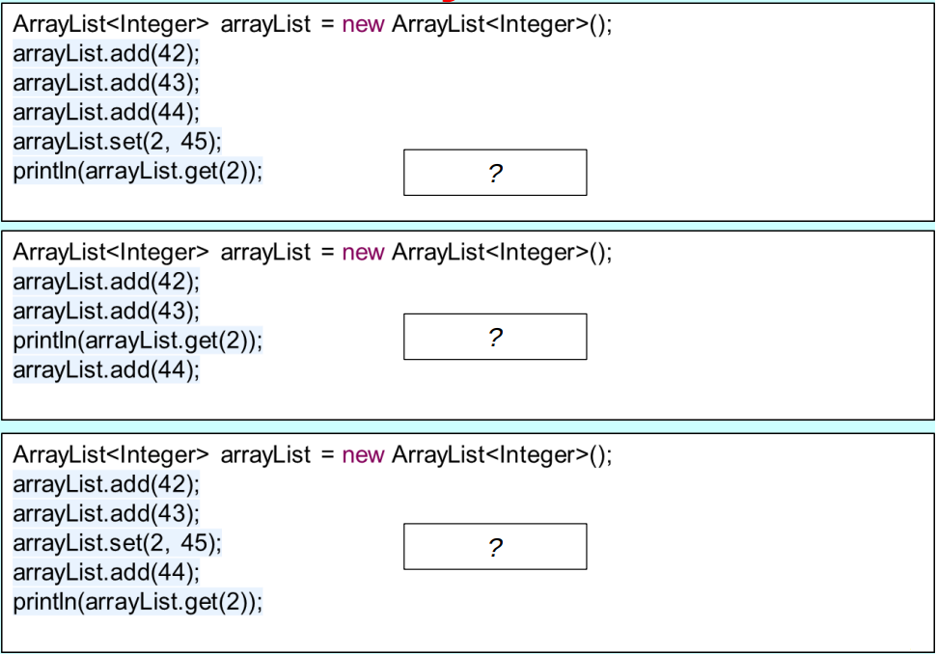
The ArrayList Class

Slide 43
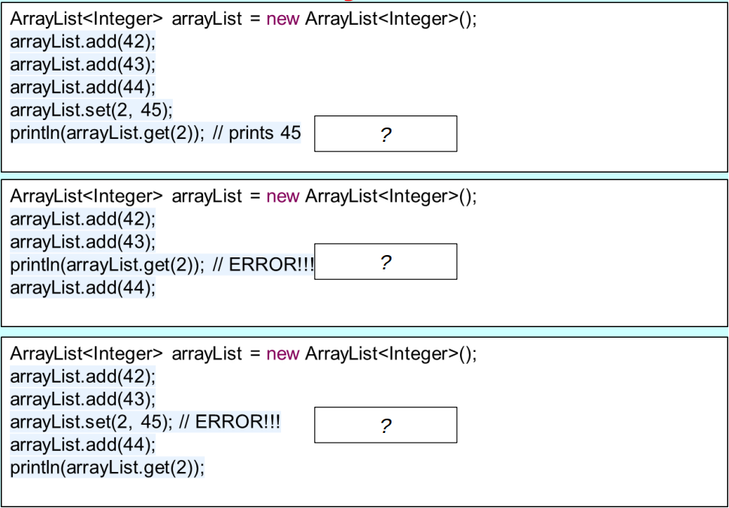
The ArrayList Class

Slide 44
The ArrayList Class
ArrayList<Integer> intList = new ArrayList<Integer>();
ArrayList<Double> doubleList = new ArrayList<Double>();
ArrayList<String> stringList = new ArrayList<String>();
intList.add(42);
doubleList.add(42.0);
stringList.add("42");
Generic Types in Java 5.0:
  The <T> notation used on the preceding slide is a new feature of Java that was introduced with version 5.0 of the language.
  In the method descriptions, the <T> notation is a placeholder for the element type used in the array.
  Class definitions that include a type parameter are called generic types.

Slide 45
Generic Types in Java 5.0
The <T> notation used on the preceding slide is a new feature of Java that was introduced with version 5.0 of the language.
In the method descriptions, the <T> notation is a placeholder for the element type used in the array.
Class definitions that include a type parameter are called generic types.
When you declare or create an ArrayList, it is a good idea to specify the element type in angle brackets.
  For example, to declare and initialize an ArrayList called names that contains elements of type String, you would write
ArrayList<String> names = new ArrayList<String>();

Slide 46
Generic Types in Java 5.0
The advantage of specifying the element type is that Java now knows what type of value the ArrayList contains.
When you call set, Java can ensure that the value matches the element type.
When you call get, Java knows what type of value to expect, eliminating the need for a type cast.

Slide 47
Any Questions?

