Slide 1

CS105
Introduction to Object-Oriented Programming
Prof. Dr. Nizamettin AYDIN
naydin@itu.edu.tr
nizamettin.aydin@ozyegin.edu.tr

Slide 2
Information Systems
Fundamentals

Slide 3
Outline
Definition of Informatics
Data - Information - I Knowledge
Definition of System
Information Systems
Digital Systems
A Digital Computer Example
Transducers
Analogue/Digital Conversion
Sampling
Measures in Computers
Data Formats
Data Representation
Number Systems
Codes
Logic

Slide 4
Informatics
The term informatics broadly describes the study and practice of creating, storing, finding, manipulating, sharing information.
Etymology:
  In 1956 the German computer scientist Karl Steinbuch coined the word Informatik
      [Informatik: Automatische Informationsverarbeitung
        ("Informatics: Automatic Information Processing")]
  The French term informatique was coined in 1962 by Philippe Dreyfus
      [Dreyfus, Phillipe. L’informatique. Gestion, Paris, June 1962, pp. 240–41]
  The term was coined as a combination of information and automatic to describe the science of automating information interactions

Slide 5
Informatics
The morphology
  informat-ion + -ics
    uses the accepted form for names of sciences,
      as conics, linguistics, optics,
    or matters of practice,
      as economics, politics, tactics
Linguistically, the meaning extends easily
  to encompass both
    the science of information
    the practice of information processing

Slide 6
Data - Information - Knowledge
Data
  unprocessed facts and figures without any added interpretation or analysis.
    {The price of crude oil is $80 per barrel.}
Information
  data that has been interpreted so that it has meaning for the user.
    {The price of crude oil has risen from $70 to $80 per barrel}
Process
  Set of logically related tasks
Knowledge
  a combination of information, experience and insight that may benefit the individual or the organisation.
    {When crude oil prices go up by $10 per barrel, it's likely that petrol prices will rise by 2p per litre.}
      [insight: the capacity to gain an accurate and deep understanding of someone or something; an accurate and deep understanding]

Slide 7
Converting data into information
Collecting data is expensive
  you need to be very clear about why you need it and how you plan to use it.
  One of the main reasons that organisations collect data is to monitor and improve performance.
    if you are to have the information you need for control and performance improvement, you need to:
      collect data on the indicators that really do affect performance
      collect data reliably and regularly
      be able to convert data into the information you need.

Slide 8
Converting data into information
To be useful, data must satisfy several conditions.
  It must be:
    relevant to the specific purpose
    complete
    accurate
    timely
      data that arrives after you have made your decision is of no value
    in the right format
      information can only be analyzed using a spreadsheet if all the data can be entered into the computer system
    available at a suitable price
      the benefits of the data must merit the cost of collecting or buying it.
The same criteria apply to information.
  It is important
    to get the right information
    to get the information right

Slide 9
Definition of system
A system is an assembly of parts where:
  the parts or components are connected together in an organized way,
  the parts or components are affected by being in the system (and are changed by leaving it),
  the assembly does something,
  the assembly has been identified by a person as being of special interest.
Any arrangement which involves the handling, processing or manipulation of resources of whatever type can be represented as a system.
A system is defined as multiple parts working together for a common purpose or goal.

Slide 10
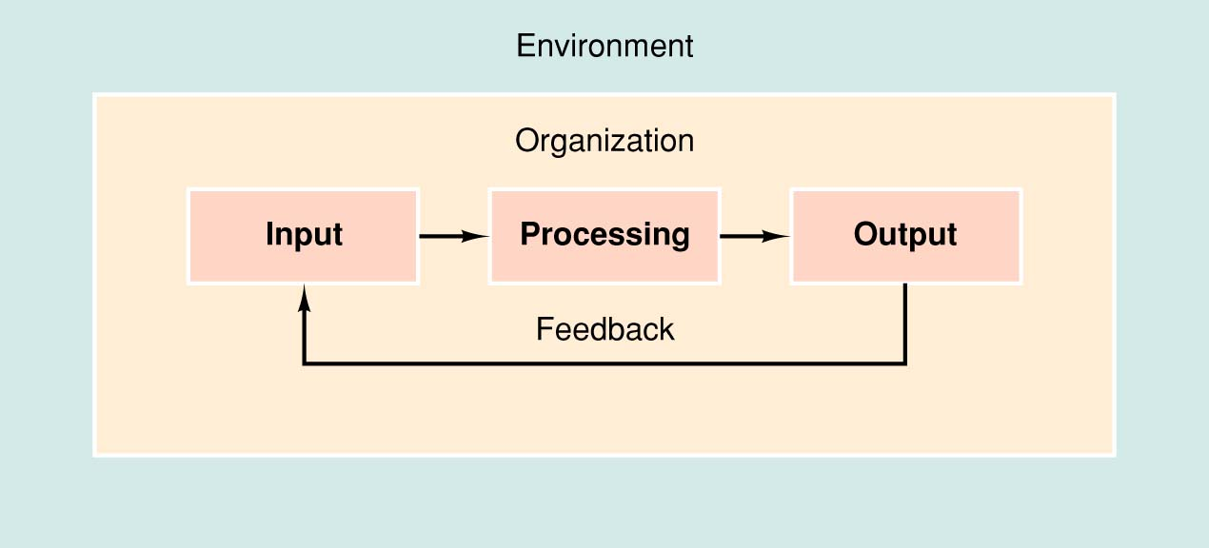
Input, Processing, Output, Feedback
Systems are usually explained using a model.
  A model helps to illustrate the major elements and their relationship
Major elements of a model:
  Input:
    Activity of gathering and
    capturing raw data
  Processing:
    Converting data into useful outputs
  Output:
    Production of useful information, usually in the form of documents and reports
  Feedback:
    Information from the system that is used to make changes to input or processing activities

Slide 11
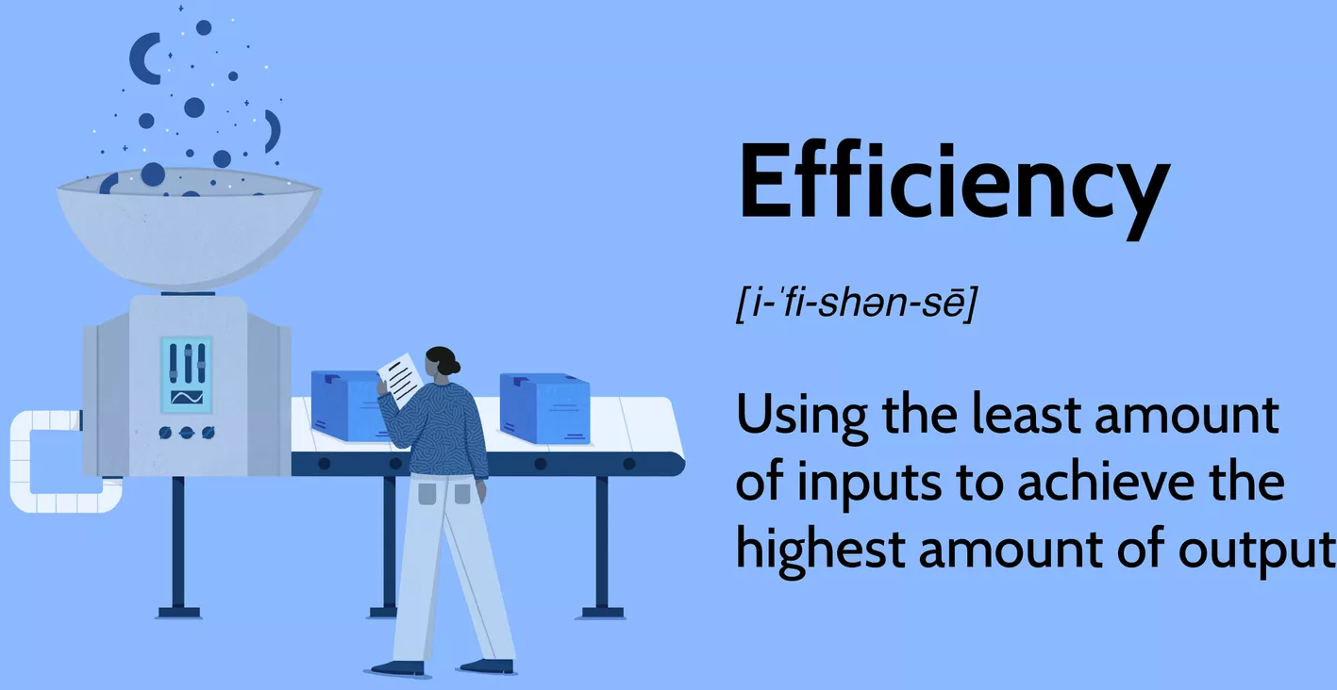
System Performance
Efficiency
  A measure of what is
  produced divided by
  what is consumed.
    occurs when you reduce waste
    to produce a given number of goods
    or services
Effectiveness
  A measure of what is achieved divided by the stated goal.
  An organization’s ability to achieve its stated goals and objectives

Slide 12
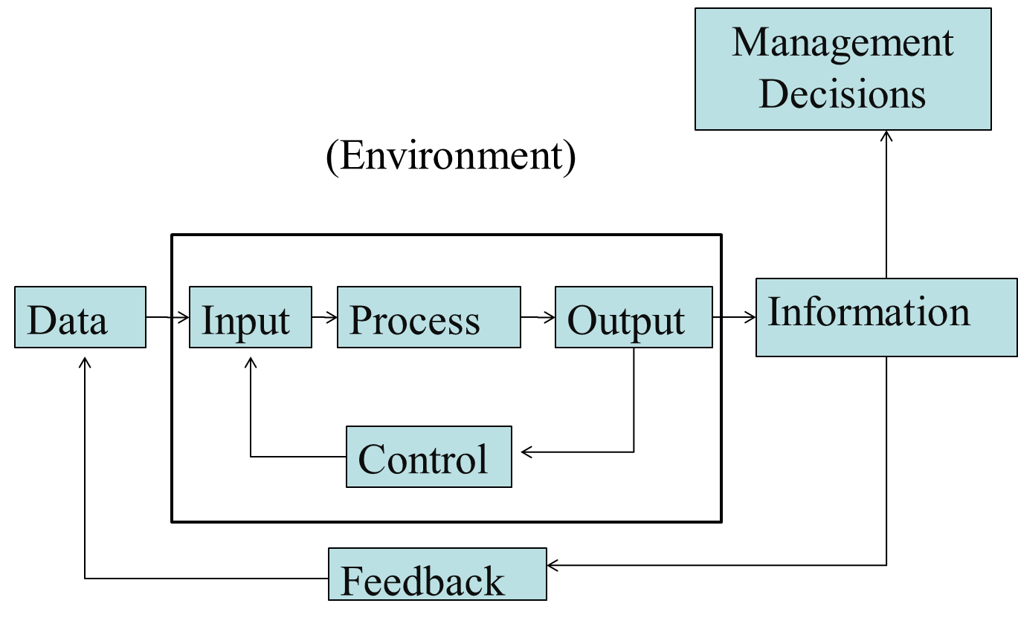
Information Systems
The ways that organizations
  Store
  Move
  Organize
  Process
their information
Components that implement information systems,
  Hardware
    physical tools:
      computer and network hardware, but also low-tech things like pens and paper
  Software
    (changeable) instructions for the hardware
  People
  Procedures
    instructions for the people
  Data/databases
General Information Systems Diagram

Slide 13
Digital System
Takes a set of discrete information (inputs) and discrete internal information (system state) and generates a set of discrete information (outputs).
Discrete
Discrete
Inputs
Information
Processing
Discrete
System
Outputs
System State

Slide 14
A Digital Computer Example
Inputs:
Keyboard,
mouse,
modem,
microphone
Outputs:
CRT,
LCD,
modem,
speakers
Synchronous or Asynchronous?

Slide 15
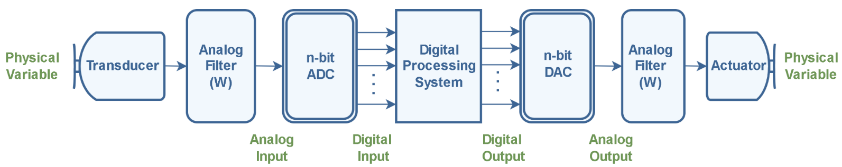
A generic complete digital processing system
Interfacing digital processing system with the analog world using n-bit ADC and DAC
A transducer is a device that converts energy from one form to another.
  In signal processing applications, the purpose of energy conversion is to transfer information, not to transform energy.
In measurement systems, transducers may be
  input transducers (or sensors)
    to convert a non-electrical energy into an electrical signal.
      for example, a microphone.
  output transducers (or actuators)
    to convert an electrical signal into a non-electrical energy.
      for example, a speaker.

Slide 16
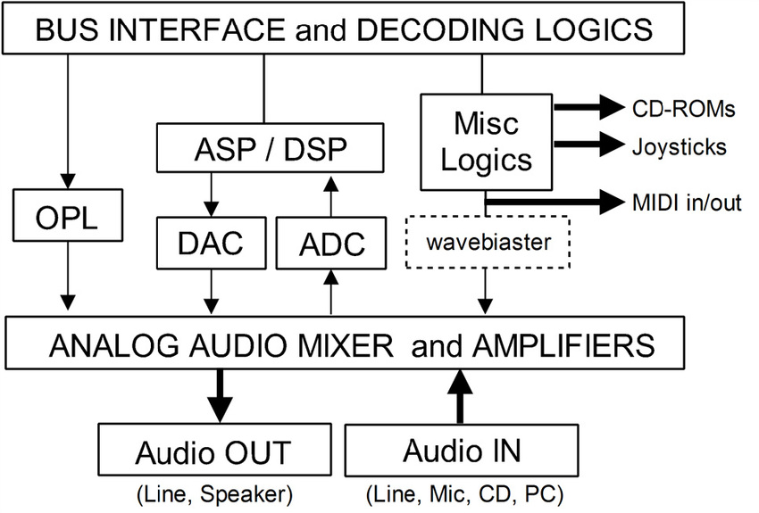
Block diagram of sound card modules

Slide 17
Analogue/Digital signal
The analogue signal
  a continuous variable defined with infinite precision
is converted to a discrete sequence of measured values using sampling and quantization and represented digitally
Information is lost in converting from analogue to digital, due to:
  inaccuracies in the measurement
  uncertainty in timing
  limits on the duration of the measurement
These effects are called quantization errors

Slide 18
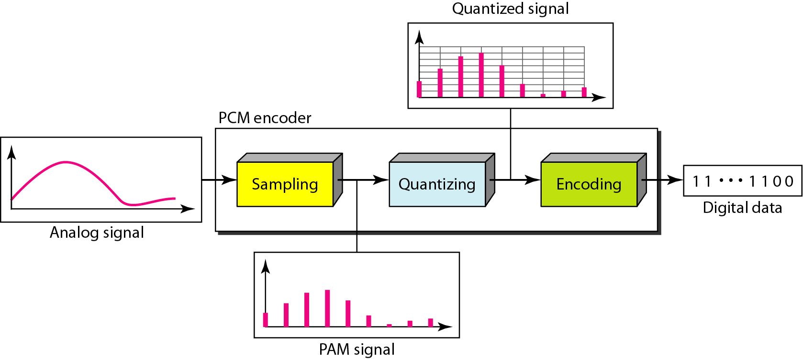
Analog-to Digital Conversion

Slide 19
Sampling
The sampling results in a discrete set of digital numbers that represent measurements of the signal
  usually taken at equal intervals of time
Sampling takes place after the hold
  The hold circuit must be fast enough that the signal is not changing during the time the circuit is acquiring the signal value
We don't know what we don't measure
In the process of measuring the signal, some information is lost

Slide 20
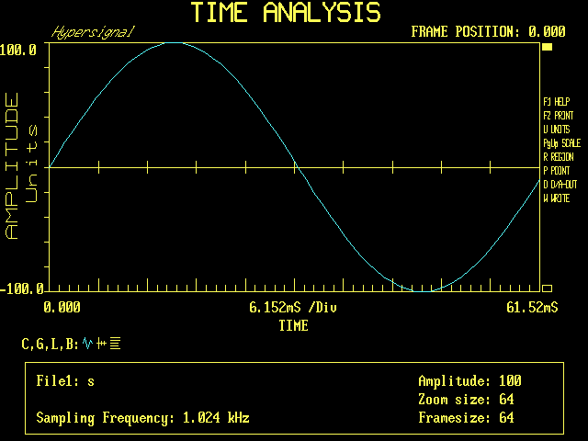
Sampling

Slide 21
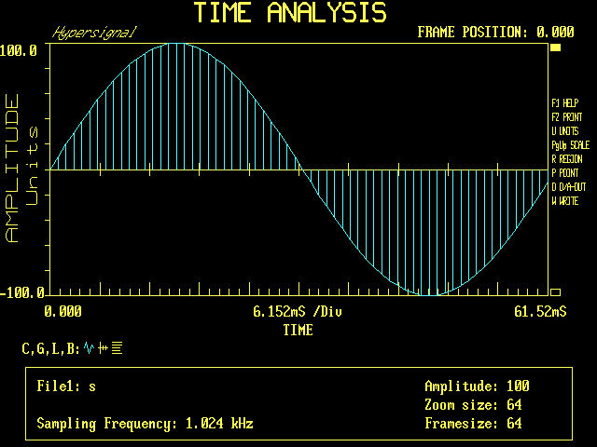
Sampling

Slide 22
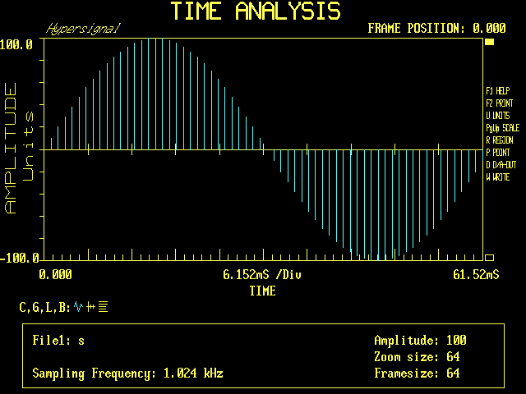
Sampling

Slide 23
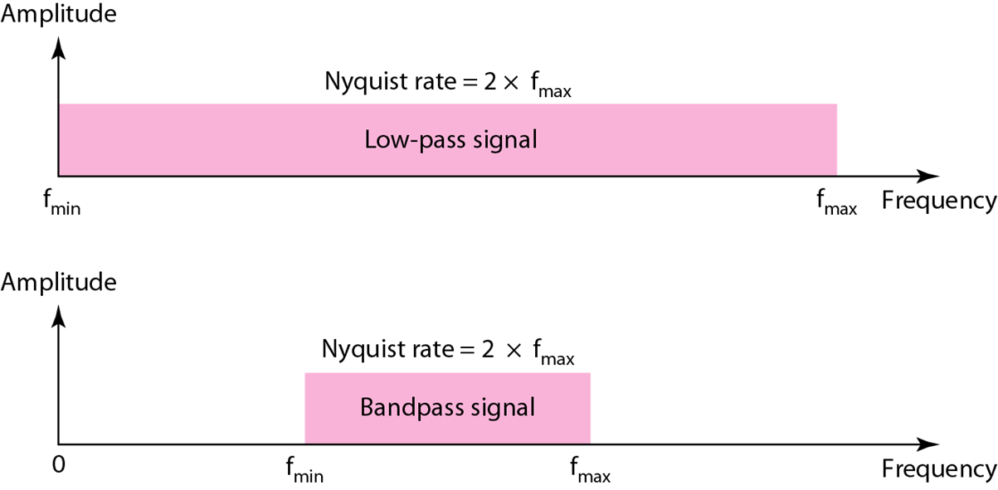
Sampling Theorem
According to the Nyquist theorem,
  the sampling rate must be at least 2 times the highest frequency contained in the signal.
F_{s} ≥ 2f_{m}

Slide 24
Quantization
Sampling results in a series of pulses of varying amplitude values ranging between two limits:
  a min and a max.
The amplitude values are infinite between the two limits.
We need to map the infinite amplitude values onto a finite set of known values.
  This is achieved by dividing the distance between min and max into L zones, each of height Δ.
Δ = (max - min)/L
Each zone is then assigned a binary code.
  The number of bits required to encode the zones, or the number of bits per sample as it is commonly referred to, is obtained as follows:
n_{b} = log₂ L

Slide 25
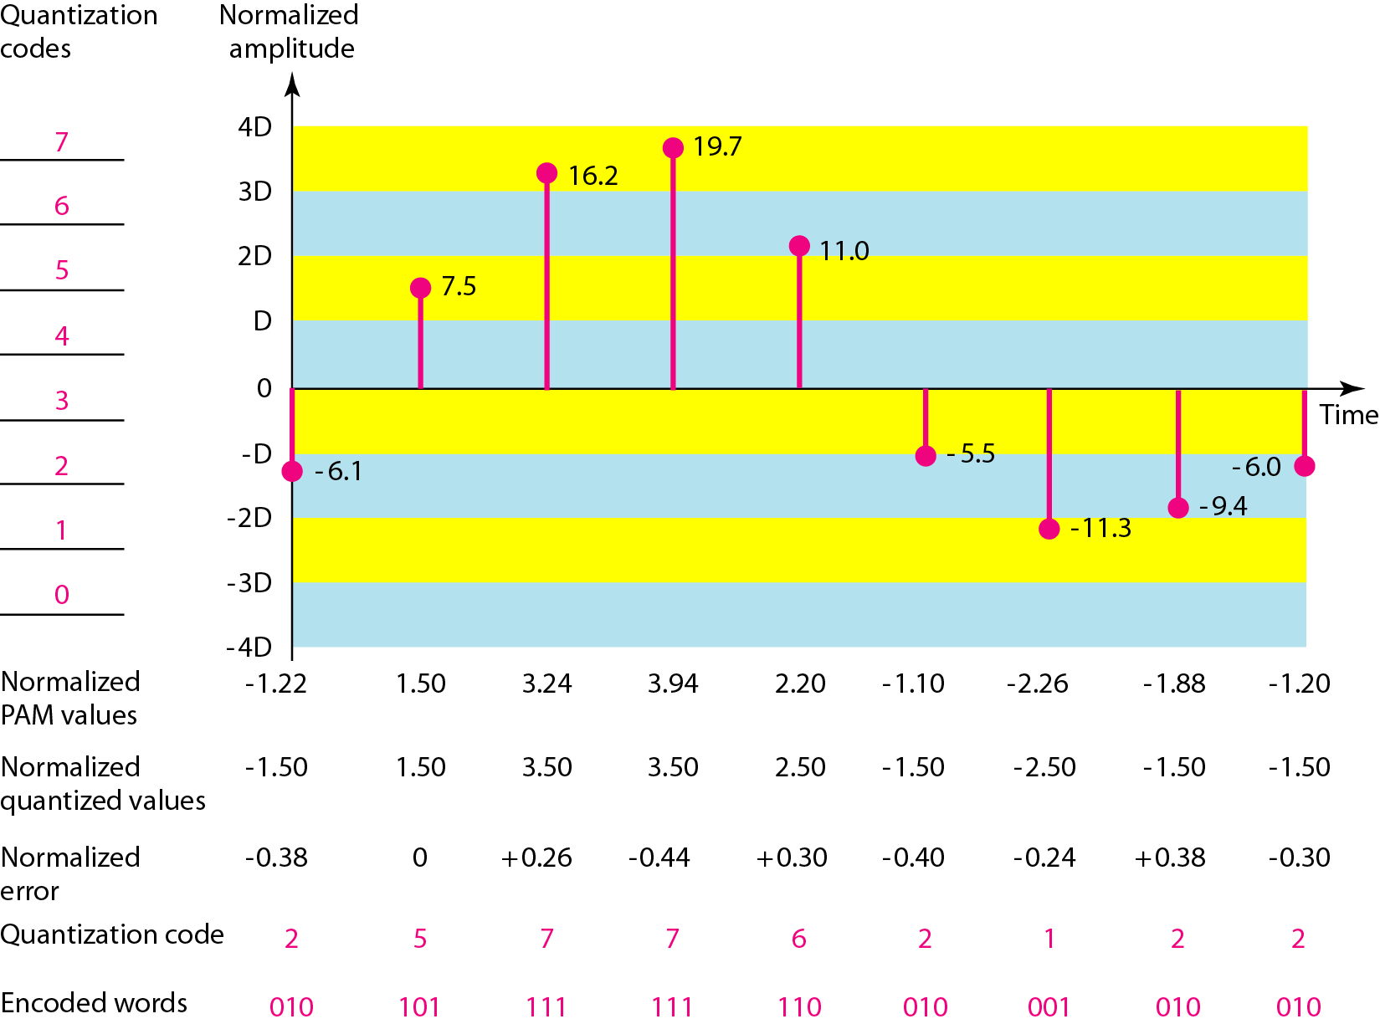
Quantization and encoding of a sampled signal

Slide 26
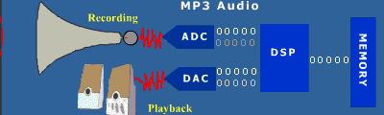
Example - Digital Sound System

Slide 27
Measures in Computers
Speed (power of 10) and Capacity (power of 2)
  Kilo- (K) = 1 thousand = 10³ and 2¹⁰
  Mega- (M) = 1 million = 10⁶ and 2²⁰
  Giga- (G) = 1 billion = 10⁹ and 2³⁰
  Tera- (T) = 1 trillion = 10¹² and 2⁴⁰
  Peta- (P) = 1 quadrillion = 10¹⁵ and 2⁵⁰
Time (power of 10) and Space (power of 10)
  Milli- (m) = 1 thousandth = 10⁻³
  Micro- (μ) = 1 millionth = 10⁻⁶
  Nano- (n) = 1 billionth = 10⁻⁹
  Pico- (p) = 1 trillionth = 10⁻¹²
  Femto- (f) = 1 quadrillionth = 10⁻¹⁵

Slide 28
Example
Hertz = clock cycles per second (frequency)
  1MHz = 1,000,000Hz
  Processor speeds are measured in MHz or GHz.
Byte = a unit of storage
  1KB = 2¹⁰ = 1024 Bytes
  1MB = 2²⁰ = 1 048 576 Bytes
  1GB = 2³⁰ = 1 073 700 000 Bytes
  1TB = 2⁴⁰ = 1 099 5 00 000 000 Bytes
  Main memory (RAM) is measured in MB (or GB)
  Disk storage is measured in GB for small systems, TB for large systems.

Slide 29
Data Formats
Computers
  Process and store all forms of data in binary format
Human communication
  Includes language, images and sounds
Data formats:
  Specifications for converting data into computer-usable form
  Define the different ways human data may be represented, stored and processed by a computer

Slide 30
Sources of Data
Binary input
  Begins as discrete input
    Example: keyboard input such as A 1+2=3 math
      Keyboard generates a binary number code for each key
Analog
  Continuous data such as sound or images
    Requires hardware to convert data into binary numbers
Computer
Computer representation:
1101000101010101…
Human form:
abcde1453
Input device
data

Slide 31
Common Data Representations
Type of Data | Standard(s)
Alphanumeric | Unicode, ASCII, EDCDIC
Image (bitmapped) | GIF (graphical image format) TIF (tagged image file format) PNG (portable network graphics)
Image (object) | PostScript, JPEG, SWF (Macromedia Flash), SVG
Outline graphics and fonts | PostScript, TrueType
Sound | WAV, AVI, MP3, MIDI, WMA
Page description | PDF (Adobe Portable Document Format), HTML, XML
Video | Quicktime, MPEG-2, RealVideo, WMV

Slide 32
Data Representation
Reflects the
  Complexity of input source
  Type of processing required
Trade-offs
  Accuracy and resolution
    Simple photo vs. painting in an art book
  Compactness (storage and transmission)
    More data required for improved accuracy and resolution
    Compression represents data in a more compact form
    Metadata
Ease of manipulation:
  Processing simple audio vs. high-fidelity sound
Standardization
  Proprietary formats for storing and processing data (WordPerfect vs. Word)
  De facto standards: proprietary standards based on general user acceptance (PostScript)

Slide 33
Metadata
A set of data that describes and gives information about other data.
  Descriptive metadata
    For finding or understanding a resource
  Administrative metadata
    Technical metadata
      For decoding and rendering files
    Preservation metadata
      Long-term management of files
    Rights metadata
      Intellectual property rights attached to content
  Structural metadata
    Relationships of parts of resources to one another
  Markup languages
    Integrates metadata and flags for other structural or semantic features within content

Slide 34
What kinds of data do we need to represent?
Numbers
  signed, unsigned, integers, floating point, complex, rational, irrational, …
Text
  characters, strings, …
Images
  pixels, colors, shapes, …
Sound
Logical
  true, false
Instructions
…
Data type:
  representation and operations within the computer

Slide 35
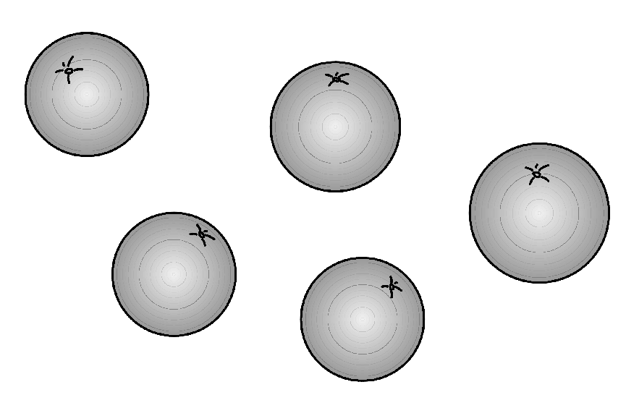
Numbers: Physical Representation
Different numerals, same number of oranges
  Cave dweller:
    IIIII
  Roman:
    V
  Arabic:
    5
Different bases, same number of oranges
  5₁₀
  101₂
  12₃

Slide 36
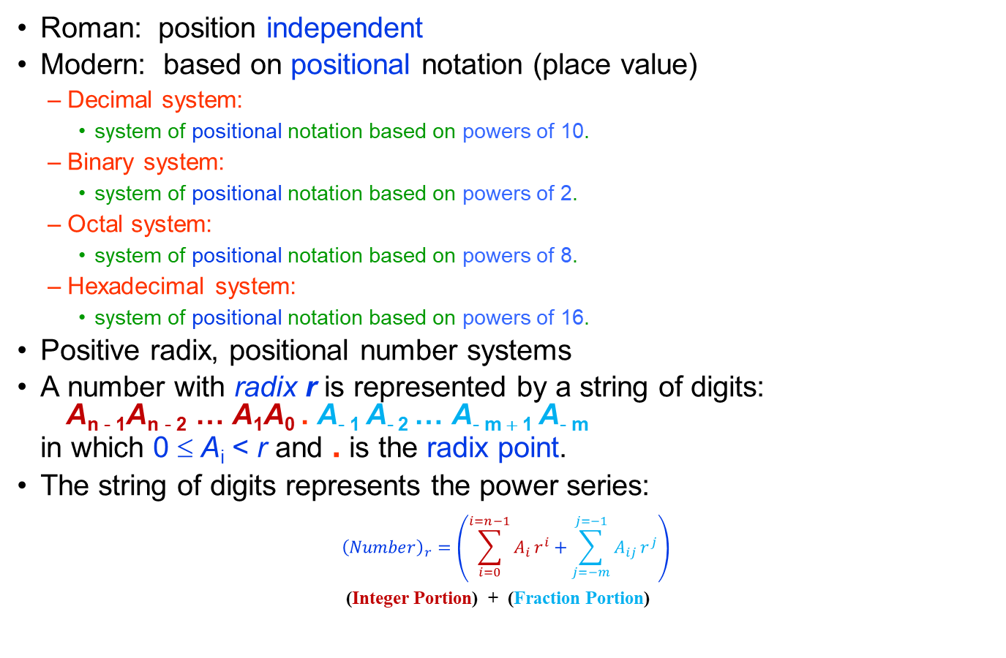
Number System
Roman: position independent
Modern: based on positional notation (place value)
  Decimal system:
    system of positional notation based on powers of 10.
  Binary system:
    system of positional notation based on powers of 2.
  Octal system:
    system of positional notation based on powers of 8.
  Hexadecimal system:
    system of positional notation based on powers of 16.
Positive radix, positional number systems
A number with radix r is represented by a string of digits:
A_{n - 1}A_{n - 2} … A₁A₀ . A₋ ₁ A₋ ₂ … A_{- m + 1} A_{- m}
in which 0 ≤ A_{i} < r and . is the radix point.
The string of digits represents the power series:
$${\left(Number\right)}_{r}=\left(\sum_{i=0}^{i=n−1}{A_{i}}r^{i}+\sum_{j=−m}^{j=−1}{A_{ij}}r^{j}\right)$$
(Integer Portion) + (Fraction Portion)

Slide 37
Decimal Numbers
Decimal means that we have ten digits to use in our representation
  the symbols 0 through 9
What is 3546?
  it is three thousands plus five hundreds plus four tens plus six ones.
  i.e. 3546 = 3×10³ + 5×10² + 4×10¹ + 6×10⁰
How about negative numbers?
  we use two more symbols to distinguish positive and negative:
  + and -

Slide 38
Internal Computer Data Format
All data stored as binary numbers
  Interpreted based on
    Operations computer can perform
    Data types supported by programming language used to create application
Simple Data Types
  Boolean:
    2-valued variables or constants with values of true or false
  Char:
    Variable or constant that holds alphanumeric character
  Enumerated:
    User-defined data types with possible values listed in definition
      Type DayOfWeek = Mon, Tues, Wed, Thurs, Fri, Sat, Sun
  Integer:
    positive or negative whole numbers
  Real :
    Numbers with a decimal point, whose magnitude (large or small) exceeds computer’s capability to store as an integer

Slide 39
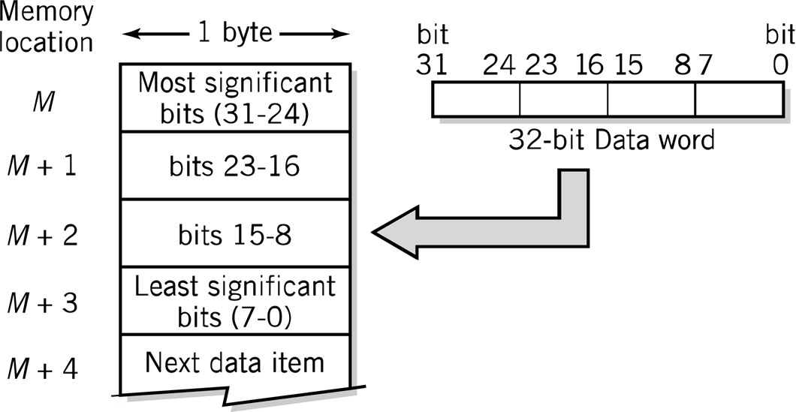
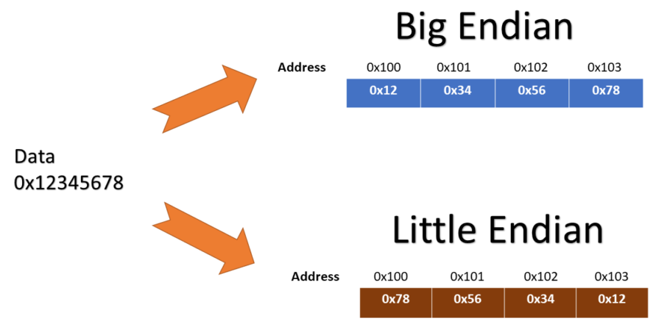
Representing Numbers - 32-bit Data Word

Slide 40
Unsigned Binary Integers
Y = “abc” = a.2² + b.2¹ + c.2⁰
(where the digits a, b, c can each take on the values of 0 or 1 only)
N = number of bits
Range is:
0 ≤ i ≤ (2^{N} – 1)
 | 3-bits | 5-bits | 8-bits
0 | 000 | 00000 | 00000000
1 | 001 | 00001 | 00000001
2 | 010 | 00010 | 00000010
3 | 011 | 00011 | 00000011
4 | 100 | 00100 | 00000100
Problem:
How do we represent
negative numbers?

Slide 41
Signed Binary Integers - 2s Complement representation
Transformation
  To transform a into -a, invert all bits in a and add 1 to the result
-16 | 10000
… | …
-3 | 11101
-2 | 11110
-1 | 11111
0 | 00000
+1 | 00001
+2 | 00010
+3 | 00011
… | …
+15 | 01111
Range is:
-2^{N-1} ≤ i ≤ (2^{N-1} – 1)
Advantages:
Operations need not check the sign
Only one representation for zero
Efficient use of all the bits

Slide 42
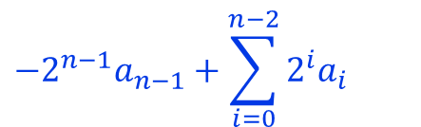
Signed Binary Integers - 2s Complement representation
2’s Complement
  +3 = 00000011 +2 = 00000010
  +1 = 00000001 +0 = 00000000
  -1 = 11111111 -2 = 11111110 -3 = 11111101
$$−2^{n−1}a_{n−1}+\sum_{i=0}^{n−2}{2^{i}a_{i}}$$

Slide 43
Limitations of integer representations
Most numbers are not integer!
  Even with integers, there are two other considerations:
Range:
  The magnitude of the numbers we can represent is determined by how many bits we use:
    e.g. with 32 bits the largest number we can represent is about +/- 2 billion, far too small for many purposes.
Precision:
  The exactness with which we can specify a number:
    e.g. a 32 bit number gives us 31 bits of precision, or roughly 9 figure precision in decimal repesentation.
We need another data type!

Slide 44
Real numbers
Our decimal system handles non-integer real numbers by adding yet another symbol
  the decimal point (.) to make a fixed point notation:
    e.g. 3456.78 = 3.10³ + 4.10² + 5.10¹ + 6.10⁰ + 7.10⁻¹ + 8.10⁻²
The floating point, or scientific notation allows us to represent very large and very small numbers (integer or real), with as much or as little precision as needed:
  Unit of electric charge e = 1.602 176 462 x 10⁻¹⁹ Coulomb
  Volume of universe = 1 x 10⁸⁵ cm³
    the two components of these numbers are called the mantissa and the exponent

Slide 45
Real numbers in binary
We mimic the decimal floating point notation to create a “hybrid” binary floating point number:
  We first use a “binary point” to separate whole numbers from fractional numbers to make a fixed point notation:
    e.g. 00011001.110 = 1.2⁴ + 1.10³ + 1.10¹ + 1.2⁻¹ + 1.2⁻² => 25.75
      (2⁻¹ = 0.5 and 2⁻² = 0.25, etc.)
  We then “float” the binary point:
    00011001.110 => 1.1001110 x 2⁴
      mantissa = 1.1001110, exponent = 4
  Now we have to express this without the extra symbols by convention, we divide the available bits into three fields:
    sign, mantissa, exponent

Slide 46
Floating Point Representation (IEEE-754 fp)
s
biased exp.
fraction
32 bits:
1
8 bits
23 bits
N = (-1)^{s} x 1.fraction x 2^{(biased exp. – 127)}
Sign: 1 bit
Mantissa: 23 bits
  We “normalize” the mantissa by dropping the leading 1 and recording only its fractional part
Exponent: 8 bits
  In order to handle both +ve and -ve exponents, we add 127 to the actual exponent to create a “biased exponent”:
    2⁻¹²⁷ => biased exponent = 0000 0000 (= 0)
    2⁰ => biased exponent = 0111 1111 (= 127)
    2⁺¹²⁷ => biased exponent = 1111 1110 (= 254)

Slide 47
Floating Point Representation (IEEE-754 fp)
Example:
  Find the corresponding fp representation of 25.75
    25.75 => 00011001.110 => 1.1001110 x 2⁴
    sign bit = 0 (+ve)
    normalized mantissa (fraction) = 100 1110 0000 0000 0000 0000
    biased exponent = 4 + 127 = 131 => 1000 0011
    so 25.75 => 0 1000 0011 100 1110 0000 0000 0000 0000 => x41CE0000
Values represented by convention:
  Infinity (+ and -):
    exponent = 255 (1111 1111) and fraction = 0
  NaN (not a number):
    exponent = 255 and fraction ≠ 0
  Zero (0):
    exponent = 0 and fraction = 0
      note: exponent = 0 => fraction is de-normalized, i.e no hidden 1

Slide 48
Floating Point Representation (IEEE-754 fp)
Double precision (64 bit) floating point
s
biased exp.
fraction
64 bits:
1
11 bits
52 bits
N = (-1)^{s} x 1.fraction x 2^{(biased exp. – 1023)}
Range & Precision:
  32 bit:
    mantissa of 23 bits + 1 => approx. 7 digits decimal
    2^{+/-127} => approx. 10^{+/-38}
  64 bit:
    mantissa of 52 bits + 1 => approx. 15 digits decimal
    2^{+/-1023} => approx. 10^{+/-306}

Slide 49
Binary Numbers and Binary Coding
Flexibility of representation
  Within constraints below, can assign any binary combination (called a code word) to any data as long as data is uniquely encoded.
Information Types
  Numeric
    Must represent range of data needed
    Very desirable to represent data such that simple, straightforward computation for common arithmetic operations permitted
    Tight relation to binary numbers
  Non-numeric
    Greater flexibility since arithmetic operations not applied.
    Not tied to binary numbers

Slide 50
Non-numeric Binary Codes
Given n binary digits (called bits), a binary code is a mapping from a set of represented elements to a subset of the 2^{n} binary numbers.
Example:
  A binary code
  for the seven
  colors of the
  rainbow
    Code 100 is
    not used
Color | Binary Number
Red | 000
Orange | 001
Yellow | 010
Green | 011
Blue | 101
Indigo | 110
Violet | 111

Slide 51
Number of Bits Required
Given M elements to be represented by a binary code, the minimum number of bits, n, needed, satisfies the following relationships:
    2^{n} > M > 2^{(n – 1)}
    n =⎡log₂ M⎤ where ⎡x⎤ , called the ceiling
    function, is the integer greater than or equal to x.
Example:
  How many bits are required to represent decimal digits with a binary code?
    4 bits are required (n =⎡log₂ 9⎤ = 4)
Notes:
M = 10
Therefore n = 4 since:
2⁴ =16 is ≥ 10 > 2³ = 8
and the ceiling function for log₂ 10 is 4.

Slide 52
Number of Elements Represented
Given n digits in radix r, there are r^{n} distinct elements that can be represented.
  But, you can represent m elements,
    m < r^{n}
Examples:
  You can represent 4 elements in radix r = 2 with n = 2 digits:
    (00, 01, 10, 11).
  You can represent 4 elements in radix r = 2 with n = 4 digits:
    (0001, 0010, 0100, 1000).

Slide 53
Binary Coded Decimal (BCD)
In the 8421 Binary Coded Decimal (BCD) representation each decimal digit is converted to its 4-bit pure binary equivalent
This code is the simplest, most intuitive binary code for decimal digits and uses the same powers of 2 as a binary number,
  but only encodes the first ten values from 0 to 9.
    For example: (57)_{dec} ➔ (?) _{bcd}
    ( 5 7 ) dec
    = (0101 0111)bcd
Notes:
Answer 1: 6
Answer 2: 1010, 1011, 1100, 1101, 1110, 1111

Slide 54
Error-Detection Codes
Redundancy (e.g. extra information), in the form of extra bits, can be incorporated into binary code words to detect and correct errors.
A simple form of redundancy is parity, an extra bit appended onto the code word to make the number of 1’s odd or even.
  Parity can detect all single-bit errors and some multiple-bit errors.
  A code word has even parity if the number of 1’s in the code word is even.
  A code word has odd parity if the number of 1’s in the code word is odd.

Slide 55
4-Bit Parity Code Example
Fill in the even and odd parity bits:
The codeword "1111" has even parity and the codeword "1110" has odd parity.
  Both can be used to represent 3-bit data.
Even Parity Message_Parity | Odd Parity Message_Parity
000_ | 000_
001_ | 001_
010_ | 010_
011_ | 011_
100_ | 100_
101_ | 101_
110_ | 110_
111_ | 111_
Notes:
Even Parity Bits: 0, 1, 1, 0, 1, 0, 0, 1
Odd Parity Bits: 1, 0, 0, 1, 0, 1, 1, 0

Slide 56
Alphanumeric Codes
Arbitrary choice of bits to represent characters
  Consistency:
    input and output device must recognize same code
Value of binary number representing character corresponds to placement in the alphabet
  Facilitates sorting and searching
Representing Characters
  ASCII:
    most widely used coding scheme
  EBCDIC:
    IBM mainframe (legacy)
  Unicode:
    developed for worldwide use

Slide 57
ASCII Character Codes
American Standard Code for Information Interchange
  ASCII
This code is a popular code used to represent information sent as character-based data.
It uses 7- bits to represent
  94 Graphic printing characters
  34 Non-printing characters
Some non-printing characters are used for text format
  e.g. BS = Backspace, CR = carriage return
Other non-printing characters are used for record marking and flow control
  e.g. STX = start text areas, ETX = end text areas.

Slide 58
ASCII Properties
ASCII has some interesting properties:
Digits 0 to 9 span Hexadecimal values 30₁₆ to 39₁₆
Upper case A-Z span 41₁₆ to 5A₁₆
Lower case a-z span 61₁₆ to 7A₁₆
  Lower to upper case translation (and vice versa) occurs by flipping bit 6
Delete (DEL) is all bits set,
  a carryover from when punched paper tape was used to store messages

Slide 59
ASCII Reference Table
MSD LSD | 0 | 1 | 2 | 3 | 4 | 5 | 6 | 7
0 | NUL | DLE | SP | 0 | @ | P |  | p
1 | SOH | DC1 | ! | 1 | A | Q | a | W
2 | STX | DC2 | “ | 2 | B | R | b | r
3 | ETX | DC3 | # | 3 | C | S | c | s
4 | EOT | DC4 | $ | 4 | D | T | d | t
5 | ENQ | NAK | % | 5 | E | U | e | u
6 | ACJ | SYN | & | 6 | F | V | f | v
7 | BEL | ETB | ‘ | 7 | G | W | g | w
8 | BS | CAN | ( | 8 | H | X | h | x
9 | HT | EM | ) | 9 | I | Y | i | y
A | LF | SUB | * | : | J | Z | j | z
B | VT | ESC | + | ; | K | [ | k | {
C | FF | FS | , | < | L | \ | l | |
D | CR | GS | - | = | M | ] | m | }
E | SO | RS | . | > | N | ^ | n | ~
F | SI | US | / | ? | O | _ | o | DEL
74₁₆
111 0100

Slide 60
EBCDIC
Extended Binary Coded Decimal Interchange Code developed by IBM
  Restricted mainly to IBM or IBM compatible mainframes
  Conversion software to/from ASCII available
  Common in archival data
  Character codes differ from ASCII
 | ASCII | EBCDIC
Space | 20₁₆ | 40₁₆
A | 41₁₆ | C1₁₆
b | 62₁₆ | 82₁₆

Slide 61
UNICODE
extends ASCII to 65,536 universal characters codes
Available in many modern applications
2 byte (16-bit) code words
ASCII Latin-I subset of Unicode
  Values 0 to 255 in Unicode table
Multilingual: defines codes for
  Nearly every character-based alphabet
  Large set of ideographs for Chinese, Japanese and Korean
  Composite characters for vowels and syllabic clusters required by some languages
Allows software modifications for local-languages

Slide 62
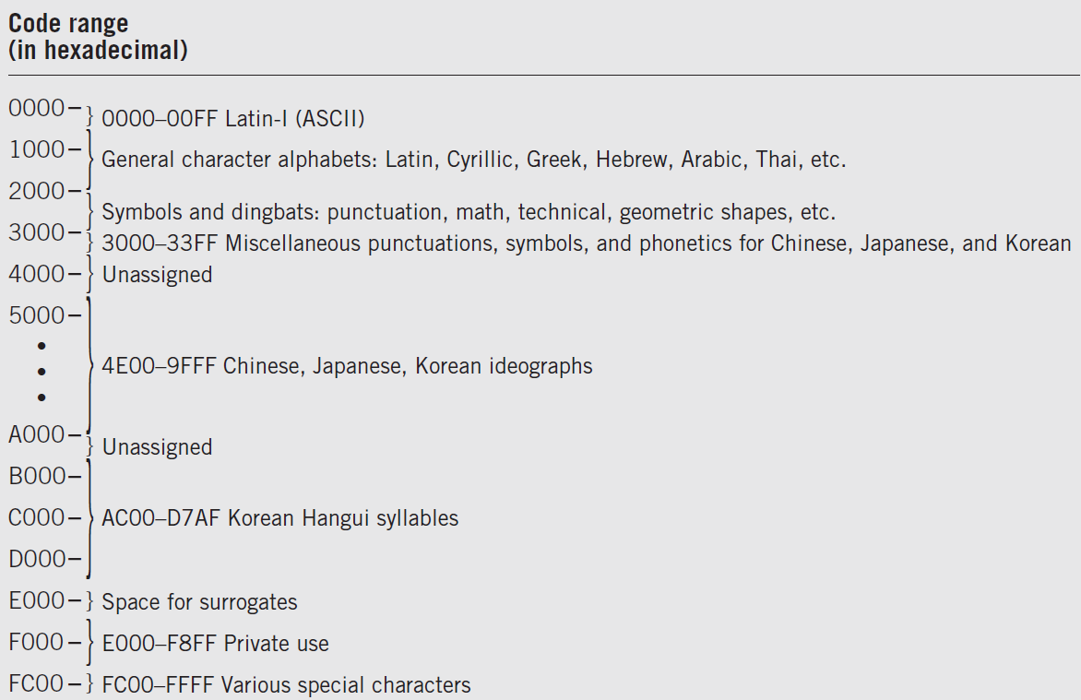
Unicode Assignment Table

Slide 63
2 Classes of Codes
Printing characters
  Produced on the screen or printer
Control characters
  Control position of output on screen or printer
    VT: vertical tab LF: Line feed
  Cause action to occur
    BEL: bell rings DEL: delete current character
  Communicate status between computer and I/O device
    ESC: provides extensions by changing the meaning of a specified number of contiguous following characters

Slide 64
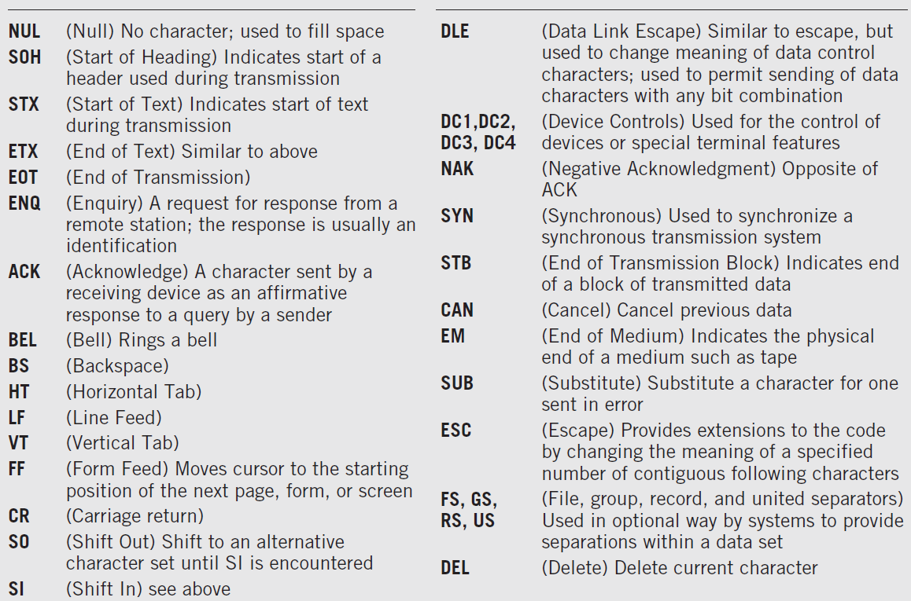
Control Code Definitions

Slide 65
Keyboard Input
Scan code
  Two different scan codes on keyboard
    One generated when key is struck and another when key is released
  Converted to Unicode, ASCII or EBCDIC by software in terminal or PC
Advantage
  Easily adapted to different languages or keyboard layout
  Separate scan codes for key press/release for multiple key combinations
    Examples: shift and control keys

Slide 66
Other Alphanumeric Input
OCR (optical character reader)
  Scans text and inputs it as character data
  Used to read specially encoded characters
    Example: magnetically printed check numbers
  General use limited by high error rate
Bar Code Readers
  Used in applications that require fast, accurate and repetitive input with minimal employee training
    Examples: supermarket checkout counters and inventory control
  Alphanumeric data in bar code read optically using wand
Magnetic stripe reader:
  alphanumeric data from credit cards
Voice
  Digitized audio recording common but conversion to alphanumeric data difficult
    Requires knowledge of sound patterns in a language (phonemes) plus rules for pronunciation, grammar, and syntax

Slide 67
Image Data
Photographs, figures, icons, drawings, charts and graphs
Two approaches:
  Bitmap or raster images of photos and paintings with continuous variation
  Object or vector images composed of graphical objects like lines and curves defined geometrically
Differences include:
  Quality of the image
  Storage space required
  Time to transmit
  Ease of modification

Slide 68
Bitmap Images
Used for realistic images with continuous variations in shading, color, shape and texture
  Examples:
    Scanned photos
    Clip art generated by a paint program
Preferred when image contains large amount of detail and processing requirements are fairly simple
Input devices:
  Scanners
  Digital cameras and video capture devices
  Graphical input devices like mice and pens
Managed by photo editing software or paint software
  Editing tools to make tedious bit by bit process easier

Slide 69
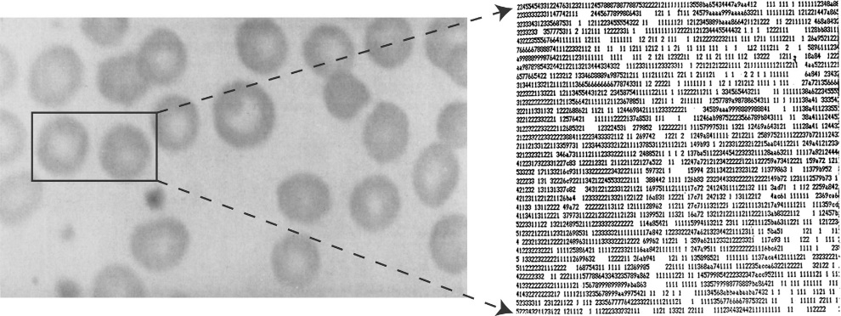
Bitmap Images
Each individual pixel (pi(x)cture element) in a graphic stored as a binary number
  Pixel:
    A small area with associated coordinate location
  Example:
    each point below represented by a 4-bit code corresponding to 1 of 16 shades of gray

Slide 70
Bitmap Display
Monochrome:
  black or white
    1 bit per pixel
Gray scale:
  black, white or 254 shades of gray
    1 byte per pixel
Color graphics:
  16 colors, 256 colors, or 24-bit true color (16.7 million colors)
    4, 8, and 24 bits respectively

Slide 71
Storing Bitmap Images
Frequently large files
  Example:
    600 rows of 800 pixels with 1 byte for each of 3 colors ➔ ~1.5 MB file
File size affected by
  Resolution:
    The number of pixels per inch
    Amount of detail affecting clarity and sharpness of an image
  Levels:
    Number of bits for displaying shades of gray or multiple colors
  Palette:
    Color translation table that uses a code for each pixel rather than actual color value
Data compression

Slide 72
GIF (Graphics Interchange Format)
First developed by CompuServe in 1987
GIF89a enabled animated images
  allows images to be displayed sequentially at fixed time sequences
Color limitation: 256
Image compressed by LZW (Lempel-Zif-Welch) algorithm
Preferred for line drawings, clip art and pictures with large blocks of solid color
Lossless compression

Slide 73
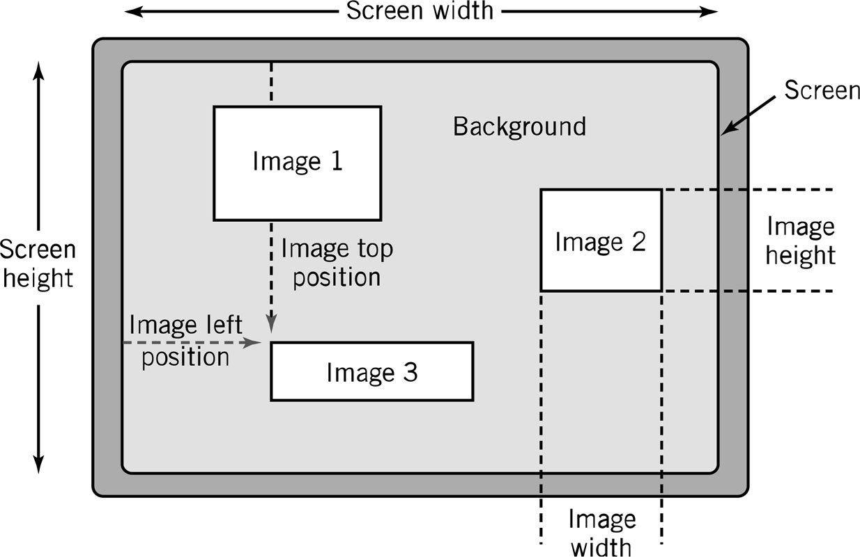
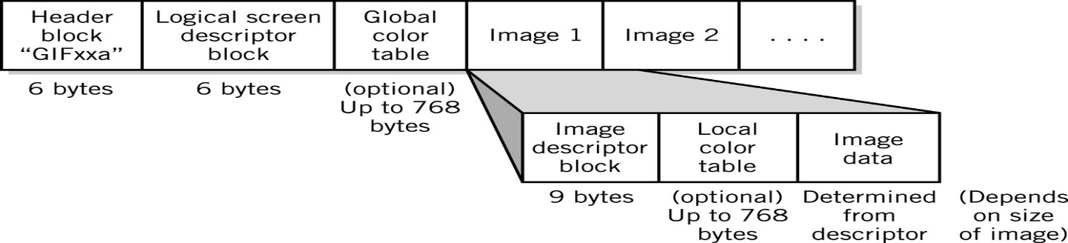
GIF (Graphics Interchange Format)

Slide 74
JPEG (Joint Photographers Expert Group)
Allows more than 16 million colors
Suitable for highly detailed photographs and paintings
Employs lossy compression algorithm that
  Discards data to decreases file size and transmission speed
  May reduce image resolution, tends to distort sharp lines

Slide 75
Other Bitmap Formats
TIFF (Tagged Image File Format): .tif (pronounced tif)
  Used in high-quality image processing, particularly in publishing
BMP (BitMaPped): .bmp (pronounced dot bmp)
  Device-independent format for Microsoft Windows environment:
    pixel colors stored independent of output device
PCX: .pcx (pronounced dot p c x)
  Windows Paintbrush software
PNG: (Portable Network Graphics): .png (pronounced ping)
  Designed to replace GIF and JPEG for Internet applications
  Patent-free
  Improved lossless compression
  No animation support

Slide 76
Object Images
Created by drawing packages or output from spreadsheet data graphs
Composed of lines and shapes in various colors
Computer translates geometric formulas to create the graphic
Storage space depends on image complexity
  number of instructions to create lines, shapes, fill patterns
    Movies Shrek and Toy Story use object images
Based on mathematical formulas
  Easy to move, scale and rotate without losing shape and identity as bitmap images may
Require less storage space than bitmap images
Cannot represent photos or paintings
Cannot be displayed or printed directly
  Must be converted to bitmap since output devices except plotters are bitmap

Slide 77
Popular Object Graphics Software
Most object image formats are proprietary
  Files extensions include .wmf, .dxf, .mgx, and .cgm
Macromedia Flash:
  low-bandwidth animation
Micrographx Designer:
  technical drawings to illustrate products
CorelDraw:
  vector illustration, layout, bitmap creation, image-editing, painting and animation software
Autodesk AutoCAD:
  for architects, engineers, drafters, and design-related professionals
W3C SVG (Scalable Vector Graphics) based on XML Web description language
  Not proprietary

Slide 78
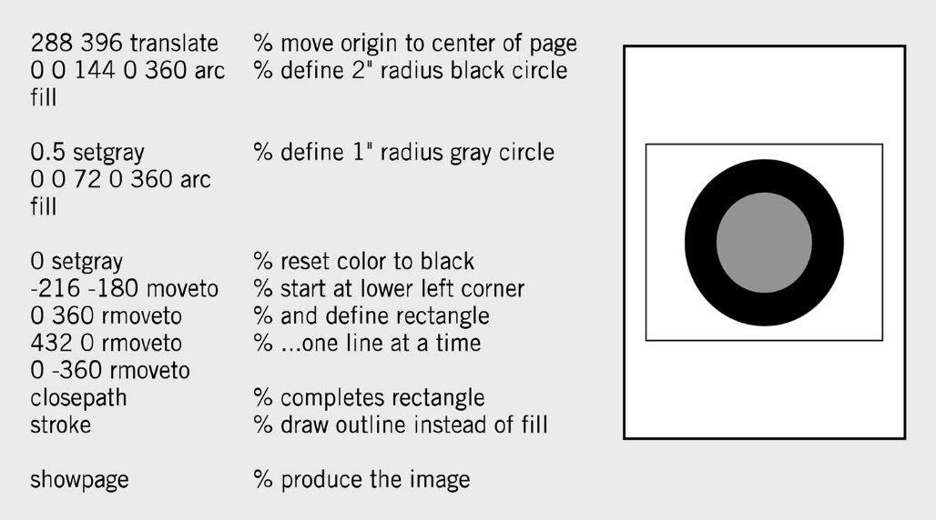
PostScript
Page description language:
  list of procedures and statements that describe each of the objects to be printed on a page
    Stored in ASCII or Unicode text file
    Interpreter program in computer or output device reads PostScript to generate image
  Scalable font
  support
    Font outline objects
    specified like other
    objects

Slide 79
Representing Characters
Characters stored in format like Unicode or ASCII
  Text processed and stored primarily for content
Presentation requirements like font stored with the character
  Text appearance is primary factor
    Example: screen fonts in Windows
Glyphs:
  Macintosh coding scheme that includes both identification and presentation requirement for characters

Slide 80
Bitmap vs. Object Images
Bitmap (Raster) | Object (Vector)
Pixel map | Geometrically defined shapes
Photographic quality | Complex drawings
Paint software | Drawing software
Larger storage requirements | Higher computational requirements
Enlarging images produces jagged edges | Objects scale smoothly
Resolution of output limited by resolution of image | Resolution of output limited by output device

Slide 81
Bitmap vs. Object Images

Slide 82
Video Images
Require massive amount of data
  Video camera producing full screen 640x480 pixel true color image at 30 frames/sec ➔ 27.65 MB of data/sec
  1-minute film clip ➔ 1.6 GB storage
Options for reducing file size:
  decrease size of image,
  limit number of colors,
  reduce frame rate
Method depends on how video delivered to users
  Streaming video:
    video displayed as it is downloaded from the Web server
      Example: video conferencing
  Local data (file on DVD or downloaded onto system) for higher quality
    MPEG-2: movie quality images with high compression require substantial processing capability

Slide 83
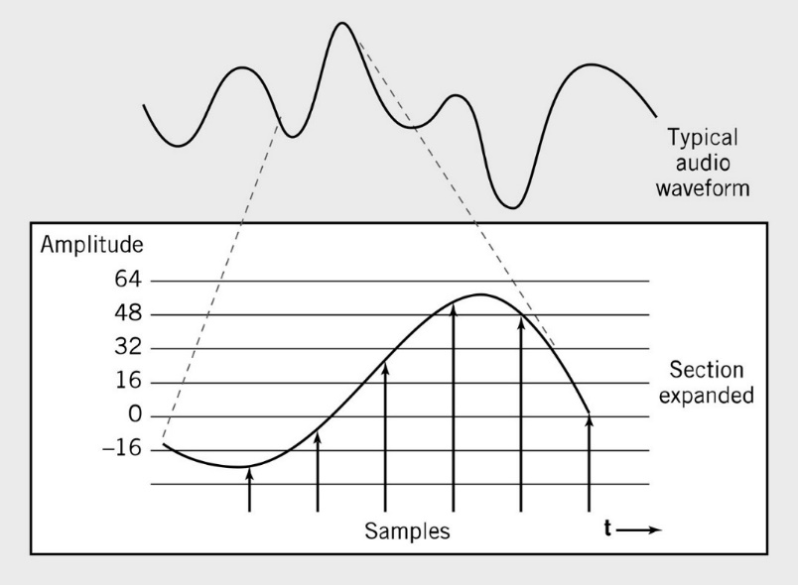
Audio Data
Transmission and processing requirements less demanding than those for video
Waveform audio:
  digital representation
  of sound
    Audio CD sampling rate
    = 44.1KHz
    Height of each sample
    saved as:
      8-bit number for radio-quality
      recordings
      16-bit number for high-fidelity
      recordings
        2 x 16-bits for stereo

Slide 84
MIDI
MIDI (Musical Instrument Digital Interface):
  instructions to recreate or synthesize sounds
    Analog sound converted to digital values by A-to-D converter
  Music notation system that allows computers to communicate with music synthesizers
  Instructions that MIDI instruments and MIDI sound cards use to recreate or synthesize sounds.
    Do not store or recreate speaking or singing voices
    More compact than waveform
      3 minutes = 10 KB

Slide 85
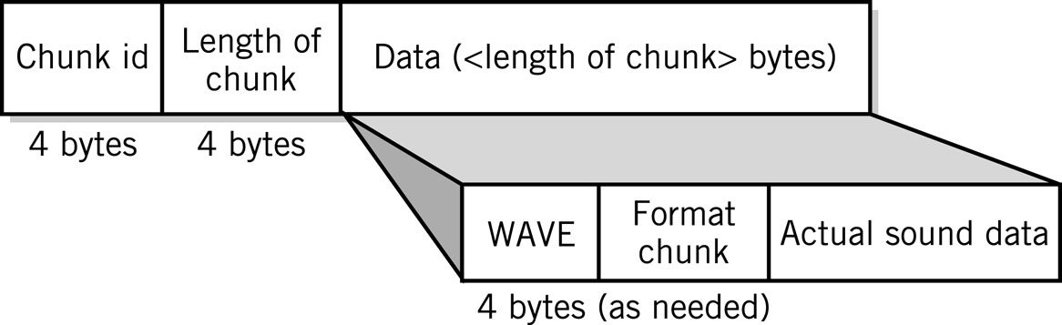
Audio Formats
MP3
  Derivative of MPEG-2 (ISO Moving Picture Experts Group)
  Uses psychoacoustic compression techniques to reduce storage requirements
  Discards sounds outside human hearing range: lossy compression
WAV
  Developed by Microsoft as part of its multimedia specification
  General-purpose format for
  storing and reproducing
  small snippets of sound

Slide 86
Data Compression
Compression: recoding data so that it requires fewer bytes of storage space.
Compression ratio: the amount file is shrunk
Lossless: inverse algorithm restores data to exact original form
  Examples: GIF, PCX, TIFF
Lossy: trades off data degradation for file size and download speed
  Much higher compression ratios, often 10 to 1
    Example: JPEG
  Common in multimedia
MPEG-2:
  uses both forms for ratios of 100:1

Slide 87
Compression Algorithms
Repetition
  0 5 8 7 0 0 0 0 3 4 0 0 0 ➔ 0 1 5 8 7 0 4 3 4 0 3
  Example: large blocks of the same color
Pattern Substitution
  Scans data for patterns
  Substitutes new pattern,
  makes dictionary entry
Example: 45 to 30 bytes plus dictionary
  Peter Piper picked a peck of pickled peppers.
   t ⇨  p ⇨   a   of  l   pp ⇨ s.
 | Pe | ✵ | pi | ❖ | ed
⇨ | er | ◎ | ck |  | pe
✪ | Pi

Slide 88
Warning: Conversion or Coding?
Do NOT mix up "conversion of a decimal number to a binary number" with "coding a decimal number with a binary code".
13₁₀ = 1101₂
  This is conversion
13 ⇔ 0001 0011_{BCD}
  This is coding

Slide 89
Another use for bits: Logic
Beyond numbers
  logical variables can be true or false, on or off, etc., and so are readily represented by the binary system.
  A logical variable A can take the values false = 0 or true = 1 only.
  The manipulation of logical variables is known as Boolean Algebra, and has its own set of operations
    which are not to be confused with the arithmetical operations.
  Some basic operations: NOT, AND, OR, XOR

Slide 90
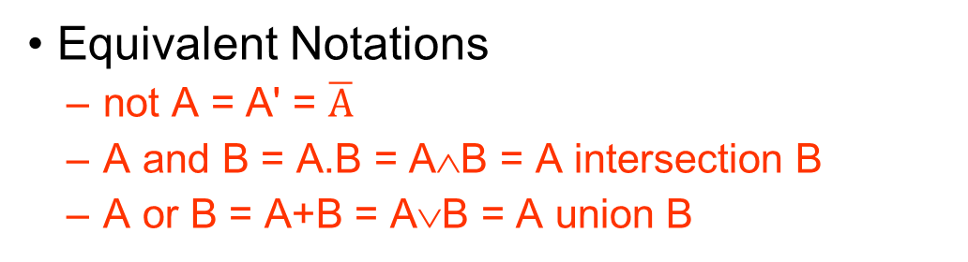
Basic Logic Operations
Truth Tables of Basic Operations
NOT
A | A'
0 | 1
1 | 0
AND
A | B | A.B
0 | 0 | 0
0 | 1 | 0
1 | 0 | 0
1 | 1 | 1
OR
A | B | A+B
0 | 0 | 0
0 | 1 | 1
1 | 0 | 1
1 | 1 | 1
Equivalent Notations
  not A = A' = $\overline{A}$
  A and B = A.B = A∧B = A intersection B
  A or B = A+B = A∨B = A union B

Slide 91
More Logic Operations
XOR
A | B | A⊕B
0 | 0 | 0
0 | 1 | 1
1 | 0 | 1
1 | 1 | 0
XNOR
A | B | (A⊕B)'
0 | 0 | 1
0 | 1 | 0
1 | 0 | 0
1 | 1 | 1
  Exclusive OR (XOR):
    either A or B is 1, not both
  A⊕B = A.B' + A'.B

Slide 92
Any Questions?

