Slide 1
CS105
Introduction to Object-Oriented Programming
Prof. Dr. Nizamettin AYDIN
naydin@itu.edu.tr
nizamettin.aydin@ozyegin.edu.tr

Slide 2
Course Details
Course Code : CS105
Course Name : Introduction to Object-Oriented Programming
Credit : 6.00 (ECTS)
Course Level : Undergradute
Course web page : https://............
Instructor(s) : Nizamettin AYDIN
Room : ……
Email : naydin@itu.edu.tr
TAs : O. Furkan Kınlı, furkan.kinli@ozyegin.edu.tr
Office Hours :

Slide 3
Course Outline
Object-oriented languages
Basic organization and control structures
Methods
Classes and Objects
Constructors
Method Overloading
Collection Libraries
Access Modifiers and “this” keyword
Objects and Memory
Inheritance
Polymorphism
Abstract Classes and Interfaces
Class Hierarchy and Class Diagrams
Static members and methods

Slide 4
Learning Outcomes
Develop the necessary interface of an object and concretization of an abstract object.
Utilize static and non-static methods.
Utilize an object-oriented library.
Write programs that use polymorphism.
Design an object-oriented solution to a problem.

Slide 5
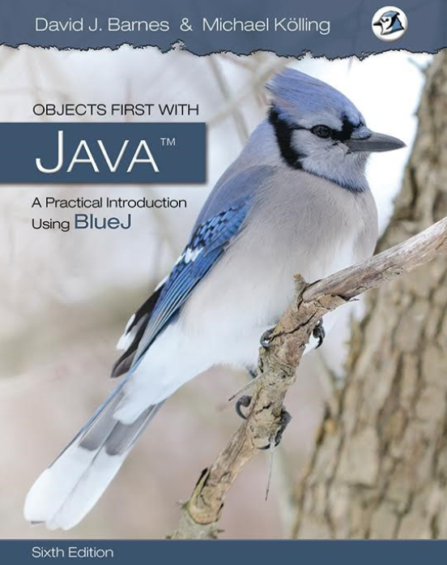
Some Books

Slide 6
Outline for Today
Course Organization
Schedule
Grading & Other course policies
First part of the course
Fundamental Concepts
A brief overview
Object-oriented languages
Hello World!

Slide 7
Course Organization

Slide 8
Weekly Schedule
Lectures
Day S.Time - E.Time Room
Wednesday: 08:40 - 12:30, EF_AB1 #241-Classroom #241
Thursday : 08:40 - 12:30, EF_AB1 #241-Classroom #241
Thursday lectures may be used
for labs
to cover additional lectures & course related materials
for quizzes
for midterm exam
Lecture slides will be uploaded to LMS

Slide 9
Assessment (Grading)
Quiz (5 x %3) : 15%
Midterm : 25%
Homework (5 x %3) : 15%
Final : 40%
Attendance & participation : 05%
Expected minimum average grade to pass : 40
Expected minimum final exam grade to pass : 35
Missing midterm exam or final exam results in a failing grade
Grades will be announced through LMS
Do not take make-up exams unless you have a very convincing reason

Slide 10
Assessment (Grading)
The total grade of the homework will be %15 (5 x %3).
Homework 1: [2024-mm-dd, 2024-mm-dd]
Homework 2: [2024-mm-dd, 2024-mm-dd]
Homework 3: [2024-mm-dd, 2024-mm-dd]
Homework 4: [2024-mm-dd, 2024-mm-dd]
Homework 5: [2024-mm-dd, 2024-mm-dd]
The total grade of the quiz will be %15 (5 x %3).
Quiz 1: 2024-mm-dd
Quiz 2: 2024-mm-dd
Quiz 3: 2024-mm-dd
Quiz 4: 2024-mm-dd
Quiz 5: 2024-mm-dd

Slide 11
Programming Environment
Programming language: Java (without ACM library)
Standard Development Kit (https://www.oracle.com/java/technologies/downloads)
Keep in mind that you may be asked to use other programming languages (Python, C++)
Some Java IDEs:
Eclipse (https://www.eclipse.org)
Intellij IDEA (https://www.jetbrains.com)
NetBeans (https://netbeans.apache.org)
BlueJ (https://www.bluej.org)
Projects will be accepted via LMS
http://lms.ozyegin.edu.tr

Slide 12
Programming Assignments
Your homework assignments will have strict guidelines for input / output / submission
Any submission which does NOT obey these guidelines will be given a 0 (zero/sıfır/null/нуль/cero/零/ صفر) grade
Late submissions will not be accepted
No exception to these rules
We expect that you adhere by basic academic ethics guidelines while working on your projects.
You can study with your friends, but the implementation must be performed individually.
Zero tolerance policy
In case of plagiarism
You will receive -100 as a grade

Slide 13
Programming Assignments
The main objective of programming assignments is for you to LEARN.
Submitting a fully-finished/working code does not necessarily mean that you will get full grade. There is more to it than making it work.
You can be asked for a demo where you explain your code or make some small changes in your code.
If you cannot show your work in these demo sessions which means that you did not learn, then your grade can be decreased.
How should we deal with assignments?
Read and understand every detail and requirement.
Use your time carefully-Do not leave it to the last day.
Make sure you understand your solution before you start coding it– otherwise you will have big problems.
Use office hours to discuss it with your professor & assistants
Don’t cheat

Slide 14
Rules of the Conduct
No eating /drinking in class
except water
Cell phones must be kept outside of class or switched-off during class
If your cell-phone rings during class or you use it in any way, you will be asked to leave and counted as unexcused absent.
No web surfing and/or unrelated use of computers,
when computers are used in class or lab.
You are responsible for checking the class web page often for announcements.
Academic dishonesty and cheating will not be tolerated and will be dealt with according to university rules and regulations.
Presenting any work that does not belong to you is also considered academic dishonesty.

Slide 15
Rules of the Conduct
The requirement for attendance is 70%
Hospital reports are not accepted to fulfill the requirement for attendance.
The students, who fail to fulfill the attendance requirement, will be excluded from the final exams and the grade of F/U will be given.
Link for the rules and regulations:
https://studentservices.ozyegin.edu.tr/tr/mevzuatlar
Exams:
Midterm
Covers almost first half of class
Final
Covers second half of class + selected material from first part
Project/homework-related knowledge may be included in the exams
So do your project/homework and do not copy!

Slide 16
How (not) to pass this course
How to pass this course
Ideas are simple, but build on one another
Attend the lectures
Read the notes after the class
Complete/solve the problems
Do the homeworks (on your own)
Work together on non-assessed work
How not to pass this course
Do not come to lecture
It’s nice out, the slides are online, and material is in the book anyway!
TRUTH:
Lecture material is the basis for exams
It is much more efficient to learn through discussion
Copy other people’s project/homework
It is cheating!
How can you answer the questions in midterm or final exams?
Get your project/homework done by ChatGPT!

Slide 17
Any Questions?

