Slide 1
CS105
Introduction to Object-Oriented Programming
Prof. Dr. Nizamettin AYDIN
naydin@itu.edu.tr
nizamettin.aydin@ozyegin.edu.tr

Slide 2
Extending Bank Account Example

Slide 3
Outline
Primitive types
Object types
Memory Allocation
Heaps
Member Functions
Memory Model
Class Instances
Standard Streams
Arrays

Slide 4
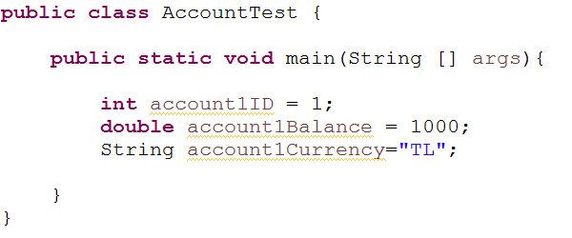
Bank Account
Lets implement a bank account program
What type of information do we need for a bank account?
Account ID (int)
Balance (double)
Currency (String)

Slide 5
Bank Account
int and double are primitive types
String is an object type
What is primitive type? What is object type?

Slide 6
Primitive types
8 types
byte
short (16 bit signed)
int (32 bit signed)
long (64 bit)
float (32 bit floating point)
double (64 bit floating point)
boolean
char

Slide 7
Object types
Everything else that is not primitive
Arrays
All other user defined classes
An object can be created with the new keyword
int [] myArray = new int [10];
When new keyword is used, some space to store this object is allocated from the memory.
Where in memory?

Slide 8
Bank Account
int and double are primitive types
String is an object type
How are they represented in memory?

Slide 9
Bank Account
Primitive types are stored in Stack
Objects are stored in Heap
What is Stack and Heap?

Slide 10
Memory Allocation
When you declare a variable in a program, Java allocates space for that variable from one of several memory regions:
Heap
Holds objects created in the program
Stack
Used during the execution of the program
Stack holds
short lived objects (local primitive types)
When a function is called a block of memory (stack frame) is allocated to hold the local variables.
It is removed when the execution of function finishes
references to other objects in the heap

Slide 11
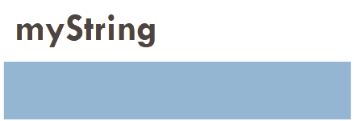
Memory Allocation
Heap vs. Stack
Heap holds the objects where Stack holds reference to these objects
Objects
When new keyword is used, some space to store this object is allocated from the heap memory.
Variable declaration:
Primitive type
int myInt;
Object type
String myString;

Slide 12
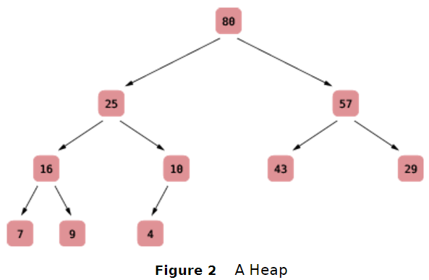
Heaps
A heap (or, for greater clarity, max-heap) is a binary tree that:
is almost complete: all nodes are filled except the last level may have some missing toward the right.
all nodes store values that are at least as large as the values stored in their descendants.
The heap property ensures that the tree’s largest element is stored in the root
The shape of a heap is very regular
In a heap, the left and right subtrees both store elements that are smaller than the root element

Slide 13
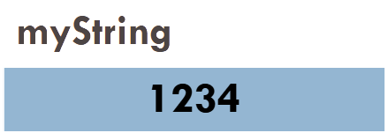
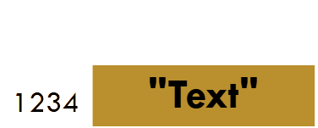
Memory Allocation
Variable assignment:
Primitive type
int myInt;
myInt = 5;
Object type
String myString;
myString = new String("Text");

Slide 14
Memory Allocation
Variable assignment:
Primitive type
int myInt;
myInt = 5;
Object type
String myString;
myString = new String("Text");
Instead of showing the address, we will use an arrow

Slide 15
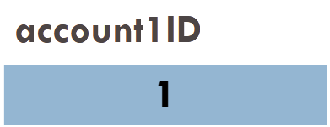
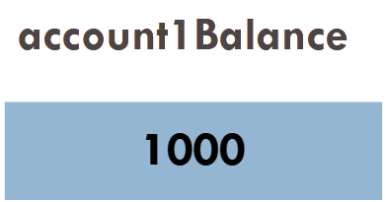
Bank Account
Primitive types are stored in Stack

Slide 16
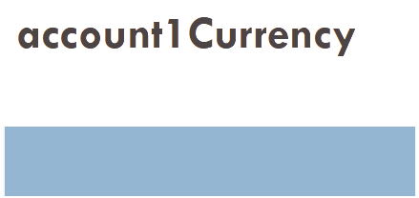
Bank Account
Objects are stored in Heap
Their reference is stored in Stack

Slide 17
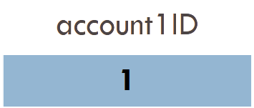
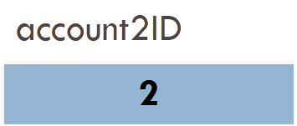
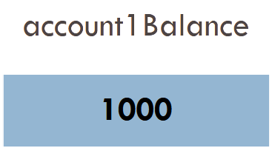
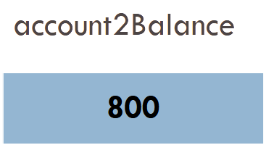
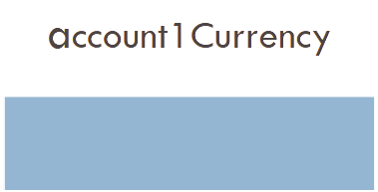
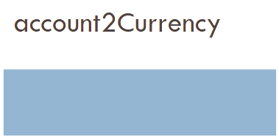
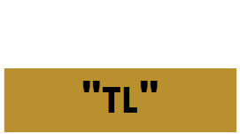
Bank Account

Slide 18
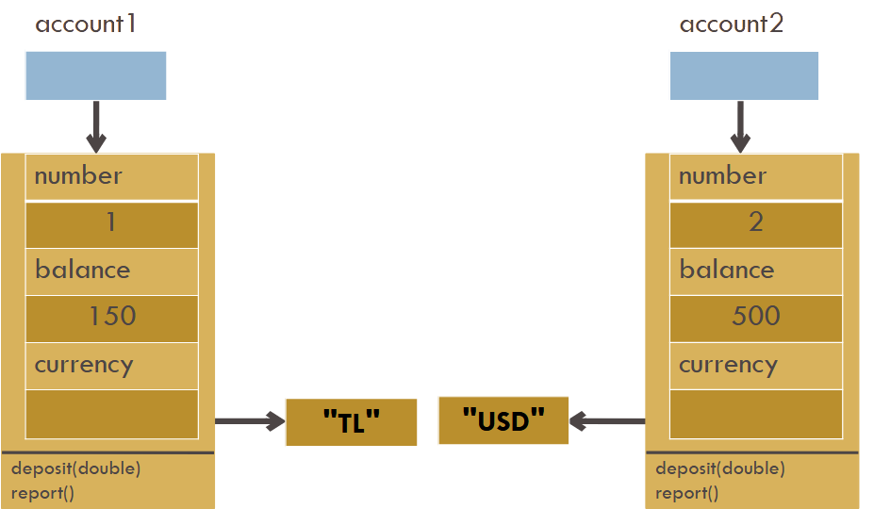
Member Functions
Member functions can also be represented in memory diagrams

Slide 19
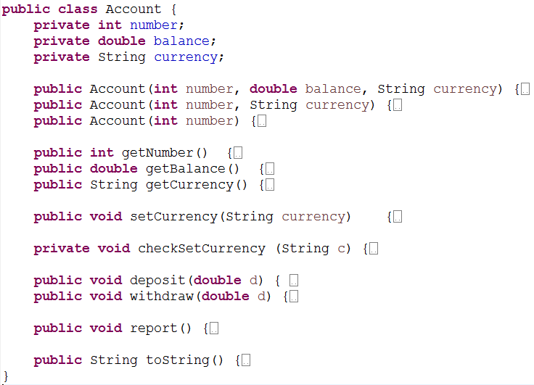
Current Account Class (Version 15)

Slide 20
Another class
Lets add another class
Customer object
Name
Account

Slide 21
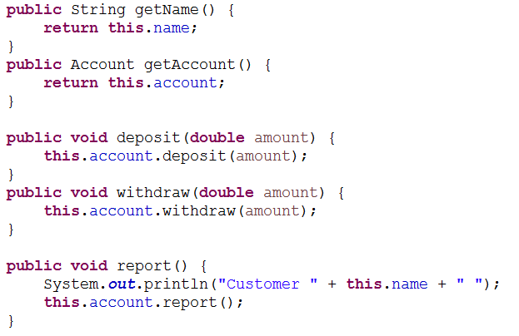
Customer Class

Slide 22
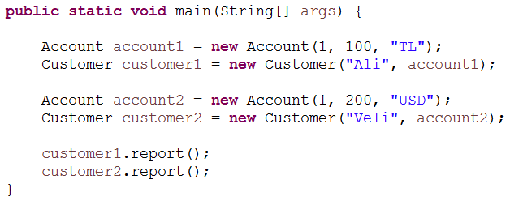
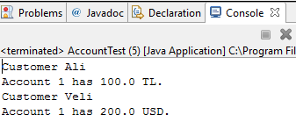
Using Customer Class
Draw the Memory Model

Slide 23
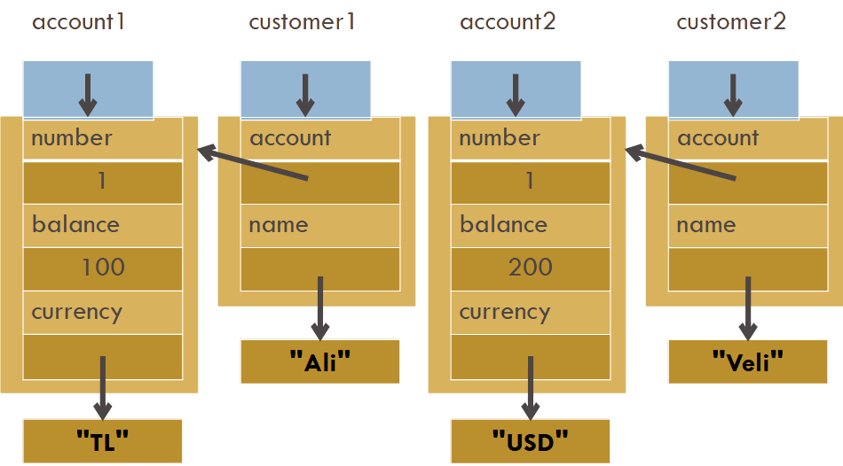
Draw the Memory Model

Slide 24
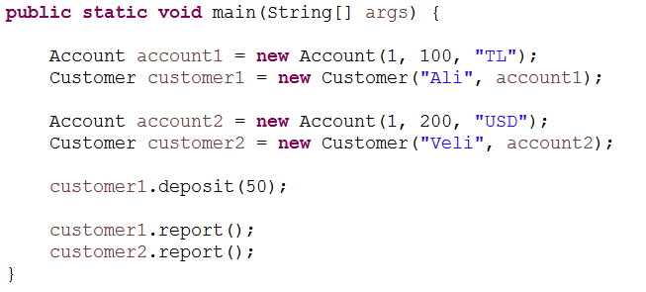
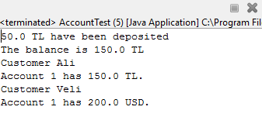
What is the output?

Slide 25
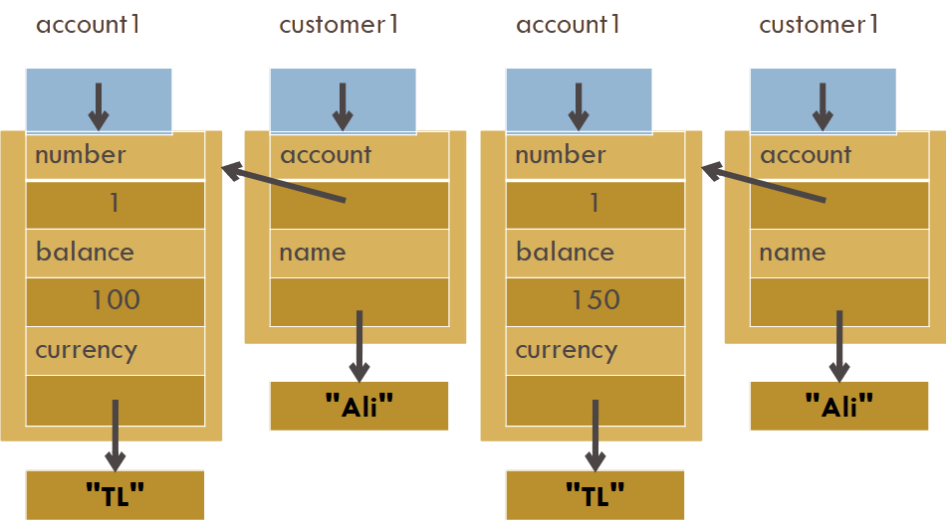
Before and After deposit

Slide 26
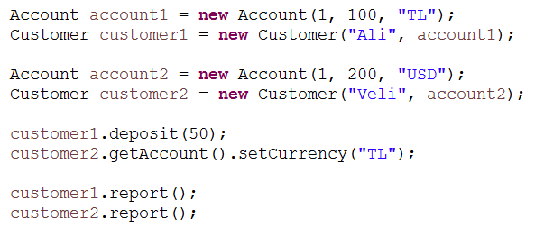
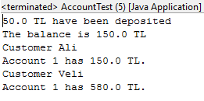
What is the output?

Slide 27
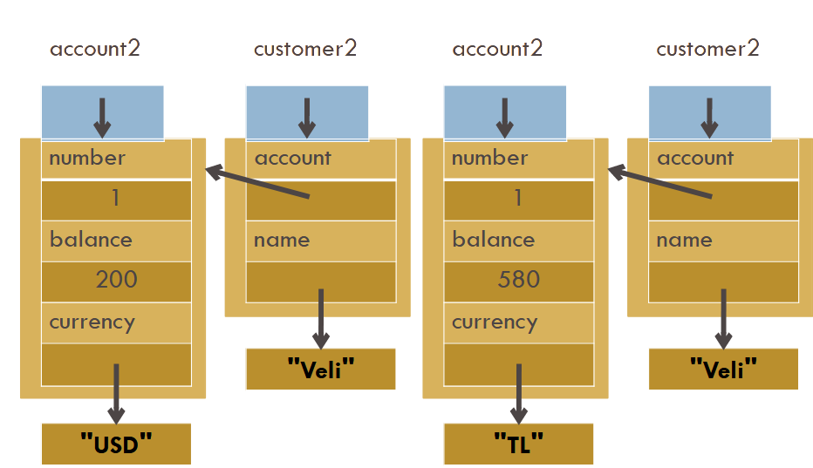
Before and After setCurrency

Slide 28
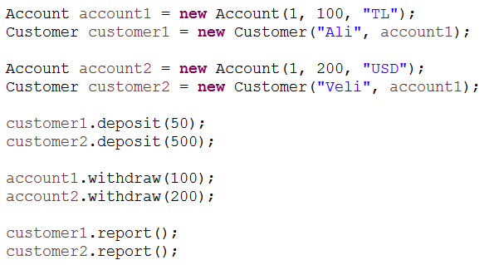
What is the final memory model?

Slide 29
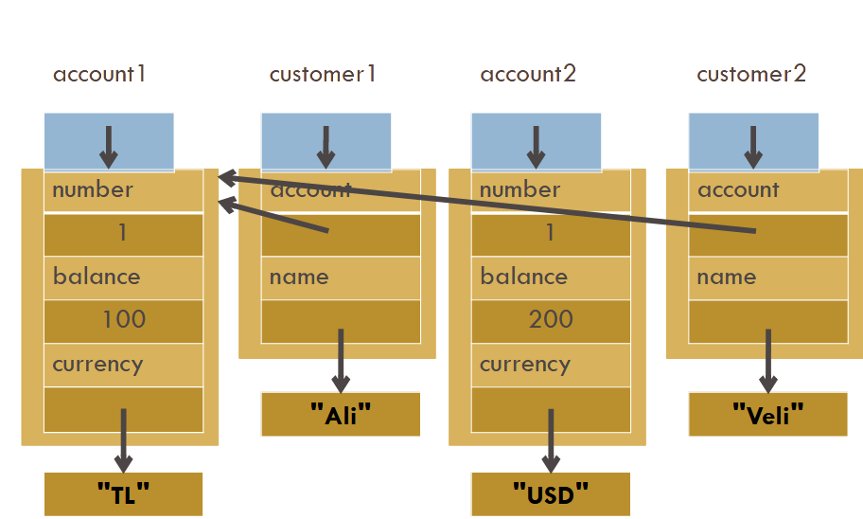

Slide 32
Additional Classes
We have customer and account, lets have a bank then.
A bank has a name and customers.
Bank Class – Class Instances:
Only one name but multiple customers.
name (String)
customers (array)
How many customers?
Need to know in advance, why?

Slide 33
Bank Class – Class Instances
Lets say a bank can have at most 3 customers.
Create an array of size 3
But you don’t have to use all 3 customers.
It can be less.
Therefore keep the number of customers value in a variable.

Slide 34
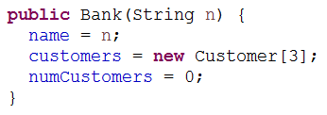
Bank Class - Constructor
Initially banks have no customers.
What should be the constructor arguments?

Slide 35
Bank Class – Adding Customers
An addCustomer method to add customers.
This method takes one customer as an argument.
It updates the array and the numCustomers value.

Slide 36
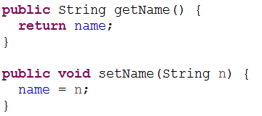
Bank Class – Other Functions

Slide 37
Bank Application
Assume that we have an application which takes customer information in runtime from users.
We need to use Scanner in order to read the input from the console.

Slide 38
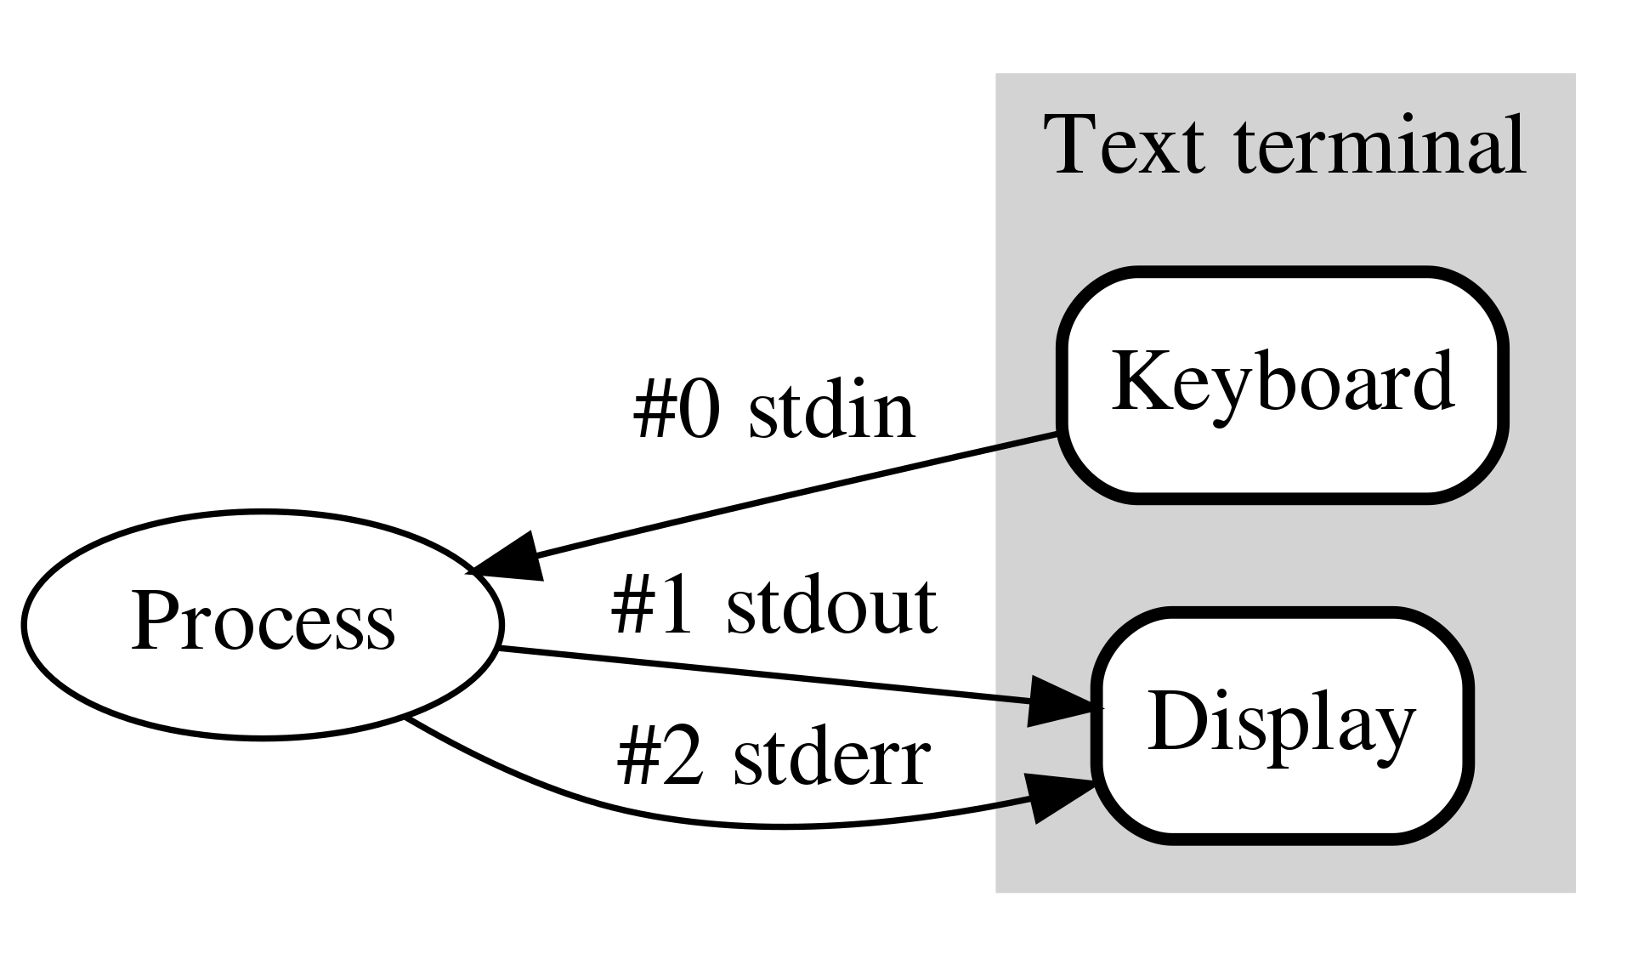
Standard Streams

Slide 39
Bank Application
For each customer, what kind of information do we need?
Name
Account
Balance
Currency
Number?
The system can assign the next available account number to the account.
Need to keep a counter for account number.

Slide 40
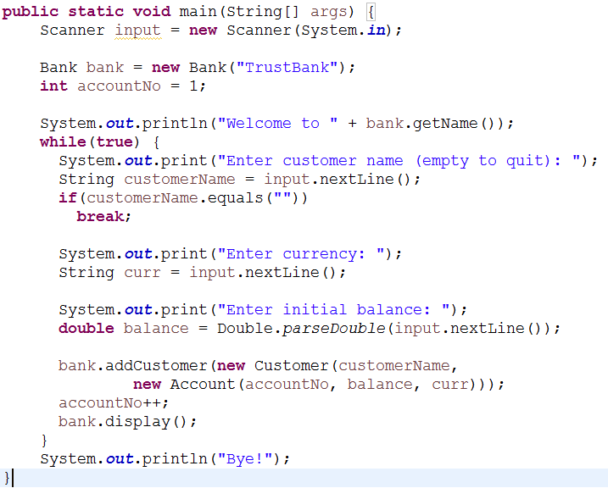
Bank Application

Slide 41
Memory Model?
What will be the memory model after user enters
‘‘Ali’’ for customer name
‘‘TL’’ for account’s currency
100 for initial balance
How many objects are we going to create?

Slide 42
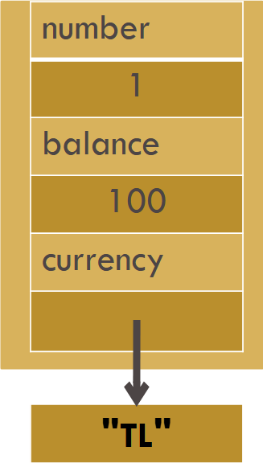
Memory Model
The path is from inside out.
User entered
"TL" for account’s currency
100 for initial balance
Return its reference to
Customer constructor.

Slide 43
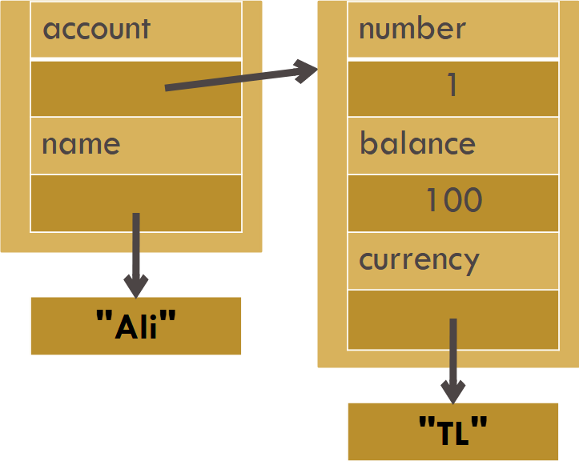
Memory Model
Save customer’s address at bank’s customer array

Slide 44
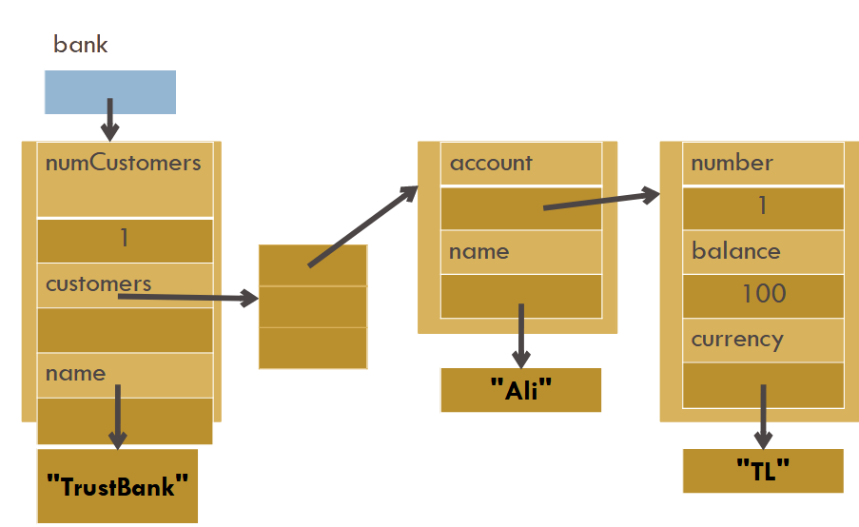
Memory Model

Slide 45
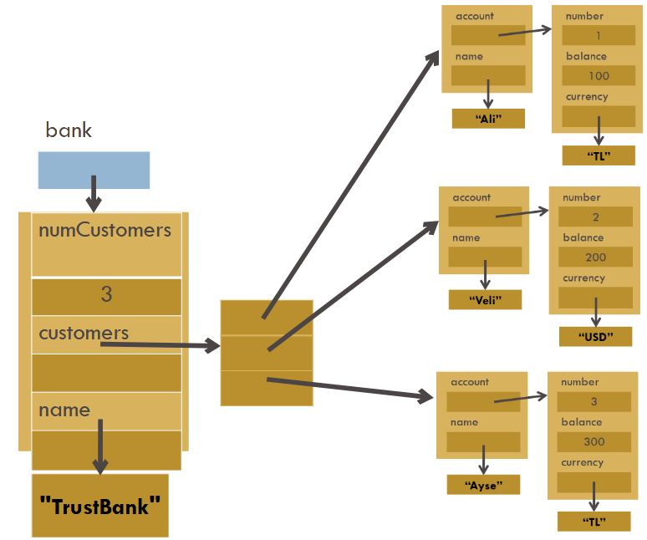
Memory Model

Slide 46
Arrays
Arrays are fixed length.
We need a data structure that can be resized.
ArrayList
ArrayList
Dynamic in size
See ArrayList slides ...

Slide 47
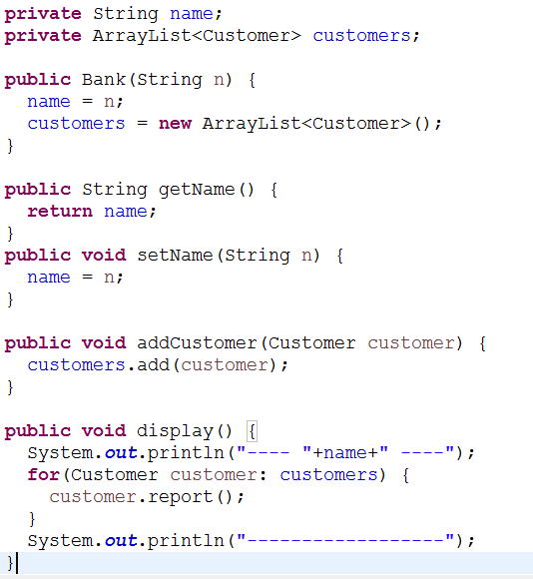
Bank Class
with ArrayList
We don’t need numCustomers anymore.

Slide 48
Any Questions?

