Slide 1
CS105
Introduction to Object-Oriented Programming
Prof. Dr. Nizamettin AYDIN
naydin@itu.edu.tr
nizamettin.aydin@ozyegin.edu.tr

Slide 2
Access Modifiers

Slide 3
Outline
Bank Account – version 8
Constructors
Class instances
Access Specification
Controlling Access to Entries
Access Modifiers
Bank Account – version 9
Accessing Class Instances
Getters
Getter Function
Setters
Setter Functions
toString method
Code Repetition
Private Function

Slide 4
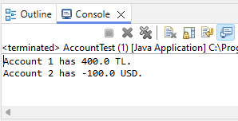
Bank Account – version 8
public class AccountTest {
public static void main(String[] args) {
Account account1 = new Account(1, 100, "TL");
Account account2 = new Account(2, 200, "USD");
account1.deposit(300);
account2.deposit(-300);
account1.report();
account2.report();
}
}

Slide 5
Definition of deposit
Deposit
dɪˈpɒzɪt/
https://www.merriam-webster.com/dictionary/deposit
https://dictionary.cambridge.org/tr/s%C3%B6zl%C3%BCk/ingilizce/deposit
A sum of money placed in a bank account.
A payment made in advance, such as a security deposit for renting a property.
A layer of sediment that settles at the bottom of a liquid.
We should not allow depositing negative amount of money.
How?

Slide 6
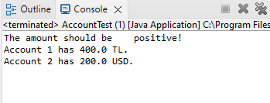
deposit function
public void deposit(double d) {
if (d > 0)
balance = balance + d;
else
System.out.println("The amount should be positive!");
}
public class AccountTest {
public static void main(String[] args) {
Account account1 = new Account(1, 100, "TL");
Account account2 = new Account(2, 200, "USD");
account1.deposit(300);
account2.deposit(-300);
account1.report();
account2.report();
}
}

Slide 7
Bank Account
Can you think of any other controls that we should have?
A bank account should get a number during initialization.
A bank account should not have negative initial balance.

Slide 8
Constructors
Assume that we don’t have the interest rate
We have the following constructors:
public Account() {
}
public Account(int n, double b, String c){
number = n;
balance = b;
currency = c;
}
public Account(int n, String c){
number = n;
balance = 0;
currency = c;
}
public Account(int n){
number = n;
balance = 0;
currency = "TL";
}

Slide 9
Constructors
A bank account should get a number during initialization.
public Account() {
}
public Account(int n, double b, String c){
number = n;
balance = b;
currency = c;
}
public Account(int n, String c){
number = n;
balance = 0;
currency = c;
}
public Account(int n){
number = n;
balance = 0;
currency = "TL";
}

Slide 10
Constructors
A bank account should get a number during initialization.
Remove the following constructor.
public Account() {
}

Slide 11
Constructors
A bank account should get a number during initialization.
public Account(int n, double b, String c){
number = n;
balance = b;
currency = c;
}
public Account(int n, String c){
number = n;
balance = 0;
currency = c;
}
public Account(int n){
number = n;
balance = 0;
currency = "TL";
}

Slide 12
Constructors
A bank account should not have negative initial balance.
public Account(int n, double b, String c){
number = n;
balance = b;
currency = c;
}
public Account(int n, String c){
number = n;
balance = 0;
currency = c;
}
public Account(int n){
number = n;
balance = 0;
currency = "TL";
}

Slide 13
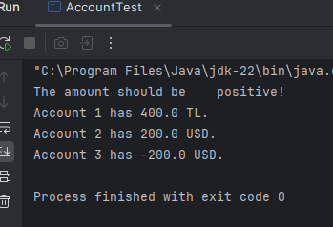
Negative Initial Balance
public class AccountTest {
public static void main(String[] args) {
Account account1 = new Account(1, 100, "TL");
Account account2 = new Account(2, 200, "USD");
Account account3 = new Account(3, -200, "USD");
account1.deposit(300);
account2.deposit(-300);
account1.report();
account2.report();
account3.report();
}
}

Slide 14
Constructors
A bank account should not have negative initial balance.
We should have check the initial balance.
public Account(int n, double b, String c){
number = n;
balance = b;
currency = c;
}
If it is negative, the balance should be 0.
public Account(int n, double b, String c){
number = n;
if (b > 0)
balance = b;
else
balance =0;
currency = c;
}

Slide 15
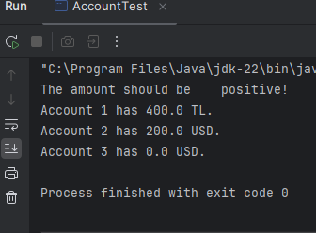
What is the output?
public class AccountTest {
public static void main(String[] args) {
Account account1 = new Account(1, 100, "TL");
Account account2 = new Account(2, 200, "USD");
Account account3 = new Account(3, -200, "USD");
account1.deposit(300);
account2.deposit(-300);
account1.report();
account2.report();
account3.report();
}
}

Slide 16
So, are we done?
With changing the constructor and the deposit function, are we sure that balance will not be a negative amount?

Slide 17
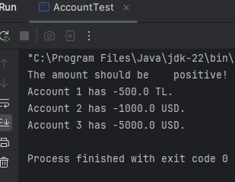
What is the output?
public class AccountTest {
public static void main(String[] args) {
Account account1 = new Account(1, 100, "TL");
Account account2 = new Account(2, 200, "USD");
Account account3 = new Account(3, -200, "USD");
account1.deposit(300);
account2.deposit(-300);
account1.balance = -500;
account2.balance = -1000;
account3.balance = -5000;
account1.report();
account2.report();
account3.report();
}
}

Slide 18
Class instances
The class instances need to be protected.
We need to keep the control of how these instances are accessed.
How?
Through using access modifiers.
Access modifiers
are used to set access levels for classes, variables, and other entries.

Slide 19
Access Specification
public class Account {
int number;
double balance;
String currency;
}
Access modifier:
For the top-level classes, it can be either
public :
visible to the earth
or
default (no keyword) :
visible only within the same package

Slide 20
Access Specification
public class Account {
int number;
double balance;
String currency;
}
These variables do not have any particular access modifier;
therefore, they are visible and accessible from only within the same package (package-private).

Slide 21
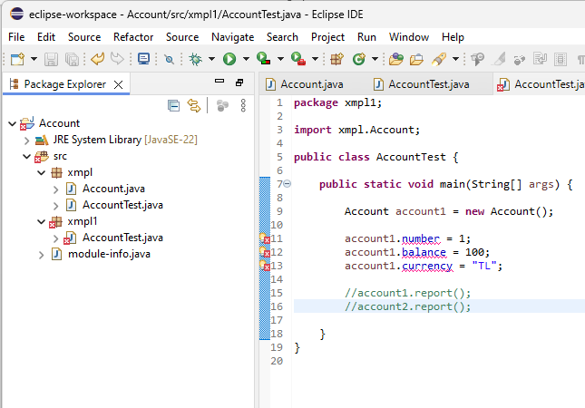
Access Specification
Let’s try to use them from outside the package

Slide 22
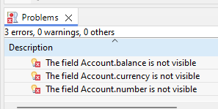
Access Specification
package xmpl;
public class Account {
int number;
double balance;
String currency;
}
package xmpl1;
import xmpl.Account;
public class AccountTest {
public static void main(String[] args) {
Account account1 = new Account();
account1.number = 1;
account1.balance = 100;
account1.currency = "TL";
}
}

Slide 23
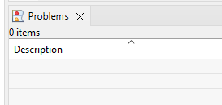
Access Specification
number, balance and currency are visible in everywhere!
package xmpl;
public class Account {
public int number;
public double balance;
public String currency;
}
package xmpl1;
import xmpl.Account;
public class AccountTest {
public static void main(String[] args) {
Account account1 = new Account();
account1.number = 1;
account1.balance = 100;
account1.currency = "TL";
}
}
No access related errors!

Slide 24
Important!!!
However, making everything public is not the solution.
When something is public, it can be accessed and also can be modified from everywhere!
It is also not a good idea to leave it package-private.
In default case (without any access modifier) that information can be accessed and modified everywhere within the package.
These are not optimum solutions.
You should encapsulate that information and limit its access and make sure that it can be modified only within your control.

Slide 25
Controlling Access to Entries
Each entry (class, class instance, member function) in a Java class is marked with one of the following keywords to control which classes have access to that entry:
public:
the entry is accessible from everywhere
private:
the entry is accessible only within the class, invisible everywhere outside the class
no keyword (default):
entry is accessible to classes inside the same package, invisible to all the others.
package private.
protected:
entry is accessible to the class itself, other classes inside the same package and all subclasses.

Slide 26
Access Modifiers
Which one is the most restrictive one?
public
private
no keyword (default)
protected
Which one is the least restrictive one?
public
private
no keyword (default)
protected
Rank them in increasing order of restrictiveness?
public
private
no keyword (default)
protected
Answer:
public, protected, default, private
protected entities can be accessed by sub-classes in other packages

Slide 27
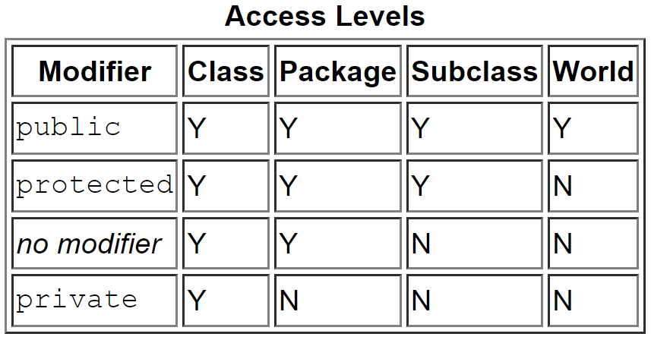
Access Modifiers: Access levels
private: the class itself
default: private + classes inside the same package
protected: default + all sub-classes
public: all classes
the access to members permitted by each modifier:
Source: http://docs.oracle.com/javase/tutorial/java/javaOO/accesscontrol.html

Slide 28
Important!!!
However, making everything public is not the solution.
When something is public, it can be accessed and also can be modified from everywhere!
It is also not a good idea to leave it package-private.
In default case (without any access modifier) that information can be accessed and modified everywhere within the package.
These are not optimum solutions.
You should encapsulate that information and limit its access and make sure that it can be modified only within your control.

Slide 29
For most of the cases
Class instances should be private
Only the class itself can access these variables
They are visible only inside the class definition
Only member functions of the class can access them
They are invisible outside the class
Therefore, the control is on the class itself only.
There may be times for exceptions.
Example: during inheritance
Class methods should be public or private
public if they will be used publicly
private if they are useful for another class function but not to be used by other classes directly
There can be exceptions to these.

Slide 30
Bank Account – version 9
Class instances
public class Account {
private int number;
private double balance;
private String currency;
}
Member functions were public already

Slide 31
No read/write access
public class AccountTest {
public static void main(String[] args) {
Account account1 = new Account(1, 100, "TL");
Account account2 = new Account(2, 200, "USD");
Account account3 = new Account(3, -200, "USD");
account1.deposit(300);
account2.deposit(-300);
account1.balance = -500;
account2.balance = -1000;
account3.balance = -5000;
account1.report();
account2.report();
account3.report();
}
}

Slide 32
Accessing Class Instances
Since class instances are private, we won’t have direct access to those instances
no read or write access
How can we access them?
by using getters and setters
get and set methods allow customized access to class instances
getter for read access
returns the class instance without modifying
setter for write access
modifies the class instance
mostly assigns the function argument’s value to the class instance

Slide 33
Getters
getter for read access
returns the class instance without modifying
An example getter function:
public int getNumber() {
return number;
}
What other getter functions do we need?

Slide 34
Getter Function
public class Account {
private int number;
private double balance;
private String currency;
}
public int getNumber() {
return number;
}
public int getBalance() {
return balance;
}
public int getCurrency() {
return currency;
}

Slide 35
Setters
Using private for class instances gives more control to the class.
The class can enforce legal value assignments through setters.
setter for write access
modifies the class instance
mostly assigns the function argument’s value to the class instance
An example setter function:
public void setCurrency(String c) {
currency = c;
}

Slide 36
Setter Functions
Do we need other setter functions?
account number
Initialized when an account is created
Cannot be changed afterwards
account balance
We don’t use a set function but instead
Deposit:
to put money in a bank account
Withdraw:
to remove money from a bank account

Slide 37
deposit and withdraw functions
We already have the deposit function
public void deposit(double d) {
if (d > 0) {
balance = balance + d;
System.out.println( d + " " + currency + " have been deposited");
System.out.println("The balance is" + balance + " " + currency);
}
else
System.out.println("The amount should be "positive!");
}
Can you write down the withdraw function?

Slide 38
deposit and withdraw functions
Can you write down the withdraw function?
Do not let withdraw if
withdraw amount is negative
withdraw amount is larger than the balance
Otherwise
withdraw the money and update the balance

Slide 39
deposit and withdraw functions
public void withdraw(double d) {
if (d > 0) {
if (balance < d) {
System.out.println("Account does not have " + d + " " + currency);
}
else {
balance = balance - d;
System.out.println( d + " " + currency + " have been withdrawn");
System.out.println("The balance is " + balance + " " + currency);
}
}
else
System.out.println("The amount should be positive!");
}

Slide 40
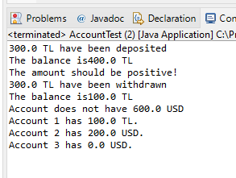
deposit and withdraw functions
public class AccountTest {
public static void main(String[] args) {
Account account1 = new Account(1, 100, "TL");
Account account2 = new Account(2, 200, "USD");
Account account3 = new Account(3, -200, "USD");
account1.deposit(300);
account2.deposit(-300);
account1.withdraw(300);
account2.withdraw(600);
account1.report();
account2.report();
account3.report();
}
}

Slide 41
setCurrency function
Let's review setCurrency function
public void setCurrency(String c) {
currency = c;
}
1 USD = 32.88 TL
How should we modify the above function?
Will this work?
public void setCurrency(String c) {
currency = c;
if (currency.equals("TL") && c.equals("USD")) {
balance = balance / 32.88;
}
if (currency.equals("USD") && c.equals ("TL")){
balance = balance * 32.88;
}
}

Slide 42
setCurrency function
public void setCurrency(String c) {
if (currency.equals("TL") && c.equals("USD")) {
balance = balance / 32.88;
}
if (currency.equals("USD") && c.equals ("TL")){
balance = balance * 32.88;
}
currency = c;
}

Slide 43
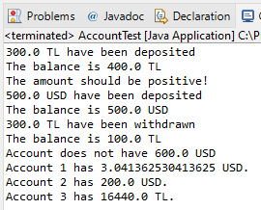
What is the output?
public class AccountTest {
public static void main(String[] args) {
Account account1 = new Account(1, 100, "TL");
Account account2 = new Account(2, 200, "USD");
Account account3 = new Account(3, -200, "USD");
account1.deposit(300);
account2.deposit(-300);
account3.deposit(500);
account1.withdraw(300);
account2.withdraw(600);
account3.setCurrency("TL");
account1.setCurrency("USD");
account1.report();
account2.report();
account3.report();
}
}

Slide 44
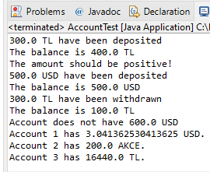
Unknown currency?
What happens in the following case?
account3.setCurrency("TL");
account1.setCurrency("USD");
account2.setCurrency("AKCE");
public void setCurrency(String c) {
if (currency.equals("TL") && c.equals("USD")) {
balance = balance / 32.88;
}
if (currency.equals("USD") && c.equals ("TL")){
balance = balance * 32.88;
}
currency = c;
}

Slide 45
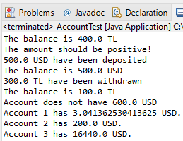
Unknown currency?
How can we fix this setCurrency function?
public void setCurrency(String c) {
if (currency.equals("TL") && c.equals("USD")) {
balance = balance / 32.88;
}
if (currency.equals("USD") && c.equals ("TL")){
balance = balance * 32.88;
}
currency = c;
}
public void setCurrency(String c) {
if (currency.equals("TL") && c.equals("USD")) {
balance = balance / 32.88;
}
if (currency.equals("USD") && c.equals ("TL")){
balance = balance * 32.88;
}
if (currency.equals("TL") || c.equals("USD")) {
currency = c;
}
}

Slide 46
Unknown currency?
The same thing can happen in constructor as well.
//Constructors
public Account(int n, double b, String c){
number = n;
if (b > 0)
balance = b;
else
balance = 0;
currency = c;
}
public Account(int n, String c){
number = n;
balance = 0;
currency = c;
}
public Account(int n){
number = n;
balance = 0;
currency = "TL";
}
In default we should set it to "TL"

Slide 47
Fixing Constructors
//Constructors
public Account(int n, double b, String c){
number = n;
if (b > 0)
balance = b;
else
balance = 0;
currency = c;
}
public Account(int n, String c){
number = n;
balance = 0;
currency = c;
}
//Constructors
public Account(int n, double b, String c){
number = n;
if (b > 0)
balance = b;
else
balance = 0;
if (c.equals("USD"))
currency = c;
else
currency = ("TL");
}
public Account(int n, String c){
number = n;
balance = 0;
if (c.equals("USD"))
currency = c;
else
currency = ("TL");
}

Slide 48
Code Repetition
//Constructors
public Account(int n, double b, String c){
number = n;
if (b > 0)
balance = b;
else
balance = 0;
if (c.equals("USD"))
currency = c;
else
currency = ("TL");
}
public Account(int n, String c){
number = n;
balance = 0;
if (c.equals("USD"))
currency = c;
else
currency = ("TL");
}
How can we write a function for this check?

Slide 49
Private Function
private void checksetCurrency(String c) {
if (c.equals("USD"))
currency = c;
else
currency = "TL";
}
//Constructors
public Account(int n, double b, String c){
number = n;
if (b > 0)
balance = b;
else
balance = 0;
checksetCurrency(c);
}
public Account(int n, String c){
number = n;
balance = 0;
checksetCurrency(c);
}

Slide 50
Private Function
private void checksetCurrency(String c) {
if (c.equals("USD"))
currency = c;
else
currency = "TL";
}
public class AccountTest {
public static void main(String[] args) {
Account account1 = new Account(1, 100, "TL");
Account account2 = new Account(2, 200, "USD");
Account account3 = new Account(3, -200, "USD");
account1.deposit(300);
account2.deposit(-300);
account3.deposit(500);
account2.checksetCurrency("TL");
account1.report();
account2.report();
}
}

Slide 51
Private Function
Functions that are helper functions to other member functions should be kept private.
Private function can be accessed from within the class.
Private function can not be accessed from outside the class.
Get and Set Functions
Setter methods usually begins with ‘set’ prefix.
setCurrency
Getter methods usually begins with ‘get’ prefix.
getCurrency
But there is an exception for Boolean values
For Boolean values the prefix ‘is’ usually used.

Slide 52
Boolean Get Functions (Version 10)
Assume that some accounts can be active while some of them are not.
They can be on hold.
Keep active information within a Boolean
private int number;
private double balance;
private String currency;
private boolean active;
//Constructors
public Account(int n, double b, String c){
number = n;
if (b > 0)
balance = b;
else
balance = 0;
checksetCurrency(c);
active = true;
}

Slide 53
Get Functions (Version 10)
public int getNumber() {
return number;
}
public double getBalance() {
return balance;
}
public String getCurrency() {
return currency;
}
public boolean isActive() {
return active;
}

Slide 54
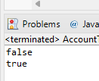
Set Functions
For set functions you can still use ‘set’ prefix
setActive
public void setActive(boolean a) {
active = a;
}
public static void main(String[] args) {
Account account1 = new Account(1, 100, "TL");
Account account2 = new Account(2, 200, "USD");
account1.setActive(false);
System.out.println(account1.isActive());
System.out.println(account2.isActive());
}

Slide 55
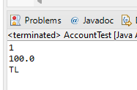
Ways of printing out the object - 1
get methods for accessing class instances one by one
public static void main(String[] args) {
Account account1 = new Account(1, 100, "TL");
System.out.println(account1.getNumber());
System.out.println(account1.getBalance());
System.out.println(account1.getCurrency());
}

Slide 56
Ways of printing out the object - 2
report method for printing report of the account
public void report() {
System.out.println("Account " + number
+ " has " + balance + " " + currency + ".");
}
public static void main(String[] args) {
Account account1 = new Account(1, 100, "TL");
account1.report();
}

Slide 57
Ways of printing out the object
Similar to other primitive types, can we just use the object inside System.out.println() function?
public static void main(String[] args) {
int i = 1000;
System.out.println(i);
Account account1 = new Account(1, 100, "TL");
System.out.println(account1);
}
What do you think the output will look like?

Slide 58
Ways of printing out the object
Similar to other primitive types, can we just use the object inside System.out.println() function?
public static void main(String[] args) {
int i = 1000;
System.out.println(i);
Account account1 = new Account(1, 100, "TL");
System.out.println(account1);
}
In order to get something meaningful, we need to override toString method of the class.

Slide 59
toString method
toString method tells Java how to display an object of the class.
It returns a String representation of the object.
public String toString() {
return "Account " + number + ": " + balance + " " + currency;
}

Slide 60
toString method
public String toString() {
return "Account " + number + ": " + balance + " " + currency;
}
public static void main(String[] args) {
int i = 1000;
System.out.println(i);
Account account1 = new Account(1, 100, "TL");
System.out.println(account1);
}

Slide 61
Any Questions?

