Slide 1

CS105
Introduction to Object-Oriented Programming
Prof. Dr. Nizamettin AYDIN
naydin@itu.edu.tr
nizamettin.aydin@ozyegin.edu.tr

Slide 2
Constructors
And
Method Overloading

Slide 3
Outline
Bank Account – version 3
Constructors
Calling constructors
No constructors
Bank Account – version 4
Multiple Constructors
Bank Account – version 5
Bank Account – version 6
Overloading Functions
Bank Account – version 7

Slide 4
Bank Account – version 3
public class AccountTest {
public static void main(String[] args) {
Account account1 = new Account();
account1.number = 1;
account1.balance = 100;
account1.currency = "TL";
Account account2 = new Account();
account2.number = 2;
account2.balance = 200;
account2.currency = "USD";
account1.report();
account2.report();
// Deposit 50 TL into account 1
account1.deposit(50);
// Deposit 300 USD into account 2
account2.deposit(300);
account1.report();
account2.report();
}
}

Slide 5
Constructors
block of codes which are automatically called when we create objects (when an instance of the class is created).
  a special type of method which is used to initialize the object.
    Every time an object is created using the new() keyword, at least one constructor is called.
// Constructor
public Account(int n, double b, String c){
number = n;
balance = b;
currency = c;
}
It looks like other methods, but...
  It has the same name with the class
  It does not have a return type,
    but it actually returns the reference to (address of) the constructed object

Slide 6
Calling constructors
Account account1 = new Account();
account1.number = 1;
account1.balance = 100;
account1.currency = "TL";
Account account1 = new Account();
// Constructor
public Account(int n, double b, String c){
number = n;
balance = b;
currency = c;
}

Slide 7
No constructors
Account account1 = new Account();
account1.number = 1;
account1.balance = 100;
account1.currency = "TL";
We did not have any constructors before.
How did we create objects without the constructor?
  If there is no explicit constructor, then the default constructor is used.
  Default constructors do not take any parameters.

Slide 8
Bank Account – version 4
public class Account {
int number;
double balance;
String currency;
// Constructor
public Account(int n, double b, String c){
number = n;
balance = b;
currency = c;
}
public void deposit(double d) {
balance = balance + d;
}
public void report() {
System.out.println("Account " + number
+ " has " + balance
+ " " + currency + ".");
}
}

Slide 9
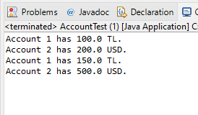
Bank Account – version 4
public class AccountTest {
public static void main(String[] args) {
Account account1 = new Account(1, 100, "TL");
Account account2 = new Account(2, 200, "USD");
account1.report();
account2.report();
// Deposit 50 TL into account 1
account1.deposit(50);
// Deposit 300 USD into account 2
account2.deposit(300);
account1.report();
account2.report();
}
}

Slide 10
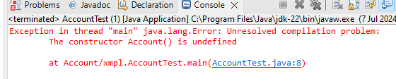
Why do we get the following error?
public class AccountTest {
public static void main(String[] args) {
Account account1 = new Account(1, 100, "TL");
Account account2 = new Account();
account2.number = 2;
account2.balance = 200;
account2.currency = "USD";
account1.report();
account2.report();
// Deposit 50 TL into account 1
account1.deposit(50);
// Deposit 300 USD into account 2
account2.deposit(300);
account1.report();
account2.report();
}
}
When a constructor (with parameters) is implemented, then the system does not provide a default (without parameters) constructor.

Slide 11
Default Constructor
When a constructor (with parameters) is implemented, then the system does not provide a default (without parameters) constructor.
Can we implement our own constructor without parameters?
Yes, we can…
  A class can have multiple constructors.
    This is possible by overloading constructors.
Method overloading gives us the capability to implement a particular function in different ways.
Overloaded functions will have the same name but different function arguments.

Slide 12

Multiple Constructors
// Constructors
public Account() {
}
public Account(int n, double b, String c){
number = n;
balance = b;
currency = c;
}
public class AccountTest {
public static void main(String[] args) {
Account account1 = new Account(1, 100, "TL");
Account account2 = new Account();
account2.number = 2;
account2.balance = 200;
account2.currency = "USD";

Slide 13
Multiple Constructors
Can we have more than two overloaded constructors?
Yes we can…
// Constructors
public Account() {
}
public Account(int n, double b, String c){
number = n;
balance = b;
currency = c;
}
public Account(int n, String c){
number = n;
balance = 0;
currency = c;
}
public Account(int n){
number = n;
balance = 0;
currency = "TL";
}
All these constructors do the same thing which is creating an object, but what they assign to the class instances are different.

Slide 14
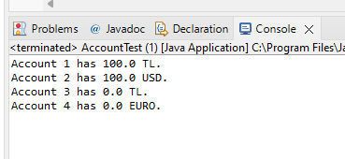
Bank Account – version 5
public class AccountTest {
public static void main(String[] args) {
Account account1 = new Account(1, 100, "TL");
Account account2 = new Account();
account2.number = 2;
account2.balance = 200;
account2.currency = "USD";
Account account3 = new Account(3);
Account account4 = new Account(4, "EURO");
account1.report();
account2.report();
account3.report();
account4.report();
}
}

Slide 15
Lets add more to our account!
interest rate (double)
int number;
double balance;
String currency;
double interestRate;

Slide 16
Modify the constructors
// Constructors
public Account() {
}
public Account(int n, double b, String c, double i){
number = n;
balance = b;
currency = c;
interestRate = i;
}
public Account(int n, String c){
number = n;
balance = 0;
currency = c;
interestRate = 0;
}
public Account(int n){
number = n;
balance = 0;
currency = "TL";
interestRate = 0;
}

Slide 17
Add more constructors
public Account (int n, double b, String c){
number = n;
balance = b;
currency = c;
interestRate = 0;
}
Account account5 = new Account(5, 200, "TL");
public Account (int n, double i, String c){
number = n;
balance = 0;
currency = c;
interestRate = i;
}
Account account6 = new Account(6, 0.02, "TL");
Do you see any problem?

Slide 18

Add more constructors
You can have multiple constructors as long as they have different argument lists.
public Account (int n, double b, String c){
number = n;
balance = b;
currency = c;
interestRate = 0;
}
public Account (int n, double i, String c){
number = n;
balance = 0;
currency = c;
interestRate = i;
}
System differentiates constructors based on their argument lists, therefore two constructors with same argument list cause compiler error.
  Duplicate method error!
Any idea to fix this?

Slide 19
Multiple Constructors
public Account (int n, double b, String c){
number = n;
balance = b;
currency = c;
interestRate = 0;
}
public Account (int n, String c, double i){
number = n;
balance = 0;
currency = c;
interestRate = i;
}
Same type of arguments, but their order is different!

Slide 20
Bank Account – version 6
Be careful when calling these functions!
Account account1 = new Account(1, 100, "TL");
Account account2 = new Account();
Account account3 = new Account(3);
Account account4 = new Account(4, "EURO");
Account account5 = new Account(5, 200, "TL");
Account account6 = new Account(5, "TL", 0.02);

Slide 21
Bank Account – version 6
public Account() {
}
public Account(int n, double b, String c, double i){
number = n;
balance = b;
currency = c;
interestRate = i;
}
public Account(int n, String c){
number = n;
balance = 0;
currency = c;
interestRate = 0;
}
public Account(int n){
number = n;
balance = 0;
currency = "TL";
interestRate = 0;
}
public Account(int n, double b, String c){
number = n;
balance = b;
currency = c;
interestRate = 0;
}
public Account(int n, String c, double i){
number = n;
balance = 0;
currency = c;
interestRate = i;
}
Account account1 = new Account(1, 100, "TL");
Account account2 = new Account();
Account account3 = new Account(3);
Account account4 = new Account(4, "EURO");
Account account5 = new Account(5, 200, "TL");
Account account6 = new Account(5, "TL", 0.02);

Slide 22
Overloading Functions
We have overloaded the constructor.
Can we overload other methods as well?
Yes, we can…
Overloading deposit function
public void deposit(double d) {
balance = balance + d;
}
public void deposit() {
balance = balance + 0;
}

Slide 23
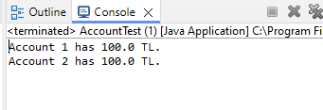
Bank Account – version 7
public void deposit(double d) {
balance = balance + d;
}
public void deposit() {
balance = balance + 0;
}
public static void main(String[] args) {
Account account1 = new Account(1, 100, "TL");
Account account2 = new Account(2);
account2.deposit(100);
account1.deposit();
account1.report();
account2.report();
}

Slide 24
Overloading deposit method
In addition to our two deposit methods, can we have the following method as well?
public double deposit(double m) {
balance = balance + m;
return balance;
}

Slide 25
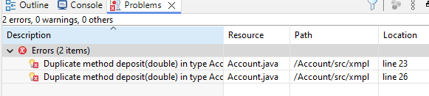
Overloading deposit method
public double deposit(double d) {
balance = balance + d;
}
public double deposit(double m) {
balance = balance + m;
return balance;
}
public double deposit() {
balance = balance + 0;
}
Overloaded methods need to have different function arguments (parameter list)
  If the arguments are same but the return type is different, we will still get compiler error

Slide 26
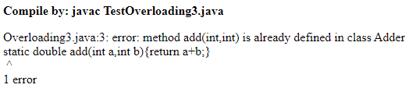
www.javatpoint.com/method-overloading-in-java
Why Method Overloading is not possible by changing the return type of method only?
  In java, method overloading is not possible by changing the return type of the method only because of ambiguity.
    Let's see how ambiguity may occur:
class Adder{
static int add(int a,int b){return a+b;}
static double add(int a,int b){return a+b;}
}
class TestOverloading3{
public static void main(String[] args){
System.out.println(Adder.add(11,11));//ambiguity
}}
Output

Slide 27
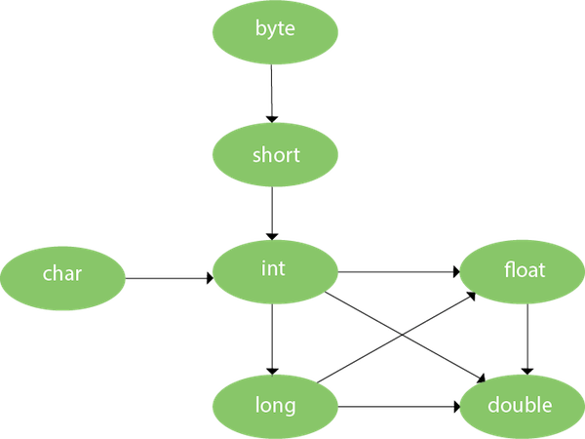
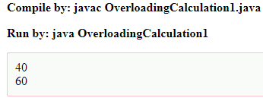
www.javatpoint.com/method-overloading-in-java
Method Overloading and Type Promotion:
  One type is promoted to another implicitly if no matching datatype is found.
    As displayed in the diagram, byte can be
    promoted to short, int, long, float or double.
    The short datatype can be promoted to int,
    long, float or double.
    The char datatype can be promoted
    to int, long, float or double and so on.
    Example of Method Overloading with TypePromotion:
class OverloadingCalculation1{
void sum(int a,long b){System.out.println(a+b);}
void sum(int a,int b,int c){System.out.println(a+b+c);}
public static void main(String args[]){
OverloadingCalculation1 obj=new OverloadingCalculation1();
obj.sum(20,20); //now second int literal will be promoted to long
obj.sum(20,20,20);
}
}

Slide 28
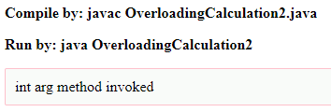
www.javatpoint.com/method-overloading-in-java
Example of Method Overloading with Type Promotion if matching found:
  If there are matching type arguments in the method, type promotion is not performed.
class OverloadingCalculation2{
void sum(int a,int b){System.out.println("int arg method invoked");}
void sum(long a,long b){System.out.println("long arg method invoked");}
public static void main(String args[]){
OverloadingCalculation2 obj=new OverloadingCalculation2();
obj.sum(20,20);//now int arg sum() method gets invoked
}
}
Output:

Slide 29
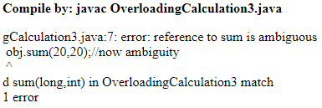
www.javatpoint.com/method-overloading-in-java
Example of Method Overloading with Type Promotion in case of ambiguity:
  If there are no matching type arguments in the method, and each method promotes similar number of arguments, there will be ambiguity.
class OverloadingCalculation3{
void sum(int a,long b){System.out.println("a method invoked");}
void sum(long a,int b){System.out.println("b method invoked");}
public static void main(String args[]){
OverloadingCalculation3 obj=new OverloadingCalculation3();
obj.sum(20,20);//now ambiguity
}
}
Output:

Slide 30
Any Questions?

