Slide 1

CS105
Introduction to Object-Oriented Programming
Prof. Dr. Nizamettin AYDIN
naydin@itu.edu.tr
nizamettin.aydin@ozyegin.edu.tr

Slide 2
Method

Slide 3
Outline
Algorithms
Removing redundancy
Methods
Using methods
Design of an algorithm
Declaring a method
Calling a method
Program with a method
Methods calling methods
Control flow
When to use method

Slide 4

ALGORITHMS
Algorithm:
  A list of steps for solving a problem.
Example algorithm: "Bake sugar cookies"
  Mix the dry ingredients.
  Cream the butter and sugar.
  Beat in the eggs.
  Stir in the dry ingredients.
  Set the oven temperature.
  Set the timer.
  Place the cookies into the oven.
  Allow the cookies to bake.
  Spread frosting and sprinkles onto the cookies.
  ...

Slide 5
PROBLEMS WITH ALGORITHMS
lack of structure:
  Many tiny steps; tough to remember.
redundancy:
  Consider making a double batch...
    Mix the dry ingredients.
    Cream the butter and sugar.
    Beat in the eggs.
    Stir in the dry ingredients.
    Set the oven temperature.
    Set the timer.
    Place the first batch of cookies into the oven.
    Allow the cookies to bake.
    Set the timer.
    Place the second batch of cookies into the oven.
    Allow the cookies to bake.
    Mix ingredients for frosting.
    ...

Slide 6
STRUCTURED ALGORITHMS
structured algorithm: Split into coherent tasks.
  Make the cookie batter.
    Mix the dry ingredients.
    Cream the butter and sugar.
    Beat in the eggs.
    Stir in the dry ingredients.
  Bake the cookies.
    Set the oven temperature.
    Set the timer.
    Place the cookies into the oven.
    Allow the cookies to bake.
  Decorate the cookies.
    Mix the ingredients for the frosting.
    Spread frosting and sprinkles onto the cookies.

Slide 7
REMOVING REDUNDANCY
A well-structured algorithm can describe repeated tasks with less redundancy.
  Make the cookie batter.
    Mix the dry ingredients.
    ...
  A. Bake the cookies (first batch).
    Set the oven temperature.
    Set the timer.
    ...
    B. Bake the cookies (second batch).
  Decorate the cookies.
    ...

Slide 8
A PROGRAM WITH REDUNDANCY
public class BakeCookies {
public static void main(String[] args) {
System.out.println("Mix the dry ingredients.");
System.out.println("Cream the butter and sugar.");
System.out.println("Beat in the eggs.");
System.out.println("Stir in the dry ingredients.");
System.out.println("Set the oven temperature.");
System.out.println("Set the timer.");
System.out.println("Place a batch of cookies into the oven.");
System.out.println("Allow the cookies to bake.");
System.out.println("Set the oven temperature.");
System.out.println("Set the timer.");
System.out.println("Place a batch of cookies into the oven.");
System.out.println("Allow the cookies to bake.");
System.out.println("Mix ingredients for frosting.");
System.out.println("Spread frosting and sprinkles.");
}
}

Slide 9
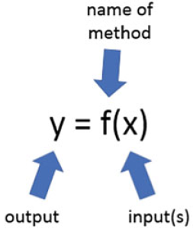
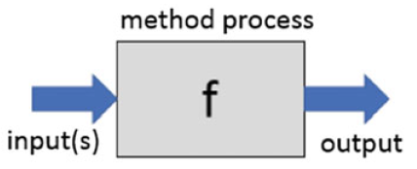
METHODS
Methods have their origins in the mathematical concept of a function.
A method is a function that belongs to a class.
  A method performs some useful behaviour made up using code.
  A method can have any number of inputs, and either one or zero output.
  A method with zero outputs is called
  a void method.
A black box model with input(s) and an output A maths function of the form y = f(x)

Slide 10
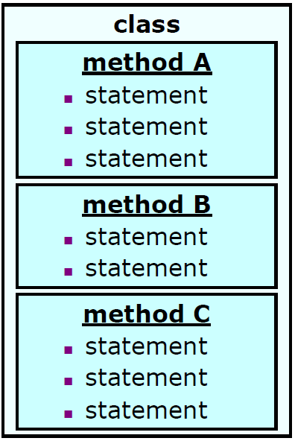
METHODS
method:
  A named group of statements.
    denotes the structure of a program
    eliminates redundancy by code reuse
procedural decomposition:
  dividing a problem into methods
Writing a method is like
  adding a new command to Java.

Slide 11
METHODS
The maths way is helpful
  helps us understand the origins of the syntax for calling methods.
The black box model is helpful
  reminds us of the procedural programming paradigm,
  process inside the method is encapsulated within that method.
All methods in Java must belong to a class
  they cannot exist in isolation.
  can be defined anywhere inside their host class.
A method definition takes the general form:
<access-modifier> <return-type> method-name(<formal-parameters>)
{
// Body of method
<return-statement-if-not-void>
}

Slide 12
METHODS
<Access-modifier>:
  public or private depending on whether the method is intended to be invokable by other classes, or only by methods inside the class in which it was defined.
  Other access modifiers also exist.
  If not specified, the access modifier is assumed to be public.
<return-type>:
  the Java type of any output generated by this method.
  If the method does not produce any returned output, the return type is void.
  A return type must always be specified.
The method-name:
  any valid name, by convention starting with a lower-case letter.
The <formal-parameters>:
  a list of zero or more parameters that the method will take as inputs to do the job that is designed to perform.
  If there are no inputs, the set of empty round brackets must still be included to denote that this is a method definition.
return statement:
  if the method produces a value to be returned, i.e. it is not void, then the return statement is used to signify the value that is returned.
  Executing a return statement at any point during a method invocation causes the method to finish.

Slide 13
METHODS
An example method definition that takes two formal parameters and produces an output:
public int addTwoNumbers(int a, int b)
{
int c;
c = a + b;
return c;
}
To use this method, we would use some calling code (within another method) like this:
int d;
d = addTwoNumbers(3,4);
System.out.println(d);
In this example, we invoke the method addTwoNumbers() with two actual parameters, 3 and 4 in this case.

Slide 14
METHODS
another example of a method that takes two parameters, determines which is larger and displays an appropriate message on the console:
public void showLarger(int a, int b){
if (a > b){
System.out.println("a is larger");
}
else if (b > a){
System.out.println("b is larger");
}
else {
System.out.println("a is equal to b");
}
}
Note that as this method is void, there is no return keyword

Slide 15
USING METHODS
Design the algorithm.
  Look at the structure, and which commands are repeated.
  Decide what are the important overall tasks.
Declare (write down) the methods.
  Arrange statements into groups and give each group a name.
Call (run) the methods.
  The program's main method executes the other methods to perform the overall task.

Slide 16
DESIGN OF AN ALGORITHM…
// This program displays a delicious recipe for baking cookies.
public class BakeCookies2 {
public static void main(String[] args) {
// Step 1: Make the cake batter.
System.out.println("Mix the dry ingredients.");
System.out.println("Cream the butter and sugar.");
System.out.println("Beat in the eggs.");
System.out.println("Stir in the dry ingredients.");
// Step 2a: Bake cookies (first batch).
System.out.println("Set the oven temperature.");
System.out.println("Set the timer.");
System.out.println("Place a batch of cookies into the oven.");
System.out.println("Allow the cookies to bake.");

Slide 17
…DESIGN OF AN ALGORITHM
// Step 2b: Bake cookies (second batch).
System.out.println("Set the oven temperature.");
System.out.println("Set the timer.");
System.out.println("Place a batch of cookies into the oven.");
System.out.println("Allow the cookies to bake.");
// Step 3: Decorate the cookies.
System.out.println("Mix ingredients for frosting.");
System.out.println("Spread frosting and sprinkles.");
}
}

Slide 18
DECLARING A METHOD
Gives your method a name so it can be executed
Syntax:
public static void name() {
statement;
statement;
...
statement;
}
Example:
public static void printWarning() {
System.out.println("This product causes cancer");
System.out.println("in lab rats and humans.");
}

Slide 19
CALLING A METHOD
Executes the method’s code
Syntax:
name();
  You can call the same method many times if you like.
Example:
printWarning();
Output:
This product causes cancer
in lab rats and humans.

Slide 20
PROGRAM WITH A METHOD
public class RapLyrics {
public static void main(String[] args) {
rap(); // Calling (running) the rap method
System.out.println();
rap(); // Calling the rap method again
}
// This method prints the lyrics to my favorite song.
public static void rap() {
System.out.println("İstisnalar kaideyi bozmaz, ");
System.out.println("Kuru yanında yaş telas yapmaz. ");
}
}
Output:
Istisnalar kaideyi bozmaz,
Kuru yanında yas telas yapmaz.
Istisnalar kaideyi bozmaz,
Kuru yanında yas telas yapmaz.

Slide 21
FINAL COOKIE PROGRAM…
// This program displays a delicious recipe for baking cookies.
public class BakeCookies3 {
public static void main(String[] args) {
makeBatter();
bake(); // 1st batch
bake(); // 2nd batch
decorate();
}
// Step 1: Make the cake batter.
public static void makeBatter() {
System.out.println("Mix the dry ingredients.");
System.out.println("Cream the butter and sugar.");
System.out.println("Beat in the eggs.");
System.out.println("Stir in the dry ingredients.");
}

Slide 22
…FINAL COOKIE PROGRAM
// Step 2: Bake a batch of cookies.
public static void bake() {
System.out.println("Set the oven temperature.");
System.out.println("Set the timer.");
System.out.println("Place a batch of cookies into the oven.");
System.out.println("Allow the cookies to bake.");
}
// Step 3: Decorate the cookies.
public static void decorate() {
System.out.println("Mix ingredients for frosting.");
System.out.println("Spread frosting and sprinkles.");
}
}

Slide 23
FINAL COOKIE PROGRAM
// This program displays a delicious recipe for baking cookies.
public class BakeCookies3 {
public static void main(String[] args) {
makeBatter();
bake(); // 1st batch
bake(); // 2nd batch
decorate();
}
// Step 1: Make the cake batter.
public static void makeBatter() {
System.out.println("Mix the dry ingredients.");
System.out.println("Cream the butter and sugar.");
System.out.println("Beat in the eggs.");
System.out.println("Stir in the dry ingredients.");
}
// Step 2: Bake a batch of cookies.
public static void bake() {
System.out.println("Set the oven temperature.");
System.out.println("Set the timer.");
System.out.println("Place a batch of cookies into the oven.");
System.out.println("Allow the cookies to bake.");
}
// Step 3: Decorate the cookies.
public static void decorate() {
System.out.println("Mix ingredients for frosting.");
System.out.println("Spread frosting and sprinkles.");
}
}

Slide 24
METHODS CALLING METHODS
public class MethodsExample {
public static void main(String[] args) {
message1();
message2();
System.out.println("Done with main.");
}
public static void message1() {
System.out.println("This is message1.");
}
public static void message2() {
System.out.println("This is message2.");
message1();
System.out.println("Done with message2.");
}
}
Output:
This is message1.
This is message2.
This is message1.
Done with message2.
Done with main.

Slide 25
CONTROL FLOW
When a method is called, the program’s execution…
  “jumps” into that method, executing its statements, then
  “jumps” back to the point where the method was called.
public class MethodsExample {
public static void main(String[] args) {
message1();
message2();
System.out.println("Done with main.");
}
...
}
public static void message1() {
System.out.println("This is message1.");
}
public static void message2() {
System.out.println("This is message2.");
message1();
System.out.println("Done with message2.");
}
public static void message1() {
System.out.println("This is message1.");
}

Slide 26
WHEN TO USE METHODS
Place statements into a method if:
  The statements are related structurally, and/or
  The statements are repeated.
You should not create methods for:
  An individual println statement.
  Only blank lines.
    (Put blank printlns in main.)
  Unrelated or weakly related statements.
    (Consider splitting them into two smaller methods.)

Slide 27
Any Questions?

