Slide 1
CS105
Introduction to Object-Oriented Programming
Prof. Dr. Nizamettin AYDIN
naydin@itu.edu.tr
nizamettin.aydin@ozyegin.edu.tr

Slide 2
DATA TYPES

Slide 3
Outline
Primitive Data Types
Java’s Primitive Data Types
Expressions
Arithmetic Operators
Precedence
Mixing Types
String Concatenation
Variables

Slide 4
PRIMITIVE DATA TYPES
type:
A category or set of data values
Any type of information including, although not limited to,
numeric data, logical data, text and objects
Constrains the operations that can be performed on data
Many languages ask the programmer to specify types
Examples: integer, real number, string
Internally, computers store everything as 1s and 0s
104 ➔ 01101000
"hi" ➔ 01101000110101
Data is stored in the form of variables
We can view the purpose of a program as a means of doing some useful work on data

Slide 5
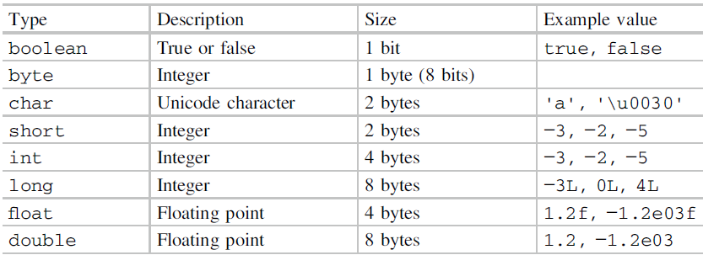
JAVA’S PRIMITIVE TYPES
primitive types:
8 simple types for numbers, text, etc.
Java also has object types, which we'll talk about later

Slide 6
JAVA’S PRIMITIVE TYPES
In Java, all numeric types are signed,
meaning that they can take on positive and negative values
there is no distinction between signed and unsigned types as there is in languages such as C
Primitive data is stored in the form of variables.
To use a variable, we must declare it first.
This ensures that the compiler knows how much memory to set aside to store each variable.
Java is a strongly typed language,
meaning that we must always state what kind of data something is before we can use it.
This declaration happens only once.
The primitive data type keywords start with lower case letters to remind us that they do not have the status of a class.
Primitive variables also have default values
0 for the numeric ones and false for boolean ones.

Slide 7
JAVA’S PRIMITIVE TYPES
some example of primitive variables being declared and then given some values:
int x;
boolean y;
double x1;
float x2;
char myLetter;
x = 3;
y = true;
x1 = 1.5;
x2 = 6.5f;
myLetter = 'x';

Slide 8
EXPRESSIONS
can combine a declaration with setting an initial value:
int x = 3;
boolean y = false;
expression:
A value or operation that computes a value.
Examples:
1 + 4 * 5
(7 + 2) * 6 / 3
42
The simplest expression is a literal value.
A complex expression can use operators and parentheses.

Slide 9
EXPRESSIONS
can manipulate variable values using an expression:
x = 5;
x = x + 2; // Add 2 to the value of x
int z = 2;
x = z + 2;
x += 4; // Add 4 to the value of x
x++; // Increase x by 1
x--; // Decrease x by 1
x = x * 6; // Multiply x by 6
x = x / 2; // Integer divide x by 2
y = false;
x2 = x2 / 5.2f;
For an expression, the right-hand side of the equals sign is evaluated and used to set the variable on the left-hand side

Slide 10
ARITHMETIC OPERATORS
operator:
Combines multiple values or expressions.
+ addition
- subtraction (or negation)
* multiplication
/ division
% modulus (a.k.a. remainder)
As a program runs, its expressions are evaluated.
1+1 evaluates to 2
System.out.println(3*4); prints 12
How would we print the text 3*4 ?

Slide 11
ARITHMETIC OPERATORS
When we divide integers, the quotient is also an integer.
14 / 4 is 3, not 3.5
3 4 52
4 ) 14 10 ) 45 27 ) 1425
12 40 135
2 5 75
54
21
More examples:
32 / 5 is
84 / 10 is
156 / 100 is
Dividing by 0 causes an error when your program runs.
6
8
1

Slide 12
INTEGER REMAINDER WITH %
The % operator computes the remainder from integer division.
14 % 4 is 2
218 % 5 is 3
3 43
4 ) 14 5 ) 218
12 20
2 18
15
3
Applications of % operator:
Obtain last digit of a number : 230857 % 10 is 7
Obtain last 4 digits : 658236489 % 10000 is 6489
See whether a number is odd : 7 % 2 is 1, 42 % 2 is 0
What is the result?
45 % 6
2 % 2
8 % 20
11 % 0

Slide 13
PRECEDENCE
precedence:
Order in which operators are evaluated.
Generally, operators evaluate left-to-right.
1 - 2 - 3 is (1 - 2) - 3 which is -4
But * / % have a higher level of precedence than + -
1 + 3 * 4 is 13
6 + 8 / 2 * 3
6 + 4 * 3
6 + 12 is 18
Parentheses can force a certain order of evaluation:
(1 + 3) * 4 is 16
Spacing does not affect order of evaluation
1 + 3 * 4 - 2 is 11

Slide 14
PRESEDENCE EXAMPLE
Example 1:
1 * 2 + 3 * 5 % 4
2 + 3 * 5 % 4
2 + 15 % 4
2 + 3
5
Example 2:
1 + 8 % 3 * 2 – 9
1 + 2 * 2 – 9
1 + 4 – 9
5 – 9
– 4

Slide 15
PRESEDENCE QUESTIONS
What values result from the following expressions?
9 / 5
695 % 20
7 + 6 * 5
7 * 6 + 5
248 % 100 / 5
6 * 3 - 9 / 4
(5 - 7) * 4
6 + (18 % (17 - 12))

Slide 16
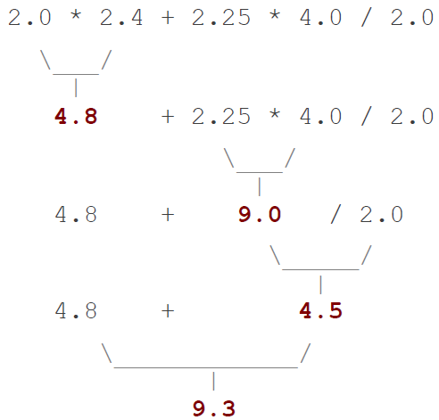
REAL NUMBERS (TYPE DOUBLE)
Examples:
6.022 , -42.0 , 2.143e17
Placing .0 or . after an integer makes it a double.
The operators + - * / % () all still work with double.
/ produces an exact answer:
15.0 / 2.0 is 7.5
Precedence is the same:
() before * / % before + -
Real number example:

Slide 17
MIXING TYPES
When int and double are mixed, the result is a double.
4.2 * 3 is 12.6
The conversion is per-operator, affecting only its operands.
7 / 3 * 1.2 + 3 / 2
2 * 1.2 + 3 / 2
2.4 + 3 / 2
2.4 + 1
3.4
2.0 + 10 / 3 * 2.5 - 6 / 4
2.0 + 3 * 2.5 - 6 / 4
2.0 + 7.5 - 6 / 4
2.0 + 7.5 - 1
9.5 - 1
8.5

Slide 18
STRING CONCATENATION
string concatenation:
Using + between a string and another value to make a longer string.
"hello" + 42 is "hello42"
1 + "abc" + 2 is "1abc2"
"abc" + 1 + 2 is "abc12"
1 + 2 + "abc" is "3abc"
"abc" + 9 * 3 is "abc27"
"1" + 1 is "11"
4 - 1 + "abc" is "3abc“
Use + to print a string and an expression's value together.
System.out.println("Grade: " + (95.1 + 71.9) / 2);
Output: Grade: 83.5

Slide 19
VARIABLES

Slide 20
RECEIPT EXAMPLE
What's bad about the following code?
public class Receipt {
public static void main(String[] args) {
// Calculate total owed, assuming 8% tax / 15% tip
System.out.print("Subtotal: ");
System.out.println(38 + 40 + 30);
System.out.print("Tax: ");
System.out.println((38 + 40 + 30) * .08);
System.out.print("Tip: ");
System.out.println((38 + 40 + 30) * .15);
System.out.print("Total: ");
System.out.println(38 + 40 + 30 +
(38 + 40 + 30) * .08 +
(38 + 40 + 30) * .15);
}
}
The subtotal expression (38 + 40 + 30) is repeated
So many println statements

Slide 21
VARIABLES
variable:
A piece of the computer's memory that is given a name and type,
can store a value.
Like preset stations on a car stereo, or cell phone speed dial:
Steps for using a variable:
Declare it –
state its name and type
Initialize it –
store a value into it
Use it –
print it or use it as part of an expression

Slide 22
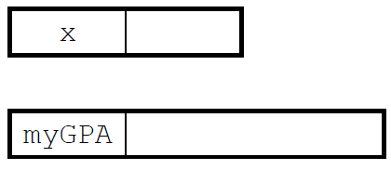
DECLARATION
variable declaration:
Sets aside memory for storing a value.
Variables must be declared before they can be used.
Syntax:
type name;
The name is an identifier.
int x;
double myGPA;

Slide 23
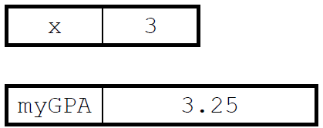
ASSIGNMENT
assignment:
Stores a value into a variable.
The value can be an expression;
the variable stores its result.
Syntax:
name = expression;
int x;
x = 3;
double myGPA;
myGPA = 1.0 + 2.25;

Slide 24
USING VARIABLES
Once given a value, a variable can be used in expressions:
int x;
x = 3;
System.out.println("x is " + x); // x is 3
System.out.println(5 * x - 1); // 14
You can assign a value more than once:
int x;
x = 3;
System.out.println(x + " here");
x = 4 + 7;
System.out.println("now x is " + x);
3
// 3 here
// now x is 11
11

Slide 25
USING VARIABLES
Once given a value, a variable can be used in expressions:
int x;
x = 3;
System.out.println("x is " + x); // x is 3
System.out.println(5 * x - 1); // 14
You can assign a value more than once:
int x;
x = 3;
System.out.println(x + " here");
x = 4 + 7;
System.out.println("now x is " + x);

Slide 26
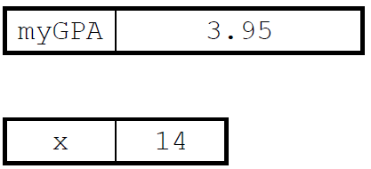
DECLARATION/INITIALIZATION
A variable can be declared/initialized in one statement.
Syntax:
type name = value;
double myGPA = 3.95;
int x = (11 % 3) + 12;

Slide 27
ASSIGNMENT AND ALGEBRA
Assignment uses = , but it is not an algebraic equation.
= means, "store the value at right in variable at left"
The right-side expression is evaluated first, and then its result is stored in the variable at left.
What happens here?
int x = 3;
x = x + 2; //Evaluate right side then put it into x

Slide 28
ASSIGNMENT AND TYPES
A variable can only store a value of its own type.
int x = 2.5;
An int value can be stored in a double variable.
The value is converted into the equivalent real number.
double myGPA = 4;
double avg = 11 / 2;
Why does avg store 5.0 and not 5.5 ?
// ERROR: incompatible types
4.0
5.0

Slide 29
COMPILER ERRORS
A variable can't be used until it is assigned a value.
int x;
System.out.println(x);
You may not declare the same variable twice.
int x;
int x;
int x = 3;
int x = 5;
How can this code be fixed?
// ERROR: x has no value
// ERROR: x already exists
// ERROR: x already exists

Slide 30
PRINTING A VARIABLE'S VALUE
Use + to print a string and a variable's value on one line.
double grade = (95.1 + 71.9 + 82.6) / 3.0;
System.out.println("Your grade was " + grade);
int students = 11 + 17 + 4 + 19 + 14;
System.out.println("There are " + students +
" students in the course.");
Output:
Your grade was 83.2
There are 65 students in the course.

Slide 31
PRECEDENCE QUESTIONS
Improve the receipt program using variables.
public class Receipt {
public static void main(String[] args) {
// Calculate total owed, assuming 8% tax / 15% tip
System.out.print("Subtotal: ");
System.out.println(38 + 40 + 30);
System.out.print("Tax: ");
System.out.println((38 + 40 + 30) * .08);
System.out.print("Tip: ");
System.out.println((38 + 40 + 30) * .15);
System.out.print("Total: ");
System.out.println(38 + 40 + 30 +
(38 + 40 + 30) * .08 +
(38 + 40 + 30) * .15);
}
}”

Slide 32
RECEIPT ANSWER
public class Receipt {
public static void main(String[] args) {
// Calculate total owed, assuming 8% tax / 15% tip
int subtotal = 38 + 40 + 30;
double tax = subtotal * .08;
double tip = subtotal * .15;
double total = subtotal + tax + tip;
System.out.println("Subtotal: " + subtotal);
System.out.println("Tax: " + tax);
System.out.println("Tip: " + tip);
System.out.println("Total: " + total);
}
}

Slide 33
Any Questions?

