Slide 1

CS105
Introduction to Object-Oriented Programming
Prof. Dr. Nizamettin AYDIN
naydin@itu.edu.tr
nizamettin.aydin@ozyegin.edu.tr

Slide 2
Introduction

Slide 3
Outline
Introduction to the Computing
What is a Program?
Programming Tools Overview
Program Translation Process
Evolution of programming languages
Programming Language Categories
Object-Oriented Languages
Object-Oriented programming
Structure of a Java Program
Names and identifiers
Keywords
Syntax
Comments
Hello World Application

Slide 4
Introduction to the Computing
In theory, computer can compute anything that’s possible to compute
  given enough memory and time
In practice, solving problems involves
computing under constraints.
  time
    weather forecast, next frame of animation, ...
  cost
    cell phone, automotive engine controller, ...
  power
    cell phone, handheld video game, ...

Slide 5
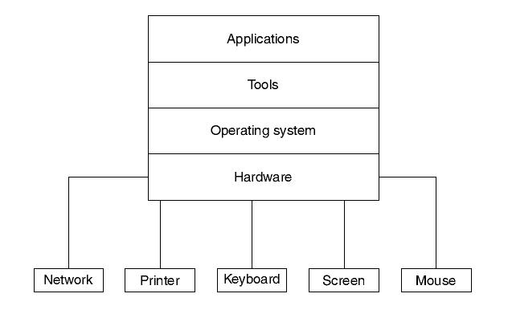
Layers of Technology

Slide 6
Layers of Technology
Operating system...
  Interacts directly with the hardware
    Responsible for ensuring efficient use of hardware resources
Tools...
  Softwares that take adavantage of what the operating system has to offer.
    Programming languages, databases, editors, interface builders...
Applications...
  Most useful category of software
    Web browsers, email clients, web servers, word processors, etc...

Slide 7
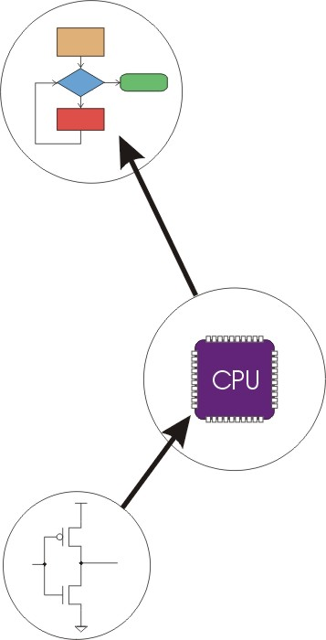
Transformations Between Layers
Problems
Algorithms
Language
Instruction Set Architecture
Microarchitecture
Circuits
Devices
Notes:
7

Slide 8
How do we solve a problem using a computer?
A systematic sequence of transformations between
layers of abstraction.
Problem
Software Design:
choose algorithms and data structures
Algorithm
Programming:
use language to express design
Program
Compiling/Interpreting:
convert language to
machine instructions
Instr Set
Architecture
Notes:
8

Slide 9
Deeper and Deeper…
Instr Set
Architecture
Processor Design:
choose structures to implement ISA
Microarch
Logic/Circuit Design:
gates and low-level circuits to
implement components
Circuits
Process Engineering & Fabrication:
develop and manufacture
lowest-level components
Devices
Notes:
9

Slide 10
Many Choices at Each Level
Solve a system of linear equations
Gaussian
elimination
Jacobi
iteration
Red-black SOR
Multigrid
FORTRAN
C
C++
Java
Tradeoffs:
cost
performance
power
(etc.)
PowerPC
Intel x86
Atmel AVR
Centrino
Pentium 4
Xeon
Ripple-carry adder
Carry-lookahead adder
CMOS
Bipolar
GaAs
The successive over-relaxation (SOR) : a method for solving a linear system of equations.
Notes:
10
Sun and Java are trademarks of Sun Microsystems, Inc. Intel, Pentium, Centrino, and Xeon are trademarks of Intel Corporation. AMD and Athlon and trademarks of Advanced Micro Devices, Inc. Atmel and AVR are registered trademarks of Atmel Corporation. PowerPC is a trademark of International Business Machines Corporation.

Slide 11
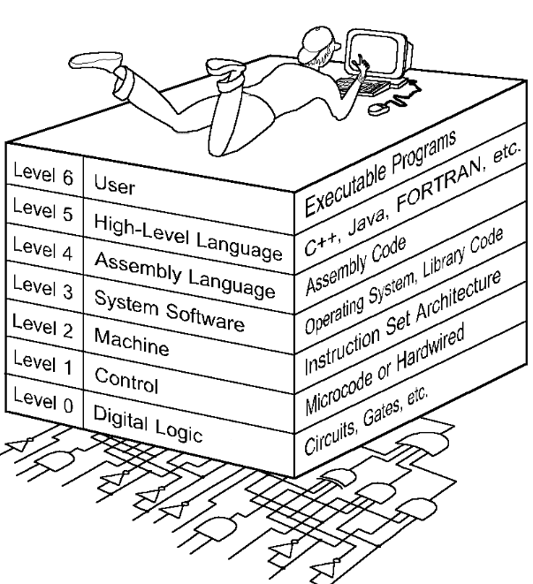
The Computer Level Hierarchy
Each virtual machine layer is an abstraction of the level below it.
The machines at each level execute their own particular instructions, calling upon machines at lower levels to perform tasks as required.
Computer circuits ultimately carry out the work.
Software?
  Program or collection of programs.
  Enables the hardware to process data.

Slide 12
Instruction Set Architecture
C
Fortran
Ada
etc.
Basic
Java
Compiler
Compiler
Assembly Language
Byte Code
Assembler
Interpreter
Executable
HW
Implementation 1
HW
Implementation 2
HW
Implementation N

Slide 13
Levels of Representation
High Level Language Program
temp = v[k];
v[k] = v[k+1];
v[k+1] = temp;
Compiler
Assembly Language Program
lw $15, 0($2)
lw $16, 4($2)
sw $16, 0($2)
sw $15, 4($2)
Assembler
00001001110001101010111101011000
10101111010110000000100111000110
11000110101011110101100000001001
01011000000010011100011010101111
Machine Language Program
Machine Interpretation
Control Signal Specification
ALUOP[0:3] <= InstReg[9:11] & MASK
°
°

Slide 14
Programming
Methodologies for creating computer programs
that perform a desired function.
  Problem Solving
    How do we figure out what to tell the computer to do?
    Convert problem statement into algorithm, using stepwise refinement.
    Convert algorithm into machine instructions.
  Debugging
    How do we figure out why it didn’t work?
    Examining registers and memory, setting breakpoints, etc.
Time spent on the first can reduce time spent on the second!

Slide 15
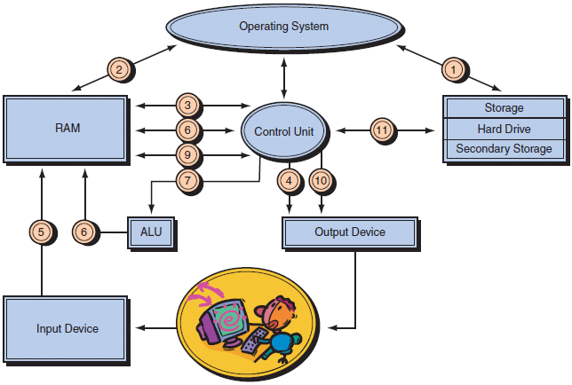
What is a Program?
Program:
  A set of instructions to be carried out by a computer.
  A sequence of steps
    For each step, an arithmetic or logical operation is done
    For each operation, a different set of control signals is needed
    For each operation a unique code is provided
      e.g. ADD, MOVE
    A hardware segment accepts the code and issues the control signals
Program execution:
  The act of carrying out the instructions
  contained in a program.
Programming language:
  A systematic set of rules used to
  describe computations in a format
  that is editable by humans
  Abbreviated forms of instructions that translate into machine language

Slide 16
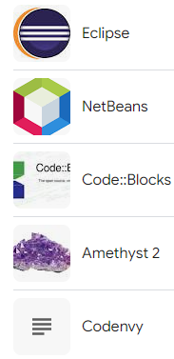
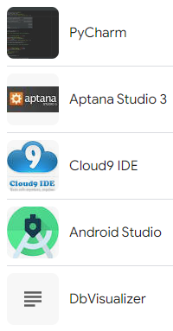
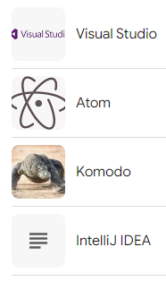
Programming Tools Overview
Editors
Assemblers
Debuggers
Compilers
Linkers
Loaders
Interpreters
Integrated Development Environments (IDEs) combine several of the above programming tools

Slide 17
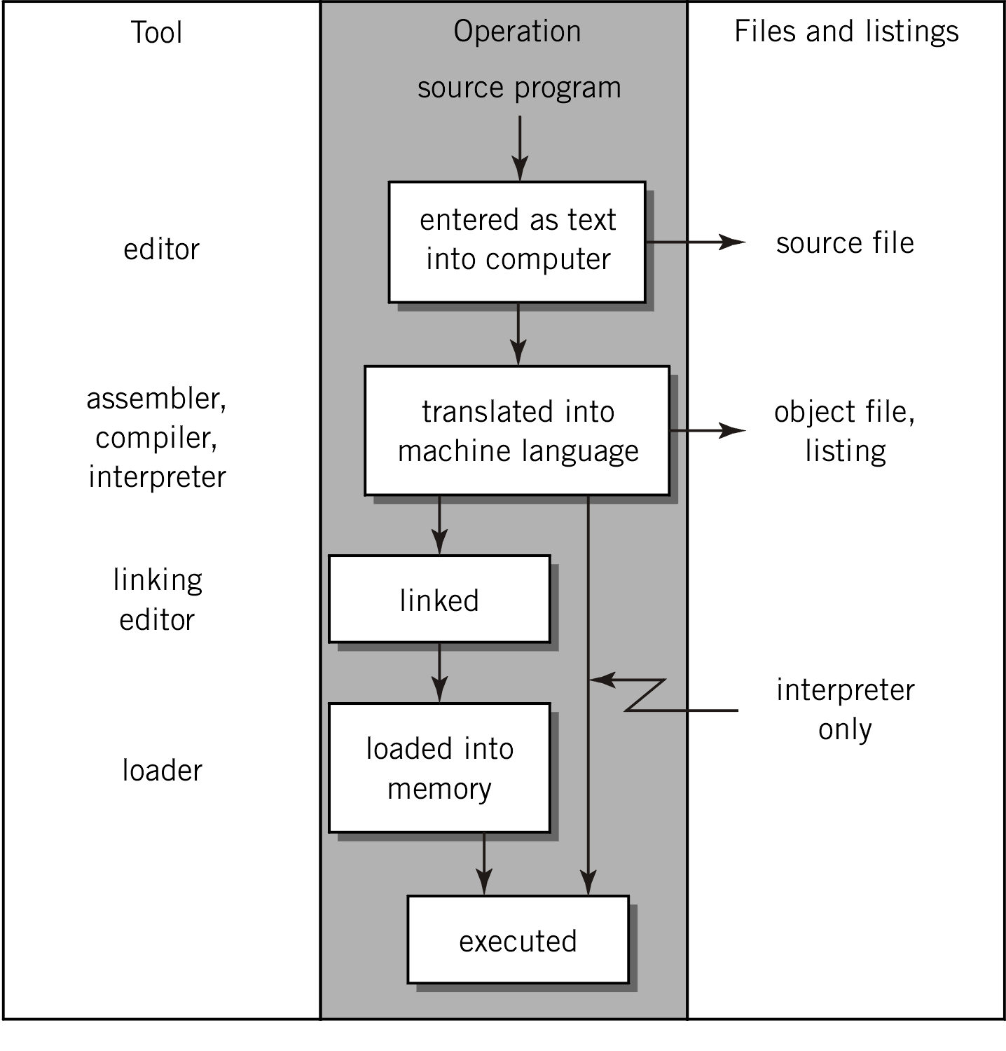
Program Translation Process
Terms,
terms, and
more terms!
Source
Translator
Object
Linker
Loader
Executable

Slide 18
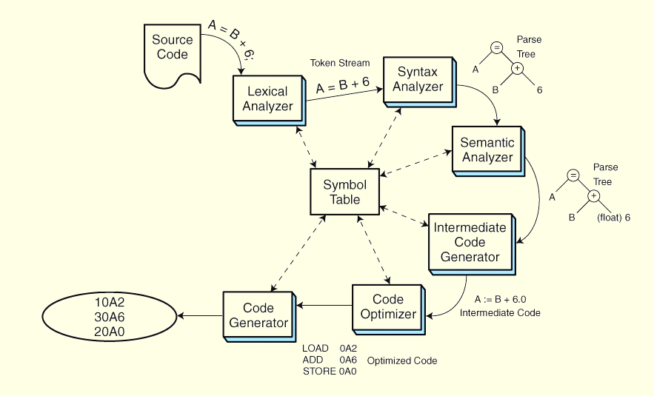
Program Translation Process
Program Translation is a six-phase process
  Lexical analysis extracts tokens, e.g., reserved words and variables.
  Syntax analysis (parsing) checks statement construction.
  Semantic analysis checks data types and the validity of operators.
  Intermediate code generation creates three address code to facilitate optimization and
  translation.
  Optimization creates assembly
  code while taking into account
  architectural features that can
  make the code efficient.
  Code generation creates
  binary code from the optimized
  assembly code.

Slide 19
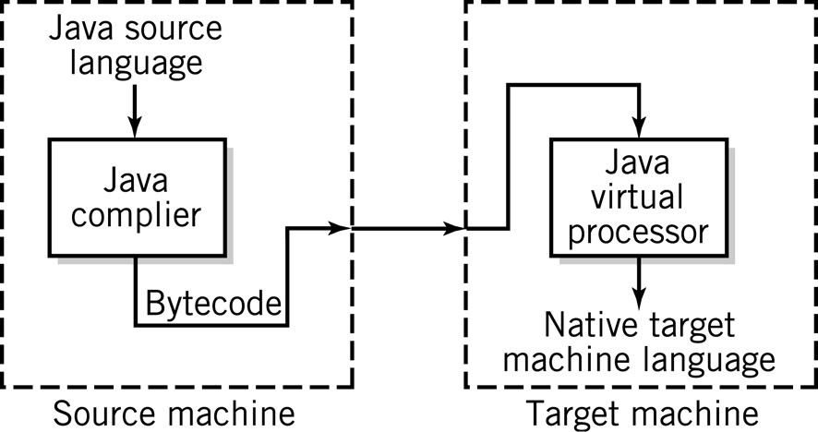
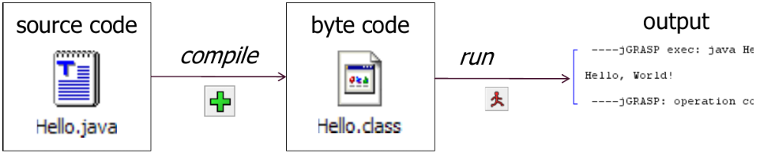
Compile/Run a Program
Write it
  Code or source code: The set of instructions in a program
Compile it
  Compile: Translate a program from one language to another
    Byte code: The Java compiler converts
    your code into a format named byte code
    that runs on many computer types
Run (execute) it:
  Output: The message printed to
  the user by a program

Slide 20
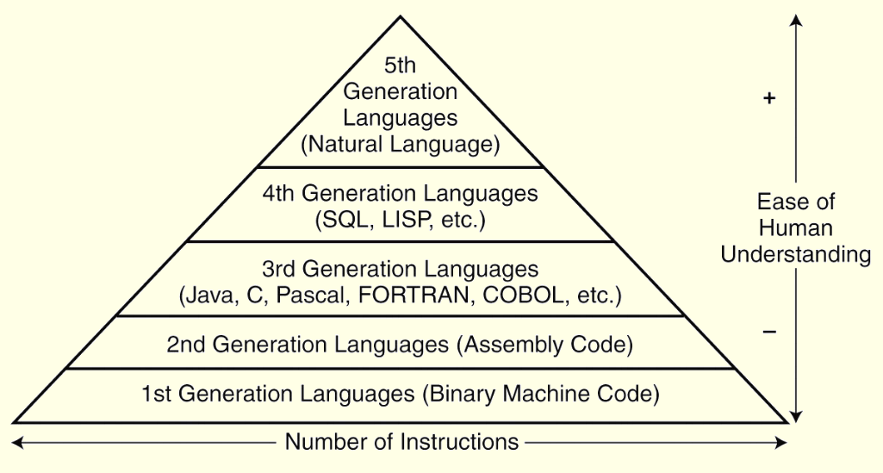
Evolution of programming languages
Keep in mind that the computer can understand only the 1GL!

Slide 21
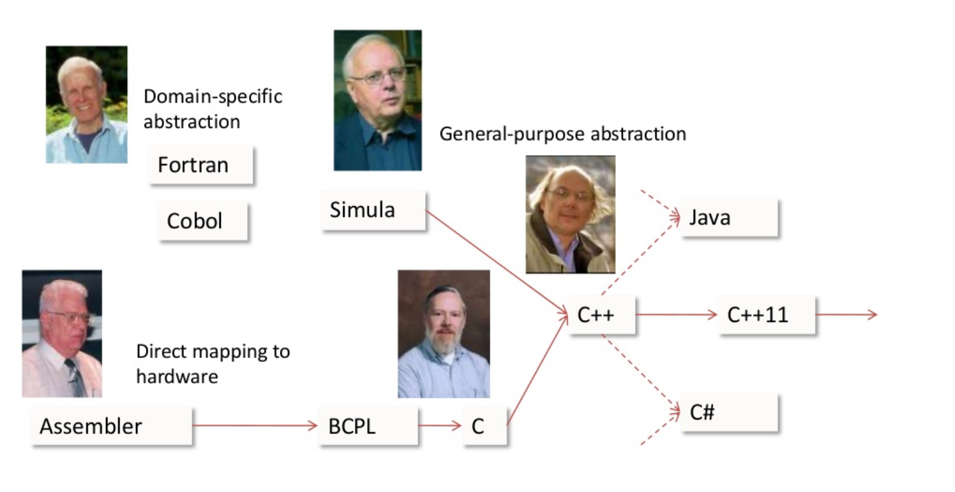
Some Programming Languages
Source: B.Stroustrup, The Essence of C++

Slide 22
Programming Language Categories
Machine Language
  Binary coded instructions
Assembly Language
  Symbolic coded instructions
Procedural Languages
  procedural statements or arithmetic notation
Fourth-generation Languages
  Natural language and nonprocedural statements
Object-oriented Languages
  Combination of objects and procedures
    Emphasis on the objects involved in the task, not on the procedure.
    An object encapsulates a data set with the code that is used to operate on it.
    Standardized programming modules can be reused.
    Applications can be rapidly developed with appropriate objects from an object library.

Slide 23


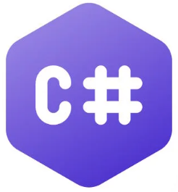












Object-Oriented Languages
OO Languages have been around since 60s.
    First example is Simula (first stable release in 1967.)
  Java
  C#
  Python
  Ruby
  PHP
  TypeScript
  Kotlin
  R
  Swift
  C++
  Julia
  Go
  Perl
  Smalltalk
  ...
    https://en.wikipedia.org/wiki/List_of_object-oriented_programming_languages

Slide 24
What Is Object-oriented Programming?
type of computer programming paradigm that centers around the concept of objects.
  In OOP, an object is a self-contained component that contains data in the form of fields (often known as attributes) and code in the form of methods.
The essence of OOP
  to encapsulate elements of a program (such as variables, data structures, and functions) within objects
increased code reusability
  by creating different classes for different types of information
saves development time and makes programs easier to maintain
suited for designing and building complex computer programs

Slide 25
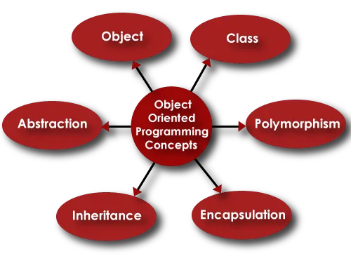
Building Blocks of Object-oriented Programming
The eight basic concepts of OOP
  Classes.
  Objects.
  Methods.
  Attributes.
  Inheritance.
  Encapsulation.
  Abstraction.
  Polymorphism

Slide 26
Structure of a Java Program
Every executable Java program consists of a class,
  that contains a method named main,
    that contains the statements (commands) to be executed.
public class name {
public static void main(String[] args) {
statement;
statement;
…
statement;
}
}
class: a program
method: a named group
of statements
statement: a command to be executed

Slide 27
Names and identifiers
You must give your program a name.
public class GangstaRap {
  Naming convention:
    Capitalize each word (e.g. MyClassName)
  Your program’s file must match exactly (GangstaRap.java)
    Includes capitalization (Java is case-sensitive)
Identifier:
  A name given to an item in your program.
Must start with a letter or _ or $
Subsequent characters can be any of those or a number
  legal: _myName TheCure ANSWER_IS_42 $bling$
  illegal: me+u 49ers side-swipe Ph.D’s

Slide 28
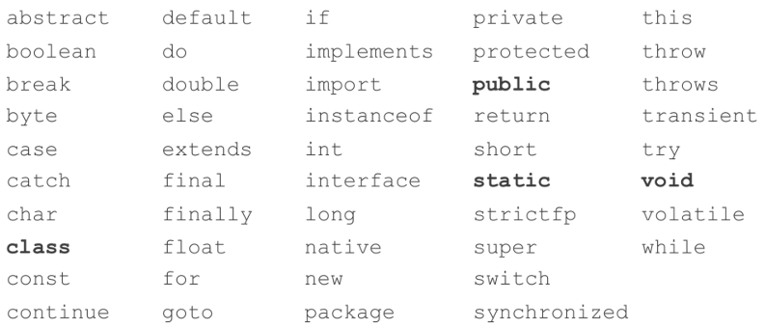
Keywords
keyword:
  An identifier that you cannot use because it already has a reserved meaning in Java

Slide 29
Syntax
syntax:
  The set of legal structures and commands that can be used in a particular language
    Every basic Java statement ends with a semicolon (;)
    The contents of a class or method occur between { and }
syntax error (compiler error):
  A problem in the structure of a program that causes the compiler to fail
    Missing semicolon
    Too many or too few { } braces
    Illegal identifier for class name
    Class and file names do not match
    …

Slide 30
Comments
comment:
  A note written in source code by the programmer to describe or clarify the code
    Comments are not executed when your program runs
Syntax:
  // comment text, on one line
  or
  /* comment text; may span multiple lines */
  Examples:
  // This is a one-line comment.
  /* This is a very long
  multi-line comment. */

Slide 31
Using comments
Where to place comments:
  At the top of each file (a “comment header”)
  At the start of every method
  To explain complex pieces of code
Comments are useful for:
  Understanding larger, more complex programs.
  Multiple programmers working together, who must understand each other’s code.

Slide 32
The Concept of an Algorithm
An algorithm is an ordered set of unambiguous, executable steps that defines a terminating process
  The steps of an algorithm can be sequenced in different ways
  Linear (1, 2, 3, …)
  Parallel (multiple processors)
  Cause and Effect (circuits)
A Terminating Process
  Culminates with a result
  Can include systems that run continuously
    Hospital systems
    Long Division Algorithm
A Non-terminating Process
  Does not produce an answer
    “Non-deterministic Algorithms”

Slide 33
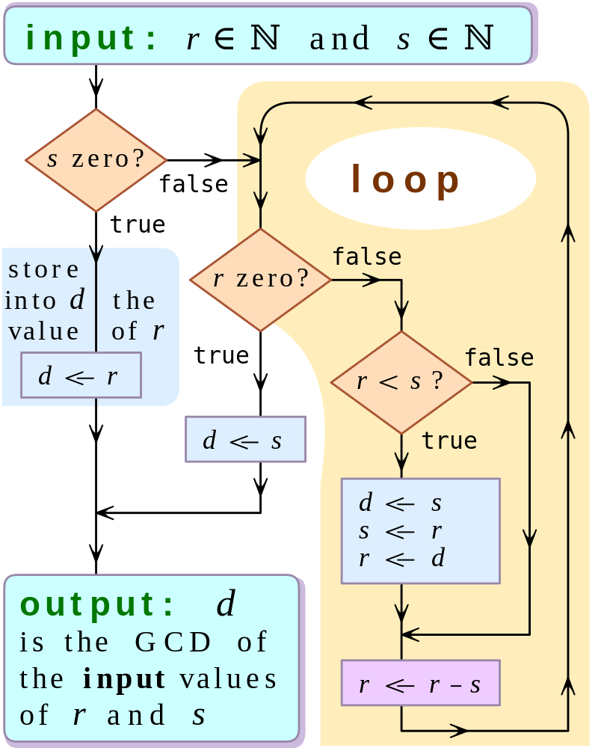
The Concept of Algorithm
Some Algorithms:
  Converting from one base to another
  Correcting errors in data
  Compression
  ⁝
  …
Many researchers believe that
every activity of the human mind
is the result of an algorithm
Etymology:
  Comes from the Latinization of
  Al-Khwarizmi's name
    Around 825 AD, Muḥammad ibn Mūsā al-Khwārizmī wrote
    kitāb al-ḥisāb al-hindī ("Book of Indian computation") and
    kitab al-jam' wa'l-tafriq al-ḥisāb al-hindī ("Addition and
    subtraction in Indian arithmetic").
    Latin translations:
    Liber Alghoarismi de practica arismetrice,
    Liber Algorismi de numero Indorum,
Flowchart of using successive subtractions to find the greatest common divisor of number r and s

Slide 34
The Abstract Nature of Algorithms
There is a difference between an algorithm and its representation.
  Analogy:
    difference between a story and a book
A Program
  a representation of an algorithm.
A Process
  the activity of executing an algorithm.
Algorithm Representation
  is done formally with well-defined Primitives
    A collection of primitives constitutes a programming language.
  is done informally with Pseudocode
    Pseudocode is between natural language and a programming language.

Slide 35
Algorithm Discovery
The first step in developing a program
  More of an art than a skill
  A challenging task
Polya’s Problem Solving Steps
  Understand the problem.
  Devise a plan for solving the problem.
  Carry out the plan.
  Evaluate the solution for accuracy and its potential as a tool for solving other problems.
Solve an easier related problem
  Relax some of the problem constraints
  Solve pieces of the problem first (bottom-up methodology)
Stepwise refinement:
  Divide the problem into smaller problems (top-down methodology)

Slide 36
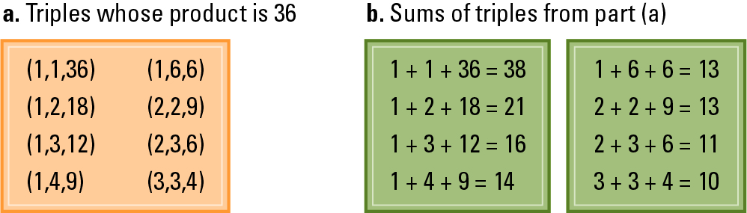
Algorithm - Example
Ages of Children Problem:
  Person A is charged with the task of determining the ages of B’s three children.
    B tells A that the product of the children’s ages is 36.
    A replies that another clue is required.
    B tells A the sum of the children’s ages.
    A replies that another clue is needed.
    B tells desired triple must be one whose sum appears at least twice in the table
    A replies that another clue is needed.
    B tells A that the oldest child plays the piano.
    A tells B the ages of the three children.
  How old are the three children?

Slide 37

Algorithm - Example
Chain Separating Problem:
  A traveler has a gold chain of seven links.
  He must stay at an isolated hotel for seven nights.
  The rent each night consists of one link from the chain.
  The traveler must pay the hotel one link of the chain each morning
  How to pay hotel bill?
    Constraint
      What is the fewest number of links that must be cut so that the traveler can pay the hotel one link of the chain each morning without paying for lodging in advance?

Slide 38
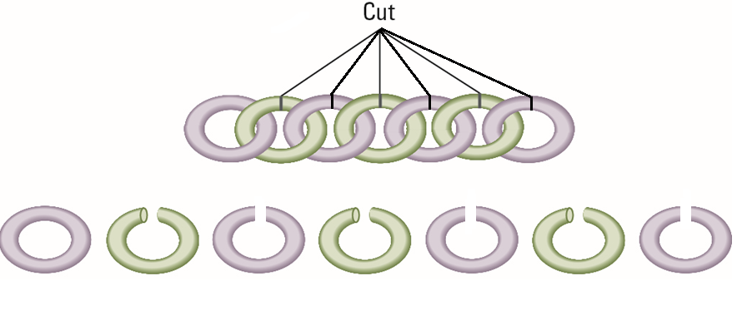
Algorithm - Example
Separating the chain using six cuts
  Cut one link each morning

Slide 39
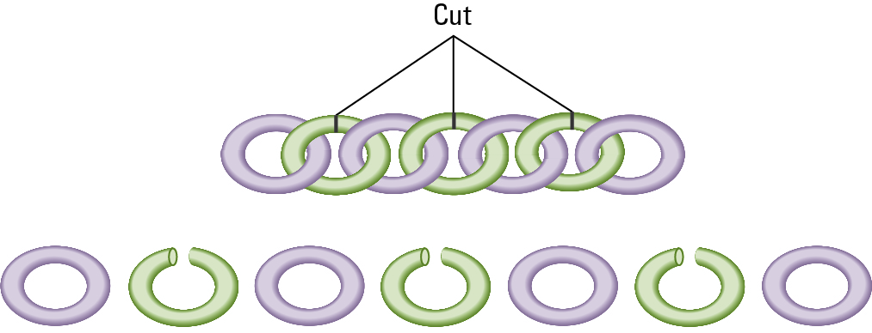
Algorithm - Example
Separating the chain using only three cuts

Slide 40
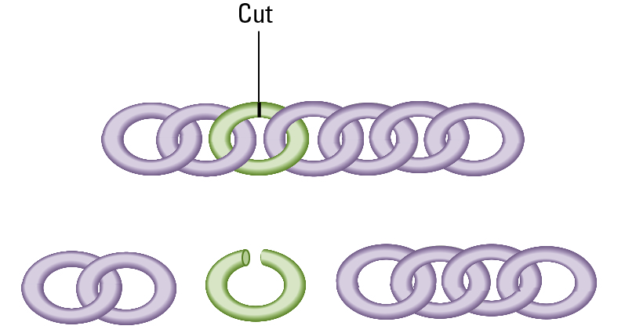
Algorithm - Example
Solving the problem with only one cut

Slide 41
Any Questions?

Slide 42
Hello World Application

Slide 43
Hello World Application
Develop a Hello World application
  We need to implement the HelloWorld class.
public class HelloWorld {
}
Access modifier
  They are used to set access levels for classes, variables, and other entries.
  For the top-level classes, it can be either
    public or
    default (no keyword)
  When it is public, this class is visible to the earth and can be accessible from everywhere.

Slide 44
Hello World Application
package week1;
class HelloWorld {
}
Without any access modifier this class is visible only within package week1 and can be accessible from package week1 only.
This default access modifier is also known as package-private.
package is a namespace to organize a set of related classes

Slide 45
Hello World Application
private class HelloWorld {
}
A top-level class cannot be private.
  Illegal modifier for the class HelloWorld
Access modifiers will be covered in detail later in the course…

Slide 46
Hello World Application
public class HelloWorld {
}
The keyword class for the class definition
The name of the class

Slide 47
Hello World Application
package week1;
class HelloWorld {
public static void main(String args[]) {
}
}
No run method, instead we have the main method
The entrance point of our program

Slide 48
Hello World Application
public static void main(String args[]) {
}
This signature is always the same.
Main method accepts a single argument
  An array of element of type String
  This array holds the command-line arguments
java HelloWorld arg1 arg2
Command-line arguments are passed to the program from the command line following the name of the program.
  They are like parameters of the program.

Slide 49
Hello World Application
public static void main(String args[]) {
}
The access modifier
  It is public, therefore can be reached from anywhere.
This method is static means that we can call this method without initializing an object from this class.
  Since this is the first method being called during the execution of the program, no object has been instantiated yet.
More details of this will be described later in this course.

Slide 50
Hello World Application
public static void main(String args[]) {
}
The return type of the method.
Nothing to return, since there is not a single line of code waiting for this function’s return.
  However, the main function may return some platform specific values which indicate the final status of the program.

Slide 51
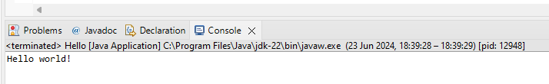
Hello World Application
package week1;
public class HelloWorld {
public static void main(String args[]) {
System.out.println(″Hello World″):
}
}
After running:
Sending println message to the out field of the System class which is the standard output.

Slide 52
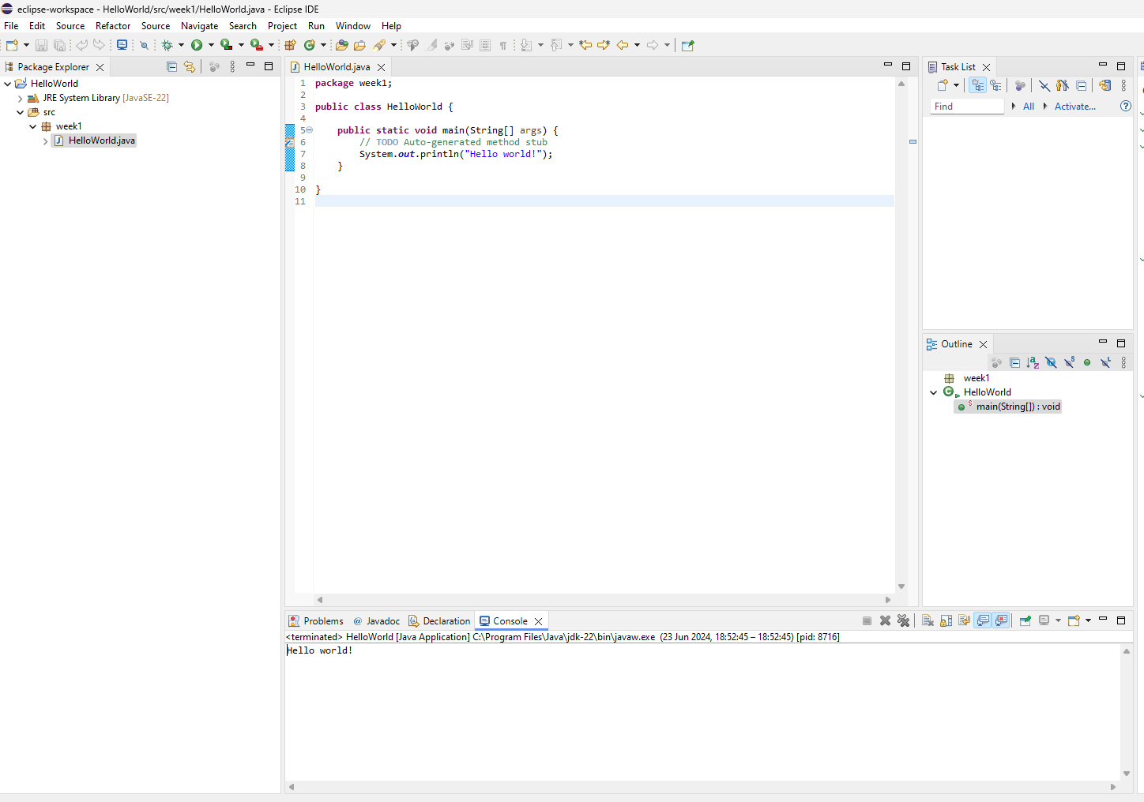
Screenshot of the Eclips IDE

Slide 53
package week1;
public class HelloWorld {
public static void main(String[] args) {
System.out.println("Hello world!");
}
}

Slide 54
Any Questions?

